Slide 1
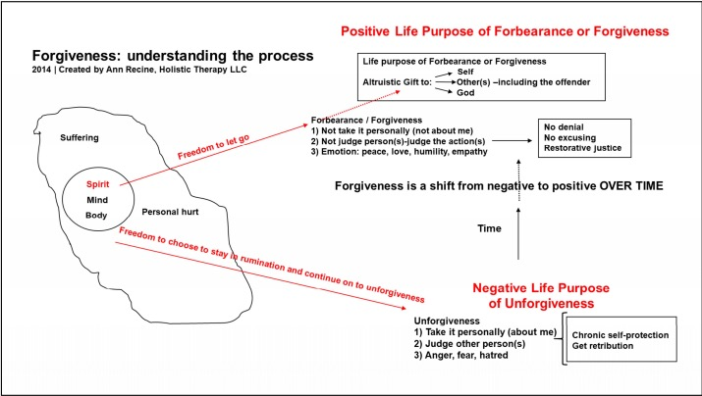
How People Forgive
A Critical Literature Review
Ann Recine, Tenzin Paldon, and Lou Recine | University of Wisconsin-Eau Claire Department of Nursing
Abstract
Number of articles found
Having a support system. Participants in a study by Maynard et al. (2016) “felt that social support systems were important in the forgiveness process to provide encouragement and support” (p. 37).
Other than support systems, use of more than one other resource such as “seminars” (Maynard et al., 2016, p. 36) and “prayer, meditation, and reflection…self-improvement, spiritual works, and rituals” (Maynard et al., 2016, p. 36).
Level of commitment between offender and victim in a relationship: “as the level of commitment between two people increases, the likelihood of forgiveness also increases” (Riek & Mania, 2012, p. 307).
Empathy, i.e., “cognitively perceiving the world from another’s perspective and emotionally experiencing what another feels” (Riek & Mania, 2012, p. 308).
Making “positive attributions for an offender’s behavior” increases the chance of being able to forgive (Riek & Mania, 2012, p. 309).
Punishment, for instance, when victims are able to punish the offender, they feel that a sense of justice has been restored and they feel empowered, which enables them to forgive offenders (Strelan et al., 2017).
Value affirmation by an offender, i.e., reaffirming the values that they have violated and acknowledging that one’s violation of those values is not representative of who one truly is, after a transgression. This gives offenders a chance to repair their moral identity through reaffirmation of violated value, which promotes genuine self-forgiving, which in turn helps a person to forgive others (Woodyatt & Wenzel, 2014).
By “acts such as confession, apology, or reparation” (Woodyatt & Wenzel, 2014, p. 128) which help or give offenders a chance to repair moral identity, which encourages self-forgiveness.
Receiving messages that stress the importance and benefits of practicing forgiveness (Jeter & Brannon, 2017).
Implementing planning techniques, i.e., an “action plan” (Jeter and Brannon, 2017, p. 1308); a plan that “includes making if-then statements about feelings or behaviors that may result from the transgression experience, such as ‘if I feel angry toward ____, then I will ____’ or ‘if I see ____ in public, then I will ____.’ ” (Jeter and Brannon, 2017, p. 1308).
Mindfulness exercises such as mindfulness breathing techniques helps to promote forgiveness by regulating emotions better or redirecting negative thoughts and feelings to positive (Jeter & Brannon, 2017).
There are many studies about forgiveness and its beneficial effects on physical and psychosocial health. However, there is limited information on how someone can become able to choose forgiveness in their lives and where people get the power to forgive. Our goal is to review scholarly literature to discover how someone can get power to choose forgiveness in the midst of personal suffering and what are the cognitive, emotional, and spiritual characteristics of people who forgive and people who don’t. Forgiveness Facilitation is a well-established nursing intervention. Yet we do not know enough about what enables people to have the power to forgive. Combining knowledge of the traits of people who forgive and how people find power to do so, with specific knowledge of a patient may provide valuable insights as nurses try to facilitate forgiveness with patients who want that. We aim to contribute to the body of nursing knowledge through this critical literature review from peer reviewed sources. We used a range of databases, limiting our search to the last seven years using key words such as “forgiveness”, “forgiveness and empowerment”, and “forgiveness and motivation”. Our research, to date, indicates that people gain the power to forgive through justice, self-affirmation, positive reinterpretation, empathy, mindfulness, and knowledge of benefits. These findings will enable nurses to understand their patients better and facilitate forgiveness by helping patients to find the personal power to forgive and heal.
Total number of potentially relevant articles found to date during literature search: 537
Total number of abstracts reviewed to date while searching for articles: 26
Total number of articles found to date that answer research questions: 6
Discussion/Results to Date
Introduction
Qualities of forgiving and unforgiving people
PROCESS OF FORGIVENESS
QUALITIES OF FORGIVING PEOPLE | QUALITIES OF UNFORGIVING PEOPLE
Are “securely attached” (Riek & Mania, 2012, p. 309). Want “peace of mind” (Maynard, Piferi, & Jobe, 2016, p. 35). They “… felt that holding onto grudges was unhealthy, physically, emotionally, or spiritually and would cause them to be stuck in their lives and limit their human potential” (Maynard et al., 2016, p. 36). Are high in “agreeableness” (Riek & Mania, 2012, p. 306). Have “trait level empathy” (Riek & Mania, 2012, p. 307). | Have a sense of “narcissistic entitlement” (Riek & Mania, 2012, p. 306). Are “high in trait anger” (Riek & Mania, 2012, p. 306). Are “high in a need for structure” (Riek & Mania, 2012, p. 306). Have “higher levels of negative emotions” (Riek & Mania, 2012, p. 311). Use drugs and/or alcohol for coping (Jeter & Brannon, 2016). Over-focus on the offense (Riek & Mania, 2012). Ruminate more (Jeter & Brannon, 2016). Are neurotic (dominated by negative feelings, are easily upset and worry about many things) (Riek & Mania, 2012). Feel vulnerable and not protected from future hurt (Strelan, Di Fiore, & Van Prooijen, 2017). Think that it is not the right time to forgive (Jeter & Brannon, 2017). Not aware of, or have limited knowledge about, the benefits of forgiveness (Jeter & Brannon, 2017).
This model of the forgiveness process was created by Ann and Lou Recine as a result of a concept analysis of forgiveness (Recine, Werner, & Recine, 2007) and focus groups. The gap discovered in this process model is described in the following questions: 1) What are the cognitive, emotional, and spiritual characteristics or traits of people who don’t forgive and/or people who forgive? 2) Where/how does a person get the power to choose forgiveness in the midst of personal suffering? These questions guided our critical literature review. The literature review is the first step in the development of a qualitative study to more fully answer these questions.
References
Jeter, W. K., & Brannon, L. A. (2016). Perceived and actual effectiveness of coping strategies used when forgiving. Counseling & Values, 61(2), 176-191. doi:10.1002/cvj.12036
Jeter, W. K., & Brannon, L. A. (2017). The effect of mindfulness and implementation planning on the process of granting and seeking forgiveness among young adults. Mindfulness, 8(5), 1304- 1318. doi:10.1007/s12671-017-0706-1
Maynard, C., Piferi, R. L., & Jobe, R. L. (2016). Role of Supportive Others in the Forgiveness
Process. Counseling & Values, 61(1), 28-43. doi:10.1002/cvj.12024 Recine, A. G., Werner, J. S., & Recine, L. (2007). Concept analysis of forgiveness with a multi- cultural emphasis. Journal of Advanced Nursing, 59(3), 308–316.
doi:10.1111/j.1365-2648.2007.04343.x Riek, B. M., & Mania, E. W. (2012). The antecedents and consequences of interpersonal forgiveness: A meta-analytic review. Personal Relationships, 19(2), 304-325. doi:10.1111/j.1475-6811.2011.01363.x
Strelan, P., Di Fiore, C., & Van Prooijen, J.-W. (2017). The empowering effect of punishment on forgiveness. European Journal of Social Psychology, 47(4), 472-487. http://dx.doi.org/10.1002/ejsp.2254
Woodyatt, L., & Wenzel, M. (2014). A needs-based perspective on self-forgiveness: Addressing threat to moral identity as a means of encouraging interpersonal and intrapersonal restoration. Journal of Experimental Social Psychology, 50, 125-135. doi:http://dx.doi.org/10.1016/j.jesp.2013.09.012
Methodology
Acknowledgements
Literature search parameters: articles from peer-reviewed journals and scholarly books written in the last seven years.
Databases searched include: Academic Search Complete, Academic Premier, and Web of Science.
Search terms used include: forgiv*, forgiv* and coping strategies, forgiveness, forgiveness and motivation, and forgiveness process.
What gives people power to forgive in the midst of personal hurt?
I would like to express my deep gratitude to my research advisor and Primary Investigator, Dr. Ann Recine and Lou Recine, co-researcher, for their extraordinary support, encouragement, advice, and guidance throughout this research work. I would also like to thank my academic advisor Dr. Rita Sperstad for connecting me with this research work. I would also to extend my thanks to Hans Kishel for his assistance and taking time to teach us how to use library resources to answer our research questions. I also thank Celebration of Excellence in Research and Creative Activity (CERCA) - Office of Research and Sponsored Programs for supporting this study.
Using humor (Jeter & Brannon, 2016).
Receiving an apology from the person who wronged them (Riek & Mania, 2012).
Seeking emotional support (Jeter & Brannon, 2016).
Positively reinterpreting the offense in the light of personal growth (Jeter & Brannon, 2016).

