Slide 1
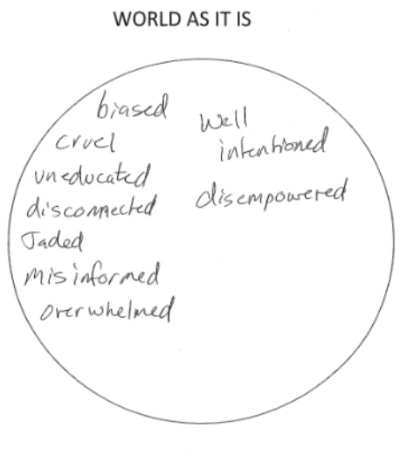
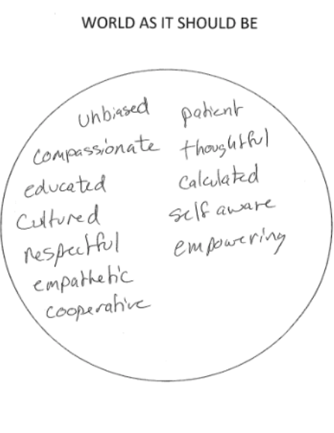
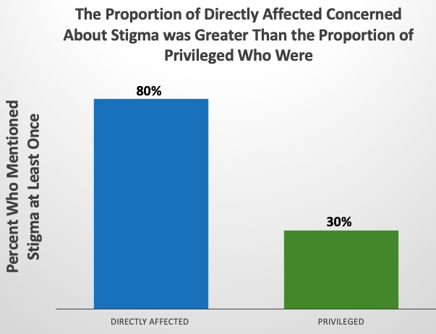
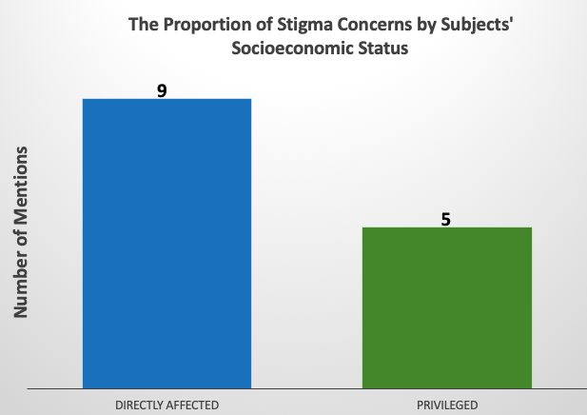
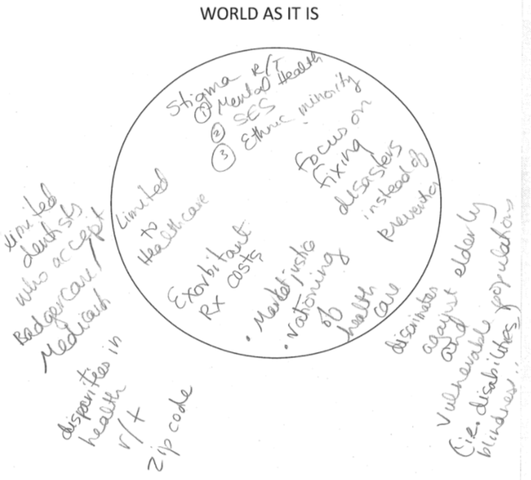
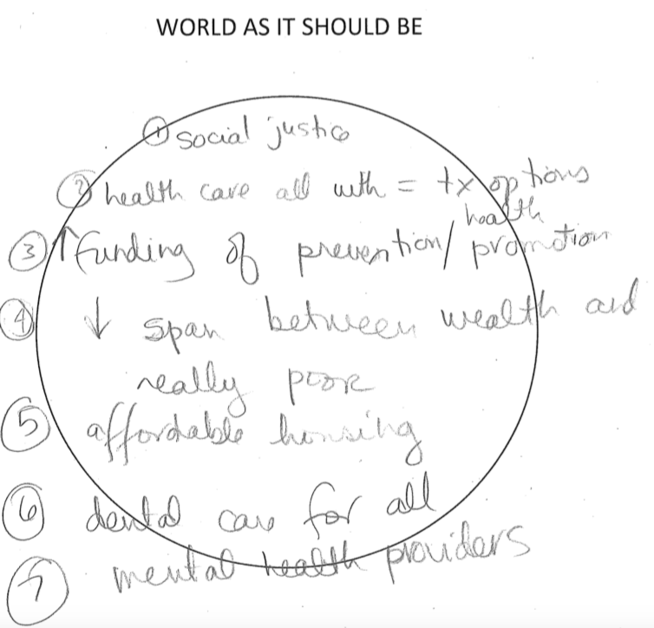
Does Low Socioeconomic Status Cause Individuals to Distrust the Healthcare Establishment?
Cole Haschke;¹ Ruth Cronje;² Eric Giordano³
Undergraduate Research Collaborator
PhD; English Professor
PhD; Director of Wisconsin Institute for Public Policy and Service
Introduction
It is well known that individuals with low socioeconomic status have worse health outcomes compared to others. One reason is they can’t afford the medical costs of their care, but current thinking acknowledges that unmet social needs have an even more significant impact on downstream health outcomes. We wondered whether low-income individuals might also have attitudinal barriers to healthcare systems that stigmatize them, thus motivating them to avoid seeking necessary medical attention.
Methods
We conducted in-depth conversational interviews with fifteen individuals in Eau Claire, five of whom were of low socioeconomic status. We asked about their own lived experience with issues of health inequity and investigated the personal values and emotions that motivate them to either seek or to avoid, resist, or distrust medical care. We were also interested in learning about their vision for “fixing” United States healthcare. To elicit their vision for healthcare improvements, we asked them:
The arrows point toward mentions of stigma, distrust, alienation, etc.
Example of stigma from transcript
As it concerns health care in our community and in the United states generally, I would like you to think about the world as it is versus the world as it should be. In other words, what would you like to see in terms of people’s health and access to good health versus what currently exists?
Subjects completed a drawing task in response to this question, and they also verbally explained their responses.
We performed conventional content analysis on both their drawings and the typescript of their verbal remarks while blinded as to their socioeconomic status. We counted the number of times each interviewee mentioned stigma, distrust, and other signals of marginalization of individuals of low socioeconomics status.
The low-income subjects also mentioned themes of stigma, alienation, distrust, and shame in their verbal responses. For example, one subject’s response regarding the world as it should be:
“Universal healthcare, paid for by our taxes, more training for healthcare staff, more experience in various sub-cultures, better transportation options, and less stigma.” (ECC7)
Low-income individuals who are directly affected by health inequity more frequently mentioned themes related to stigma, distrust, and alienation than the privileged did.
Discussion
It is well known that individuals with low income have worse health outcomes than others because they can’t afford healthcare costs. Our study indicates that attitudinal barriers also influence their ability to seek medical care and likely influence their health outcomes.
Our study suggests that the directly affected may distrust the healthcare system and fear being stigmatized by their providers, clinic staff, and other healthcare personnel.
Our interview data indicate that these attitudinal barriers can prevent low-income individuals from seeking timely medical intervention, adhering to doctor’s orders, and returning to seek further care.
The fear of being stigmatized likely affects patient-provider communication dynamics, and is one factor explaining why low-income individuals have worse health outcomes.
Results
How the interviewees Responded
In these fifteen subjects’ responses, there were a total of 14 mentions of stigma. Of those, 64% were mentioned by low-income individuals while only 36% were mentioned by the privileged.
All five of the individuals of low socioeconomic status mentioned stigma. Only three out of the ten privileged individuals mentioned stigma.
Acknowledgments
We’d like to thank the following for their support for or cooperation in this research:
The Office of Research and Sponsored Programs (ORSP) of the University of Wisconsin—Eau Claire
Marshfield Clinic
Family Health Center of Marshfield, Inc.
Wisconsin Institute for Public Policy and Service (WIPPS)
The arrows point toward mentions of stigma, distrust, alienation, etc.

