Slide 1

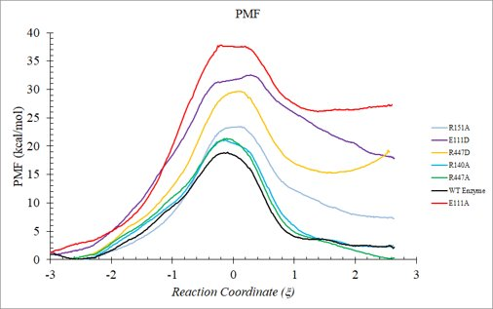
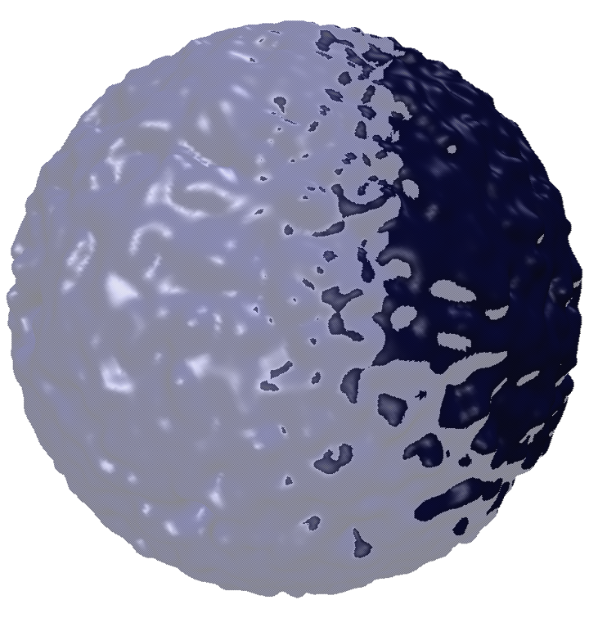
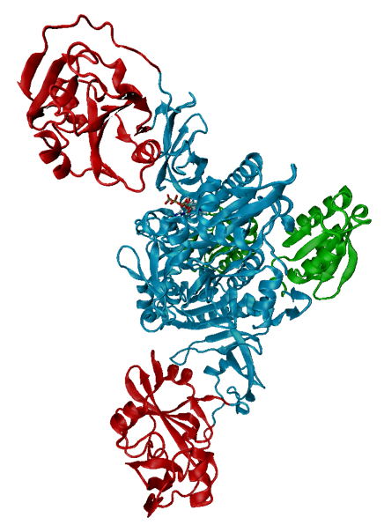
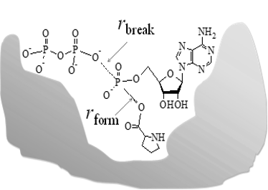
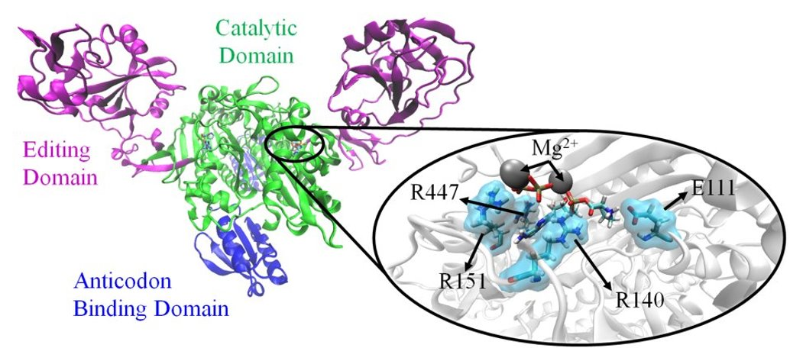
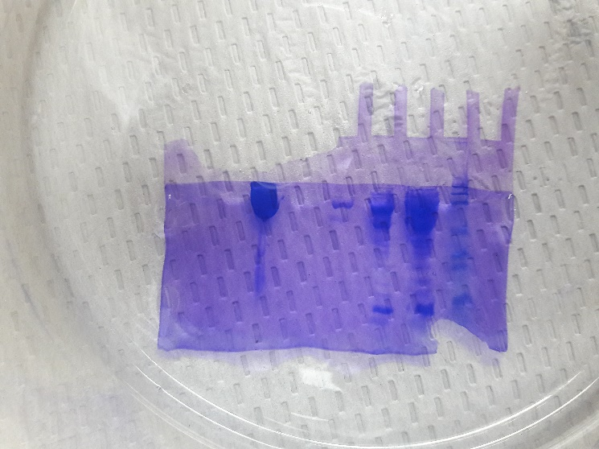
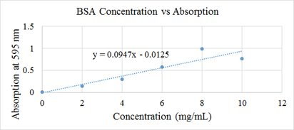
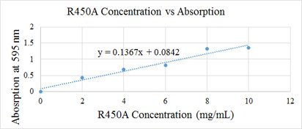
Investigating Catalytically Important in Escherichia coli Prolyl-tRNA Synthetase Using Site- Directed Mutagenesis and Computational Studies Katelyn Weeks, Murphi Weinzetl, Huakun Hu (PI: Sanchita Hati, Sudeep Bhattacharyya) ​ Chemistry Department, University of Wisconsin-Eau Claire, Eau Claire, WI, 54702
Abstract:
This research project is a continuing effort focused on the molecular-level understanding of the relationship between structure, dynamics, and function in aminoacyl-tRNA synthetases (AARSs). Recent computational studies have identified four charged amino acid residues at the active site [three positively charged arginine (R) and one negatively charged glutamic acid (E)] that are directly involved in catalysis in Escherichia coli Prolyl-tRNA Synthetase (Ec ProRS). Our current objective is to experimentally confirm these computational findings by mutating these residues to a neutral amino acid, alanine, as well as two of the amino acids (E111 and R450) to aspartic acid, a shorter negatively charged amino acid. These mutations are also being run computationally in order to compare results and validate our computational model used. By studying the kinetics and catalytic rate of these mutations, we can determine the importance of these specific active site residues, indicated to be directly involved in the enzymatic ProRS reaction. This knowledge can potentially be used to develop selective drug against pathogenic AARSs. AARSs are potential drug targets as they play a key role in protein synthesis in all living organisms. Herein, we will present the preliminary result of our work.
Objectives:
Results:
Confirm
Confirm the catalytic importance of arginine and glutamic acid residues from computational findings​
Understand
Further understand how the structure of individual amino acids can effect protein structure, function, and dynamics​
Validate
Validate our computational tools for studying protein dynamics
Computational:
All mutations caused an increase in the activation barrier indicating decrease in the catalytic rate
Experimental:
Rate of aminoacylation pmol/sec
Only E111D and R140A remain slightly active after mutation. This table verifies the catalytic importance of these residues.
Computational Methods:
Use Protein Data Bank to access the 3D form of ProRS
Add substrates to the active site
Solvate structure in 60 A of water
Treat the system with QM/MM
Run umbrella sampling to form a potential mean force
ProRS | 10nM | 100nM | 250nM
Wildtype | 0.000185 | 0.0046 | 0.0039
E111A | - | 0 | -
E111D | 0.0000983 | 0 | 0.0008
R140A | - | 0.0008 | -
R151A | - | 0 | -
R447A | - | 0 | -
R447D | - | 0 | -
Reaction site
Treated with Quantum Mechanics
Protein zone up to 60 Å
Treated with Molecular Mechanics
Water
Treated with Molecular Mechanics
Background:
Aminoacyl-tRNA Synthetases
Function: Help form the proteins required for life​
Proteins are large, complex molecules consisting of amino acids
Ex. Kinesin, insulin, hemoglobin
Precise Function: unite an amino acid with the matching tRNA through aminoacylation​
AA+AARS+ATP AARS*AA-AMP + PP_{i​}
AARS*AA-AMP + tRNA AA-tRNA + AMP + AARS
Prolyl-tRNA Synthetases (ProRSs)​
Catalyze the covalent attachment of proline to tRNA^{Pro.}​
E. coli ProRS possesses an editing mechanism and a separate domain to hydrolyze Ala-tRNA^{Pro} [1].
Certain residues have been found to have important roles in this catalysis:
E111, R140, R151, R447
Experimental Methods:
Primer Design:
Ex. Arginine CGT to Alanine GCT
Polymerase Chain Reaction (PCR): Amplifies mutant DNA
DPN1 Digestion: Removes Parent DNA
Transformation with XL1 Blue Cells: Competent cells used for their ability to pick up and amplify foreign plasmids
DNA Purification and Quantification
Sanger Sequencing: Done at UW- Madison
Transformation with SG13009 Cells: Competent cells used for their ability to pick up foreign plasmids and express proteins
Protein Overexpression: Using IPTG
Protein Prep/Purification: Cobalt Affinity Column with imidazole wash
Protein Quantification: Biorad assay:
Then the protein samples were sent to the research group of Dr. Musier-Forsyth at Ohio State University for kinetic assays.
Conclusion:
R447 displays important electrostatic interactions with the phosphate group of ATP​
Neutralization or alteration of the positive charge of this arginine has severe effect on catalysis​
E111 is important for proline binding​
Neutralization or alteration of the charge caused an increase in the activation barrier and a decrease in thermodynamic favorability
All other mutations rendered the enzyme inactive, validating their catalytic importance
E111A
100mM
10mM
LB
Std
WB
FT
Future Directions:
Resources: (1)Beuning et al. (2001) J. Biol. Chem. 276, 30779-307856) Schultz et al. (1961) J. Gen. Physiol. 44, 1189-1199​
(2) Muino et al.(2009) J. Biophys. B., 2572-2577​
(3) Hixon, et al. (2009) MDPI, 2: 1155-1176​
(4) Vivian et al (2001), Biophys J., 80, 2039-2109.
This study follows the catalysis of step one of the reaction. In the future, we hope to study the catalysis of the second step of the reaction, the binding of the tRNA.
Acknowledgements: UWEC-Office of Research and Sponsored Programs, UW- Eau Claire Department of Chemistry,​ National Institute of Health, UW- Madison, the research group of Dr. Musier-Forsyth, LTS

