Slide 1

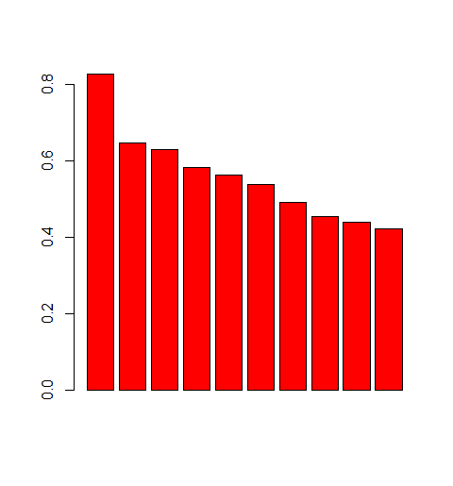
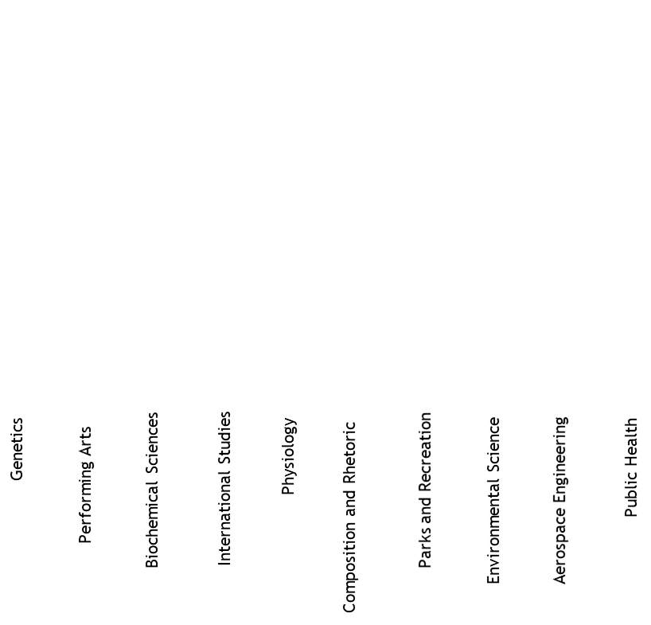
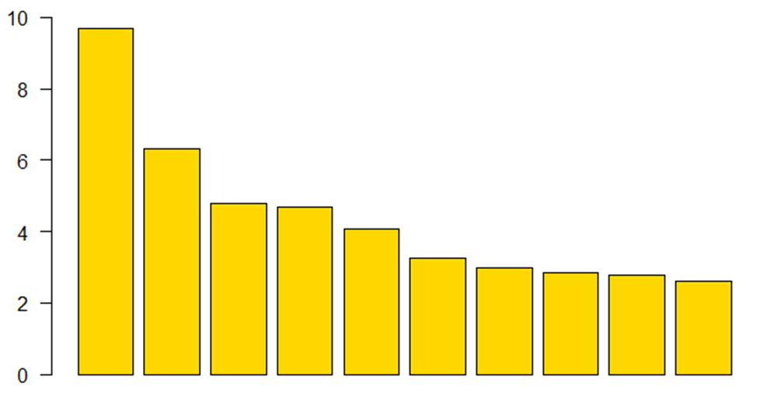
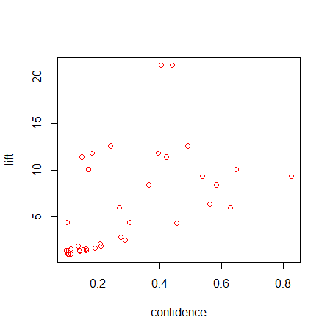
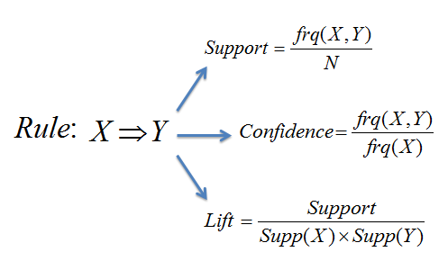
An Age-based Analysis of College-to-Career Path.
Student Researchers: Nicolas Larson and Chuqi Zheng, Professor Mentor: Abra Brisbin
University of Wisconsin-Eau Claire
Introduction
A lot of students struggle deciding on their majors and understanding the career paths a specific major is connected to.
We are looking to help students make more informed decisions on their choice of major.
The question of the research is to understand the strongest associations between majors and occupations.
Another goal of the research is to understand which majors are changing in importance between people under and over 30.
Results: Associations
Majors such as education, finance, criminal justice have strong associations with certain occupation types.
Large lift doesn’t necessarily mean large confidence.
No matter what major a person chooses, in most cases, they can end up in a variety of occupations.
Results: Age Based Analysis
2 Sample test is used to test for differences in proportions of a variable within two populations.
Population was separated into over and under 30.
Majors such as education, accounting, and electrical engineering have seen considerable decreases.
Increases in sciences and in some arts. In general, people are moving to more specific majors.
These changes are expected as people move away from low paying education jobs and towards high paying stem positions.
Methods: Data Collection
Data from the American Community Survey was collected and used for this research.
The ACS is a nationwide survey that collects and produces information on social, economic, housing, and demographic characteristics about our nation's population every year.
Data was used from Minnesota and Wisconsin.
Over 100 thousand data points were collected
Data was filtered to only include people who had completed a bachelors program, no more no less.
Individuals with a large amount of missing data were also removed.
After these filters were applied over 15,000 data points were used.
Data was separated into 2 groups for people over 30 and people under 30.
  Methods: Analysis
Market Basket Analysis was used to uncover the strength of associations between items.
  Looked for association between field of study and occupations.
  Occupations grouped into categories to increase strength of relationships.
2 Sample test was used to test for differences in proportions of a field of study with people under and over 30.
(Figure 1)
Figure 2
NURSING – Medical
Medical - NURSING
ACCOUNTING – Finance
ELE EDUCATION - Education
SOCIAL WORK – Social Work
COMPUTER SC – Computers/Math
TREATMENT THERAPY - - Medical
Public Servants – CRIMINAL JUST
GENERAL EDUCATION - Education
COMMERCIAL ART – Entertainment
Figure 2: A higher proportion of students reported experiencing frustration with worked examples.
Figure 2: The top 10 associations by confidence. Majors are in all caps, occupation types are in normal case.
Figure 4: Largest ratio increase in majors.
Conclusion
No matter what major you choose you can end up in a wide variety of occupations.
In the future, further research could be done to model how the associations weaken as people get older
Students are moving away from education and business and towards STEM and Arts.
In the future, jobs could be categorized to produce a better understanding of the big picture.
Suggestions? brisbia@uwec.edu or larsonnd@uwec.edu
Figure 1: A visual display of how market basket analysis measures association strength.
Figure 3: Large lift doesn’t necessarily mean large confidence.
Acknowledgements
This research was supported by a student research grant from the UW-Eau Claire office of research and sponsored programs.

