Slide 1

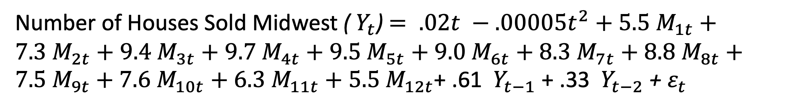
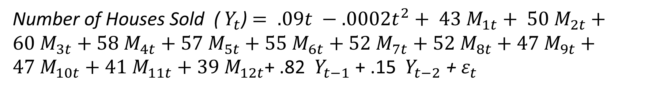
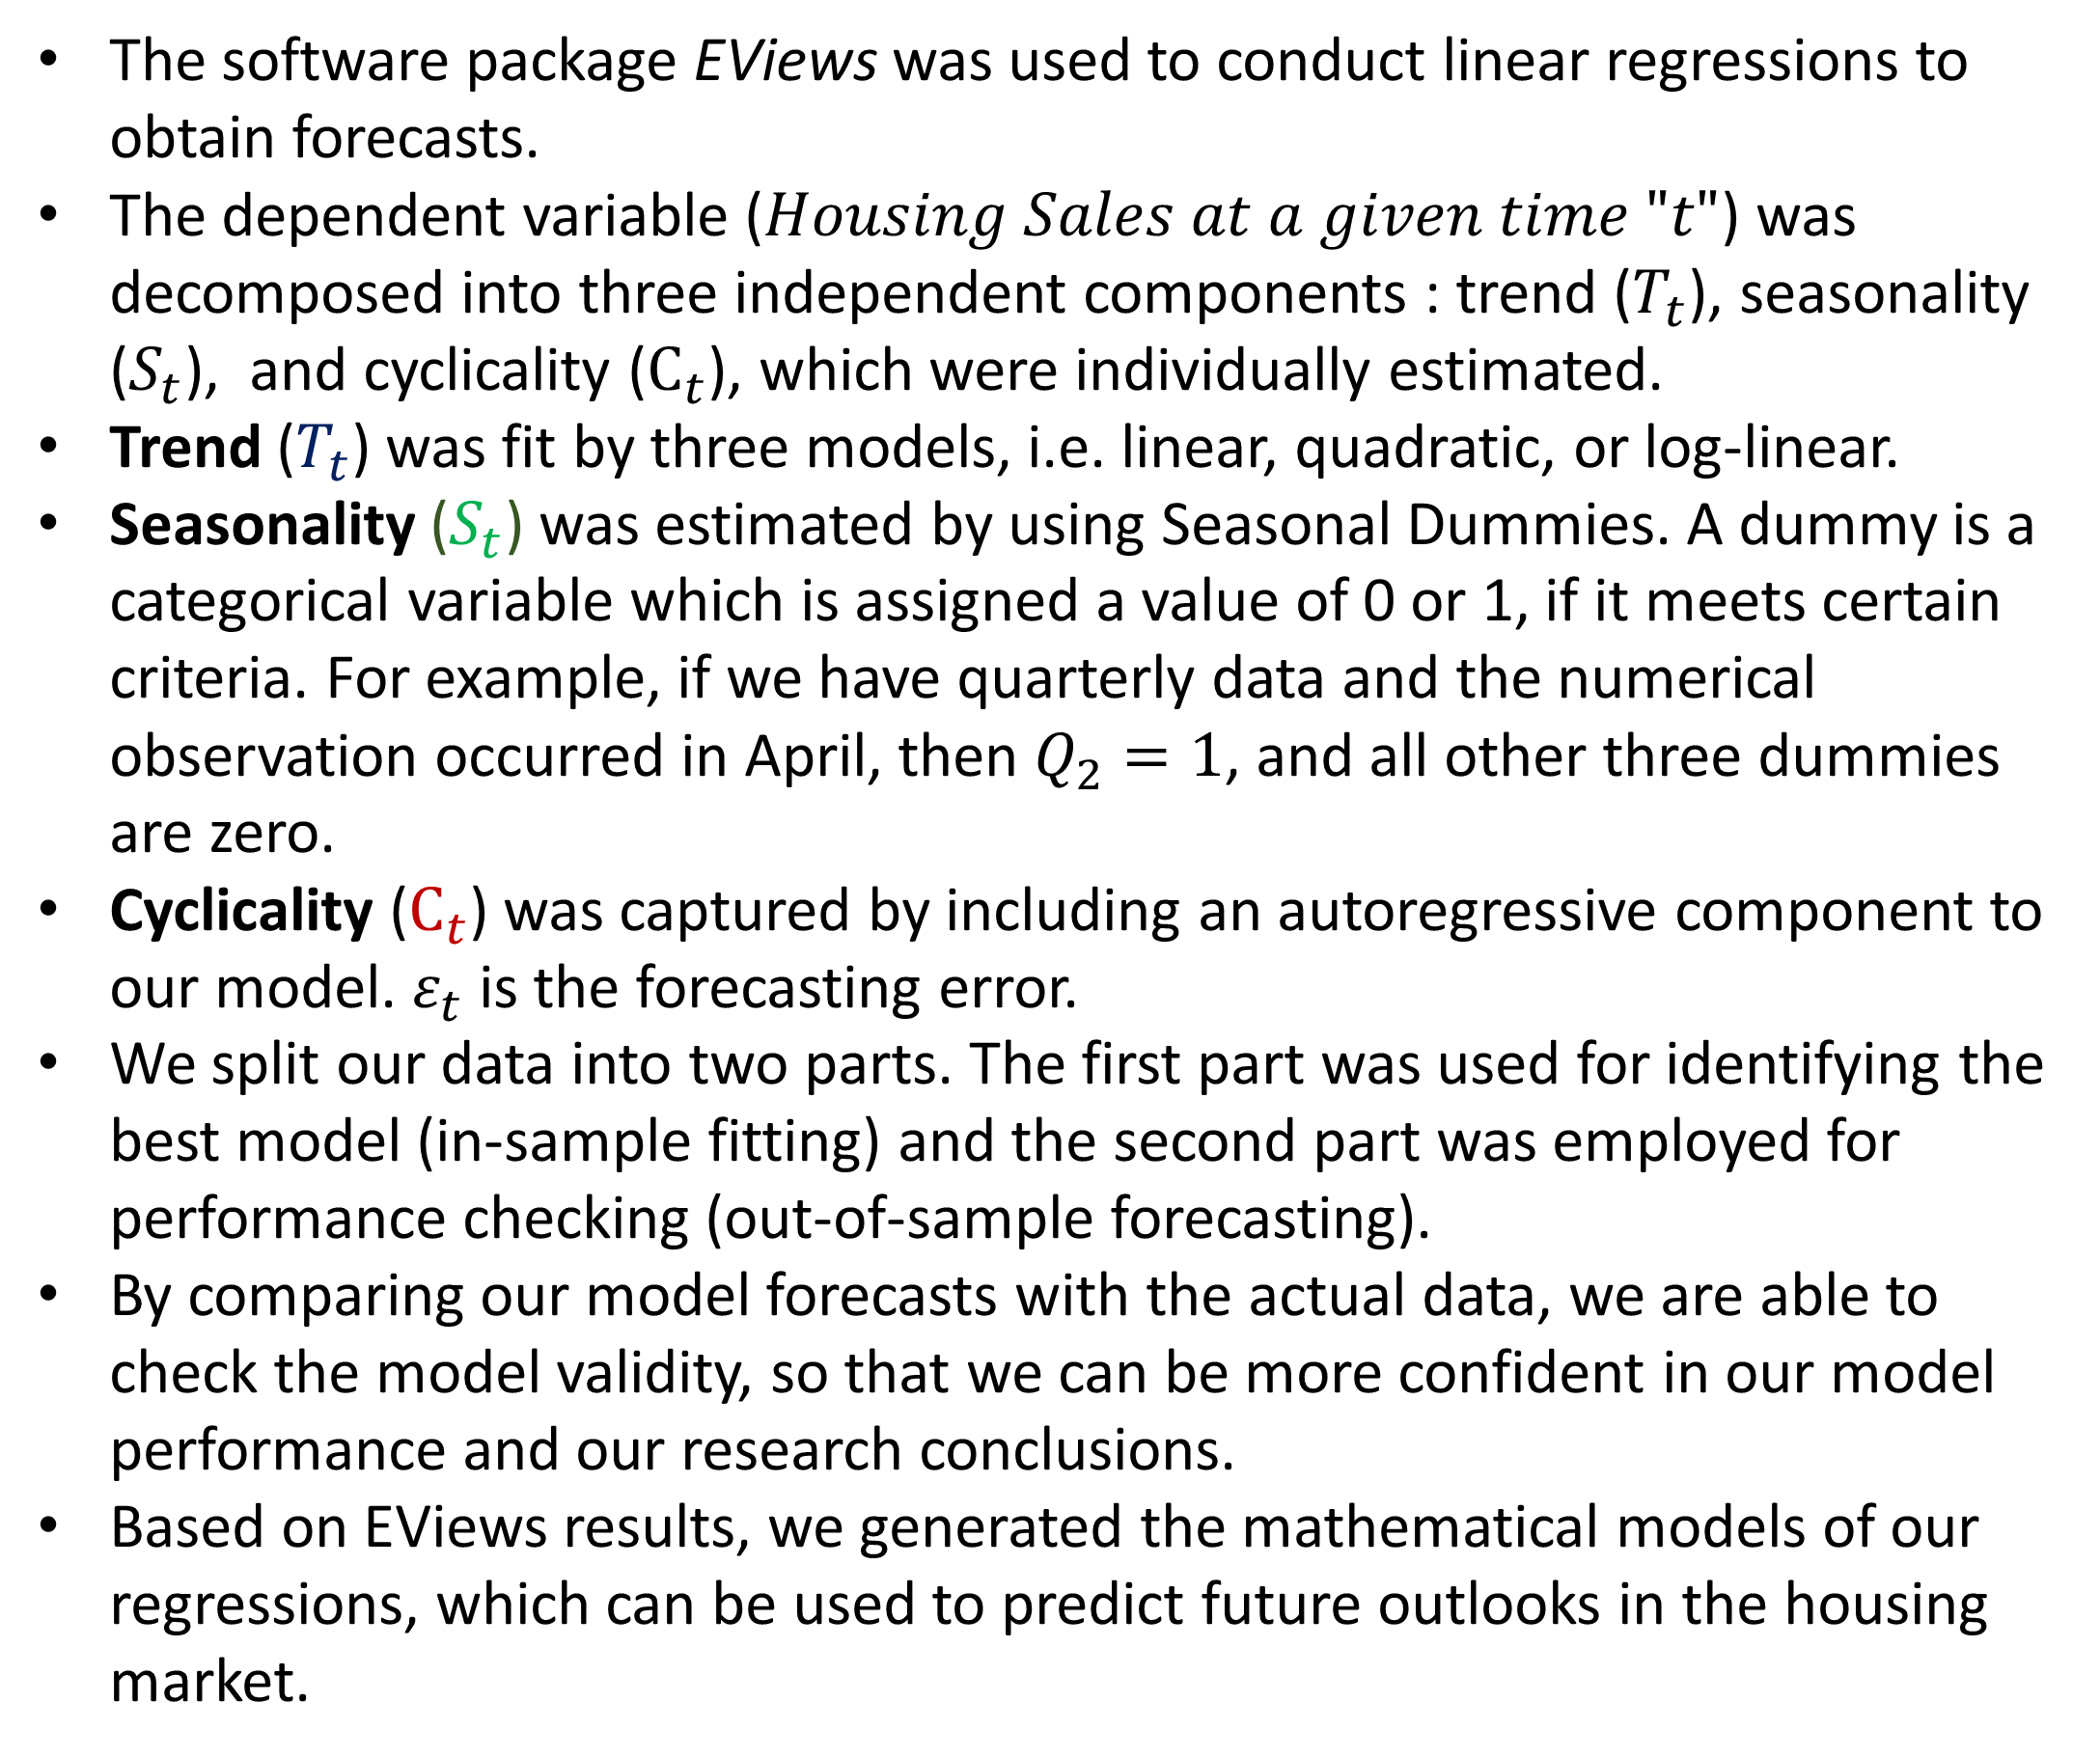
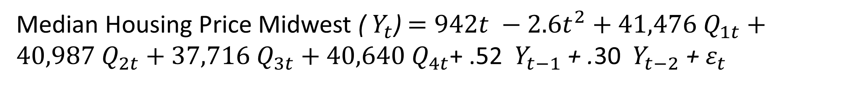
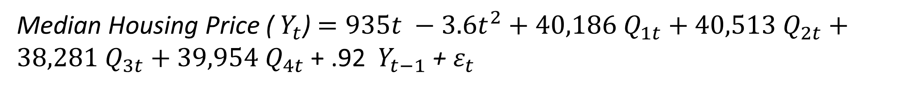
Economic Indicators: U.S. Housing Forecasts
predictions based on the u.s. census data
Andrew Fink, Wyatt Pajtash and Dr. Yan Li | Department of Economics
Introduction
Median Housing Price - US
Number of Houses Sold -US (Thousands)
Forecasting is vital and has far-reaching impact on business performance and economic development.
Housing price is a crucial indicator because it reflects the health of an economy.
By using a linear regression model with autoregressive-moving-average components along with monthly / quarterly data dating back to 1975, we carried out forecasting on median housing prices and houses sold in various regions across the United States.
Our model generated quality forecasts and allowed us to predict how U.S. housing prices and units sold may vary over the next few years.
Objectives and Contributions
Our goal is to fit time-series models to previous data, test their validity, and use them to predict the outlook of the housing market.
Median Housing Price (${ Y}_{t}$) $=935t −3.6t^{2}+40,186{ Q}_{1t}+40,513{ Q}_{2t}+38,281{ Q}_{3t}+39,954{ Q}_{4t}$ + .92 ${ Y}_{t−1}$ + $ε_{t}$
Number of Houses Sold (${ Y}_{t}$) $= .09t −.0002t^{2}+ 43{ M}_{1t}+ 50{ M}_{2t}+60{ M}_{3t}+58{ M}_{4t}+57{ M}_{5t}+55{ M}_{6t}+52{ M}_{7t}+52{ M}_{8t}+47{ M}_{9t}+47{ M}_{10t}+41{ M}_{11t}+39{ M}_{12t}$+ .82 ${ Y}_{t−1}$ + .15 ${ Y}_{t−2}$ + $ε_{t}$
Median Housing Price - Midwest
Number of Houses Sold – Midwest
Methodology
$$Housing Sales_{t}=T_{t}+S_{t}+C_{t}+ε_{t}$$
The software package EViews was used to conduct linear regressions to obtain forecasts.
The dependent variable ($Housing Sales at a given time "t"$) was decomposed into three independent components : trend ($T_{t}$), seasonality ($S_{t}$), and cyclicality ($C_{t}$), which were individually estimated.
Trend ($T_{t}$) was fit by three models, i.e. linear, quadratic, or log-linear.
Seasonality ($S_{t}$) was estimated by using Seasonal Dummies. A dummy is a categorical variable which is assigned a value of 0 or 1, if it meets certain criteria. For example, if we have quarterly data and the numerical observation occurred in April, then $Q_{2}=1$, and all other three dummies are zero.
Cyclicality ($C_{t}$) was captured by including an autoregressive component to our model. $ε_{t}$ is the forecasting error.
We split our data into two parts. The first part was used for identifying the best model (in-sample fitting) and the second part was employed for performance checking (out-of-sample forecasting).
By comparing our model forecasts with the actual data, we are able to check the model validity, so that we can be more confident in our model performance and our research conclusions.
Based on EViews results, we generated the mathematical models of our regressions, which can be used to predict future outlooks in the housing market.
Median Housing Price Midwest (${ Y}_{t}$)$=942t −2.6t^{2}+41,476{ Q}_{1t}+40,987{ Q}_{2t}+37,716{ Q}_{3t}+40,640{ Q}_{4t}$+ .52 ${ Y}_{t−1}$ + .30 ${ Y}_{t−2}$ + $ε_{t}$
Number of Houses Sold Midwest (${ Y}_{t}$)$= .02t −.00005t^{2}+5.5{ M}_{1t}+7.3{ M}_{2t}+9.4{ M}_{3t}+9.7{ M}_{4t}+9.5{ M}_{5t}+9.0{ M}_{6t}+8.3{ M}_{7t}+8.8{ M}_{8t}+7.5{ M}_{9t}+7.6{ M}_{10t}+6.3{ M}_{11t}+5.5{ M}_{12t}$+ .61 ${ Y}_{t−1}$ + .33 ${ Y}_{t−2}$ + $ε_{t}$
Major Conclusions
Future Work
This time-series study found that the best regression models to capture the housing data might be a quadratic trend with seasonal dummies in addition to autoregressive components.
Static autoregressive models seemed to produce a better performance than the dynamic models.
By using our models, we may generate future outlooks for the U.S. housing market and make certain policy recommendations accordingly.
Future directions of this research could be analysis of the same indicators but within suburbs, cities, and rural areas.
Future areas of interest would also include the real price of housing, or in other words, what percentage of the average Americans income goes into their housing and what kind of quality of housing they receive in return.
We may consider comparative studies in housing markets across countries.
Selected References
Diabold, Francis X. (2008). Elements of Forecasting. Fourth Edition. Southwestern.

