Slide 1
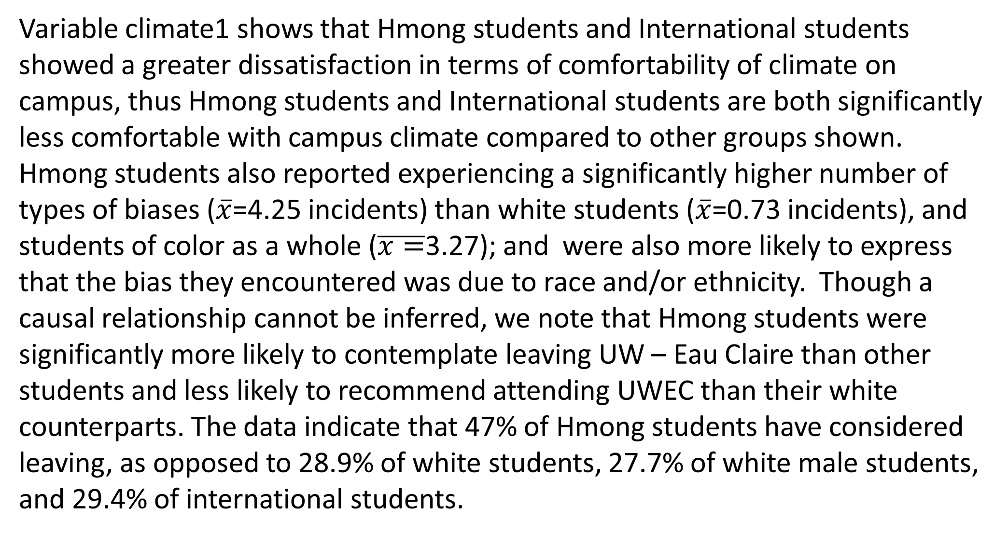
Factors Affecting Retention Rates of UW – Eau Claire Hmong Students
Susan Vang and Chia Mee Xiong | Sociology
Abstract
Methods
Other categories of students of color were similarly high or higher on this variable (e.g. African American students (61.5% and all students of color (44.7%). Hmong students were also significantly more likely to choose not to recommend the university than other groups.
Our aim is to look at how retention of Hmong students is negatively affected by racism on campus. Specifically, we will be looking at how Hmong students are more likely to consider leaving the university due to racism and how Hmong students who have experienced race-based incidents are less likely to report the incident due to the expectation that no action will be taken. Our research brings up the importance of diversity and inclusivity. Examining students of colors’ experience on campus not only acknowledges but enables a more critical outlook in ways the University can correct and change. Using the Campus Climate Survey from the University of Wisconsin - Eau Claire (UWEC), we conducted a research using both quantitative and qualitative data. In order to analyze properly, we used SPSS to crosstab questions and comments. Specifically, we used questions that correlate with retention and bias incidents to further our research. By examining the most recent campus climate survey, we hope it will raise awareness to improve matters with the campus climate. Ultimately, we want to bring a better perspective and knowledge as to why Hmong student’s retention is affected by factors such as the campus climate.
A total of 3,167 students took part in the 2015 UWEC Campus Climate Survey. The survey included items relating to their experience and their thoughts on the campus climate at the University. Of these 3,167 students, 101 of the students marked that they identified as Hmong and 1,719 marked that they identified as White. Participants who marked themselves as Hmong or White were used as comparisons for studying retention rates when it comes to race-based incidents. Questions related to retention, bias incidents and treatment were then analyzed for the two groups and other categories.
Questions consisted of a likert scale of whether participants agreed or disagreed to the statements at hand. Significance of data was interpreted through the use of cross tabulations and descriptive means.
Due to the fact that there is not a direct measure of retention in the 2015 Climate Dataset, two variables,(Q43 and Q45) were chosen as indirect measures of retention. Climate1 variable was chosen as a measurement due to the fact that it got a sense of how participants, specifically Hmong students felt when it comes to their comfortability here on campus, although the feeling of comfort is different from feeling safe, this question allowed an understanding of why a student may choose to stay or leave the University. Q20_5 and Q20_17 variables correlated with retention by taking into account the treatment of the participant based on their race and ethnicity, thus the correlation between bias incidents and retention of a student. Variable Q43 is the most important question into understanding retention of students by giving an understanding of the number of participants who have seriously considered leaving the university. Lastly variable Q45 was chosen as a variable due to the idea that it relates to Q43 of why an individual would want to ever leave the University. If a participant wanted to leave the university, they would be less likely to recommend the University.
Discussion and Conclusion
Results from this analysis indicate that Hmong students tend to experience more types of bias incidents than white students of students of color in general. They are also more likely to feel that these bias incidents are due to their race and/or their ethnicity. We suggest that these two factors are likely to contribute to the greater likelihood of considering leaving UWEC and the lower likelihood of recommending UWEC to friends and family. The results of bias incidents and recommendations show that Hmong students are in fact facing race-based incidents and thus becoming a factor into reasons Hmong students decide to leave the university. When looking at comments of Hmong students in regards to climate, many of the comments spoke about racism. Ten out of the thirty four had mentioned race and ethnicity as a factor when it came to comments about leaving. When it came to comments about whether they would recommend the university, nine out of the twenty seven comments said that they wouldn’t due to some form of discrimination. Many other comments made by Hmong students were met with frustration of climate being bad on campus due to race based incidents and recommendations of change. Thus we come to find that indirectly measuring, retention rate of Hmong students is affected by more than one factor but race-based incidents are a factor when it comes to retention.
In addition, our research is limited in the sense of intersectionality. It focuses in on one factor of affect but there are also many other conditional variables such as financial needs, family needs, mental health, sexism and etc. With our findings of race-based incident factors we believe it can add to and contribute to further research on this topic of retention and the different outlining factors that play a role into what causes Hmong students and even other students of color to choose to leave the university. This research can expand beyond just Hmong students and go in to other ethnic groups on campus.
The university and its administration need to implement more awareness on diversity on campus. First, hiring faculty that are competent in different departments for students’ academics should be a top priority. Next, faculty and students should engage in more critical and educational events that will accommodate to students of colors and their safety. Finally, future studies should look into race along with other intersectionalities that intertwine with students of colors in academic settings at the institution level.
Introduction
The ideal college experience ranges from staying in the dorms, having a good advisor, taking the right courses, feeling welcome, and ultimately graduating. In regards to college experiences, the intention of our research is to analyze how students of colors’ college experience, as a student with many other identities and backgrounds, show differences within a predominantly white campus. Our interest falls on the Critical Race theory in which we examine how the environment on campus looks like for marginalized groups such as Hmong students.
Critical Race Theory (CRT) emerges from the view of race as a socially constructed concept which serves to uphold the interests for a white population. When we talk about race in our study we focus on the idea of whiteness. CRT helps us critically think of ways race plays a role in our everyday life. Altogether, the theory addresses relationships between race, racism, and power (Delgado and Stefancic). In regards to our hypothesis, CRT informs our study about the different experiences between Hmong students and white students. While Hmong students experience different treatments base on their race, white students do not experience this. Thus, white students do not experience bias incidents like Hmong students do on campus. Our finding confirm what CRT predicts, i.e. that the college experience for students of color is mitigated by race. Furthermore, the experience of Hmong students on campus differs and in some ways is less satisfactory than other students of color. The similarities between many students of color are that students of colors’ experience institutional racism whether it be in classrooms, faculties, due to teaching contents, and more.
Findings
VARIABLES
Variable climate1 shows that Hmong students and International students showed a greater dissatisfaction in terms of comfortability of climate on campus, thus Hmong students and International students are both significantly less comfortable with campus climate compared to other groups shown. Hmong students also reported experiencing a significantly higher number of types of biases ($\overline{x}$=4.25 incidents) than white students ($\overline{x}$=0.73 incidents), and students of color as a whole ($\overline{x=}$3.27); and were also more likely to express that the bias they encountered was due to race and/or ethnicity. Though a causal relationship cannot be inferred, we note that Hmong students were significantly more likely to contemplate leaving UW – Eau Claire than other students and less likely to recommend attending UWEC than their white counterparts. The data indicate that 47% of Hmong students have considered leaving, as opposed to 28.9% of white students, 27.7% of white male students, and 29.4% of international students.
Climate 1: Overall, how comfortable are you with the climate at UW-Eau Claire?
Q20_5: For the items above, if any of the aspects of your identity played a role in others' treatment of you – Ethnicity
Q20_17: For the items above which, if any of the aspects of your identity played a role in others' treatment of you – Race
Q43: Have you ever seriously considered leaving UW-Eau Claire?
Q45: Would you recommend attending UW-Eau Claire to family and friends?
ACKNOWLEDGMENTS
LTS Research Poster Printing Services
Professor Melissa Bonstead-Bruns
(ORSP) Office of Research and Sponsored Programs
UWEC 2015 Campus Climate Survey
REFERENCES
Delgado, R., Stefancic, J., & Harris, A. P. (2017). Critical race theory: An introduction. New York: New York University Press.
University of Wisconsin – Eau Claire 2015 Campus Climate Survey

