Slide 1
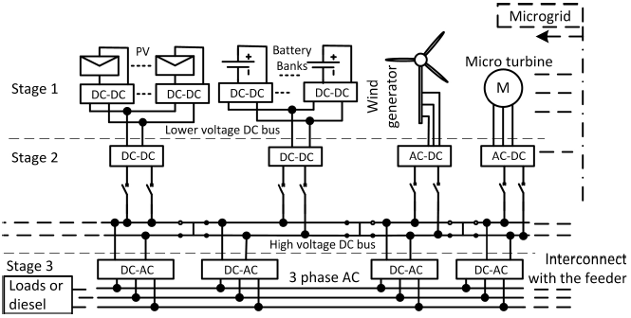
DC MICROGRID MODELING AND ENERGY STORAGE PLACEMENT TO ENHANCE SYSTEM STABILITY
Carl Westerby
5/1/2013

Slide 2
Acknowledgments
Dr. Yu
Committee Members
Dr. Nasiri
Dr. Hosseini
Qiang Fu
Associates at Univ. Wisconsin – Madison
Dr. Han
Junjian Zhao

Slide 3
Table of Contents
Introduction
Load and Line Characterization
Dual Active Bridge (DAB) Converter Overview
Dynamic System Modeling
UWM System Modeling
System Analysis
System Simulation
Conclusion
References

Slide 4
1. Introduction
Benefits of Microgrids
Integrating distributed generation from renewables
Modularized approach increases reliability
Benefits of DC over AC
No Reactive Power
Enhanced System Efficiency
No Frequency Synchronization with Grid
Importance of Energy Storage with Distributed Generation
Optimal placement to reduce cost
Creating a System Model to Analyze

Slide 5
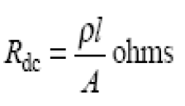
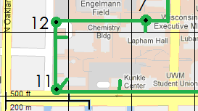
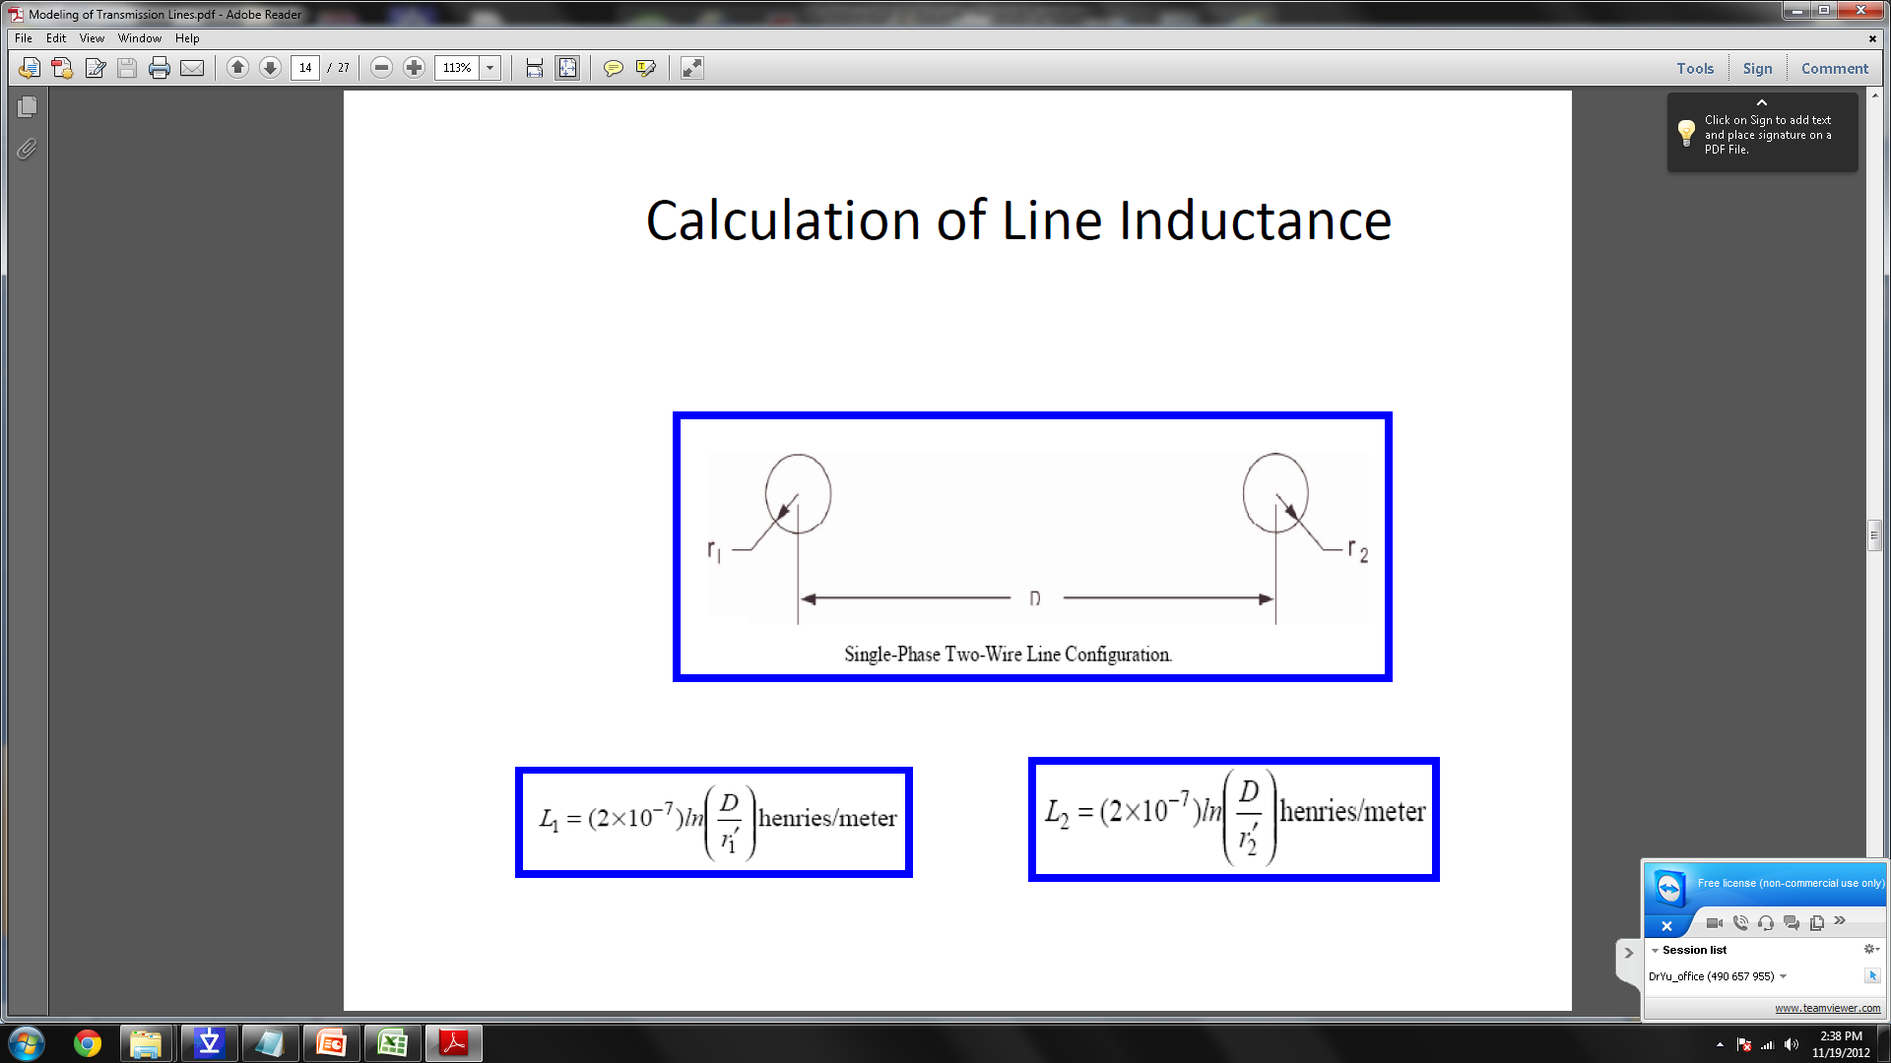
2. DC System Impedances
Estimate Cable Lengths using Satellite images
Calculate the cable resistance using the resistance/area of copper(10.371ohms/mil2/foot)
The line inductance can be calculated using the mutual inductance formula.

Slide 6
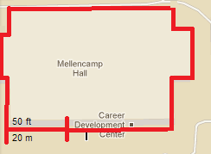
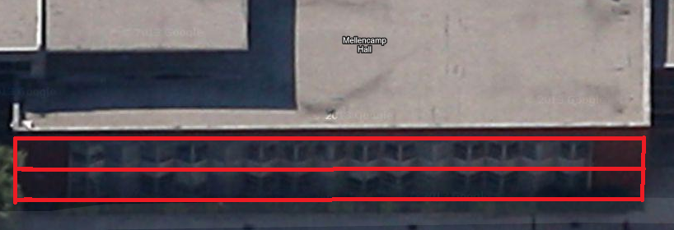
2. DC System Load Calculation
Description | Value | Source | Reference
Lighting Load | 3 VA/ft² | NEC prescribed estimate | 3
Office Receptacle Load | 1 VA/ft² | NEC prescribed estimate | 3
Heating and Cooling Load | 0.9 W/ft² | HVAC Sizing Rule of Thumb (600 ton/ft²) | 4
$$P_{load}=A\left(N_{s}\right)(3.0+1.0+0.9)$$

Slide 7
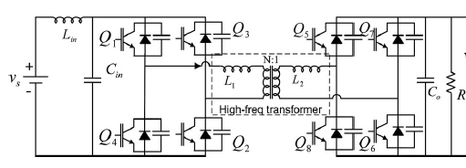
3. Dual Active Bridge (DAB) Converter Overview
Two Active H-bridges (Bi-directional)
Designed Series Inductance
High Frequency Transformer (Isolation)

Slide 8
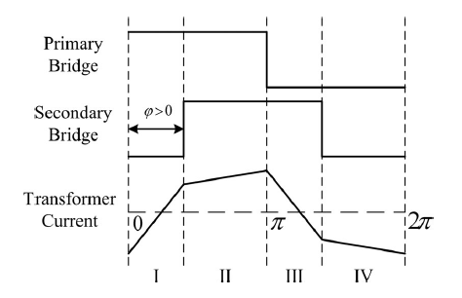
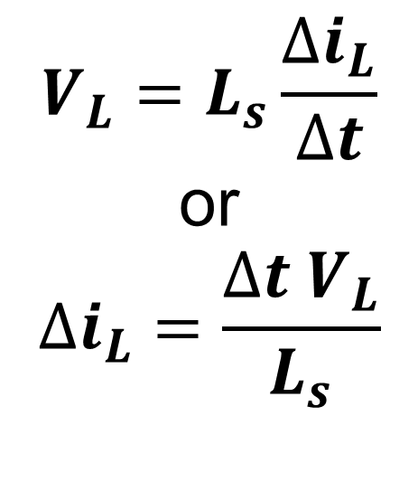

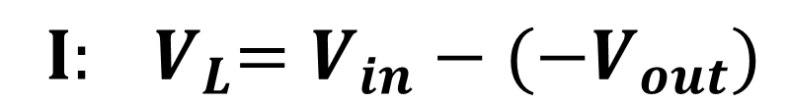
3. DAB Converter Operation
$$V_{L}=L_{s}\frac{∆i_{L}}{∆t}$$
or
$$∆i_{L}=\frac{∆t{ V}_{L}}{L_{s}}$$
$${ I: V}_{L}=V_{in}−(−V_{out})$$
$${II: V}_{L}=V_{in}−V_{out}$$

Slide 9
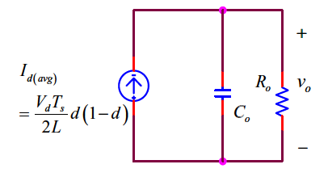
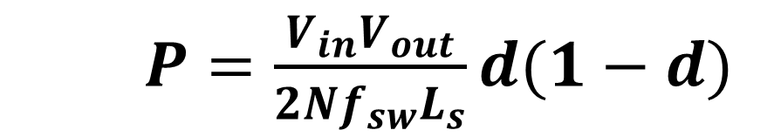
3. DAB Average Model
$P=\frac{V_{in}V_{out}}{2Nf_{sw}L_{s}}d(1−d)$

Slide 10
4. DC Microgrid Modeling
Use previous methods to create a dynamic system model using differential equations:
Line Impedances
Load Resistances
DAB Average Model
Capacitors
Current Sources

Slide 11
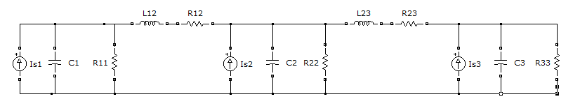
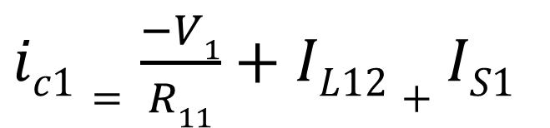
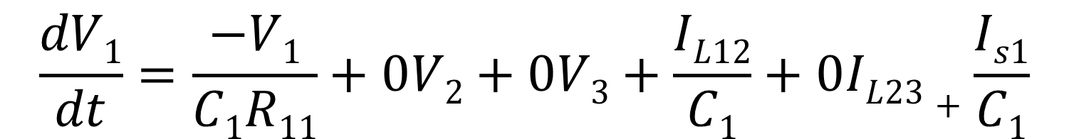
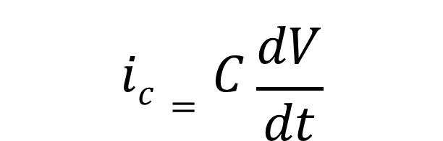
4. DC Microgrid Modeling
I_{L12}
I_{L23}
. . .
KCL at Each Node
Node 1:
$$ic=C\frac{dV}{dt}$$
$ic1=\frac{−V1}{R11}+IL12+IS1$
$$\frac{dV1}{dt}=\frac{−V1}{C1R11}+0V2+0V3+\frac{IL12}{C1}+0IL23+\frac{Is1}{C1}$$

Slide 12
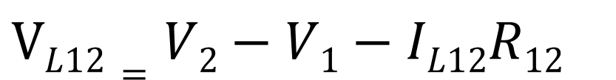
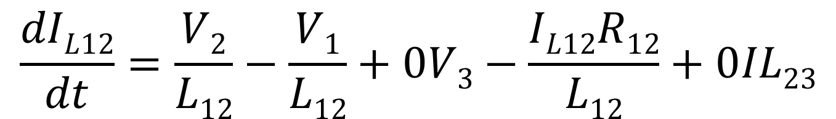
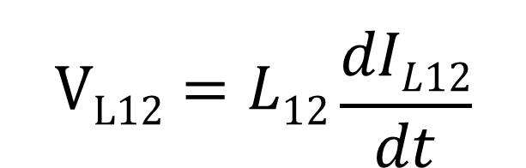
4. DC Microgrid Modeling
I_{L12}
I_{L23}
. . .
KVL across L₁₂:
$$VL12=L12\frac{dIL12}{dt}$$
$VL12=V2−V1−IL12R12$
$$\frac{dIL12}{dt}=\frac{V2}{L12}−\frac{V1}{L12}+0V3−\frac{IL12R12}{L12}+0IL23$$

Slide 13
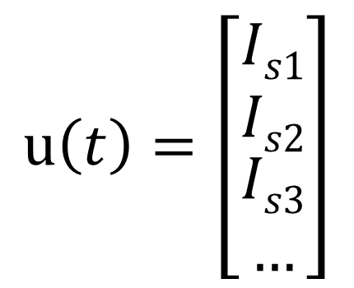
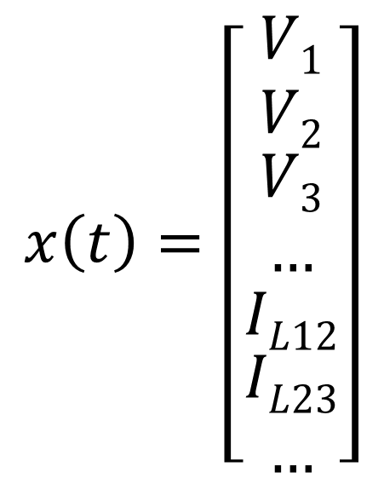
4. State Space Modeling
One state is needed for each independent energy storage device
Capacitor Voltages and Inductor Currents are a natural choice
Input is chosen to be the current sources
$$x\left(t\right)=\left[\begin{matrix}V1 \\ V2 \\ \begin{aligned}V3 \\ …\end{aligned} \\ IL12 \\ \begin{aligned}IL23 \\ …\end{aligned}\end{matrix}\right]$$
$$u\left(t\right)=\left[\begin{matrix}Is1 \\ Is2 \\ \begin{aligned}Is3 \\ …\end{aligned}\end{matrix}\right]$$

Slide 14
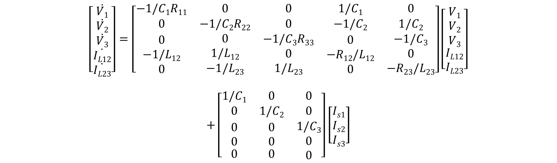
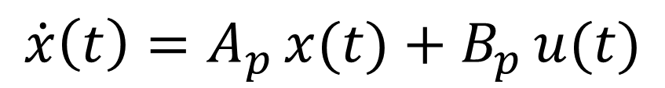
4. State Space Modeling Cont.
Model for a simple 3 bus system:
$$\dot{x}\left(t\right)=A_{p }x(t)+B_{p }u(t)$$
$$\left[\begin{aligned}\dot{V1} \\ \dot{V2} \\ \dot{V3} \\ \dot{IL12} \\ \dot{IL23}\end{aligned}\right]=\left[\begin{matrix}−1/C1R11 & 0 & 0 & 1/C1 & 0 \\ 0 & −1/C2R22 & 0 & −1/C2 & 1/C2 \\ \begin{aligned}0 \\ −1/L12 \\ 0\end{aligned} & \begin{aligned}0 \\ 1/L12 \\ −1/L23\end{aligned} & \begin{aligned}−1/C3R33 \\ 0 \\ 1/L23\end{aligned} & \begin{aligned}0 \\ −R12/L12 \\ 0\end{aligned} & \begin{aligned}−1/C3 \\ 0 \\ −R23/L23\end{aligned}\end{matrix}\right]\left[\begin{aligned}\begin{matrix}V1 \\ V2 \\ V3\end{matrix} \\ IL12 \\ IL23\end{aligned}\right]$$
$$+\left[\begin{matrix}1/C1 & 0 & 0 \\ 0 & 1/C2 & 0 \\ \begin{aligned}\begin{aligned}0 \\ 0\end{aligned} \\ 0\end{aligned} & \begin{aligned}\begin{aligned}0 \\ 0\end{aligned} \\ 0\end{aligned} & \begin{aligned}1/C3 \\ 0 \\ 0\end{aligned}\end{matrix}\right]\left[\begin{matrix}Is1 \\ Is2 \\ Is3\end{matrix}\right]$$

Slide 15
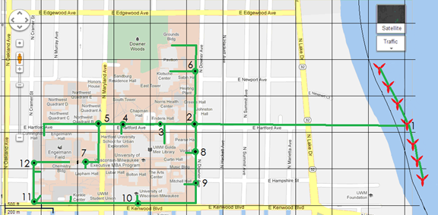
5. UWM DC Microgrid

Slide 16
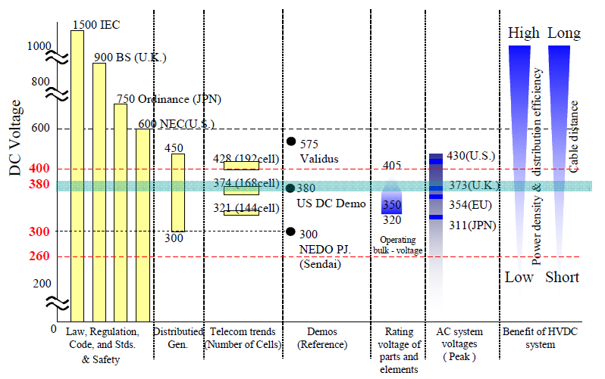
5. Voltage Selection
Safety Issues
System Efficiency
Standards
NEC Voltage limit (600 V)
ETSI Standard for the 380 VDC voltage level (EN 300 132-3-1)

Slide 17
5. System Bus Parameters
Bus | Bus Load (kW) | R_{load} (ohms) | Generation (kW) | # of Converters | C (F)
1 | Line Parasitics | 1000 | 3000 | 15 | 0.015
2 | 147 | 0.982 | 147 | 7 | 0.007
3 | 1347.5 | 0.107 | 650 | 33 | 0.033
4 | 12.25 | 11.788 | 0 | 1 | 0.001
5 | 560.44 | 0.258 | 250 | 13 | 0.013
6 | 686 | 0.210 | 420 | 21 | 0.021
7 | 796.25 | 0.181 | 230 | 12 | 0.012
8 | 294 | 0.491 | 100 | 5 | 0.005
9 | 1310.75 | 0.110 | 510 | 26 | 0.026
10 | 1102.5 | 0.131 | 540 | 27 | 0.027
11 | 695.2 | 0.208 | 34 | 2 | 0.002
12 | 600.25 | 0.241 | 160 | 8 | 0.008

Slide 18
5. System Line Parameters
Line | Distance (feet) | R (mΩ) | L (μH)
Bus 1-2 | 3000 | 5.186 | 93.80
Bus 2-3 | 500 | 0.864 | 15.60
Bus 2-6 | 500 | 0.864 | 15.60
Bus 3-4 | 625 | 1.080 | 19.50
Bus 4-5 | 300 | 0.519 | 9.38
Bus 5-7 | 600 | 1.037 | 18.80
Bus 2-8 | 300 | 0.519 | 9.38
Bus 9-8 | 600 | 1.037 | 18.80
Bus 10-9 | 1100 | 1.901 | 34.40
Bus 11-10 | 1600 | 2.766 | 50.00
Bus 12-11 | 600 | 1.037 | 18.80

Slide 19
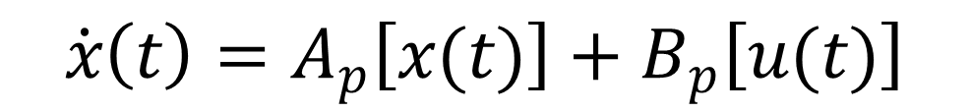
6. System Analysis
$$\dot{x}\left(t\right)=A_{p}\left[x(t)\right]+B_{p}\left[u(t)\right]$$
Part 1 Eigenvalue Analysis:
Damping
Speed
Part 2 Input Matrix Analysis:
Magnitude of effect on System Modes
Number of Modes Affected

Slide 20
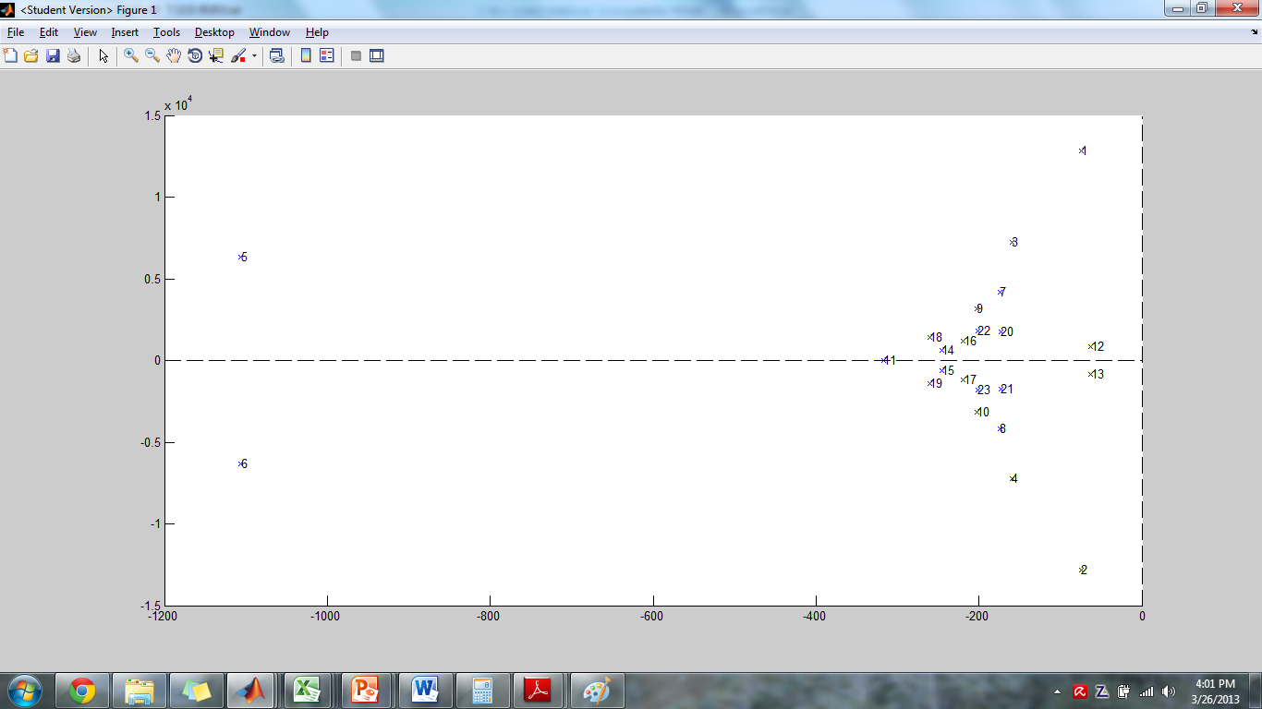
6. System Eigenvalues

Slide 21
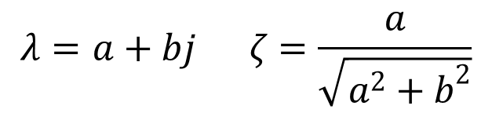
6. System Eigenvalue Damping
$$λ=a+bj ζ=\frac{a}{\sqrt{a^{2}+b^{2}}}$$

Slide 22

6. System Eigenvalue Speed
$$ω_{n}=\sqrt{a^{2}+b^{2}}$$

Slide 23
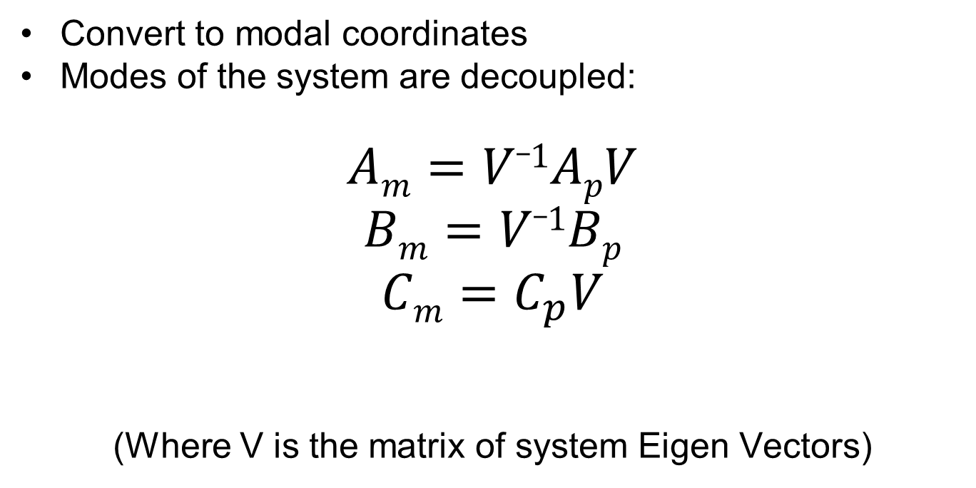
6. Input Matrix analysis
Convert to modal coordinates
Modes of the system are decoupled:
$$Am=V_1ApV$$
$$Bm=V_1Bp$$
$$Cm=C_{p}V$$
(Where V is the matrix of system Eigen Vectors)

Slide 24
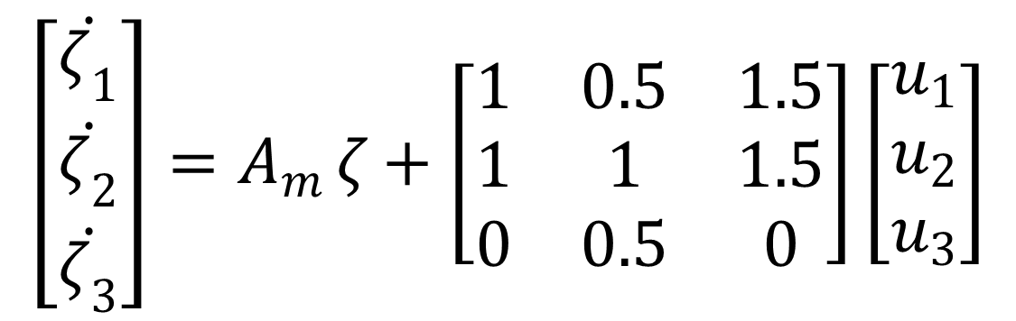
6. Controllability
Can the input reach all the states?
Example Matrix:
Magnitude of elements (ΔVoltage/Amp injected)
Number of Modes effected
$$\left[\begin{matrix}\dot{ζ_{1}} \\ \dot{ζ_{2}} \\ \dot{ζ_{3}}\end{matrix}\right]=A_{m }ζ+\left[\begin{matrix}1 & 0.5 & 1.5 \\ 1 & 1 & 1.5 \\ 0 & 0.5 & 0\end{matrix}\right]\left[\begin{matrix}u_{1} \\ u_{2} \\ u_{3}\end{matrix}\right]$$

Slide 25
6. Proposed Indexing
Sum the magnitude of elements in each column
Count the number of non-zero elements in each column
Create a Multiplicative Factor Based on non-zero elements
Factor=1+[(# non-0) –(minimum # non-0 in all column)]
Example:
Bm | u1 | u2 | u3
Eig 1 | 1 | 0.5 | 1.5
Eig 2 | 1 | 1 | 1.5
Eig 3 | 0 | 0.5 | 0
Sum | 2 | 2 | 3
# non-0 | 2 | 3 | 2
Min(# non-0) | 2 | 2 | 2
Factor calculation | 1+(2-2) | 1+(3-2) | 1+(2-2)
Factor | 1 | 2 | 1
Index | 2 | 4 | 3

Slide 26
6. B_{m} Indexing for UWM
 | Bus 1 | Bus 2 | Bus 3 | Bus 4 | Bus 5 | Bus 6 | Bus 7 | Bus 8 | Bus 9 | Bus 10 | Bus 11 | Bus 12
Eig 1 | 0.00 | 3.25 | 45.14 | 4664.25 | 252.04 | 0.00 | 7.01 | 0.50 | 0.00 | 0.00 | 0.00 | 0.00
Eig 2 | 0.00 | 3.25 | 45.14 | 4664.25 | 252.04 | 0.00 | 7.01 | 0.50 | 0.00 | 0.00 | 0.00 | 0.00
Eig 3 | 18.36 | 1329.51 | 52.26 | 21.00 | 4.33 | 82.36 | 0.40 | 1422.01 | 59.23 | 1.25 | 0.62 | 0.08
Eig 4 | 18.36 | 1329.51 | 52.26 | 21.00 | 4.33 | 82.36 | 0.40 | 1422.01 | 59.23 | 1.25 | 0.62 | 0.08
Eig 5 | 0.00 | 0.45 | 0.01 | 0.00 | 0.00 | 0.02 | 0.00 | 0.39 | 1.23 | 43.23 | 2299.68 | 441.78
Eig 6 | 0.00 | 0.45 | 0.01 | 0.00 | 0.00 | 0.02 | 0.00 | 0.39 | 1.23 | 43.23 | 2299.68 | 441.78
Eig 7 | 37.41 | 896.18 | 120.67 | 17.33 | 35.20 | 186.85 | 11.70 | 1212.44 | 171.44 | 11.50 | 3.14 | 1.90
Eig 8 | 37.41 | 896.18 | 120.67 | 17.33 | 35.20 | 186.85 | 11.70 | 1212.44 | 171.44 | 11.50 | 3.14 | 1.90
Eig 9 | 4.70 | 62.00 | 110.76 | 541.18 | 804.14 | 27.23 | 635.98 | 52.50 | 16.00 | 2.08 | 0.26 | 0.50
Eig 10 | 4.70 | 62.00 | 110.76 | 541.18 | 804.14 | 27.23 | 635.98 | 52.50 | 16.00 | 2.08 | 0.26 | 0.50
Eig 11 | 77.60 | 86.67 | 86.70 | 87.26 | 87.57 | 85.99 | 88.32 | 88.20 | 91.10 | 95.73 | 103.62 | 104.44
Eig 12 | 575.18 | 48.31 | 78.53 | 128.22 | 154.65 | 62.50 | 182.85 | 40.01 | 31.67 | 45.64 | 62.10 | 69.21
Eig 13 | 575.18 | 48.31 | 78.53 | 128.22 | 154.65 | 62.50 | 182.85 | 40.01 | 31.67 | 45.64 | 62.10 | 69.21
Eig 14 | 188.83 | 118.59 | 228.91 | 308.10 | 345.20 | 136.51 | 384.17 | 55.83 | 175.88 | 441.15 | 599.83 | 644.54
Eig 15 | 188.83 | 118.59 | 228.91 | 308.10 | 345.20 | 136.51 | 384.17 | 55.83 | 175.88 | 441.15 | 599.83 | 644.54
Eig 16 | 250.15 | 264.93 | 83.57 | 217.52 | 359.39 | 473.77 | 523.92 | 277.47 | 288.21 | 168.20 | 468.92 | 594.11
Eig 17 | 250.15 | 264.93 | 83.57 | 217.52 | 359.39 | 473.77 | 523.92 | 277.47 | 288.21 | 168.20 | 468.92 | 594.11
Eig 18 | 70.27 | 135.37 | 127.13 | 42.77 | 123.13 | 361.71 | 225.13 | 86.14 | 325.96 | 308.16 | 589.90 | 847.31
Eig 19 | 70.27 | 135.37 | 127.13 | 42.77 | 123.13 | 361.71 | 225.13 | 86.14 | 325.96 | 308.16 | 589.90 | 847.31
Eig 20 | 7.36 | 25.62 | 496.06 | 86.69 | 124.93 | 502.86 | 431.72 | 45.98 | 79.98 | 83.18 | 42.02 | 80.26
Eig 21 | 7.36 | 25.62 | 496.06 | 86.69 | 124.93 | 502.86 | 431.72 | 45.98 | 79.98 | 83.18 | 42.02 | 80.26
Eig 22 | 3.12 | 11.71 | 138.52 | 27.53 | 27.98 | 100.37 | 114.24 | 164.65 | 421.52 | 371.74 | 165.71 | 335.04
Eig 23 | 3.12 | 11.71 | 138.52 | 27.53 | 27.98 | 100.37 | 114.24 | 164.65 | 421.52 | 371.74 | 165.71 | 335.04
Sum | 2388.36 | 5878.51 | 3049.82 | 12196.44 | 4549.55 | 3954.35 | 5122.56 | 6804.04 | 3233.34 | 3047.99 | 8567.98 | 6133.9
# non-0's | 19 | 23 | 23 | 21 | 21 | 21 | 21 | 23 | 21 | 21 | 21 | 21
(x) | 1 | 5 | 5 | 3 | 3 | 3 | 3 | 5 | 3 | 3 | 3 | 3
Index | 2388.36 | 29392.59 | 15249.30 | 36589.36 | 13648.64 | 11863.02 | 15367.69 | 34020.22 | 9699.96 | 9144.13 | 25703.93 | 18401.70

Slide 27
6. Analysis Summary
Bus Voltages at nodes: 1, 2, 3, 4, 7, 8, 9, 10 are all weakly damped (ordered weakest to strongest)
Bus Voltages at nodes: 10, 9, 8, 7, 6, 3, 4 are the slowest (ordered slowest to fastest)
Energy Storage placement at Bus 2, 4, 8 is recommended based on the input matrix analysis

Slide 28
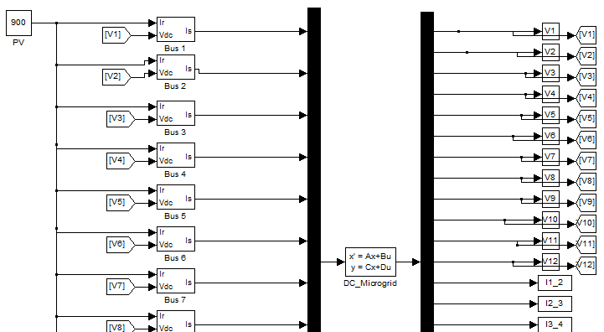
7. System Simulation Model

Slide 29
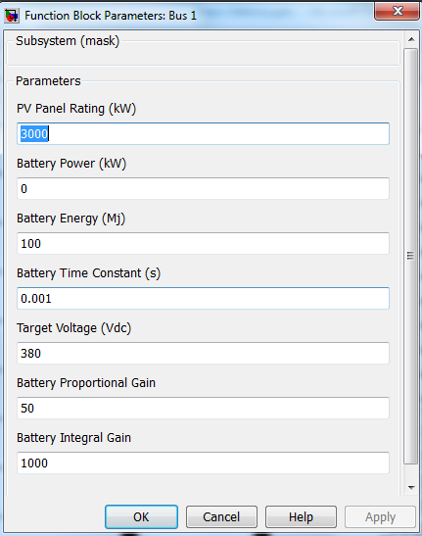
7. Battery and PV Modeling

Slide 30
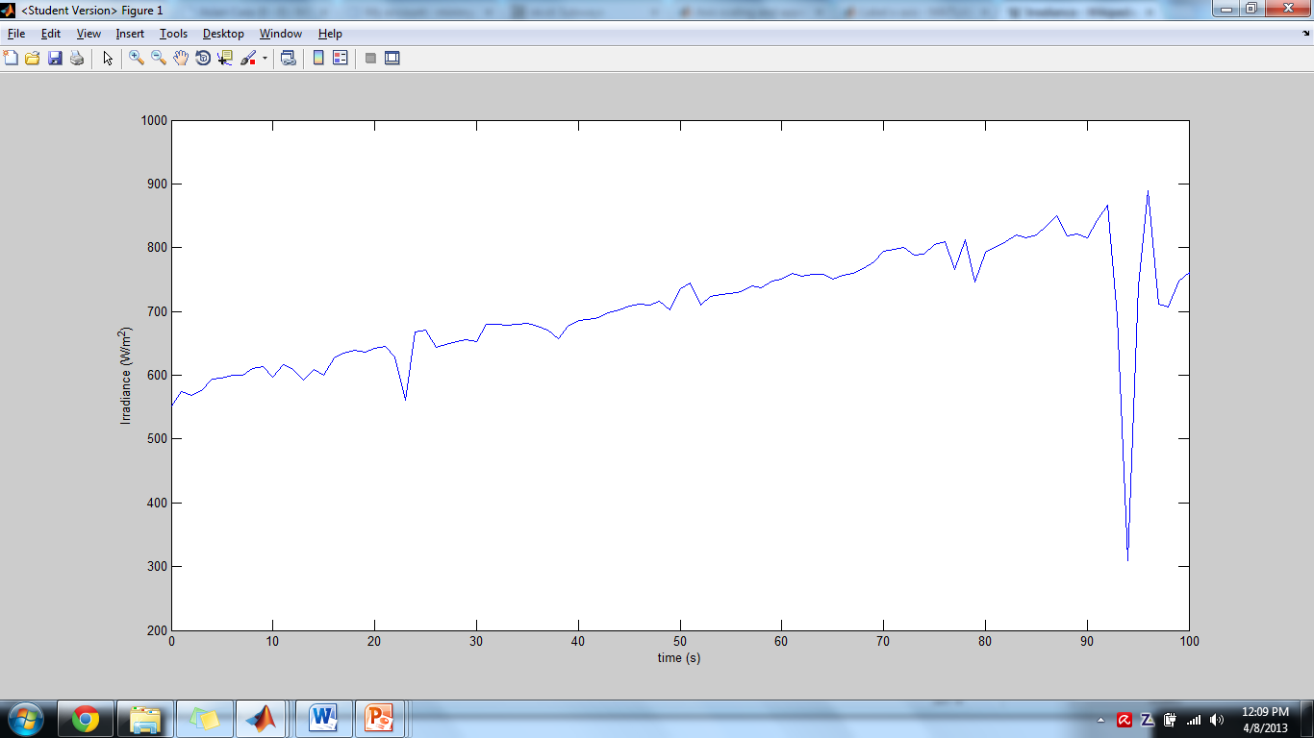
7. System Simulation
Potential Disturbances:
Changes in Irradiance
5% Step Increase in Load
5% Step Decrease in Load

Slide 31
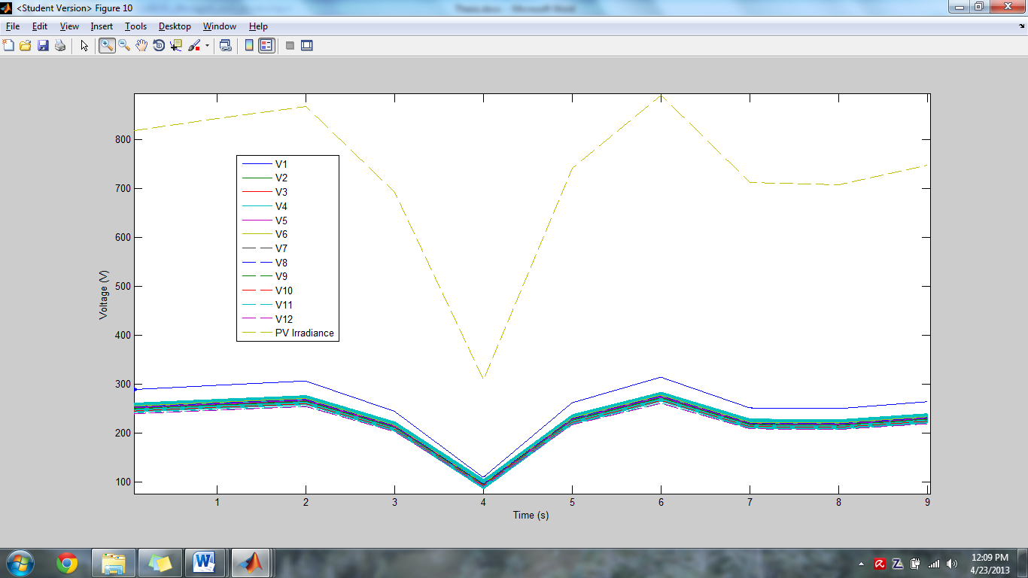
7. PV Irradiance Changes (No batteries)

Slide 32
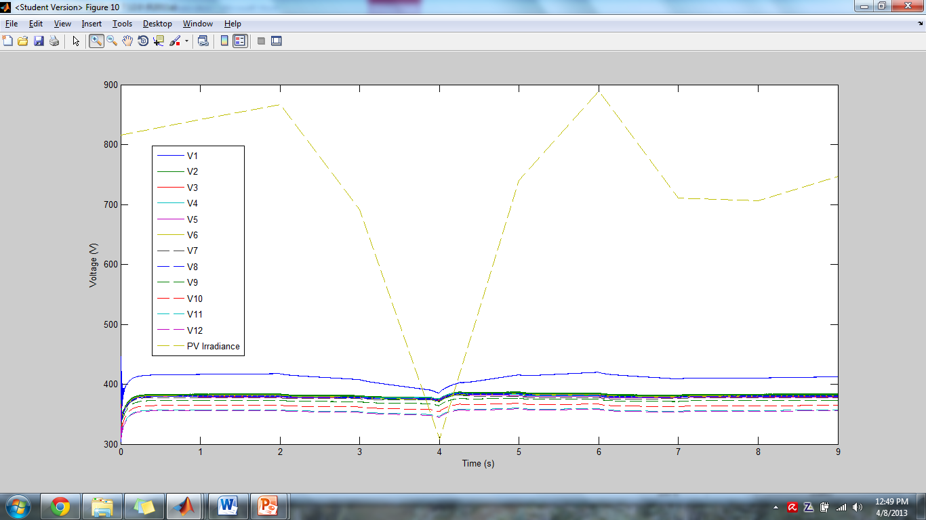
7. PV Irradiance Changes (3MW at Bus 4 and Bus 8)

Slide 33
7. PV Voltage Change Summary
 | Bus 1 | Bus 2 | Bus 3 | Bus 4 | Bus 5 | Bus 6 | Bus 7 | Bus 8 | Bus 9 | Bus 10 | Bus 11 | Bus 12
Bus1 | 26.72 | 26.81 | 26.92 | 25.89 | 27.82 | 26.84 | 25.84 | 26.83 | 26.83 | 26.83 | 19.02 | 14.14
Bus 2 | 26.81 | 17.58 | 11.72 | 11.35 | 12.69 | 12.83 | 13.34 | 11.50 | 12.82 | 12.30 | 13.44 | 13.71
Bus 3 | 26.92 | 11.72 | 20.06 | 14.38 | 15.99 | 12.66 | 17.02 | 11.58 | 11.53 | 12.31 | 13.83 | 14.23
Bus 4 | 25.89 | 11.35 | 14.38 | 23.18 | 19.45 | 12.58 | 20.81 | 11.36 | 11.97 | 12.19 | 13.92 | 14.51
Bus 5 | 27.82 | 12.69 | 15.99 | 19.45 | 27.54 | 14.45 | 24.92 | 13.04 | 12.24 | 13.48 | 16.54 | 16.97
Bus 6 | 26.84 | 12.83 | 12.66 | 12.58 | 14.45 | 21.60 | 14.53 | 16.30 | 16.35 | 13.26 | 14.91 | 15.34
Bus 7 | 25.84 | 13.34 | 17.02 | 20.81 | 24.92 | 14.53 | 33.55 | 12.80 | 14.36 | 14.71 | 17.97 | 19.07
Bus 8 | 26.83 | 11.50 | 11.58 | 11.36 | 13.04 | 16.30 | 12.80 | 18.86 | 13.00 | 13.87 | 15.07 | 15.34
Bus 9 | 26.83 | 12.82 | 11.53 | 11.97 | 12.24 | 16.35 | 14.36 | 13.00 | 21.87 | 17.67 | 18.73 | 20.05
Bus 10 | 26.83 | 12.30 | 12.31 | 12.19 | 13.48 | 13.26 | 14.71 | 13.87 | 17.67 | 29.80 | 27.97 | 30.16
Bus 11 | 19.02 | 13.44 | 13.83 | 13.92 | 16.54 | 14.91 | 17.97 | 15.07 | 18.73 | 27.97 | 43.54 | 41.57
Bus 12 | 14.14 | 13.71 | 14.23 | 14.51 | 16.97 | 15.34 | 19.07 | 15.34 | 20.05 | 30.16 | 41.57 | 48.56
Average | 25.04 | 14.18 | 15.18 | 15.97 | 17.93 | 15.97 | 19.08 | 14.96 | 16.45 | 18.71 | 21.38 | 21.97

Slide 34
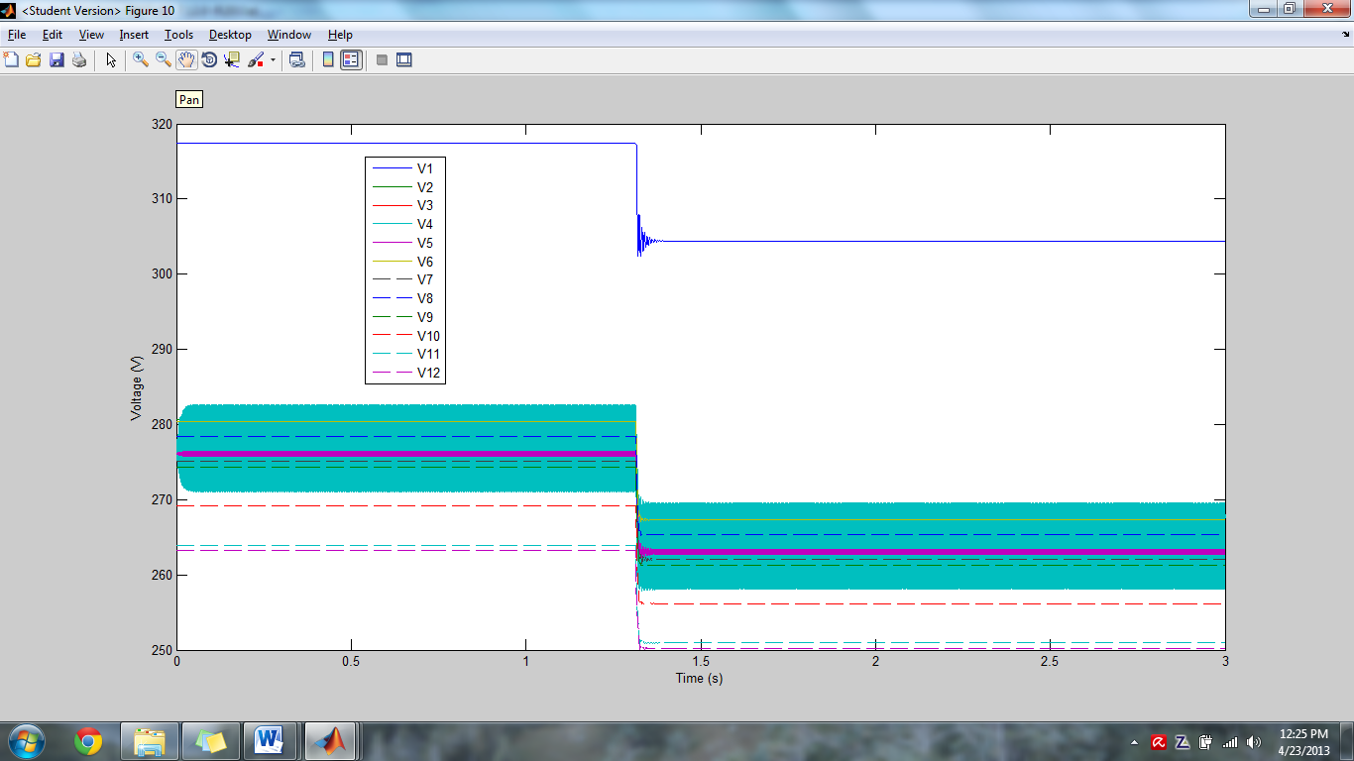
7. 5% Step Load Increase (No batteries)

Slide 35
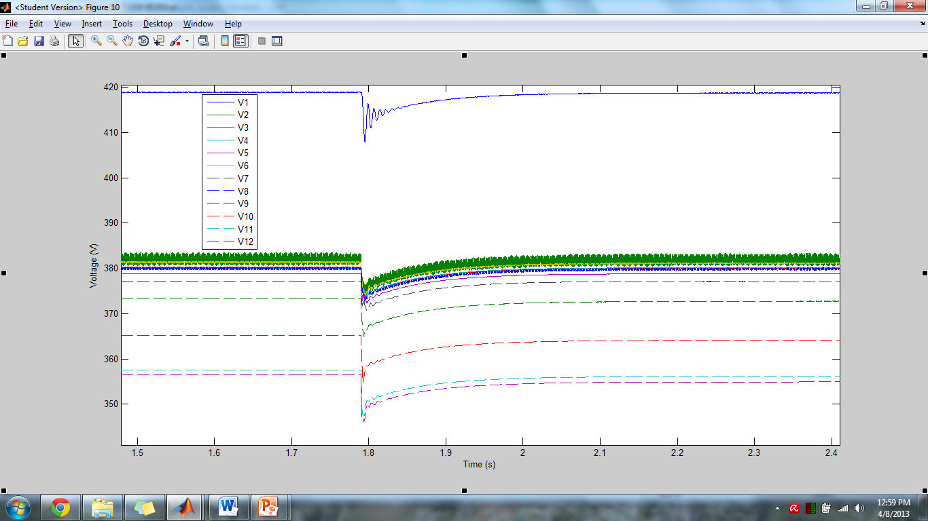
7. 5% Step Load Increase (3MW at Bus 4 and Bus 8)

Slide 36
7. 5% Load Increase Voltage Changes
 | Bus 1 | Bus 2 | Bus 3 | Bus 4 | Bus 5 | Bus 6 | Bus 7 | Bus 8 | Bus 9 | Bus 10 | Bus 11 | Bus 12
Bus1 | 11.66 | 13.24 | 13.36 | 12.46 | 15.54 | 13.62 | 11.30 | 13.20 | 13.26 | 13.42 | 10.58 | 10.64
Bus 2 | 13.24 | 11.68 | 9.86 | 8.82 | 10.41 | 9.99 | 9.79 | 8.91 | 10.19 | 10.15 | 9.90 | 9.89
Bus 3 | 13.36 | 9.86 | 12.07 | 9.21 | 10.68 | 9.98 | 9.41 | 9.60 | 9.73 | 9.80 | 12.09 | 9.83
Bus 4 | 12.46 | 8.82 | 9.21 | 11.18 | 9.69 | 9.17 | 9.84 | 8.38 | 8.92 | 9.04 | 11.16 | 8.96
Bus 5 | 15.54 | 10.41 | 10.68 | 9.69 | 12.65 | 9.47 | 11.35 | 8.89 | 8.87 | 9.62 | 12.71 | 10.50
Bus 6 | 13.62 | 9.99 | 9.98 | 9.17 | 9.47 | 11.97 | 9.22 | 9.91 | 10.13 | 10.23 | 12.02 | 10.16
Bus 7 | 11.30 | 9.79 | 9.41 | 9.84 | 11.35 | 9.22 | 12.87 | 8.90 | 9.47 | 9.85 | 12.89 | 10.19
Bus 8 | 13.20 | 8.91 | 9.60 | 8.38 | 8.89 | 9.91 | 8.90 | 11.70 | 10.16 | 10.52 | 11.85 | 10.01
Bus 9 | 13.26 | 10.19 | 9.73 | 8.92 | 8.87 | 10.13 | 9.47 | 10.16 | 12.26 | 10.94 | 12.23 | 10.55
Bus 10 | 13.42 | 10.15 | 9.80 | 9.04 | 9.62 | 10.23 | 9.85 | 10.52 | 10.94 | 13.12 | 13.13 | 11.47
Bus 11 | 10.58 | 9.90 | 12.09 | 11.16 | 12.71 | 12.02 | 12.89 | 11.85 | 12.23 | 13.13 | 14.32 | 14.06
Bus 12 | 10.64 | 9.89 | 9.83 | 8.96 | 10.50 | 10.16 | 10.19 | 10.01 | 10.55 | 11.47 | 14.06 | 14.06
Average | 12.69 | 10.23 | 10.47 | 9.74 | 10.86 | 10.49 | 10.42 | 10.17 | 10.56 | 10.94 | 12.25 | 10.86

Slide 37
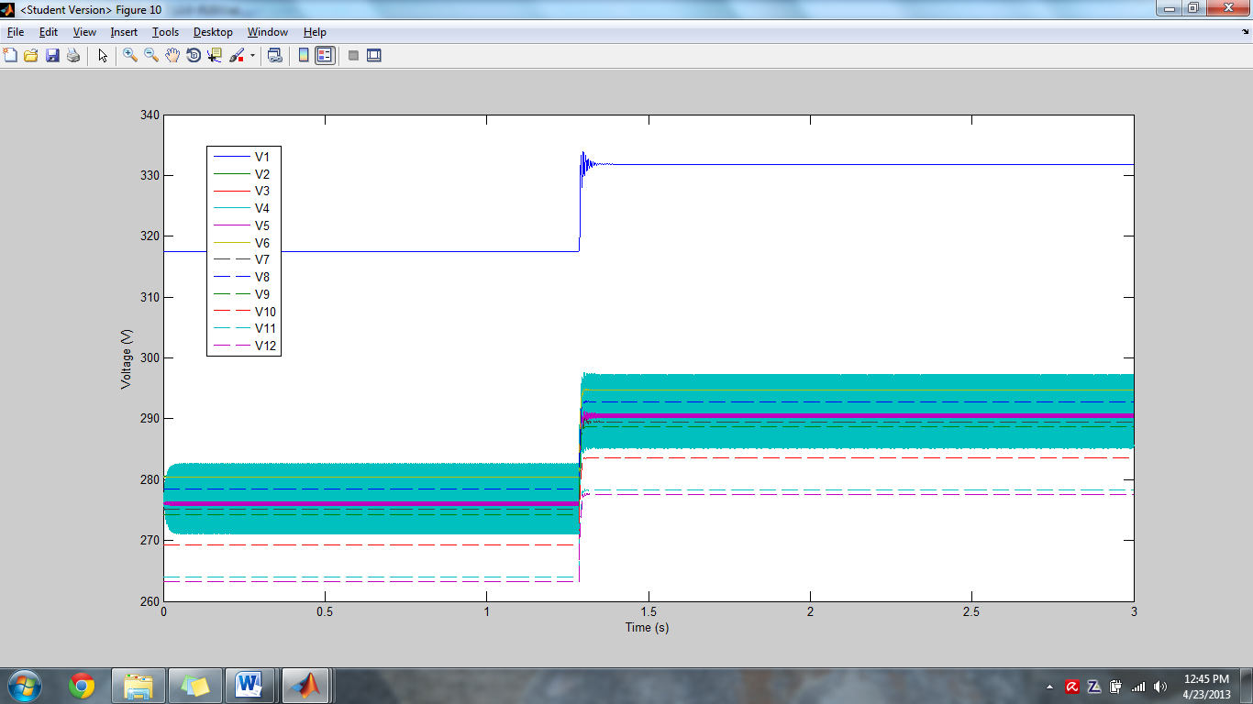
7. 5% Step Load Decrease (No Batteries)

Slide 38
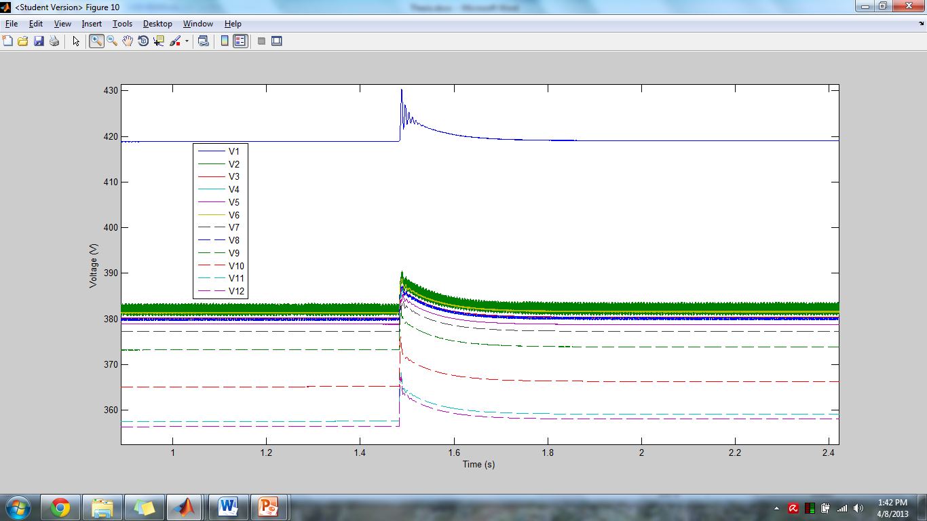
7. 5% Step Load Decrease (3MW at Bus 4 and Bus 8)

Slide 39
5% Load Decrease Voltage Changes
 | Bus 1 | Bus 2 | Bus 3 | Bus 4 | Bus 5 | Bus 6 | Bus 7 | Bus 8 | Bus 9 | Bus 10 | Bus 11 | Bus 12
Bus1 | 12.35 | 13.85 | 13.91 | 12.62 | 14.70 | 13.95 | 12.13 | 13.82 | 13.88 | 13.99 | 11.16 | 11.15
Bus 2 | 13.85 | 12.22 | 10.20 | 9.08 | 9.18 | 10.53 | 10.37 | 10.18 | 10.43 | 10.24 | 9.92 | 9.99
Bus 3 | 13.91 | 10.20 | 12.70 | 9.59 | 10.26 | 10.47 | 10.87 | 9.97 | 10.06 | 9.95 | 9.92 | 10.07
Bus 4 | 12.62 | 9.08 | 9.59 | 11.79 | 10.13 | 9.56 | 10.39 | 8.80 | 9.11 | 9.12 | 9.09 | 9.19
Bus 5 | 14.70 | 9.18 | 10.26 | 10.13 | 13.25 | 9.65 | 11.84 | 9.18 | 9.86 | 10.05 | 10.09 | 10.20
Bus 6 | 13.95 | 10.53 | 10.47 | 9.56 | 9.65 | 12.59 | 9.59 | 10.55 | 10.59 | 10.56 | 10.29 | 10.35
Bus 7 | 12.13 | 10.37 | 10.87 | 10.39 | 11.84 | 9.59 | 13.54 | 9.38 | 10.00 | 10.28 | 10.44 | 10.54
Bus 8 | 13.82 | 10.18 | 9.97 | 8.80 | 9.18 | 10.55 | 9.38 | 12.25 | 10.46 | 10.46 | 10.11 | 10.21
Bus 9 | 13.88 | 10.43 | 10.06 | 9.11 | 9.86 | 10.59 | 10.00 | 10.46 | 12.86 | 11.10 | 10.77 | 10.88
Bus 10 | 13.99 | 10.24 | 9.95 | 9.12 | 10.05 | 10.56 | 10.28 | 10.46 | 11.10 | 13.81 | 11.91 | 12.04
Bus 11 | 11.16 | 9.92 | 9.92 | 9.09 | 10.09 | 10.29 | 10.44 | 10.11 | 10.77 | 11.91 | 14.62 | 13.33
Bus 12 | 11.15 | 9.99 | 10.07 | 9.19 | 10.20 | 10.35 | 10.54 | 10.21 | 10.88 | 12.04 | 13.33 | 14.88
Average | 13.13 | 10.52 | 10.66 | 9.87 | 10.70 | 10.72 | 10.78 | 10.45 | 10.83 | 11.13 | 10.97 | 11.07

Slide 40
Voltage Difference Plot
 | 2,4 | 2,8 | 4,8 | 4,9 | 5,9 | 3,8 | 3,9 | 4,9 | 4,11
PV Change | 11.35 | 11.5 | 11.36 | 11.97 | 12.24 | 11.58 | 11.53 | 11.97 | 13.92
5% Load ↑ | 8.82 | 8.91 | 8.38 | 8.92 | 8.87 | 9.6 | 9.73 | 8.92 | 12.71
5% Load ↓ | 9.08 | 10.18 | 8.8 | 9.11 | 9.86 | 9.97 | 10.06 | 9.11 | 9.09
Average | 9.75 | 10.20 | 9.51 | 10.00 | 10.32 | 10.38 | 10.44 | 10.00 | 11.91

Slide 41
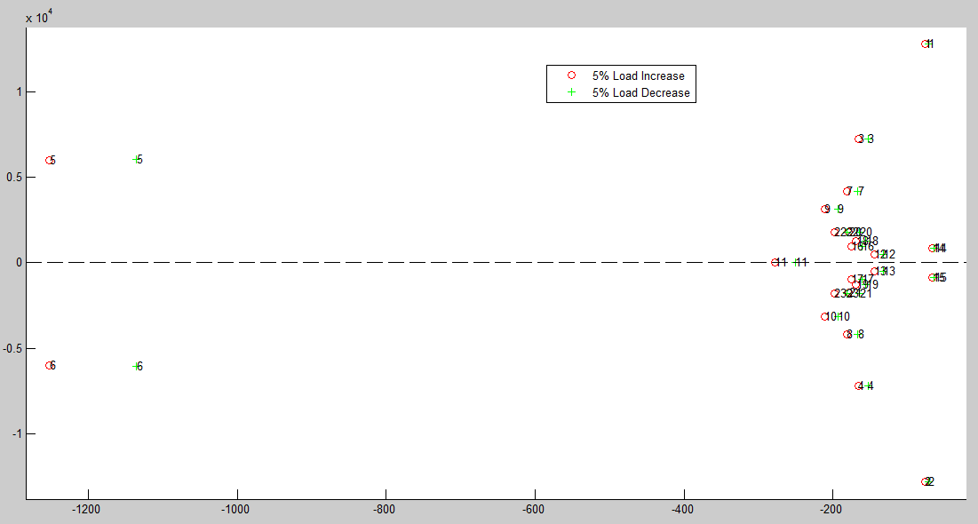
Eigenvalues Plot (5% Load ↑↓)

Slide 42
8. Conclusions
Microgrid stability is important for profitability
Optimal energy storage placement reduces costs
Practical Modeling Approach
Model Analysis
Eigenvalues (Damping and Natural Frequency)
Input Matrix (B_{m})
Magnitude of Change
Number of Modes Effected
Simulation Confirmation of Analysis
Changes in PV Irradiance
Step Load Increase and Decrease

Slide 43
9. References
S. Anand, B. Fernandes, "Reduced Order Model and Stability Analysis of Low Voltage DC Microgrid," IEEE Transactions on Industrial Electronics, vol. 99.
H. Seneff, “Study of the Method of Geometric Mean Distances Used in Inductance Calculation,” M.S. thesis, University of Missouri, United States,1947.
NFPA 70, The National Electrical Code. 2008 Edition. Quincy, MA: National Fire Protection Agency, 2007.
A. Bhatia, “HVAC Refresher - Facilities Standard for the Building Services (Part 2).” Internet: http://www.pdhcenter.com/courses/m216/m216content.pdf, [2012].

Slide 44
9. References
J. Salasovich, G. Mosey, “Feasibility Study of Economics and Performance of Solar Photovoltaics at the Refuse Hideaway Landfill in Middleton, Wisconsin.” NREL, Internet: http://www.nrel.gov/docs/fy11osti/49846.pdf, [August 2011].
Q. Hengsi, J. Kimball, "Generalized Average Modeling of Dual Active Bridge DC–DC Converter," IEEE Transactions on Power Electronics, vol. 27, no.4, pp. 2078-2084, April 2012.
H. Krishnamurthy, R. Ayyanar, "Building Block Converter Module for Universal (AC-DC, DC-AC, DC-DC) Fully Modular Power Conversion Architecture," IEEE Power Electronics Specialists Conference, 2007, pp. 17-21, June 2007.

Slide 45
9. References
A. Fukyui et. al, “HVDC Power Distribution Systems for Telecom sites and Data Centers” in 2010 International Power Electronics Conference, ISBN 978-1-4244-5393-1/10, p.p. 874-880.
S. Anand, B. Fernandes, “Optimal Voltage Level for DC Microgrids”, ISBN 978-1-4244-5226-2/10, pp. 3034-3039

