Slide 1


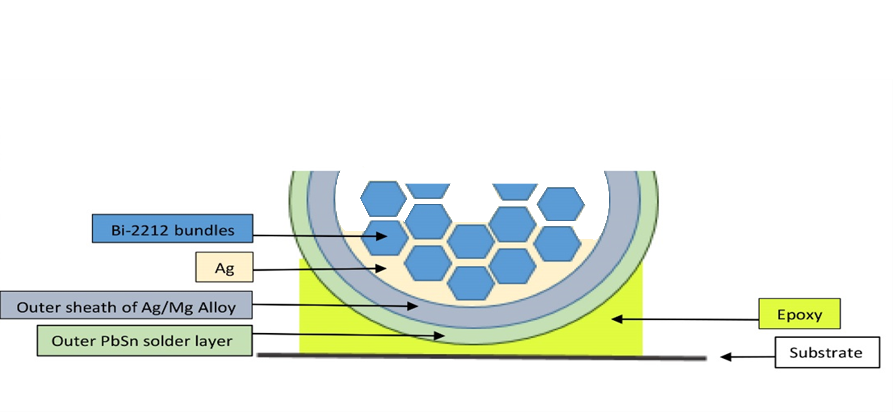
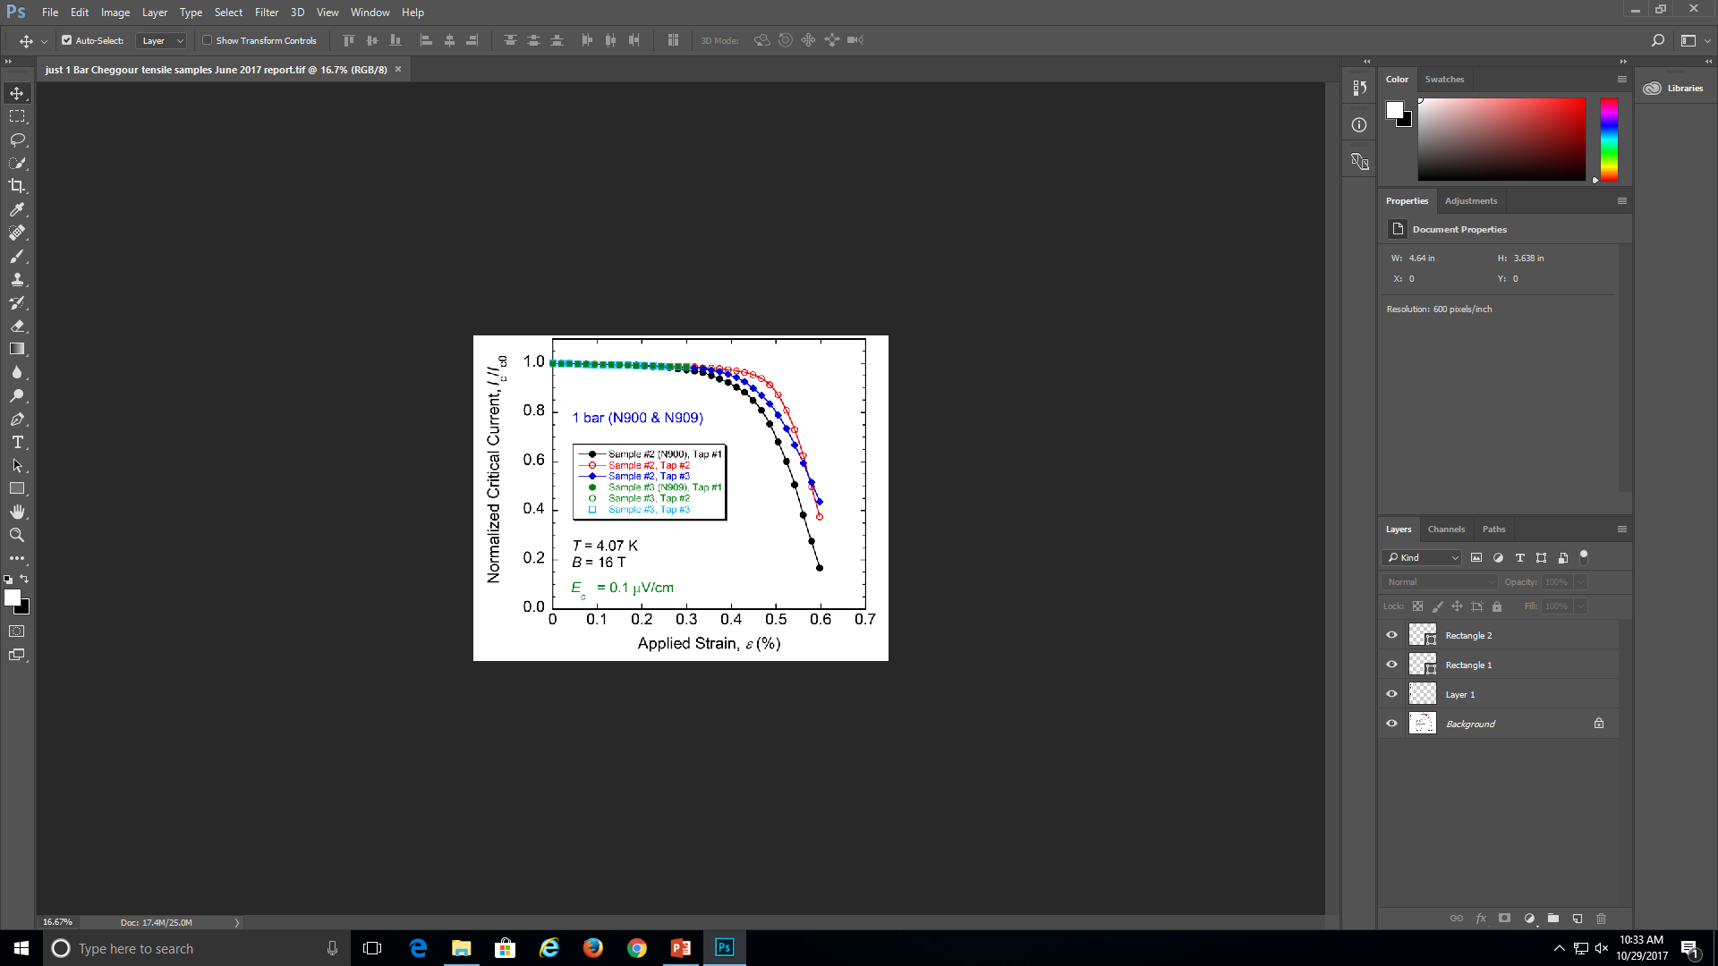
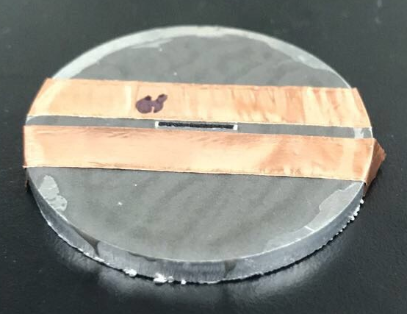
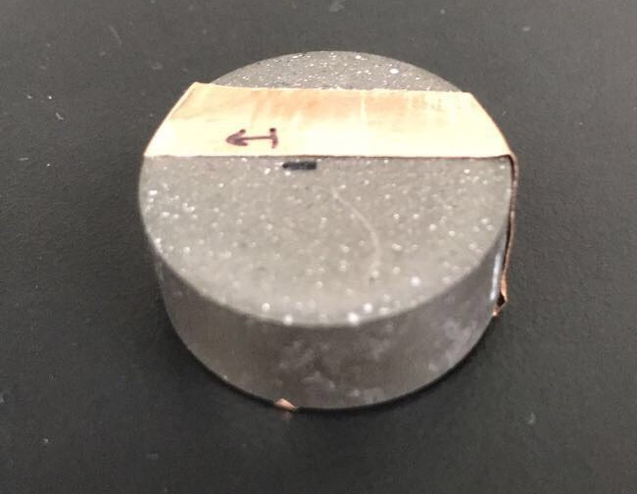
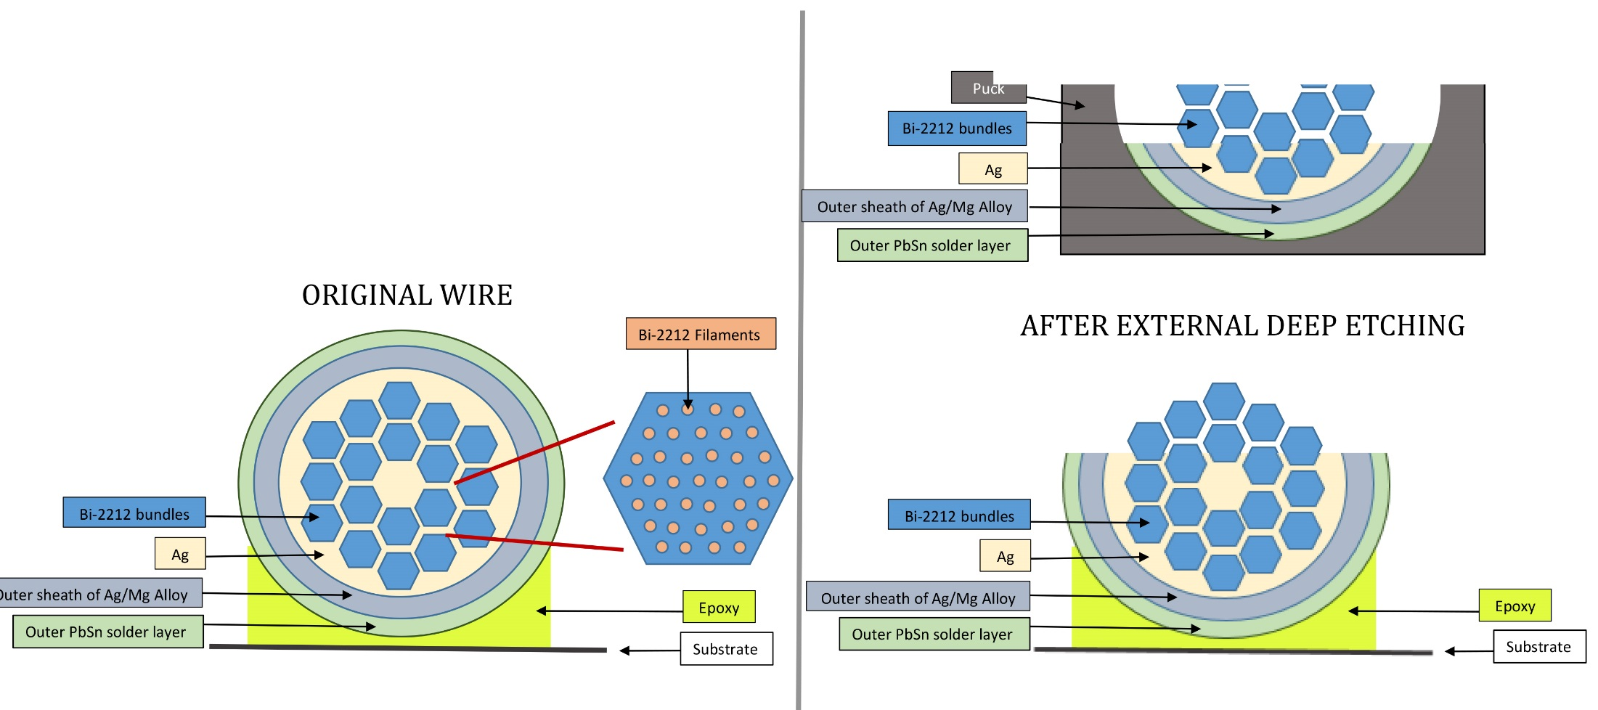
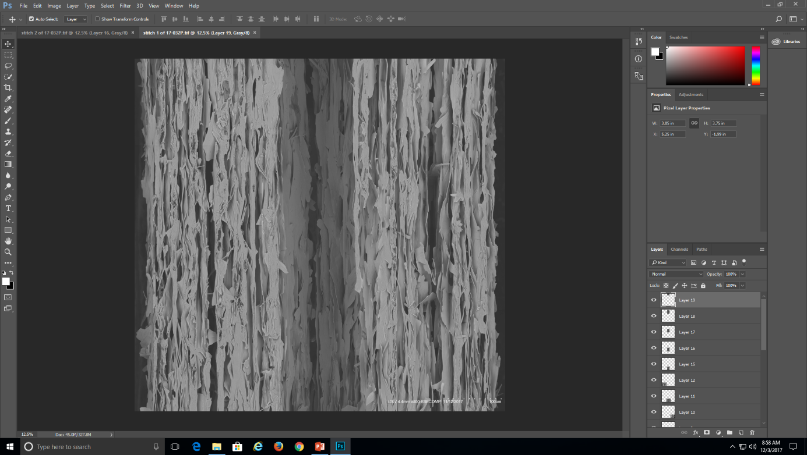
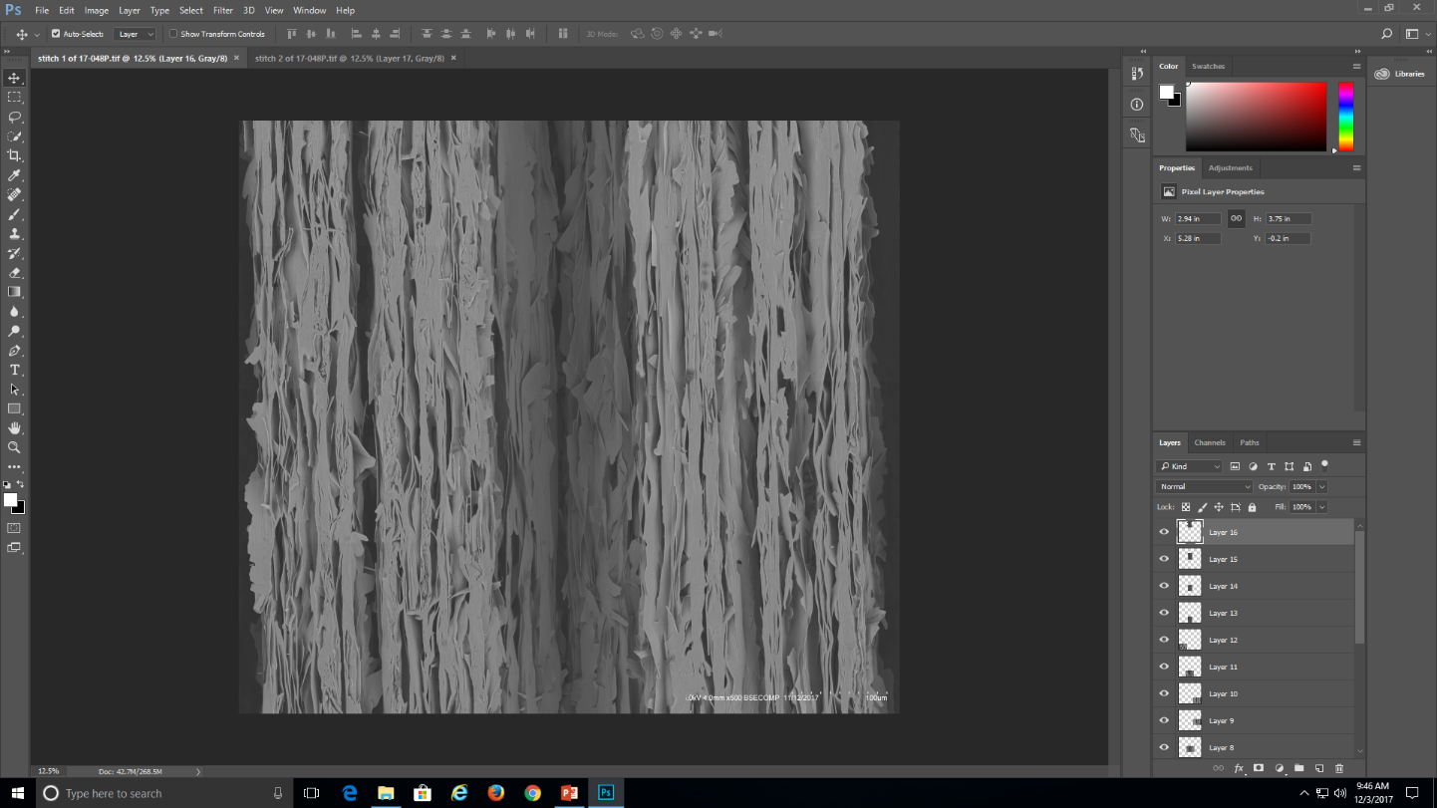
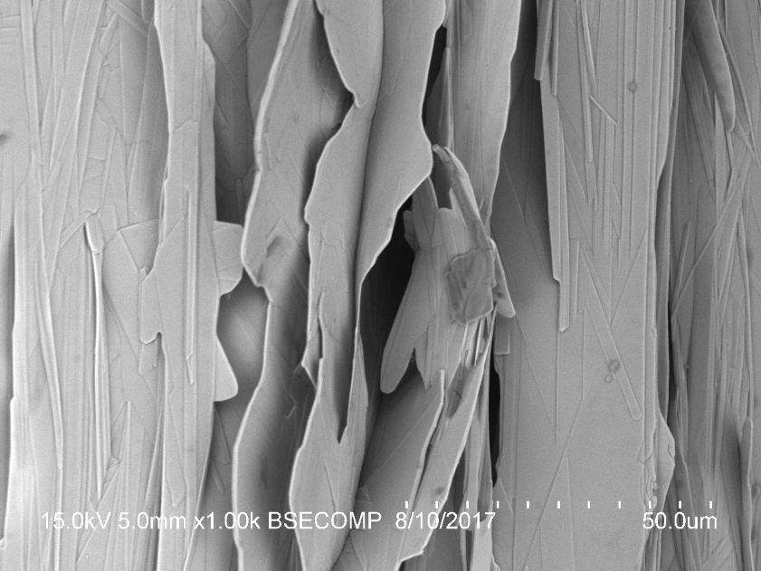
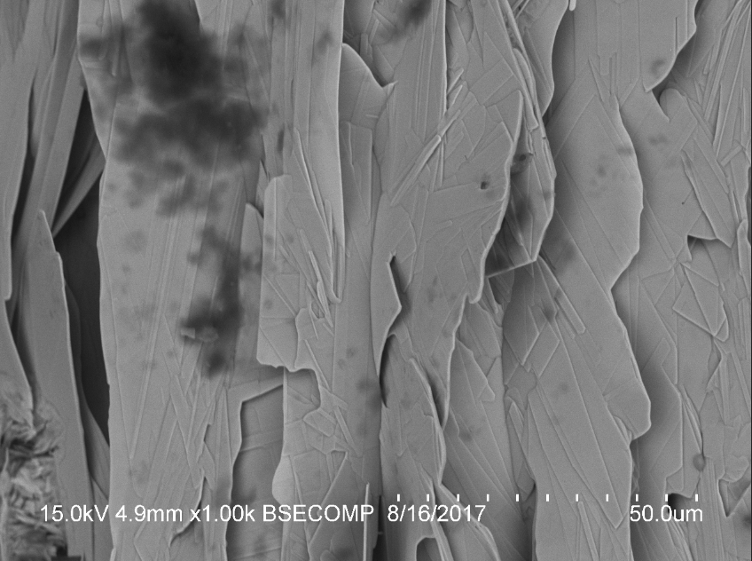
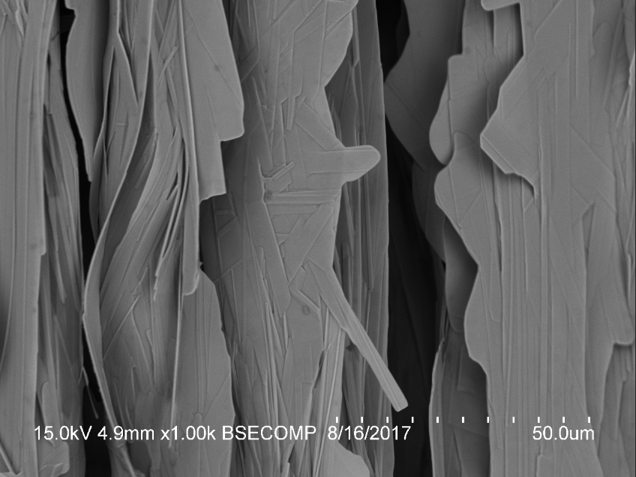
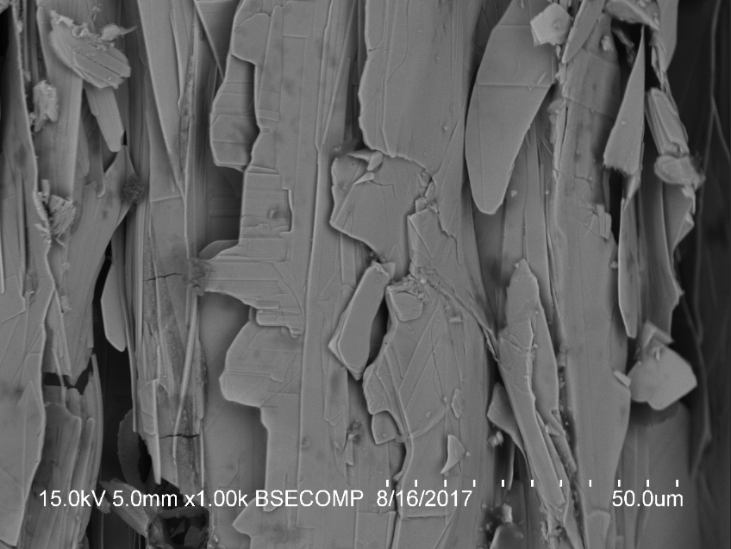
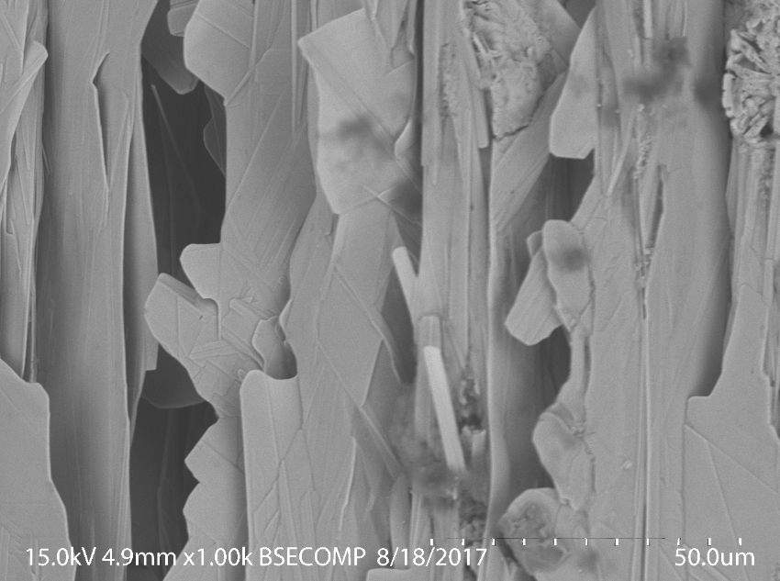
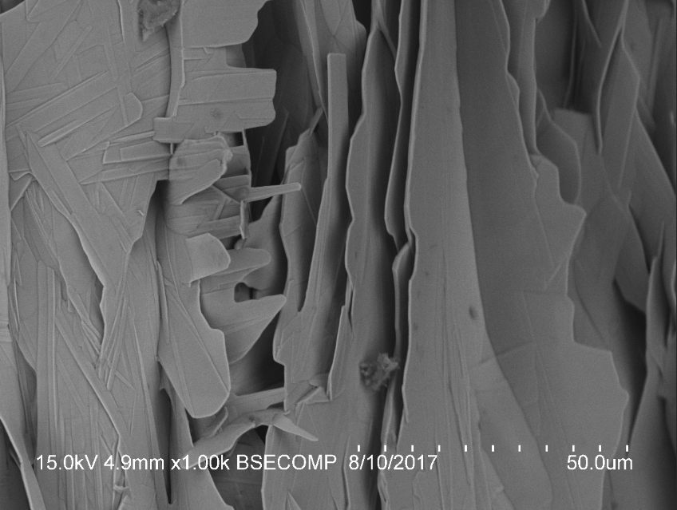
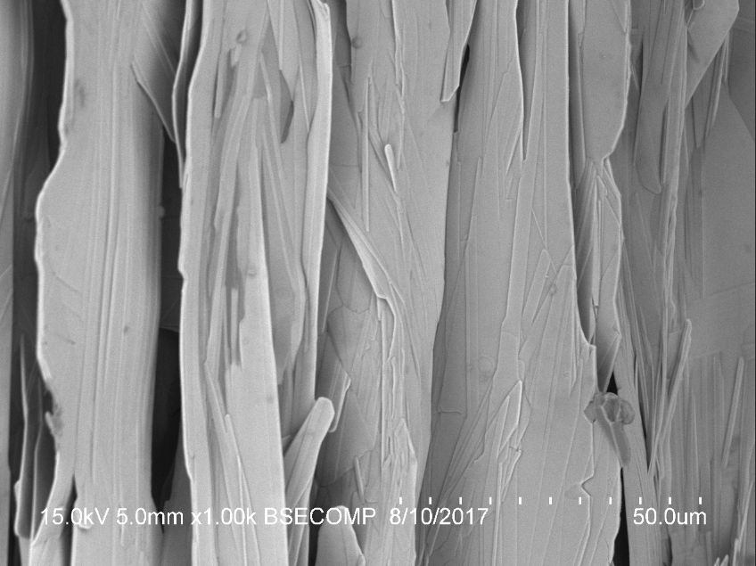
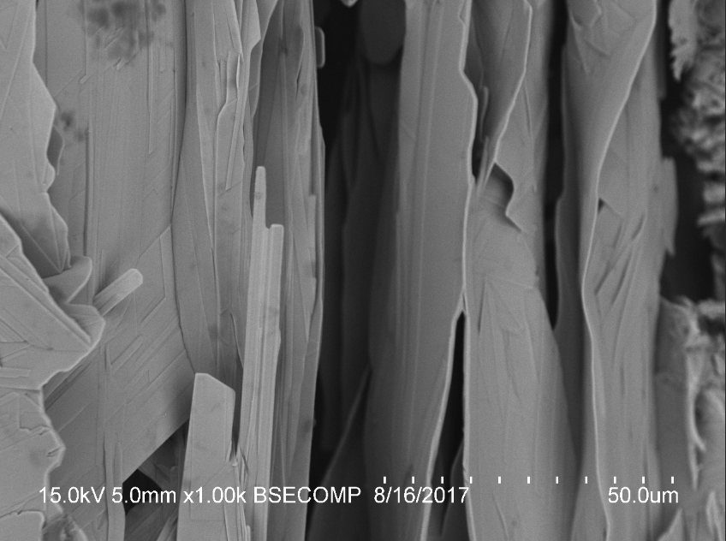
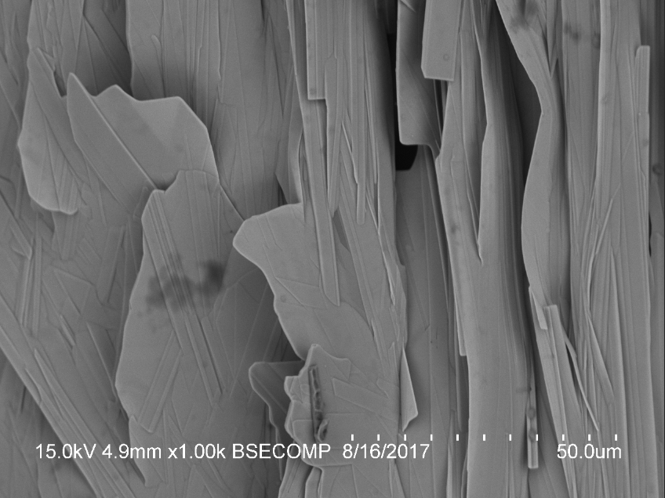
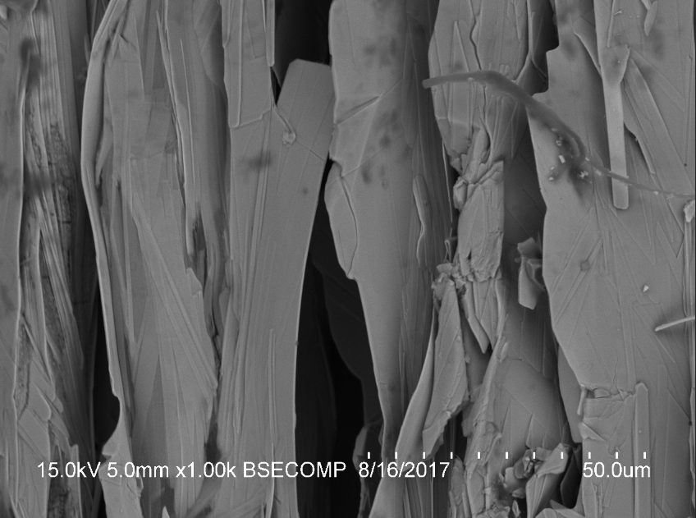
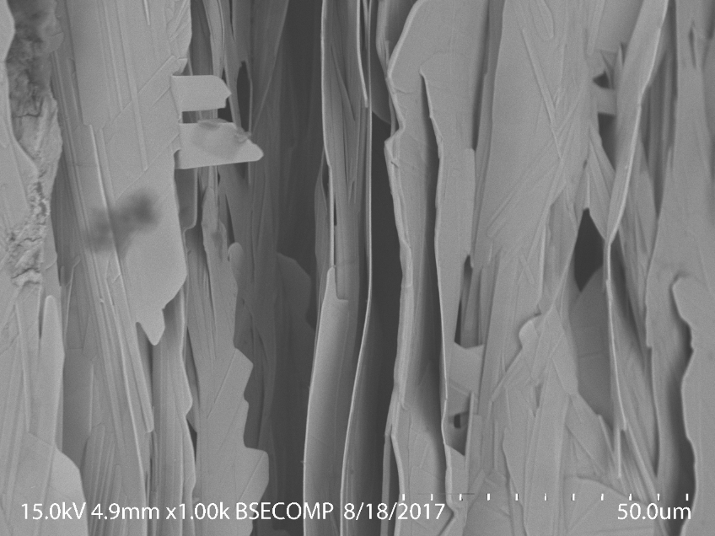
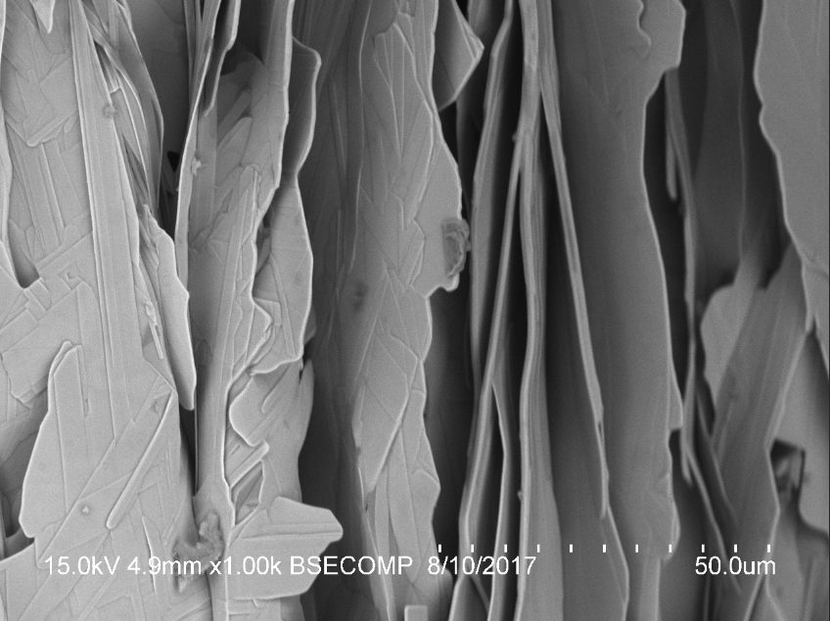
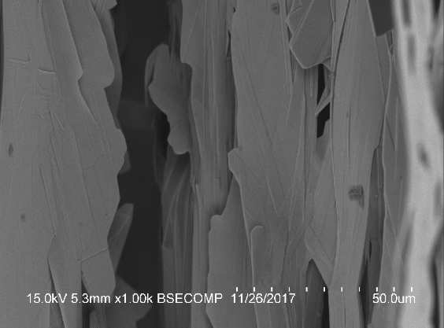
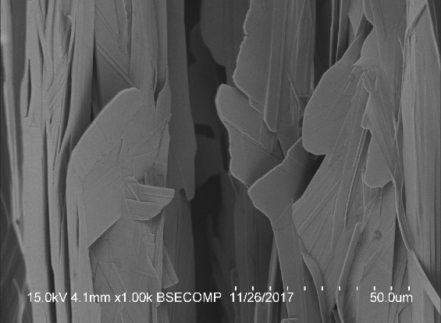
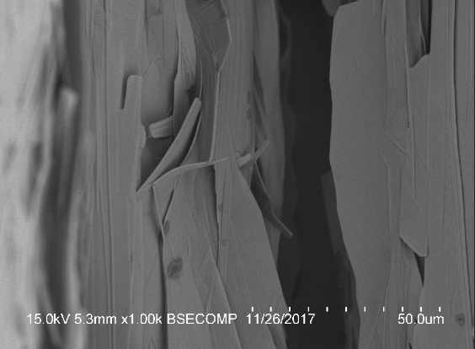
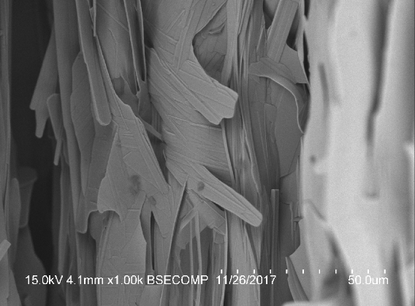
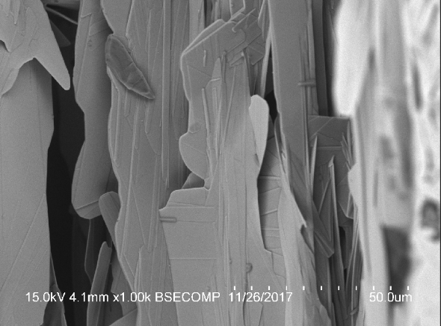


Characterization of Filament Damage on Externally and Internally Etched Bi₂Sr₂CaCu₂O_{8-x} (Bi-2212) Superconducting Wires after Tensile Strain
J.A. Egner-Schnitzler¹, L.J. Jarocki², and M.C. Jewell¹
¹Materials Science and Engineering Program, University of Wisconsin-Eau Claire, Eau Claire, WI, 54702
²Department of Physics and Astronomy, University of Wisconsin-Eau Claire, Eau Claire, WI, 54702
UW-Eau Claire
Introduction
Testing and Analysis
What are we studying?
Bi₂Sr₂Ca₁Cu₂O_{8-x} (Bi-2212): a superconducting material that is able to produce magnetic fields greater than 25 T.
Previous electromechanical tests were executed at UC-Boulder and those results were compared to these newly tested wires examined at UW-Eau Claire.
Bi-2212 wires are strained on an Instron at UW-Eau Claire, then chemically etched to evaluate damage.
Internal Etch
1 Bar OP Overview
Levels of strain (ranging from 0-0.8% strain) at 77K were selected for testing to understand the mechanical behavior of the wires.
Critical current (I_{c}) degradation happened quickly on wires that experienced tensile strain.
The degradation pattern on the wire is not a linear relationship, instead the graph indicates that mechanical damage ma evolve more quickly above 0.4-0.5% strain.
The range of degradation increases with applied strain.
0.332%
0.477%
Why are we studying it?
The study of sub-atomic particles in physics is progressing and needs higher magnetic fields for large particle accelerators.
Bi-2212 is currently the only superconducting round wire capable of producing magnetic fields in excess of 20 T.
For microstructural analysis of tested Bi-2212 wires, various etching and mounting techniques to expose Bi-2212 filaments were developed by UW-Eau Claire.
Scanning electron microscopy (SEM) was used to analyze of microstructural defects caused by testing.
0.402%
0.581%
External Etch
What are we looking for?
Bi-2212 filaments in the silver matrix are brittle and vulnerable to damage during mechanical testing.
This research seeks to understand how the damage varies for different chemical etches and how that damage is influenced by various levels of strain.
Disk (External Etch)
Puck (Internal Etch)
Wires for external etching (outer filament bundles) were gently placed on a disk then etched. Wires for internal etching (inner filament bundles) were first mounted in an epoxy puck, then put through internal etching process.
External etching gently gets rid of the outer layers to reveal filaments in outer ring. Internal etching gets rid of the inside silver after the sample is polished.
The graph above demonstrates the I_{c} behavior as a function of applied strain for 1 Bar samples in tension. Tested strains are indicated on the graph.
Damage on Internally Etched Samples
Damage On Externally Etched Samples
No Strain (Untested)
0.8% Strain
No Strain (Untested)
0.332% Strain
0.402% Strain
0.477% Strain
0.581% Strain
0.8% Strain
1
3
2
4
1
3
SEM images of a 1 Bar Bi-2212 wire externally etched for 22 minutes and was untested.
Scanning electron microscopy images of Bi-2212 0.332% strain wire externally etched for 26 minutes.
Images of a Bi-2212 wire which was strained to 0.402% and externally etched for 23 minutes.
SEM images of a Bi-2212 wire at 0.477% strain and externally etched for 28 minutes.
SEM images of a Bi-2212 wire externally etched for 23 minutes and strained to 0.581%.
Images taken on the SEM of a Bi-2212 wire externally etched for 19 minutes and tested to 0.8% strain.
2
4
1
2
3.
3
4.
4
5.
5
1.
2.
The filament structure still has maintained the continuous structure at this point as strain is slightly increased. At a strain of 0.477%, the jagged edges and projections are thinner and more slender than those at lower strains. Here the projections’ direction and orientation does not change as strain increases.
The amount of jagged edges increases as the strains increases from 0.477% to 0.581%. As the strain is increased to 0.581% strain, the filament projections start to orientate themselves away from the main structure. From 0.477% to 0.581% strain, the edges become less straight by developing some broken ends within them. There is more randomness in the filament structure at 0.581% strain.
The main filament structure still maintains its straight edges but some discontinuity is observed as more projections develop. The amount and characteristics of the jagged edges stays relatively about the same as strain increases. As the strain increases to 0.8% the randomness and amount of projections increases.
A few sharp ends start to appear with the increase in strain. The edges of the filaments have a few jagged edges in the untested and 0.332%.
As the strain is increased, the filament structure remains straight and continuous. The jagged edges on the filaments increase slightly as strain increases.
SEM images of an untested sample which was internally etched for 45 minutes.
SEM images of a 0.8% strain samples which was internally etched for 45 minutes.
Key Results for Externally Etched Samples:
For these wires exposed by external etching, as the amount percent strain applied to the wire increases it in return increases the amount and degree of damage observed in the wires.
Key Results for Internally Etched Samples:
Increasing the amount of applied strain, mainly causes more jagged edges to develop.
Conclusion
More Damage Progression from 0.477% to 0.581% Strain
Untested samples have a more continuous straight filament structure compared to the 0.8% strain.
An increase in strain increases the amount of jagged edges and projection in the filament structure.
The jagged edges that develop in the 0.8% strain are more extreme and jagged in comparison to the untested sample.
Damage As A Result of Tensile Strain:
  For both the inner and outer filament bundles, the jagged edges are the main indicator of filament damage in the wire.
  As strain increases the amount mechanical damage increases as evidence of the amount of projections and jagged edges observed.
  At low percent strains, the damage slowly increases. Then, around 0.581% strain the damage dramatically progresses through the samples, which is in good agreement with the decrease in electrical performance seen in the graph at the top .
0.477% Strain
0.581% Strain
The externally etched samples at 0.8% have more jagged edges than the internally etched samples.
Since jagged edges are the main change in the filament structure as strain increases, these images confirm the strain on the internally etched samples do not have as much of a damaging effect compared to the externally etched samples.
Acknowledgements
Damage As A Function of Location in the Wire:
  The outer filament bundles at 0.8% strain have more jagged edges than the 0.8% strain inner filament bundles.
  Since jagged edges are the main change in the filament structure as strain increases, these images confirm the strain on the inner filament bundles do not have as much of a damaging effect compared to the outer filament bundles.
This work was financially supported by the U.S. Department of Energy (DoE), Office and High Energy Physics (OHEP), award DE-FG02-13ER42036, and benefited from the support of the Materials Science & Engineering Center at UW-Eau Claire.
Key Results for Externally Etched Samples at 0.477% and 0.581% Strain:
Increasing the amount of percent strain from 0.477% to 0.581% strain dramatically increases the amount of jagged edges. This increase confirms the graph trend depicted at the top of the poster.
Celebration of Excellence in Research and Creative Activity (CERCA) April 30-May 4, 2018
The authors thank the UWEC Office of Research and Sponsored Programs and the Blugold Differential Tuition Program for student support at CERCA 2018.
Wisconsin Science & Technology Symposium (WSTS) – August 2 & 3, 2016

