Slide 1


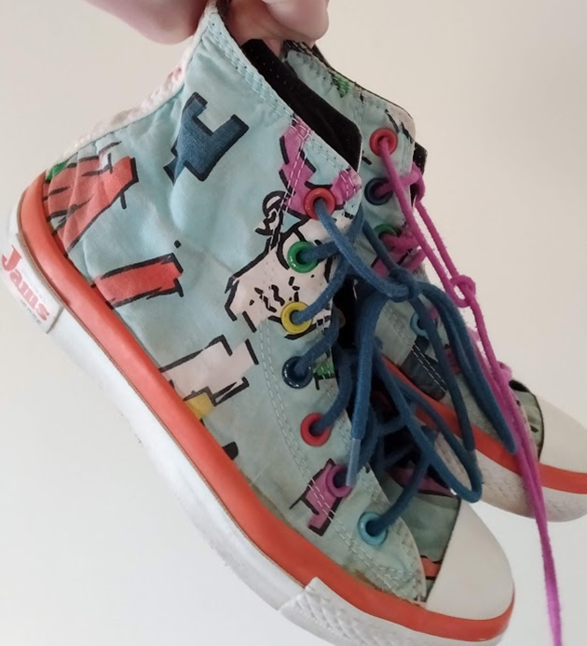
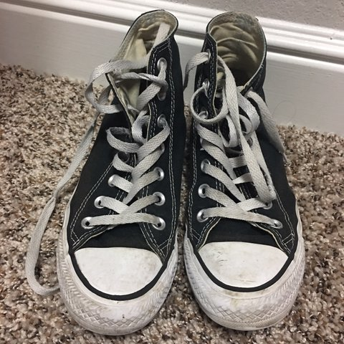
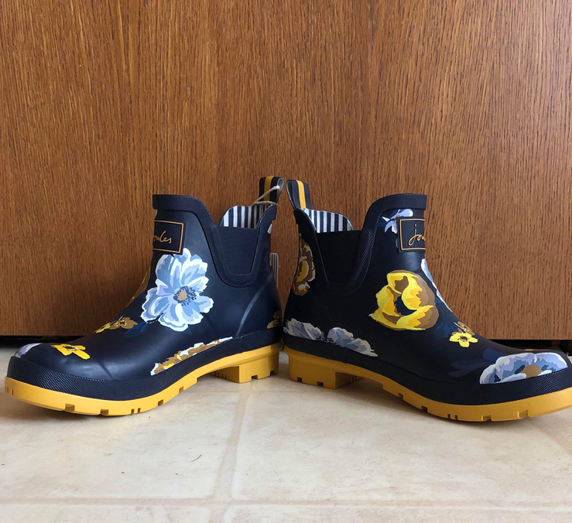
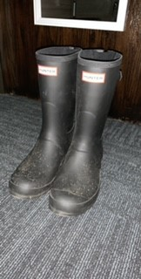
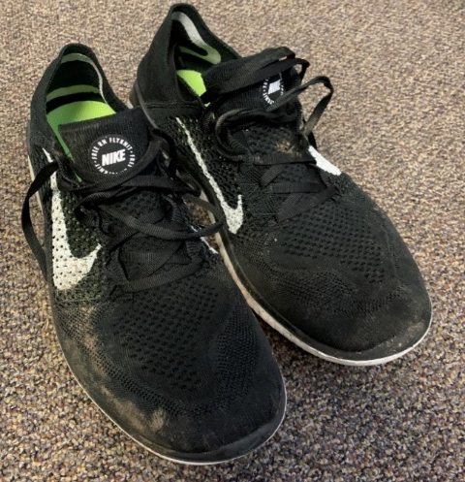
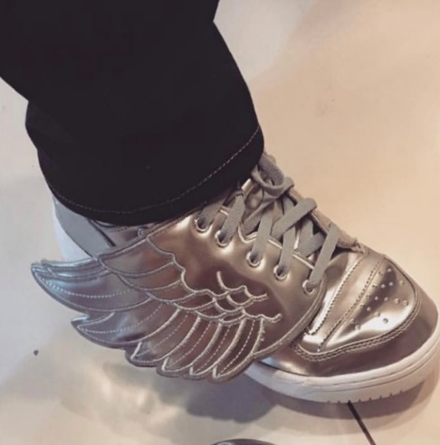
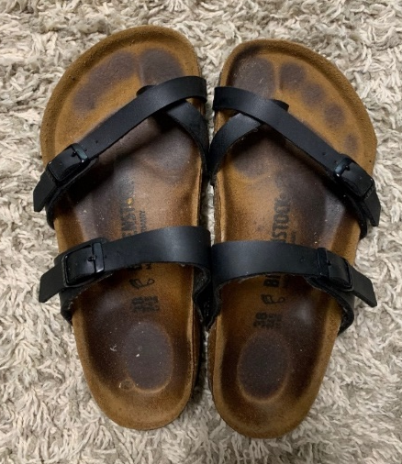
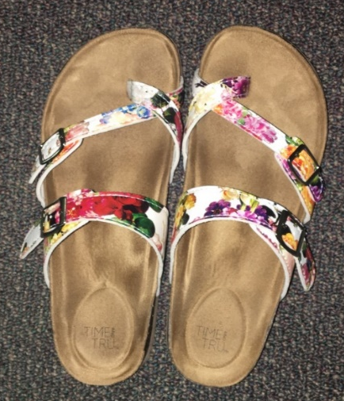
Those Shoes Are So You!
Personality Expressed in Shoes
Stephanus Badenhorst, Rian Drexler, and Katie Paulich  Faculty Mentor: April Bleske-Rechek  Psychology Department  University of Wisconsin-Eau Claire
Background
Inexpensive/Expensive
Low/High Quality
Dirty/Clean
Broken/Well-maintained
Barely worn/Very worn
Weak (flimsy)/Durable (hardy)
Impractical/Practical
Single/Multi-purpose
Generic/High-Status brand
Understated/Showy (flashy)
Dully colored/Brightly colored
Monochrome/Multicolored
Plain/Patterned
Not sporty/Sporty
Uncomfortable/Comfortable
Casual/Dressy
Common/Unique (original)
Outdated/Trendy
Masculine/Feminine
People express their personality traits and attitudes in many ways. People express themselves in the way they speak and carry themselves¹, what they post on social media², the leisure activities they pursue³, the music they prefer⁴, and even the clothes they wear⁵.
We aim to determine whether shoes are a systematic form of self-expression. Only one other research team has pursued this question⁶; in that study, men and women completed a brief (10-item) personality inventory and submitted a photo of the shoes they wear most often. The researchers showed that characteristics of people’s shoes are tied to their gender (more feminine shoes) and income (more expensive shoes), but they found very few links between people’s personality traits and shoe characteristics.
In the current study, we extend past research by (1) using a comprehensive personality inventory, (2) asking participants to report on their shoe purchasing and decision-making behaviors, and (3) asking participants to submit a photo of the shoes they think best represents their personality.
In this poster, we present the results of analyses designed to test two hypotheses:
The shoes that people wear are tied to their personality (e.g., more conscientious people wear cleaner and well-maintained shoes); and
People’s shoe-buying and shoe-decision-making behaviors are tied to their personality traits (e.g., more extraverted people own more shoes and spend more money on their shoes).
Students from UWEC participated in this research. A total of 126 students reported on their personality traits and attitudes.
For personality, participants completed the Big Five Inventory (BFI), a 44-item measure of Openness to Experience (e.g., imagination, creativity, intellectual curiosity; alpha=.77), Conscientiousness (e.g., order, self-discipline; alpha=.75), Extraversion (e.g., activity, excitement seeking; alpha=.87), Agreeableness (e.g., trust, tendermindedness; alpha=.75), and Neuroticism (e.g., self-consciousness, anxiety; alpha=.81). All ratings were given on a five-point scale (Disagree to Agree).
For attitudes, participants responded to Likert-type items that assessed their religiosity (alpha=.96), political liberalism-conservatism, short-term mating orientation (alpha=.82), and long-term mating orientation (alpha=.66).
Participants also reported their age, biological sex, sexual orientation, and social class.
A total of 93 participants uploaded a picture of the pair of shoes they own that best represents their personality. The four researchers independently coded each shoe submission on 19 different elements such as Inexpensive-Expensive, Dirty/Clean, Generic/Status Brand, and Outdated/Trendy. All ratings were made on a 10-point scale. Inter-rater reliabilities ranged from .61 to .93 (mean reliability = .79).
Results and Discussion
Figure 2: Most participants spent at least $30 on a typical pair of shoes. The mean amount was between $60-$70.00.
Total Pairs of Shoes Owned
Perceptions of Shoes Expressing Personality
Figure 1: Most participants own somewhere between a dozen to two dozen pairs of shoes; the typical participant reported 18 pairs.
Figure 3: In response to the question, ““How much do people use shoes as an expression of their personality?”, most participants responded toward the high end of the scale.
Amount Spent on a Typical Pair of Shoes
Table 1:
Some shoe characteristics were associated with shoe owners’ Extraversion (E), Agreeableness (A), Conscientiousness (C), and Neuroticism (N). For example, as predicted, more conscientious individuals’ shoes were rated as cleaner, more well-maintained, and less worn. Shoe characteristics were not associated with shoe owners’ level of Openness to Experience.
Table 2:
Some of participants’ shoe-buying and shoe-decision-making behaviors were associated with some of their personality traits. For example, more extraverted individuals spent more time shopping for shoes and spent more money on shoes. Individuals’ shoe-buying and decision-making behaviors were not associated with their level of Openness to Experience.
 | E | A | C | N | O
Inexpensive---Expensive | .21* | .15 | .15 | -.26* | .05
Low Quality---High Quality | .12 | .19 | .17 | -.30* | .07
Dirty---Clean | .13 | .22 | .28* | -.08 | -.02
Broken---Well-Maintained | .15 | .23* | .24* | -.14 | -.03
Barely Worn---Very Worn | -.10 | -.23* | -.29* | .13 | -.00
Weak---Durable | .21* | .16 | .10 | -.21 | .02
Impractical---Practical | -.04 | .09 | .05 | -.11 | -.08
Single Purpose---Multipurpose | -.08 | .11 | .05 | -.08 | -.06
Generic---High-Status Brand | .12 | .08 | .03 | -.22* | .01
Understated---Showy | .11 | .08 | .02 | .05 | .09
Dully Colored---Brightly Colored | .12 | .17 | .06 | .07 | .02
Monochrome---Multicolored | -.06 | .04 | .02 | .07 | -.05
Plain---Patterned | -.11 | .04 | .03 | .09 | -.01
Not Sporty---Sporty | -.13 | .04 | .02 | -.12 | -.01
Uncomfortable---Comfortable | .01 | .19 | .09 | -.24* | -.01
Casual---Dressy | -09 | .07 | .12 | .12 | .06
Common---Unique | .03 | .04 | .01 | .13 | .14
Outdated---Trendy | .18 | .02 | .15 | .04 | -.07
Masculine---Feminine | .21* | .13 | .11 | .14 | -.16
 | E | A | C | N | O
Perceive Shoes as an Expression of Personality | .17 | .25* | .16 | .09 | .09
Time Spent Shopping for Shoes Relative to other Apparel | .20* | .16 | .00 | -.04 | .14
Time Spent Deciding Which Shoes to Wear | .18 | .19* | .02 | .01 | .03
Amount of Money Spent on a Typical Pair of Shoes | .22* | .05 | -.01 | -.16 | .11
Money Spent on Shoes Relative to other Apparel | .05 | .16 | .15 | -.05 | -.08
Total Number of Pairs of Shoes Owned | .07 | .01 | .01 | .24* | .02
Method
As far as we know, we are only the second research team to test the hypothesis that people drop hints about their personality through the shoes they wear; further, we are the first team to investigate how people’s shoe decision-making and shoe consumer habits relate to their personality traits.
Not all personality traits were correlated with all shoe characteristics, and the correlations that were statistically significant were generally weak in magnitude. However, we had a lot of shoes that did not vary from each other: 3 people uploaded a basic Converse, 15 people uploaded a black or neutral toned running shoe, and 4 people uploaded a basic white Vans canvas loafer. It is possible that the links between shoe characteristics and shoe-owner personality traits would be a bit stronger if we had a sample of shoes posted by individuals – perhaps middle-aged adults – who have fewer financial constraints and perhaps fewer conformity concerns that presumably limit the degree of variability in shoe characteristics within a college student sample.
References
Acknowledgments
This research is supported by the Office of Research and Sponsored Programs at UWEC. We thank LTS for printing this poster and members of the IDEP lab for their feedback on the development of this project.
1. Back, M. D., Schmukle, S. C., & Egloff, B. (2010). Why are narcissists so charming at first sight? Decoding the narcissism-popularity link at zero acquaintance. Journal of Personality and Social Psychology, 98, 132-145.
2. Schwartz, H. A., et al. (2013). Personality, gender, and age in the language of social media: The open-vocabulary approach. PLoS ONE, 8, e73791.
3. Gallagher, P., et al. (2013). Correlates of daily leisure-time physical activity in a community sample: Narrow personality traits and practical barriers. Health Psychology, 32, 1227-1335.
4. Rentfrow, P. J., & Gosling, S. D. (2003). The do re mi’s of everyday life: The structure and personality correlates of music preferences. Journal of Personality and Social Psychology, 84, 1236-1256.
5. Borkenau, P., & Liebler, A. (1992). Trait inferences: Sources of validity at zero acquaintance. Journal of Personality and Social Psychology, 62, 645–657.
6. Gillath, O., Bahns, A. J.., Ge, F., & Crandall, C. S. (2012). Shoes as a source of first impressions. Journal of Research in Personality, 46, 423-430.
Notes:
Highlighted: Still not sure why “do not” is highlighted and underlined
In the discussion I think it should say “correlational and causal language”
I feel good about the lines and box spacing, but if you could take a second look that would be great!
I doubled checked all of the numbers in the table.
Do you want the headings to be in Calibri instead of Century Gothic like the hindsight poster?
I shifted the table to be in the middle of the results box, do you like it better to the right where is was before?

