Slide 1
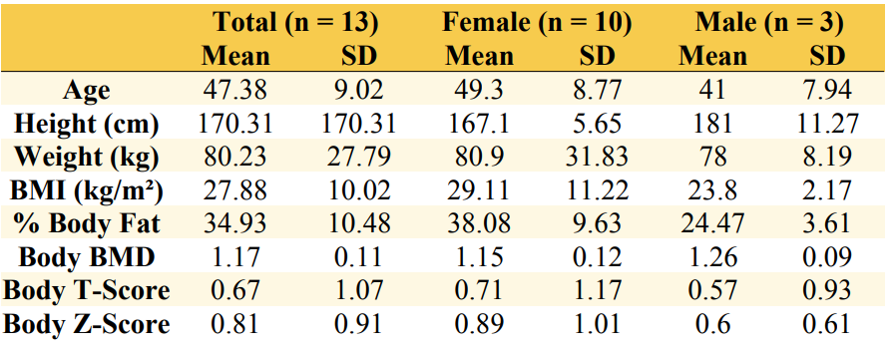
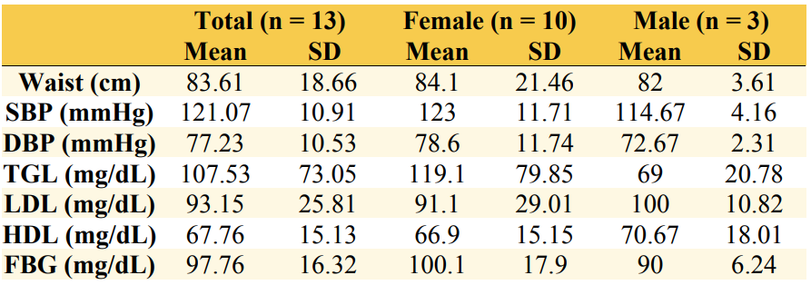
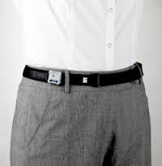
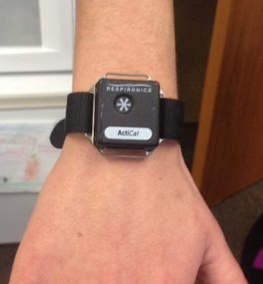
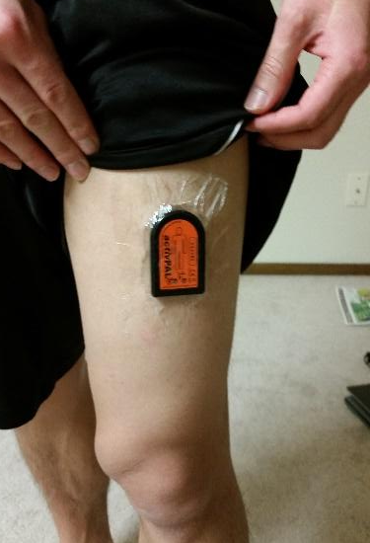
RELATIONSHIP BETWEEN PATTERNS AND AMOUNT OF OCCUPATIONAL SITTING ON METABOLIC RISK FACTORS
Independent of leisure time physical activity
Erin Buck, Megan Dobbertin, Carrie Rosenthal & Eric Stadtmueller | Department of Kinesiology
Faculty Mentors: Saori I. Braun, PhD & Marquell J. Johnson, PhD
Abstract
Hypothesis
Table 1: Participant Demographics and DXA Values
Our research study aims to discover if there is a relationship between occupational sedentary behavior and metabolic risk factors despite varying amounts of leisure-time physical activity among low-intensity professions. Current research on sedentary behavior has focused on total sedentary time among US adults, which is beneficial in establishing relationships between metabolic syndrome and sedentary jobs. However, Kim et al. (2015) suggests further research is needed to describe the patterns and duration of sedentary bouts.
Data was collected in Fall 2017 and included 13 office workers between the ages of 35-58 years old. The office workers wore two different accelerometers, the ActivPal and Actical, to measure their physical activity levels over the course of 7 consecutive days. Participants underwent a biometric screening that measured height, weight, blood pressure, waist circumference, cholesterol levels, triglycerides, and fasting blood glucose following physical activity monitoring. Data will be analyzed to determine a relationship between physical activity levels and metabolic risk factors among office workers.
We anticipate seeing a positive relationship between occupational sedentary time and increased prevalence of metabolic risk factors. We believe that leisure-time physical activity will not compensate for high amounts of occupational sedentary activity enough to reduce metabolic risk factors.
Methods
Data Collection
13 participants between the ages of 35-58 were recruited from Mayo Clinic health systems in Eau Claire via email.
To be included in the study, participants had to have jobs that required them to be seated for at least 50% of their work hours per day.
Participants were excluded if they were taking medications to control cholesterol or blood pressure.
Accelerometers were used to provide objective measures of physical activity throughout the day. Participants wore three accelerometers: one ActivPal and two Actical devices.
Note: SD = Standard Deviation, BMI = Body Mass Index, BMD = Bone Mineral Density
Table 2: Metabolic Risk Factors
Introduction
The Sedentary Behaviour Research Network (SBRN) defines sedentary behavior as “any waking behavior characterized by an energy expenditure of ≤ 1.5 metabolic equivalents (METs), while in a sitting, reclining, or lying posture” (SBRN, 2017). Too much sitting has been shown to have negative health consequences, such as metabolic syndrome. As per Mayo Clinic, metabolic syndrome is diagnosed by measuring five different variables: waist circumference, triglyceride level, high-density lipoprotein cholesterol, blood pressure, and fasting blood glucose (2018). If an individual surpasses at least three out of five of the cutoffs that have been determined for these variables, they can be diagnosed with metabolic syndrome (Mayo Clinic, 2018). In the last 50 years, according to U.S. census data from the years 1950 to 2000, the number of individuals employed in low-intensity occupations has nearly doubled, from 23.3% to 42.6% (Kirk and Rhodes, 2011).
Instrumentation
ActivPal
ActivPals are small, flat devices that are worn at the top middle of the non-dominant thigh. ActivPals classify posture by measuring its angle of tilt to determine if one is sitting/laying down, standing, or walking (PAL Technologies, Glasgow, Scotland).
Actical
Acticals are small, square, flat devices that can be attached to a variety of straps and worn at many different body locations. Acticals function by tracking human movement using an omnidirectional sensor in set 15 second time increments (epoch). The data points, called activity counts, are then classified into the intensity categories of sedentary, light, moderate, or vigorous (Mini Mitter, Sunriver, OR).
Note: SD = Standard Deviation, SBP = Systolic Blood Pressure, DBP = Diastolic Blood Pressure, TGL = Triglyceride, LDL = Low Density Lipoprotein,
HDL = High Density Lipoprotein, FBG = Fasting Blood Glucose
Data Analysis
Significance
At the end of the data collection period, participants were brought in for a metabolic risk factor screening session and a bone mineral assessment. Bone mineral density scores are presented in Table 1, and metabolic risk factor screening results are presented in Table 2.
Multiple regression analyses will be performed to evaluate the relationship between activity intensity and metabolic risk factors as well as between postural changes and metabolic risk factors in both occupational and leisure-time settings.
Paired sample t-tests will be conducted to determine the difference in means of physical activity intensities during occupational and leisure-time. If the results of the t-tests are deemed significant, Tukey post-hoc tests will be conducted as well.
Significance will be set at p < 0.05
Means and standard deviations will be provided for time spent in different activity categories, metabolic risk factors, and number of steps.
This research may raise awareness of how prevalent sedentary behavior has become in the workplace and how this trend is associated with negative health risks. These results will hopefully lead to companies changing their values to promote a healthier office environment. In addition to creating a healthier lifestyle for their employees, workplaces would be able to reduce total spending on health costs. Hopefully, this will influence a societal shift involving the importance of physical activity.
Future Implications
Creating a standardized Log Sheet format and protocol for data collection would improve the quality of data being collected
Further research is also needed to separate the effects of occupational physical activity levels and leisure-time physical activity levels
This research will allow researchers to educate the general public about the health consequences of sedentary occupations
ActivPal
Actical (hip)
Actical (wrist)
References
Authors. (2012). Sedentary Research Behaviour Network. What is sedentary behavior? Retrieved from https://www.sedentarybehaviour.org/what-is-sedentary-behaviour/
Authors. (2018). Mayo Clinic, Diseases and Conditions: Metabolic Syndrome. Retrieved from https://www.mayoclinic.org/diseases-conditions/metabolic-syndrome/diagnosis-treatment/drc-20351921
Kim, Y., Welk, G. J., Braun, S. I., & Kang, M. (2015). Extracting objective estimates of sedentary behavior from accelerometer data: Measurement considerations for surveillance and research applications. PLoS ONE, 10(2), 1-15.
Kirk, M. A., & Rhodes, R. E. (2011). Occupation correlates of adults' participation in leisure-time physical activity. American Journal of Preventive Medicine., 40(4), 476-485.

