Slide 1


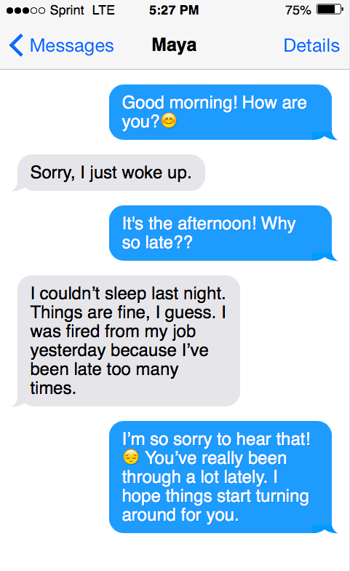
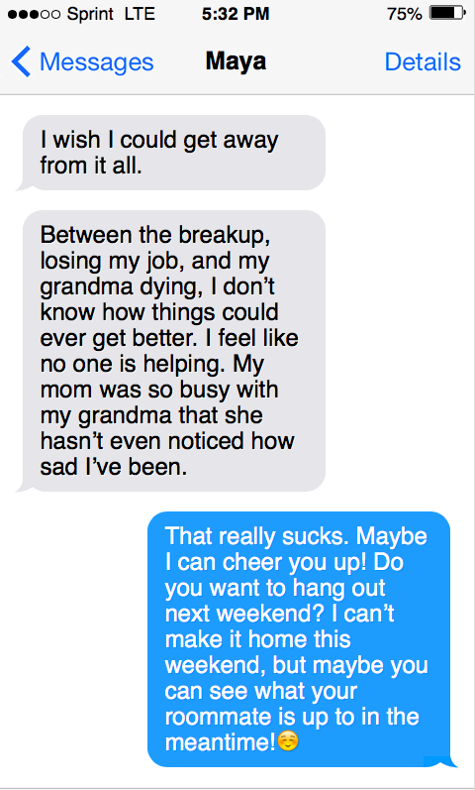
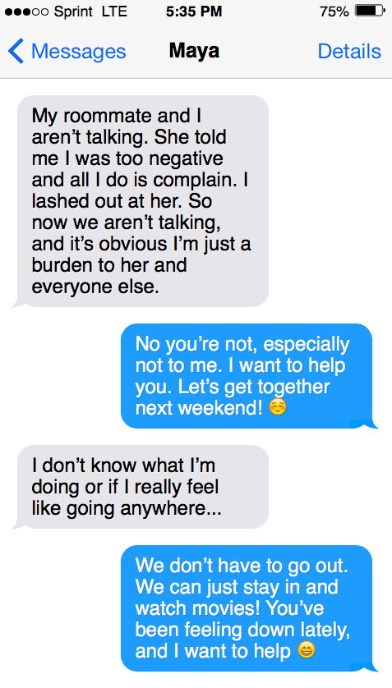
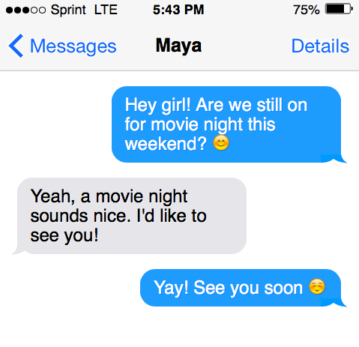
Unwarranted Blame: The Role of Hindsight Bias in Judgments of Suicide Likelihood and Preventability
Jordyn Fetkenheuer, Nicole Kleinschmidt, & Katie Paulich Faculty Mentor: April Bleske-Rechek  Department of Psychology  University of Wisconsin-Eau Claire
Background
Method
Results
Hindsight bias is commonly referred to as the “I knew it all along” effect. Individuals who are informed of a specific outcome prior to judging how the event will pan out perceive that outcome as more likely to occur than do individuals who are not informed of any outcome.¹ In essence, individuals perceive a given outcome as more obvious when they know that it happened.
Hindsight bias has been documented in many contexts:
In the context of suicide specifically, individuals often look back and wish they had seen the signs or done things differently.
In this study, we investigated the effects of outcome knowledge on individuals’ perceptions of the foreseeability and preventability of a suicide. To do this, we provided all participants with a description of a young woman (Maya) with various symptoms of depression, but afterward, told only half of participants that the woman subsequently died by suicide.
We hypothesized that, relative to participants who were not informed of Maya’s eventual suicide, those who were informed would…
Perceive symptoms of depression as more indicative of a likely suicide
View an eventual suicide as more likely and expected
Perceive Maya and others close to her as targets of blame
Perceive Maya as emotionally unstable and in need of professional help
Participants were recruited through online social networking sites and SONA. The original sample included 232 adults; after omitting respondents with incomplete data, the final sample include 192 adults (M_{age}=26.25 ± 13.12; 161 women, 24 men, 7 other/sex unreported).
Step 1: Participants were given introductory information about Maya:
As shown in the table below, participants in the two conditions did not differ. We did not show that people’s reactions to a suicide (or the circumstances surrounding a suicide) are affected by knowledge that a suicide occurred.
“Maya is a close friend of yours from high school. You go to separate universities, but you stay in close contact with each other through texting, usually several times per day. Unfortunately, Maya has been through a lot lately. She and her significant other broke up, she hasn’t been getting along with her roommate, and her grandma recently passed away. On top of that, you know she has been struggling in her classes and hasn’t been studying as much as usual for her exams. Normally, she is motivated, outgoing, and friendly, but lately she seems withdrawn, unmotivated, and unpredictable. It has gotten to the point where you feel anxious whenever you see a message from Maya because you don’t know what to expect. You have been worried about Maya, so you decide to make plans to get together with her.”
Statement | No Outcome Knowledge (Control) | Outcome Knowledge (Experimental)
Maya seems like a reliable person. | 3.82 | 3.62
Maya’s negativity has driven people away. | 5.32 | 5.13
Maya’s roommate should be trying harder to get along with her. | 4.91 | 4.93
Maya treats other people well. | 4.05 | 4.26
Maya’s mom should make more time for Maya. | 5.60 | 5.67
Maya’s mom has not been paying enough attention to her. | 5.38 | 5.23
Maya's mom seems very loving. | 4.16 | 4.39
Maya seems like someone you would want to be friends with. | 4.52 | 4.46
Maya has probably been seeing a therapist. | 2.54 | 2.23
Maya is a valuable person. | 6.44 | 6.27
Maya’s text messages indicate she needs you to help her. | 6.02 | 6.16
Maya’s text messages suggest that she should seek professional help. | 6.23 | 6.31
Maya’s text messages show she has had thoughts of suicide. | 4.95 | 5.12
Maya’s text messages imply plans of suicide. | 3.50 | 3.59
Maya’s text messages make suicide seem expected. | 3.69 | 3.70
Given the text message conversation, how likely is it that Maya was depressed? | 9.64 | 10.09
Given the text message conversation, how likely is it that Maya would die by suicide? | 5.46 | 5.70
Individuals’ judgments of historical events¹
Sporting events²
Medical diagnoses³
Witness testimonies⁴
Employee evaluations⁵
Perceived obviousness of research outcomes⁶
Study Objectives
Step 2: Participants were asked to read the hypothetical text conversation between themselves and Maya.
We based these texts on known symptoms of severe depression, such as abnormal sleeping patterns, feelings of worthlessness, and turbulent relationships.
Step 3 (the manipulation): Participants were randomly assigned to one of two statements:
1) “A few days later, your mom calls to tell you that Maya has died by suicide,” or 2) “Please click the arrow to continue.”
Sample
Step 4: Participants responded to multiple questions concerning Maya’s well-being, the likelihood and expectancy of her death by suicide, and perceptions of Maya and those close to her. The results are shown in the table to the right.
All items except for the last two were rated on 7-point scales (7 being strongly agree). The last two items were rated on a scale ranging from 0-10 (10 being completely likely). Values displayed are condition means.
Discussion
In the context of so many other studies showing the prevalence of hindsight bias in human judgment, how do we explain the lack of hindsight bias in our data?
One possibility is that our vignette was too clear-cut; we provided all the clues that are needed to indicate that Maya was depressed and hence at risk of suicide. Indeed, participants in both conditions gave high scores to the likelihood that Maya was depressed and in need of professional help. In research on hindsight bias, the “noisy” signals in foresight are reinterpreted as “clear” signals in hindsight. Hence, perhaps we didn’t provide enough noisy signals in foresight to be reinterpreted as clear signals in hindsight.
Another explanation for the lack of hindsight bias might be related to a large number of participants withdrawing from the study immediately after receiving the outcome knowledge. If they were affected by the outcome knowledge manipulation, we didn’t get to hear it.
There is a silver lining in our data. Our findings show that participants recognized symptoms of depression and that they understood such symptoms do not always indicate the risk of suicide. Additionally, the majority of our participants recognized that Maya should seek professional help, which may be a sign that the stigma surrounding mental health has lessened.
We hypothesized that participants who received outcome knowledge of Maya’s suicide would perceive a higher risk of suicide and would have more negative perceptions of Maya and those close to her than would participants who received no outcome knowledge. The data did not support our hypotheses; those who received outcome knowledge did not differ significantly from those who did not receive outcome knowledge.
Schwartz, B., Ward, A., Monterosso, J., Lyubomirsky, S., White, K., & Lehman, D. R. (2002). Maximizing versus satisficing: Happiness is a matter of choice. Journal of Personality and Social Psychology, 83, 1178-1197.
Dar-Nimrod, I., Rawn, C. D., Lehman, D. R., & Schwartz, B. (2009). The maximization paradox: The costs of seeking alternatives. Personality and Individual Differences, 46, 631-635.
Wu, P., & Chiou, W. (2009). More options lead to more searching and worse choices in finding partners for romantic relationships online: An experimental study. CyberPsychology & Behavior, 12, 315-318.
Iyengar, S. S., Wells, R. E., & Schwartz, B. (2006). Doing better but feeling worse: Looking for the “best” job undermines satisfaction. Psychological Science, 17, 143-150.
John O. P., & Srivastava, S. (1999). The Big Five trait taxonomy: History, measurement, and theoretical perspectives. In L. A. Pervin and O. P. John (Eds.), Handbook of personality: Theory and research (pp. 102–138). New York: Guilford Press.
Diab, D. L., Gillespie, M. A., & Highhouse, S. (2008). Are maximizers really unhappy? The measurement of maximizing tendency. Judgment and Decision Making, 3, 364-370.
Schwartz, B., Ward, A., Monterosso, J., Lyubomirsky, S., White, K., & Lehman, D. R. (2002). Maximizing versus satisficing: Happiness is a matter of choice. Journal of Personality and Social Psychology, 83, 1178-1197.
Dar-Nimrod, I., Rawn, C. D., Lehman, D. R., & Schwartz, B. (2009). The maximization paradox: The costs of seeking alternatives. Personality and Individual Differences, 46, 631-635.
Wu, P., & Chiou, W. (2009). More options lead to more searching and worse choices in finding partners for romantic relationships online: An experimental study. CyberPsychology & Behavior, 12, 315-318.
References
Acknowledgments
This research is supported by the Office of Research and Sponsored Programs at UWEC. We thank LTS for printing this poster and Dr. Jennifer Muehlenkamp, as well as members of the IDEP lab for their feedback on project development.

