Slide 1
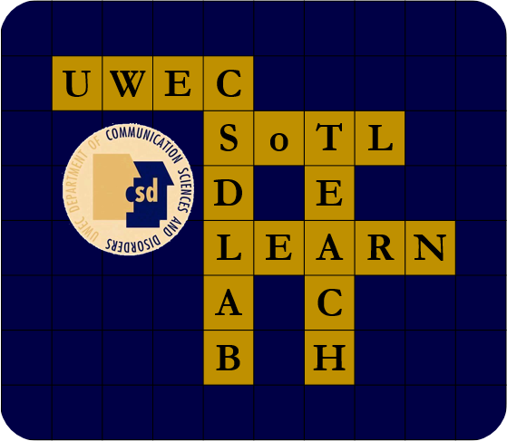

Comparing Undergraduate Research Experiences to a Multi-Mentor Lab: A survey
Skylee Lara & Joey Lim | Communication Sciences and Disorders
Faculty Mentors: Abby Hemmerich, Ph.D., CCC-SLP & Jerry Hoepner, Ph.D., CCC-SLP
The Value of UG Research
Research Question
Results
Undergraduate (UG) research fosters development of research skills (Landrum & Nelson, 2002; Lei & Chuang, 2009)
Skills gained by undergraduate students who completed a mentored research program include (Petrella & Jung, 2008):
Understanding of the research process
How scientists work on problems
How to implement lab techniques
How to analyze and interpret data
Ability to integrate theory & practice
Working with a research mentor provides an opportunity for undergraduates to connect with faculty (Landrum & Nelson, 2002)
Non-academic skills, such as managing obstacles, working independently, self-confidence also result from UG research (Petrella et al., 2008)
How do students with experience in SoTL Lab compare to students who have completed traditional student-faculty research (e.g., one-on-one projects), students who have only completed a research course, and students who have done no research on the following measures:
Research skills
Professional development
Personal development (i.e., confidence, connections with CSD faculty)
Team-based skills
MANOVA results for omnibus test were significant (F=3.07, p=0.035)
No significant differences in the Research Skills Category across all groups
The SoTL Lab Group scored significantly higher than the CSD 235 Group in Professional Development Category. No other comparisons were significantly different.
The SoTL Lab Group scored significantly higher than the Non-CSD Research Group, CSD 235 Group, and the No Research Group in the Personal Development Category
No significant differences in the Team-Based Category across all groups
Challenges to UG Research
Students require significant hands-on training throughout, but especially early in the process (Coker & Davies, 2006)
Faculty time availability can limit the number of students and productivity
Use of structured time followed by unsupervised work time can be effective for mentoring (Karsai, et al, 2011)
Team-based research manages time and productivity, as well as creates a research community (Karsai, et al., 2011)
Students may not see the full research process for projects that span years
Methods
Survey with quantitative & qualitative items
Completed by 74 CSD students
MANOVA
IV: Research experience type
DV: Types of skills gained
SoTL Lab
CSD Research
Non-CSD Research
CSD Research Course
No Research
Discussion
Why SoTL?
Self-efficacy for Research Skills was relatively high in all groups
Overestimation could be a factor in the No Research Group
Post-bacc students may have research knowledge from courses in other fields
In depth research experience seems to be a factor in Professional Development
SoTL Lab offers opportunities to discuss the field in a different way than a research class
Personal Skills skewed toward CSD research experiences
Questions related to SLP field and CSD department
Students in the research course have much larger student-faculty ratio, so have fewer opportunities to connect
Team-Based Skills showed no significant differences across all groups
CSD department encourages collaboration in the classroom
Non-CSD research group is the lowest among all; this could indicate that research within the department differs from other departments
In each experience, participants' peers have different levels of skills and experience
SoTL Lab participants have peers with higher skills.
CSD & Non-CSD Research is generally conducted in small groups/one-on-one
CSD Research course participants are generally underclassmen with fewer overall experiences
The Scholarship of Teaching and Learning (SoTL) is research to evaluate aspects of teaching and learning to develop evidence-based teaching practices (Boyer, 1990; Schulman, 1993).
Students are familiar with teaching & learning from everyday exposure
SoTL projects can often be completed in shorter time-frames, to allow students to experience the entire research process
Research Skills
Professional Skills
Personal Skills
Team-based Dynamics
SoTL Lab
Future Directions
SoTL Lab is a research lab focused on teaching & learning research
Students work in teams of two-to-three on assigned projects
Multiple faculty mentors participate; each research team has a primary mentor, but also can access other mentors
Faculty-student, student-student, and faculty-faculty collaborations occur
Being mentored while also providing mentoring to others helps students gain professional research skills and behaviors, as well as providing psychosocial support and promoting career advancement (Anderson, Tenenbaum, Ramadorai, & Yourick, 2015).
Deeper analysis of Professional Development Category and Personal Development Category.
Relationship between academic standing, experiences, and perceptions
Analysis of qualitative data
Anderson, M., Tenenbaum, L.S., Ramadorai S.B., & Yourick, D.L (2015) Near-peer Mentor Model: Synergy within Mentoring, Mentoring & Tutoring: Partnership in Learning, 23:2, 116-132,
Boyer, E.L. (1990). Scholarship reconsidered: Priorities of the professoriate. Princeton: Carnegie Foundation for the Advancement of Teaching
Coker, J.S. & Davies, E. (2006). Ten time-saving tips for undergraduate research mentors. Journal of Natural Resources & Life Sciences Education 35, 110-112
Karsai, I., Knisley, J., Knisley, D., Yampolsky, L., & Godbole, A. (2001). Mentoring interdisciplinary undergraduate students via a team effort. CBE-Life Sciences Education 10, 250-258.
Landrum, E. R. & Nelsen, L. R. (2002, January). The Undergraduate research assistantship: An analysis of the benefits. Teaching of Psychology, 29(1), 15-19. Retrieved from https://doi-org.proxy.uwec.edu/10.1207%2FS15328023TOP2901_04
Lei, S. A. & Chuang, N. K. (2009). Undergraduate research assistantship: A comparison
benefits and costs from faculty and students’ perspectives. Education, 130(2), 232-240. ISSN: 0013-1172
Petrella, J. K. and Jung, A. P. (2008, July). Undergraduate research: Importance,
benefits, and challenges. Int J Exerc Sci, 1(3), 91-95. Retrieved from https://www.ncbi.nlm.nih.gov/pmc/articles/PMC4739295/
Shulman, L. S. (1993). Teaching as community property: Putting an end to pedagogical solitude.Change, 6, 6-7.

