Slide 1
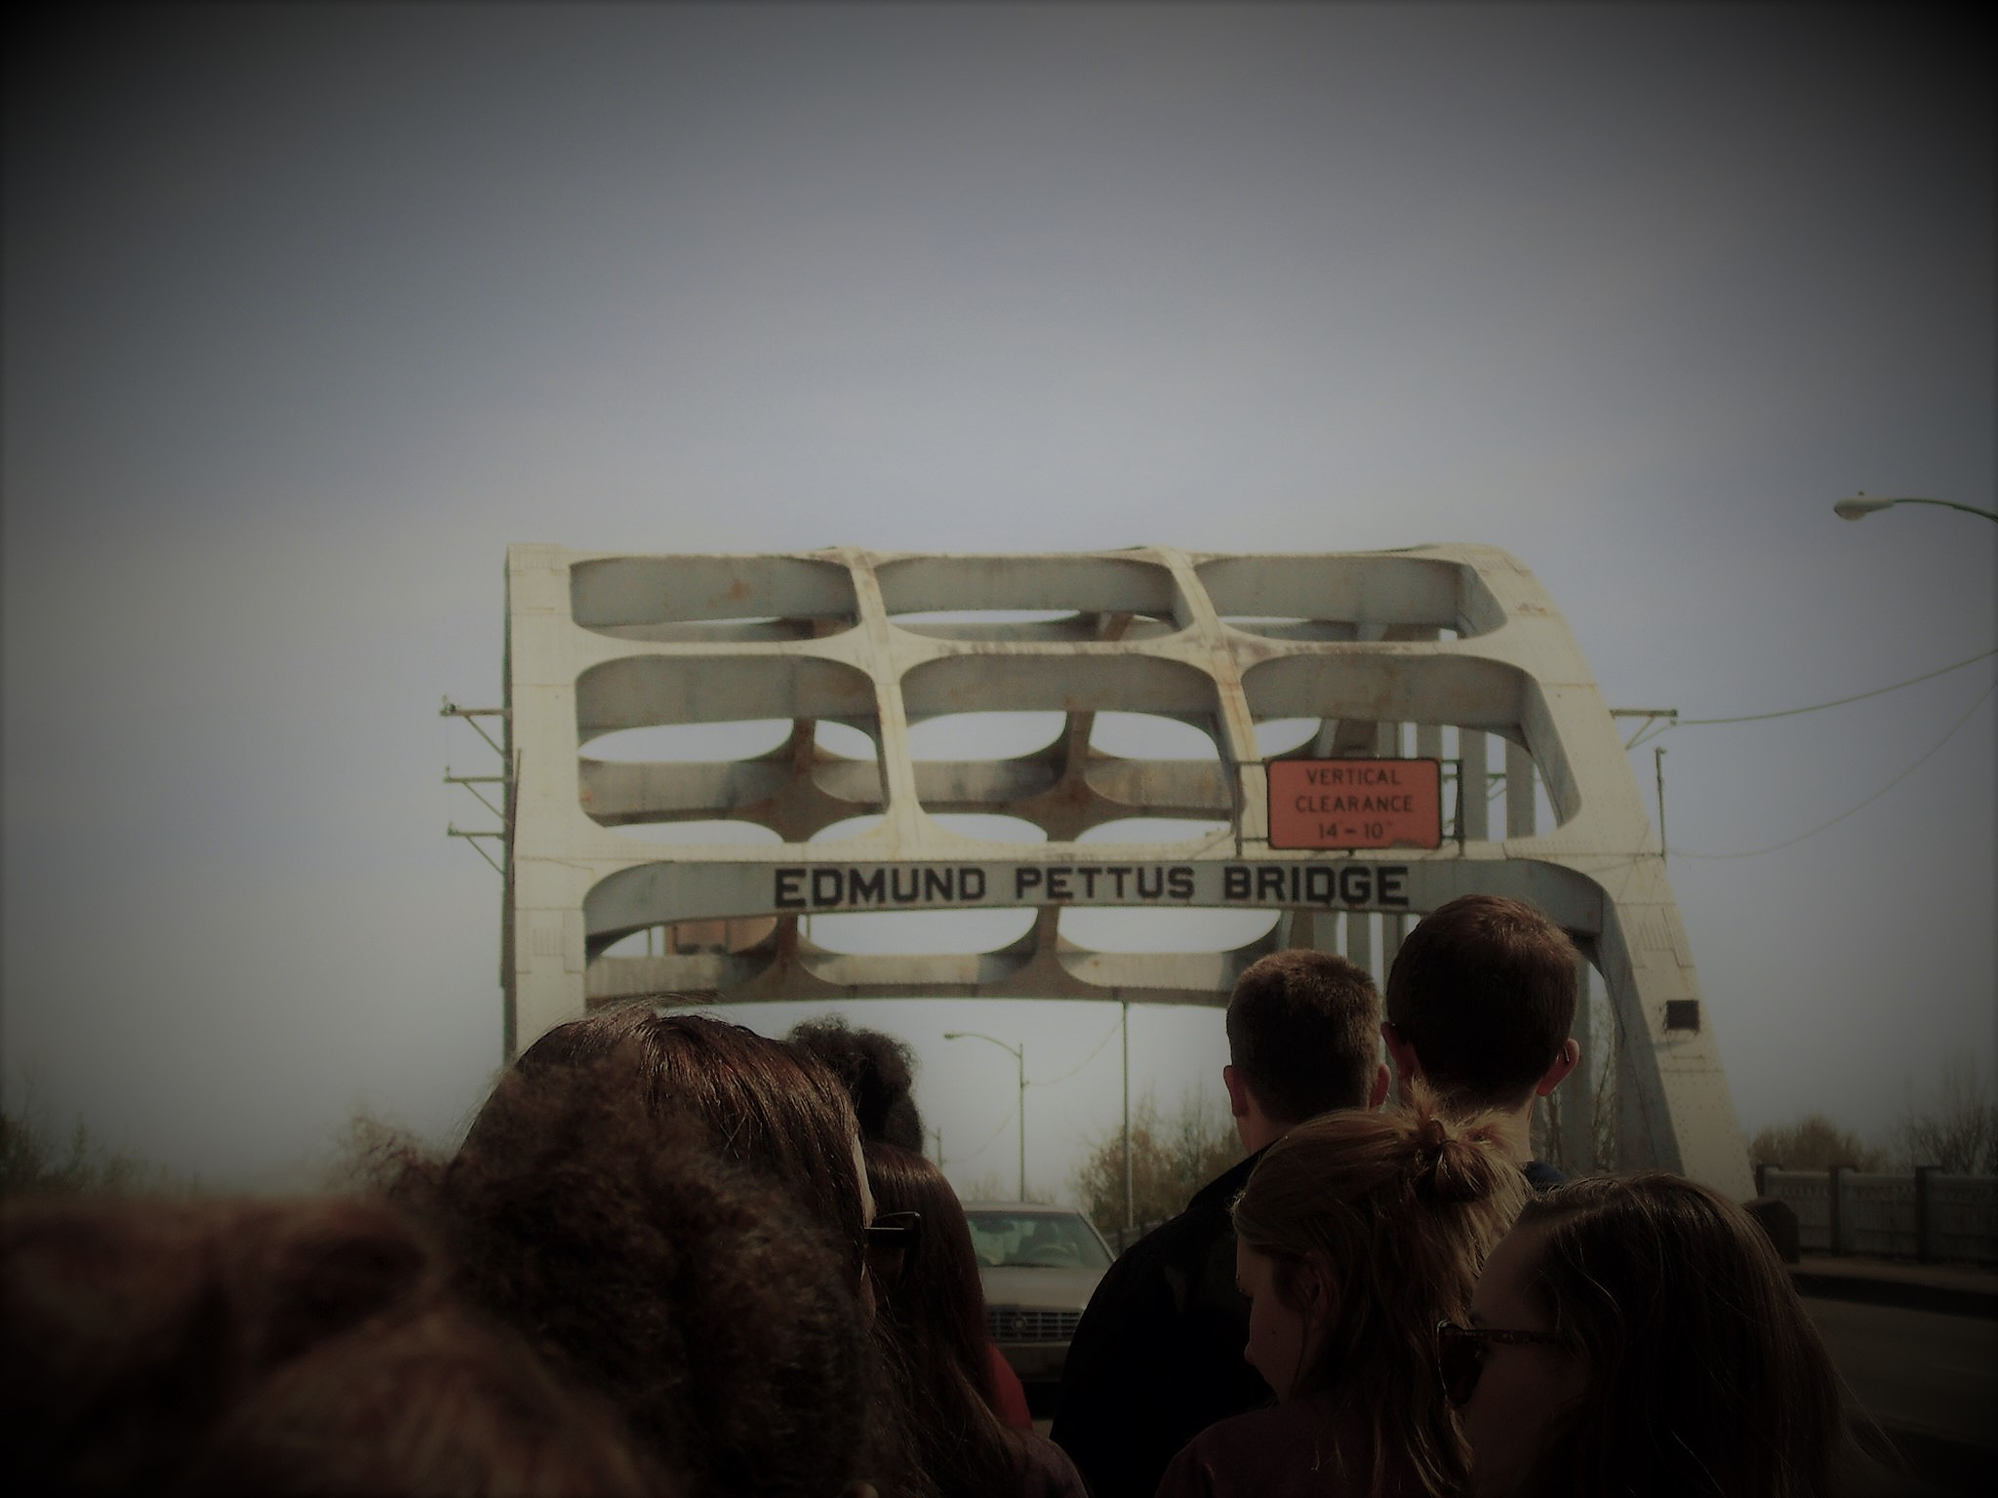
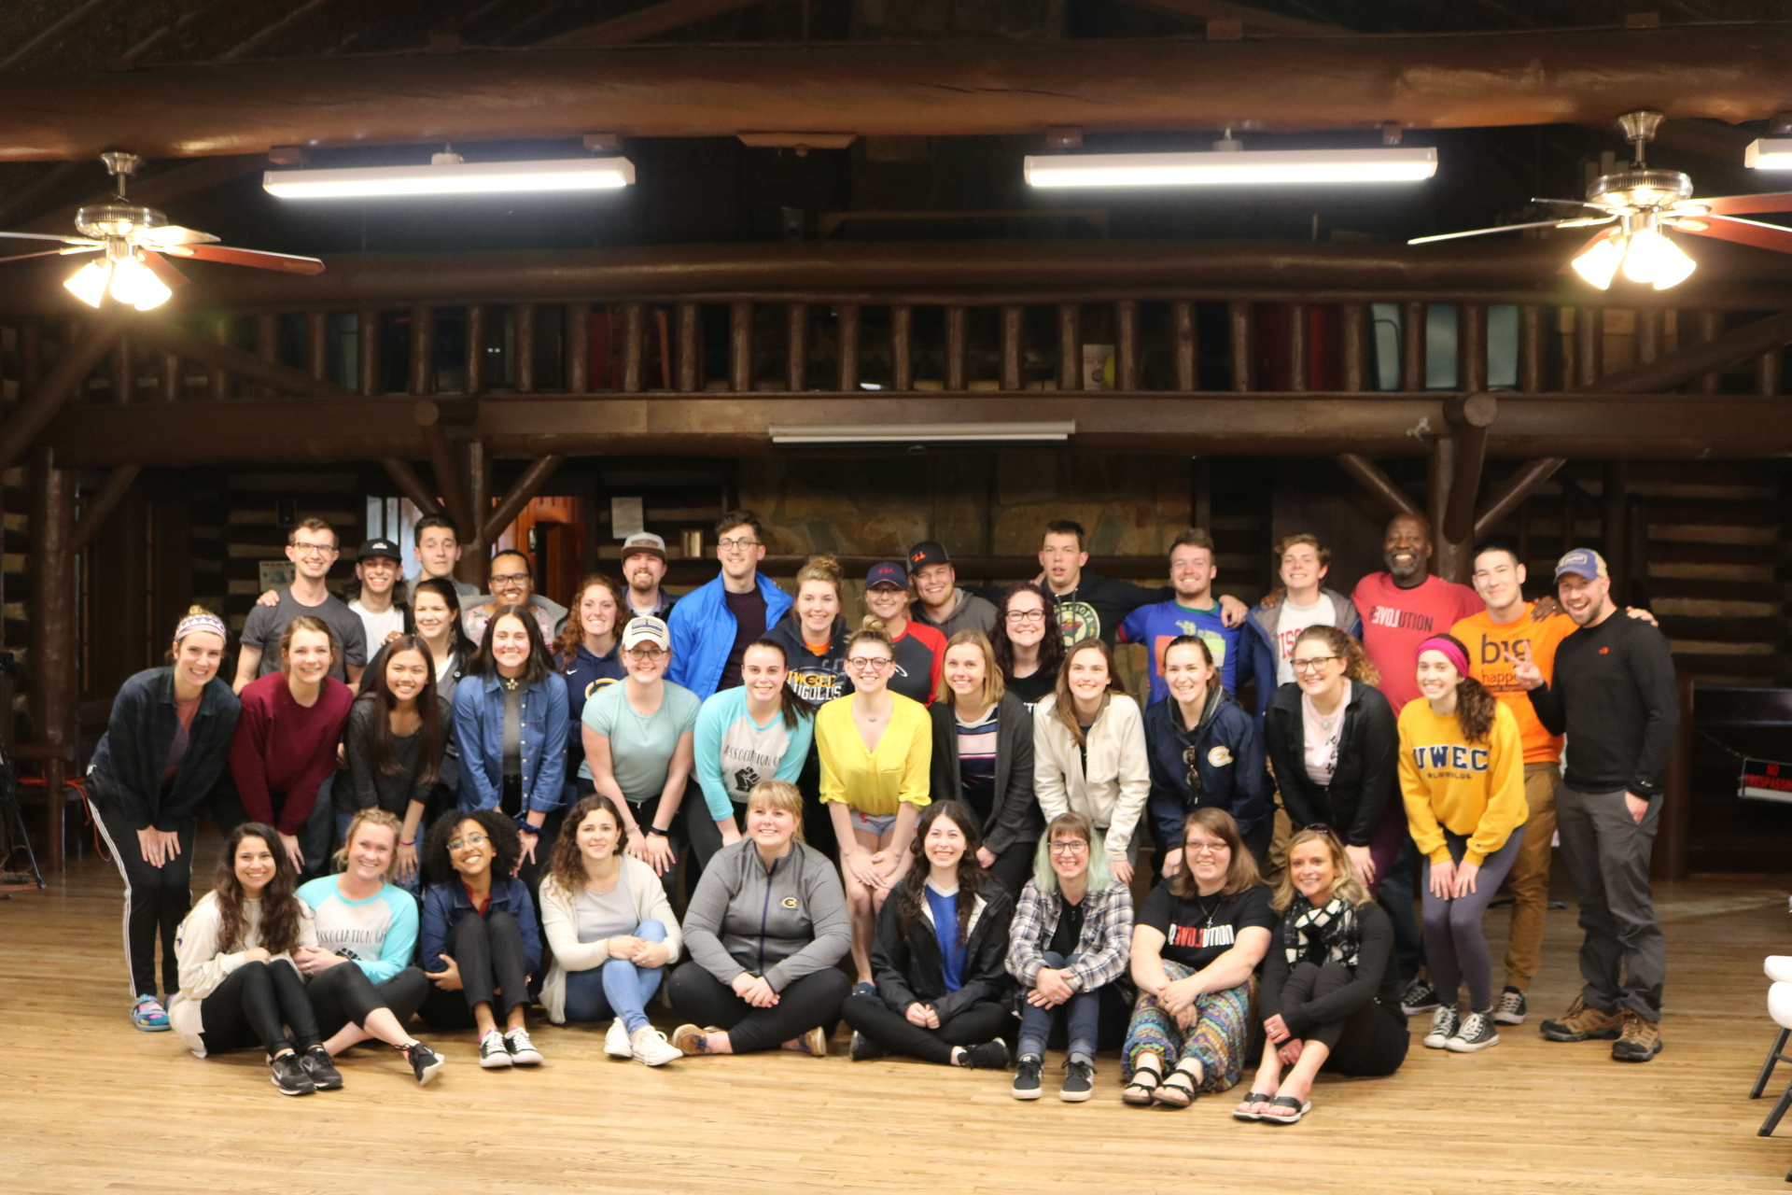
UWEC [And] the Something New ASB Domestic Intercultural Immersion: Exploring the Impacts of High-Impact Practices on Students’ Attitudes Surrounding EDI Initiatives
Alyssa Greene (Student Researcher)
Nicole Schulze, Ph.D and Josh Nesja (Faculty/Staff Mentors) | Department of Communication and Journalism
Introduction
Participant Demographics of the Post-Trip Survey
~ CJ/WMNS 111 had 6 identify as male, 11 identify as female
~ General trip had 3 identify as male, 13 identify as female
~ CJ/WMNS 111 had 2 identify as African American, 15 identify as Caucasian
~ General trip had 1 identify as Hispanic/Latino, 1 identify as Asian, 12 identify as Caucasian, 1 identify as European, 1 identify as White
~ CJ/WMNS 111 had 5 identify as First year, 4 identify as Second year, 7 identify as Third year, 1 identify as Fourth year
~ General trip had 4 identify as First year, 1 identify as Second year, 6 identify as Third year, 3 identify as Fourth year
Data Analysis
~ Descriptive statistics were used to analyze the online Qualtrics survey, taking elements from the Immigration Attitudes Measure (Danso, H.A., Sedlovskaya, A., and Suanda, S.H., 2007), Symbolic Racism 2000 Scale (Henry, P.J. and Sears, D.O., 2002), White Privilege Attitudes Scale (Pinterits, E.J., Poteat, V.P., and Spanierman, L. B., 2009), and the AAC&U rubrics to assess cultural competence (Association of American Colleges and Universities, 2009).
~ Thematic analysis was used to analyze the qualitative and quantitative research of the Qualtrics Survey.
LIBERAL EDUCATION: INTEGRATIVE LEARNING
The topics of immigration and refugees have been in the media spotlight lately. Media and the political climate is causing uneasiness and confusion around immigration and refugees. The research that has been put together on the Something New Alternative Spring Break (ASB) Domestic Intercultural Immersion (DII) trip, should show the experiences that Blugolds have taken away from these high-impact practice trips. The ASB trip is approved and funded by the University of Wisconsin-Eau Claire and gives students a motivating experience. The purpose of this trip is to expose students to different cultures, primarily that of refugees and immigrants that have come to the United States. This experience brings forth the political climate, relationships, and activism that is taking place and the community surrounding the diverse culture. Through the University support of the ASB trip, the importance of Equity, Diversity, and Inclusivity (EDI) initiatives is brought forth on campus. Also through this research, aspects of both the Social Judgement Theory and the Critical Race theory are assessed and relate back to the ASB trip.
With integrating the Something New Alternative Spring Break trip into CJ/WMNS 111: Gender, Race, Class, and Communication, integrating learning from new level. The goal of the class is to integrate the learning dynamics across courses and diversify disciplines into the community and the UWEC campus.
Element 1: Connections to Experience
~ Students the CJ/WMNS 111 class connect life experiences to the class and the Something New Alternative Spring Break trip.
Element 2: Connections Across Disciplines
~ Students from the CJ/WMNS 111 class connect what they have learned from the disciplines of Communication Studies and Women’s Studies to the Something New Alternative Spring Break trip. By making these connections, they are able to take their knowledge and address local social issues.
Element 3: Transfer Between Contexts
~ Students from the CJ/WMNS 111 class apply their gained knowledge and skills from the class and the Something New Alternative Spring Break trip from one setting to another. By doing this, the students should be able to address problem solving on issues with confidence.
SOCIAL JUDGEMENT THEORY
Results
According to Sherif’s Social Judgement Theory, when humans are given a new piece of knowledge, we automatically judge that knowledge based on our current knowledge and experience. The new information is put into one of three zones: 1) latitude of acceptance; 2) latitude of non-commitment; 3) latitude of rejection. Our ego-involvement on the certain topic is what makes us put that information into these zones. The definition of ego-involvement is how important a topic is to one’s own self. For instance, if someone states a contrasting belief to one that has high ego-involvement, they will be in that zone of rejection where they don’t believe in what is stated. If someone states a belief that is within the latitude of acceptance, then there is agreement in what was stated. In order to shift someone’s attitude, they must judge how far it is from their belief. Once the thought process is complete, adjustments can be made due to the new information that was received. According to Sherif, the information that is received in the best way, is the information that is far enough away from that anchored belief but still within the latitude of acceptance.
Intercultural Knowledge and Competence is "a set of cognitive, affective, and behavioral skills and characteristics that support effective and appropriate interaction in a variety of cultural contexts.” (AAC&U, 2009). Themes that emerged from the survey was that students were able to gain knowledge and appreciation for other cultures.
Students Walking Across the Historical Edmund Pettus Bridge: Selma, AL
Courtesy of Brianna Sexton
Research questions
Research Question 1: By looking at the pre- and post-assessment of the Something New Alternative Spring Break Immersion trip, how has cultural competence (as defined by AAC&U 2009 Rubric) changed, if any, in the eyes of the UWEC students?
Research Question 2: By looking at the experiences from the post-assessment survey, what themes emerged towards the intercultural immersion?
CRITICAL RACE THEORY
The Critical Race theory is based off of the civil rights movement of the mid-1950s and a political race-related climate of the 1960s. Being that the name of the theory is critical, this suggests that it is against the popular vote. A significant portion of the critical race theory pertains to the role of race in politics, laws, and the government. The critical race theory helped Derrick Bell in 1980 with the Brown v. Board case. The Critical Race theory helped Bell show that laws benefit the White majority, not minorities. This theory helps show that the best way to make change is by speaking up and using the knowledge and skills gained from experience and learning.
Methods
Qualitative and quantitative research was done by conducting two different surveys. There was a pre-trip survey distributed with various questions about race, white privilege, culture, and many other question types. There was also a post-trip survey distributed to the students asking both very similar questions and adding in their experiences and what they will take away from the Domestic Intercultural Immersion trip. The students that went on the trip were broke up into two different groups to calculate the differences between those in CJ/WMNS 111 class and those who signed up for the ASB trip by another method. By surveying these groups separately, it would show whether the class had an impact on the experiences and views of the students.
Participant Demographics of the Pre-trip Survey:
~ CJ/WMNS 111 had 5 identify as male, 9 identify as female
~ General trip had 3 identify as male, 12 identify as female
~ CJ/WMNS 111 had 1 identify as African American, 14 identify as Caucasian
~ General trip had 1 identify as Hispanic/Latino, 1 identify as Asian, 11 identify as Caucasian, 1 identify as European, 1 identify as White-European
~ CJ/WMNS 111 had 4 identify as First year, 6 identify as Second year, 3 identify as Third year, 1 identify as Fourth year
~ General trip had 4 identify as First year, 2 identify as Second year, 3 identify as Third year , 3 identify as Fourth year
Implications
Through DII Immersions, faculty and staff are able to implement and contextualize the experiences gained within the classroom and university setting from these types of EDI Initiatives.
The students will be able to bring back their experiences and use them to understand cultural competence. Students will also be able to understand the oppression and discrimination that is facing not only immigrants and refugees, but racial minorities as well. Students should to use their experiences to advocate and raise awareness to others about the pressing issues that are facing refugees, immigrants, and racial minorities.
References
Association of American Colleges & Universities. (2009). Intercultural knowledge and Competence VALUE rubric. Retrieved from: https://www.aacu.org/value/rubrics/intercultural-knowledge
Babbie, E. (2017). Critical race theory. Some social science paradigms (pp. 39-40). Boston, MA: Cengage Learning
Griffin, M. (2006). Social judgement theory. A first look at communication theory (pp. 206-215). New York, NY: McGraw Hill
Henry, P. J., & Sears, D. O. (2002). The Symbolic Racism 2000 Scale. Political Psychology, 23(2), 253-283. doi:10.1111/0162-895X.00281
Integrative Learning Rubric Worksheet. (2012). University of Wisconsin-Eau Claire. Retrieved from: http://www.uwec.edu/Undergrad/upload/IL-rubric-Rev-8-21-12-8x11.pdf
Pinterits, E. J., Poteat, V. P., & Spanierman, L. B. (2009). The White Privilege Attitudes Scale: Development and initial validation. Journal Of Counseling Psychology, 56(3), 417-429. doi:10.1037/a0016274
A Day of Nonviolence Training with Something New

