Slide 1
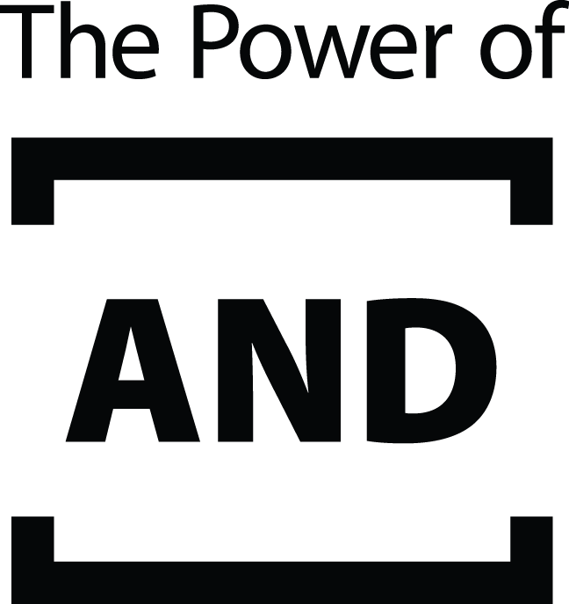
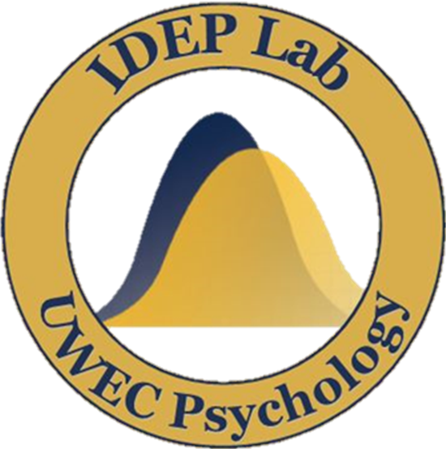
I’ve Chosen Well, But Perhaps I Could Do Better: Maximizing Tendencies and Romantic Relationship Judgments
Paige Shafer and Michaela Gunseor
Faculty Mentor: April Bleske-Rechek  Department of Psychology
Overview & Method
Results
People make choices in nearly every domain of life, and individuals differ in their choice-making strategies:¹
Maximizers search extensively for the best possible option.
Satisficers search just until they encounter an option that fits what they are looking for.
Studies suggest that maximizers ensure they have a lot of options to choose from,² invest more time into exploring all options,³ and report less certainty about having made the right choice (even though they often end up with highly favorable options).⁴
In this study, we explored how maximizing-satisficing manifests in romantic relationships.
Hypotheses:
Because maximizers search for the best, they should select high quality mates and hence (1) perceive their current partner just as favorably as satisficers do. However, because maximizers experience more uncertainty about their choices and continue to search for the elusive best, they should also (2) report more attention to alternatives; (3) report less relationship commitment, investment, and satisfaction (i.e., relationship positivity); and (4) make more negative forecasts about the future stability of their romantic relationship.
Participants:
Participants were 327 young adults (53 male, 272 female, 2 unspecified) who were enrolled at a midsized liberal arts university (M_{age}=19.49 yrs; SD=1.4 yrs) and currently involved in a romantic relationship (M_{duration}=18 mts; SD=18 mts).
Method:
All participants (1) reported their current relationship status; (2) made forecasts of their relationship status five months in the future; (3) completed the Big Five Inventory,⁵ an expanded Maximizing-Satisficing scale,^{1,6} the Investment Model Scale,⁷ and measures of relationship quality adapted from the Quality Marriage Index;⁸ and (4) evaluated their partner’s mate value.⁹
Hypothesis 1:
Maximizers will perceive their current partner just as favorably as satisficers will.
Participants’ maximizing-satisficing scores were reported on a 0-100 scale (M=58.03, SD=11.42). We used those continuous scores for our hypothesis tests (bivariate correlational analyses). For visual displays of the findings, we split participants into those who scored in the lower 25% of maximizing (score<50.15), middle 50% (scores of 50.16 to 65.24) and upper 25% (score>65.24). For group comparisons shown in the figures, error bars represent ±2 SEM.
Hypothesis 1 was supported:
Overall, participants rated their partner’s mate value quite favorably (M=5.68, SD=0.93). Maximizing and partner mate value were not correlated, r(326)=.05, p=.357. As shown in the upper left bar graph, maximizers perceived their partner just as favorably as satisficers did.
Hypothesis 2 was supported:
Maximizing was positively associated with perceived quality of alternatives, r(326)=.11, p=.048. That is, participants who scored higher in maximizing perceived the quality of possible romantic alternatives to be higher than did participants who scored lower in maximizing. The upper right bar graph shows that this association was weak.
Hypothesis 3 was not supported:
Contrary to expectation, maximizing and relationship positivity were not correlated, r(326)=-.08, p=.149. As shown in the bottom left bar graph, maximizers did not score reliably lower than satisficers in relationship positivity.
Hypothesis 4 was supported:
Maximizing was negatively associated with forecasted relationship stability, r(321)=-.13, p=.016. As shown in the bottom right bar graph, maximizers rated their relationships as less likely to endure over the next five months than satisficers did.
Hypothesis 2:
Maximizers will report more attention to alternatives than satisficers will.
Hypothesis 3:
Maximizers will report less overall relationship positivity than satisficers will.
Hypothesis 4:
Maximizers will make more negative forecasts about the future stability of their romantic relationships than satisficers will.
Discussion
We conducted the current research to extend these previous findings of maximizing tendencies to how people feel about their current romantic relationships (after the search process has already occurred).
As expected, we found that maximizers perceived their partners just as favorably as satisficers did, yet they viewed alternative partners as higher in quality; they also made less positive forecasts about the future stability of their romantic relationship. Contrary to our prediction, however, maximizers did not differ from satisficers in relationship positivity.
Our findings may be limited because our primary variables of interest are range-restricted. That is, participants were at ceiling in their forecasts of relationship stability over time and overall relationship positivity. The vast majority of participants were very committed, satisfied, and invested in their relationship, and 91% forecasted that their relationship would strengthen or stay the same rather than weaken over the subsequent 5 months. The next phase of this research is a 5-month follow-up of these participants. The outcome data will reveal which couples do stay together, and whether maximizing predicts break-up.
Maximizing-satisficing is an individual differences attribute that manifests itself during decision making in a variety of contexts: consumer behavior (e.g., shopping),² job searches,⁴ and even romantic partner searches.³ For example, research suggests that maximizers more than satisficers engage in extended romantic partner search, even when they are explicitly told that as they continue their search options will be less suited to their preferences.
References
Acknowledgments
Schwartz, B., Ward, A., Monterosso, J., Lyubomirsky, S., White, K., & Lehman, D. R. (2002). Maximizing versus satisficing: Happiness is a matter of choice. Journal of Personality and Social Psychology, 83, 1178-1197.
Dar-Nimrod, I., Rawn, C. D., Lehman, D. R., & Schwartz, B. (2009). The maximization paradox: The costs of seeking alternatives. Personality and Individual Differences, 46, 631-635.
Wu, P., & Chiou, W. (2009). More options lead to more searching and worse choices in finding partners for romantic relationships online: An experimental study. CyberPsychology & Behavior, 12, 315-318.
Iyengar, S. S., Wells, R. E., & Schwartz, B. (2006). Doing better but feeling worse: Looking for the “best” job undermines satisfaction. Psychological Science, 17, 143-150.
John, O. P., & Srivastava, S. (1999). The Big Five trait taxonomy: History, measurement, and theoretical perspectives. In L. A. Pervin and O. P. John (Eds.), Handbook of personality: Theory and research (pp. 102–138). New York: Guilford Press.
Diab, D. L., Gillespie, M. A., & Highhouse, S. (2008). Are maximizers really unhappy? The measurement of maximizing tendency. Judgment and Decision Making, 3, 364-370.
Rusbult, C. E., Martz, J. M., & Agnew, C. R. (1996). The Investment Model Scale: Measuring commitment level, satisfaction level, quality of alternatives, and investment size. Personal Relationships, 5, 357-391.
Norton, R. (1983). Measuring martial quality: A critical look at the dependent variable. Journal of Marriage and the Family, 45, 141-151.
Edlund, J. E., & Sagarin, B. J. (2014). The Mate Value Scale. Personality and Individual Differences, 64, 72-77.
This research is supported by internal grants and the EvaluateUR Program through the Office of Research and Sponsored Programs at UWEC. We thank LTS for printing this poster and members of the IDEP lab for their feedback on project development.

