Slide 1

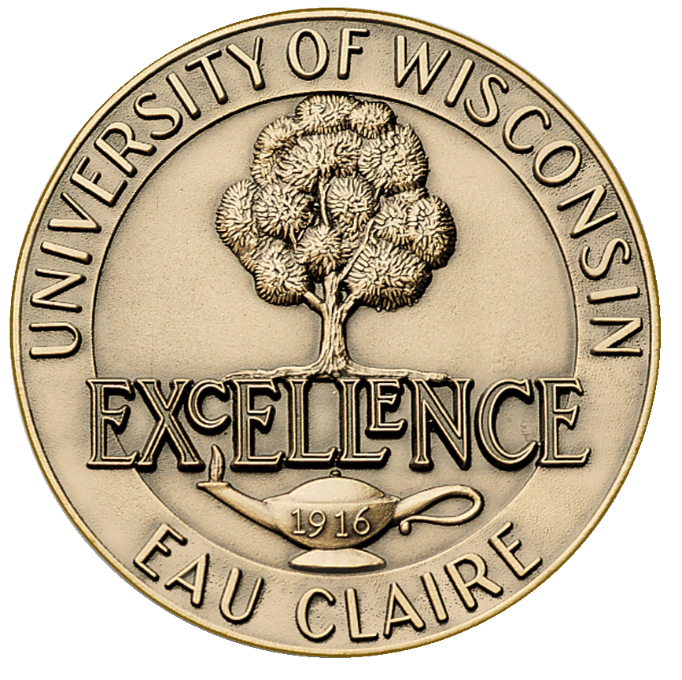
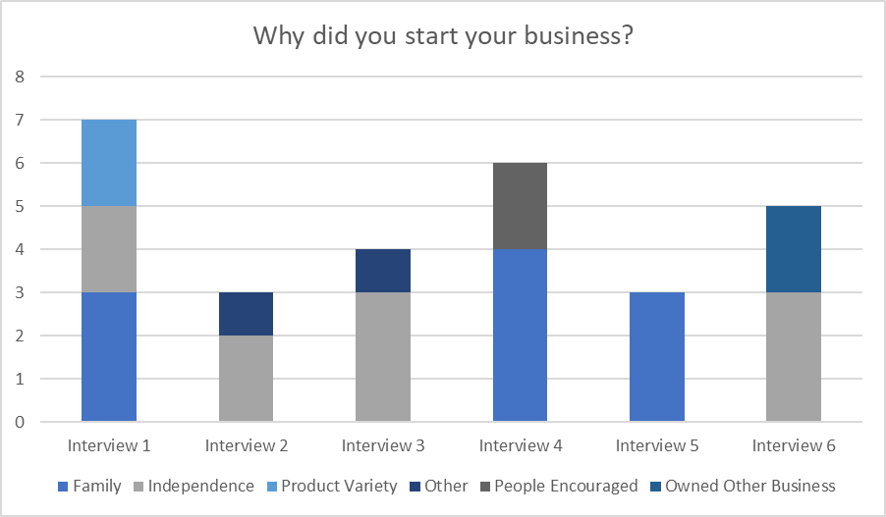
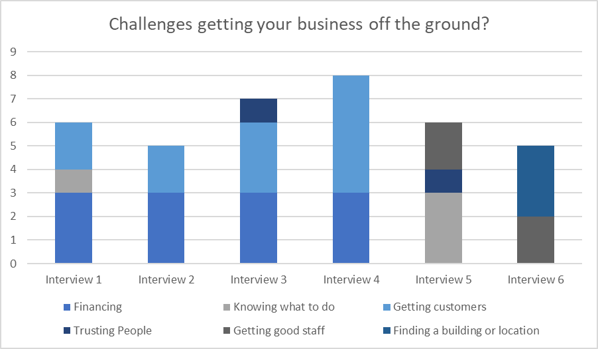
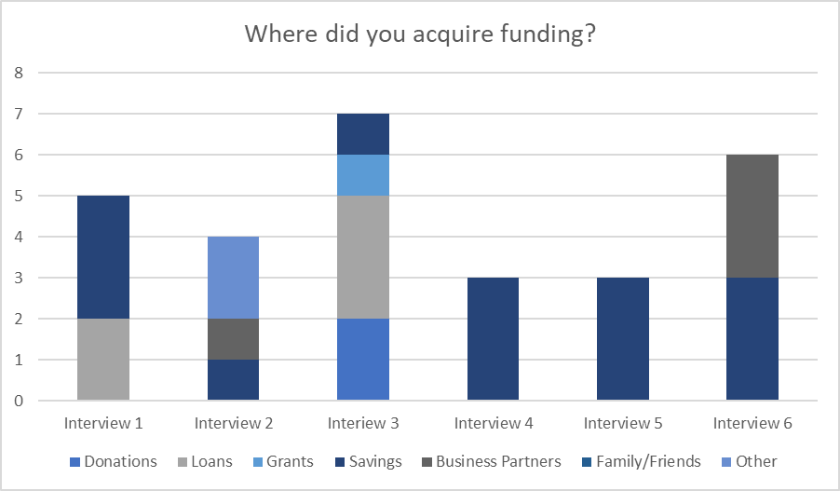
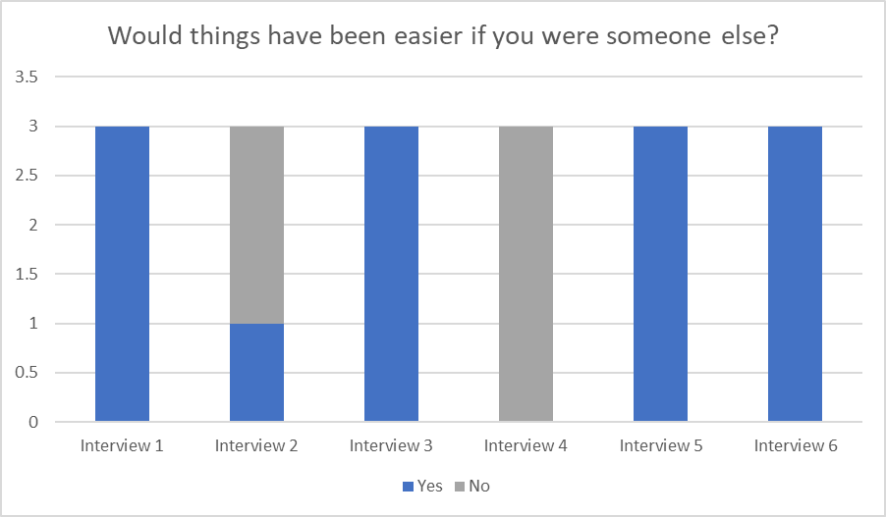
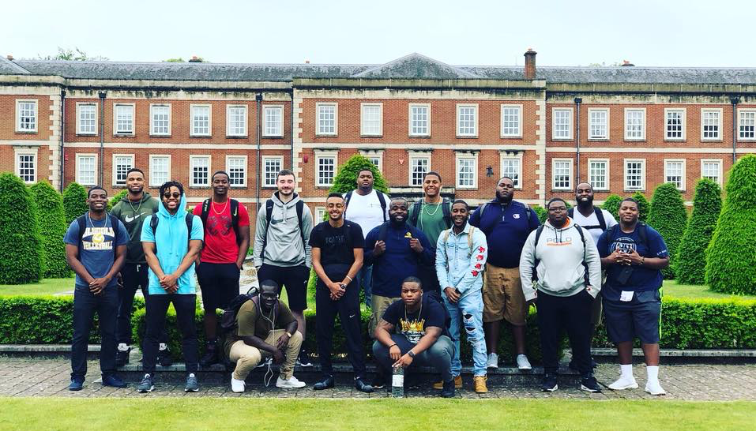
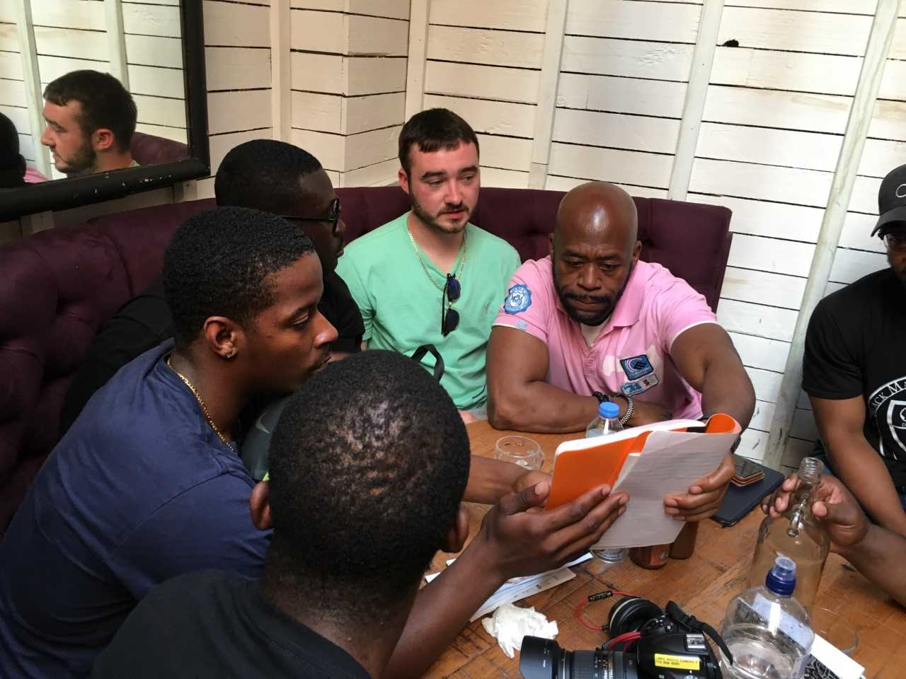
An Analysis of Black Business Ownership in England Student Researchers: Lewis Balom, Leeshaun Evans, Collis McCloud Jr, Zach Zilm Jr. Faculty Mentors: Jodi Thesing-Ritter, Nancy Hanson-Rasmussen, Dennis Beale IRB #: MCCLOUDS121202018
INTRODUCTION
RESULTS
METHODS
Of the forty million businesses in the world, only 2.6 million of those businesses are Black owned. To understand the barriers and opportunities for business ownership for Black entrepreneurs. Researchers conducted a qualitative interviews with six Black owned businesses in London, England and will conduct interviews with six similar businesses throughout Wisconsin. Through face to face interviews, researchers asked business owners twenty questions about the process of beginning, financing, and sustaining a business. Business owners shared their most significant challenges and opportunities.
According to the African American Population Report, between 2007 and 2012 Black owned businesses in the United States increased 34.5% to 2.6 million Black firms. Yet, more than 95% of these businesses are sole proprietorship or partnerships with no paid employees. This study helped researchers to understand how black owned businesses are able to overcome barriers to establish themselves and grow. Upon return to UW-Eau Claire, student research teams participated in a one credit independent study in their major to complete the analysis of their research data collection. Data gleaned from this study will inform African Americans, seeking to start a business, about the experiences of established Black business owners in developing their respective businesses.
Student researchers conducted a qualitative research study by interviewing six black owned businesses in London. Interview recordings were transcribed and coded to compare the results received from each interview. Codes are ‘‘tags or labels for assigning units of meaning to the descriptive or inferential information compiled during a study’’ (Miles and Huberman 1994: 56). Potential codes were assigned to each interview question by three independent parties after they reviewed the researcher developed questions. These codes were then used to create a codebook. A codebook is a set of codes, definitions, and examples used as a guide to help analyze interview data. Codebooks are essential to analyzing qualitative research because they provide a formalized operationalization of the codes (MacQueen et al. 1998; Crabtree and Miller 1999; Fereday and Muir-Cochrane 2006; Fonteyn et al. 2008). Researchers then read each interview transcript and assigned a code(s) to each answer. Answers were then entered into an excel spreadsheet. This process allowed researchers to engage in data simplification. According to Coffey and Attkinson, this allows researchers to make new connections between concepts and convert data into meaningful units,and rethinking theoretical associations. (1996). Codes were then converted to graphs for visual representation of key themes.
RECOMMENDATIONS
To conclude our interviews, we asked each business owner for some advice that they would give to future minority business owners. The most popular answers were connecting with people who will help you and keep you motivated, go to programs that will help you learn more about business and be prepared to sacrifice your time and money.
MAKING CONNECTIONS
Student researchers touring sites of historical significance during travels to England.
Photo courtesy of Jodi Thesing-Ritter. Used with permission.
ADDITIONAL RESEARCH
ACKNOWLEDGEMENTS
Researchers intended to conduct comparison research with similar businesses in Milwaukee to understand differences between England and the United States. The interviews in the U.S. will be conducted in the summer of 2019. These interviews will provide insight into similarities and differences in business development and sustainability. Further analysis of the factors leading to successful business ownership by Blacks will offer young Black entrepreneurs with roadmaps for success.
Thank you to UW Eau-Claire faculty and staff members- Jodi Thesing-Ritter, Dennis Beale, and Dr. Nancy Hanson-Rasmussen, Winchester faculty, Carol Smith, and all the business owners that participated in this project. Additionally, Kimera Way, Executive Director of the UW-Eau Claire Foundation provided valuable support for this project.
Students researchers learning from Romeo Effs, Executive Coach and Author of Enthusiasm Unchained
Photo courtesy of Jodi Thesing-Ritter. Used with permission.
Funding Support for this project came from student differential tuition funds through the University of Wisconsin-Eau Claire International Fellows Program Differential Tuition Program.

