Slide 1
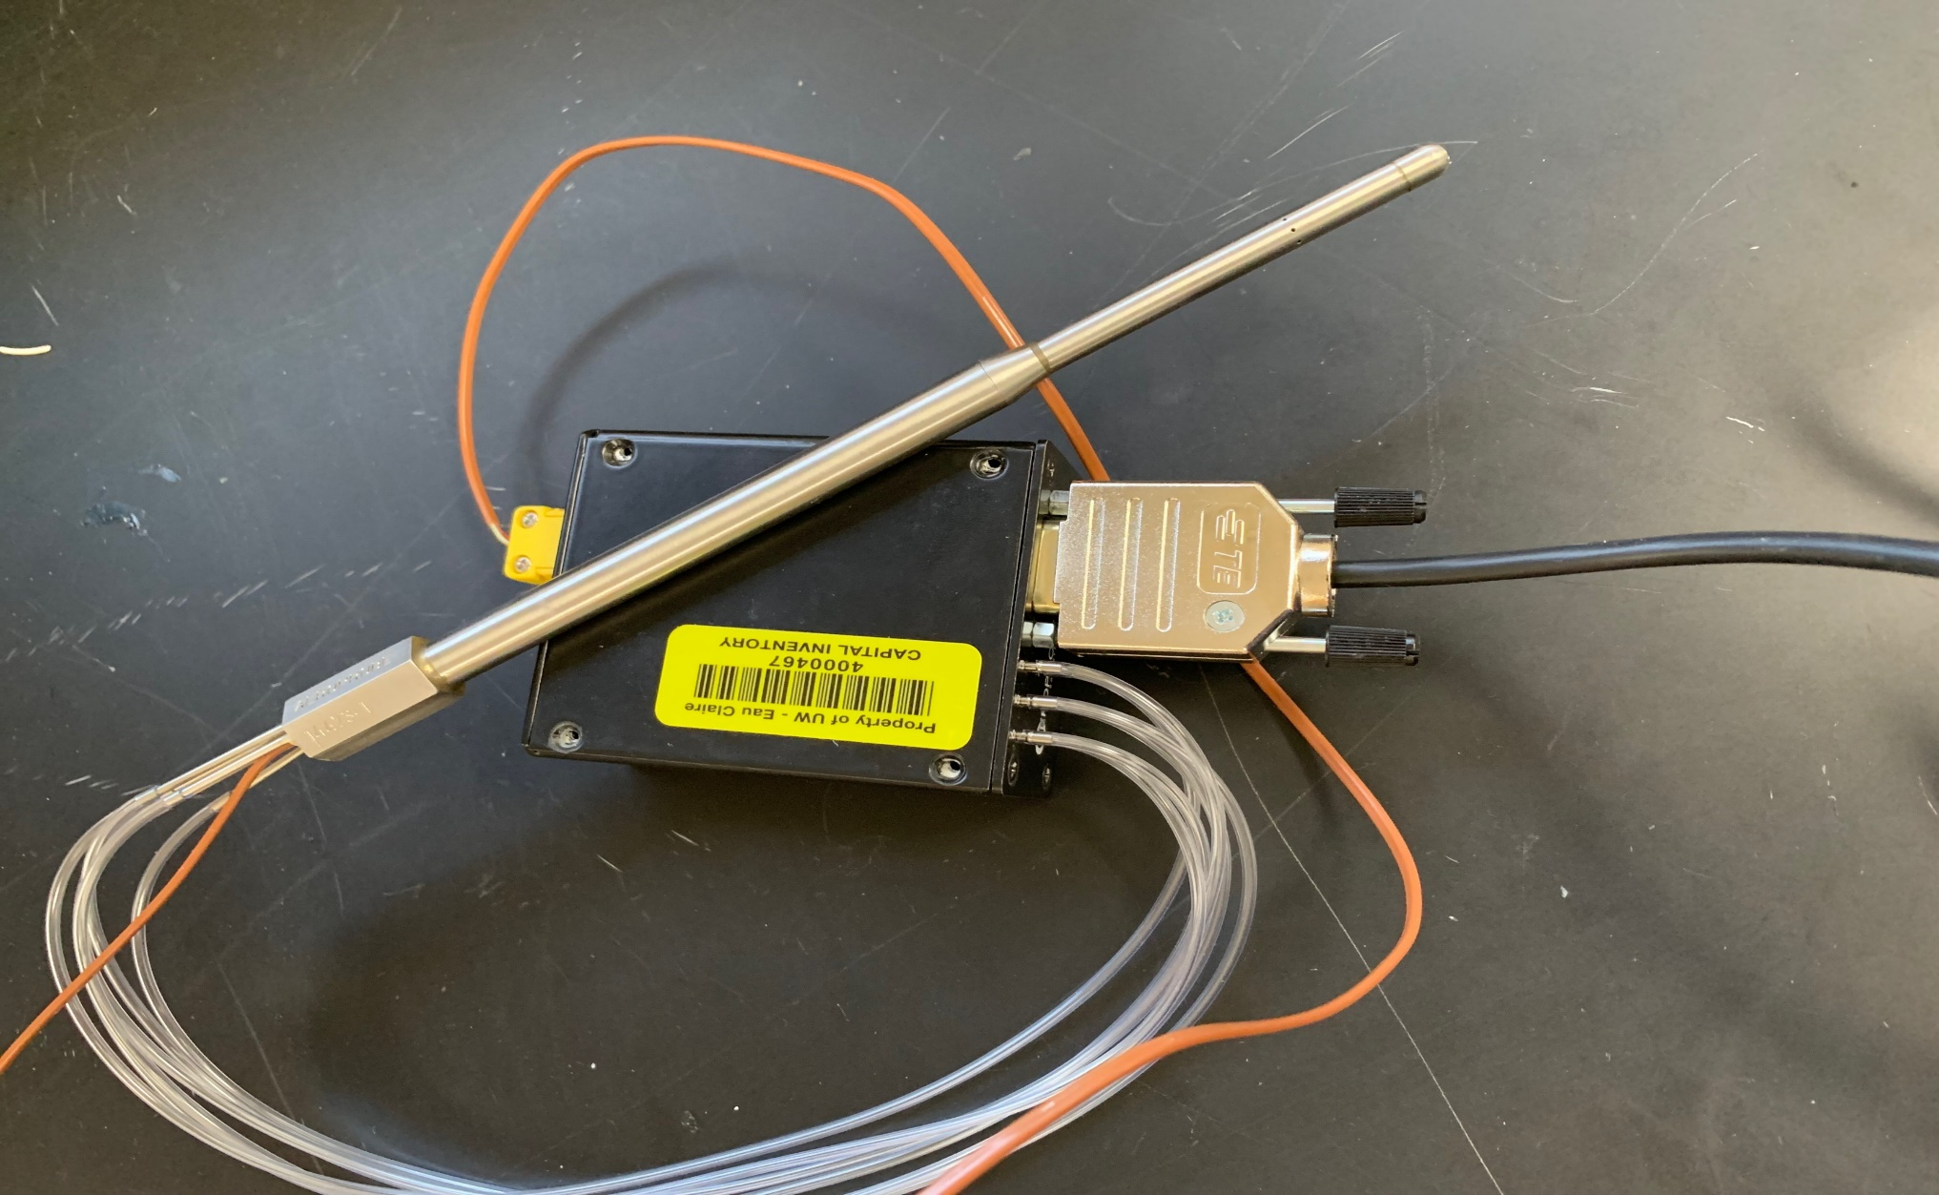
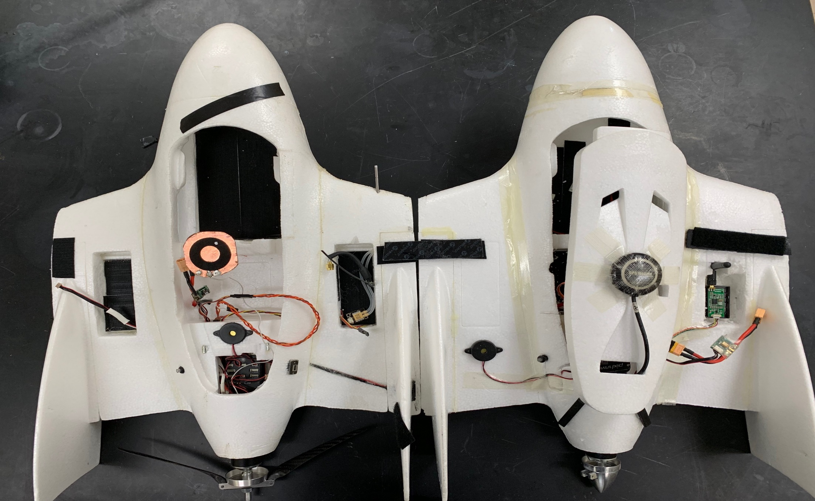
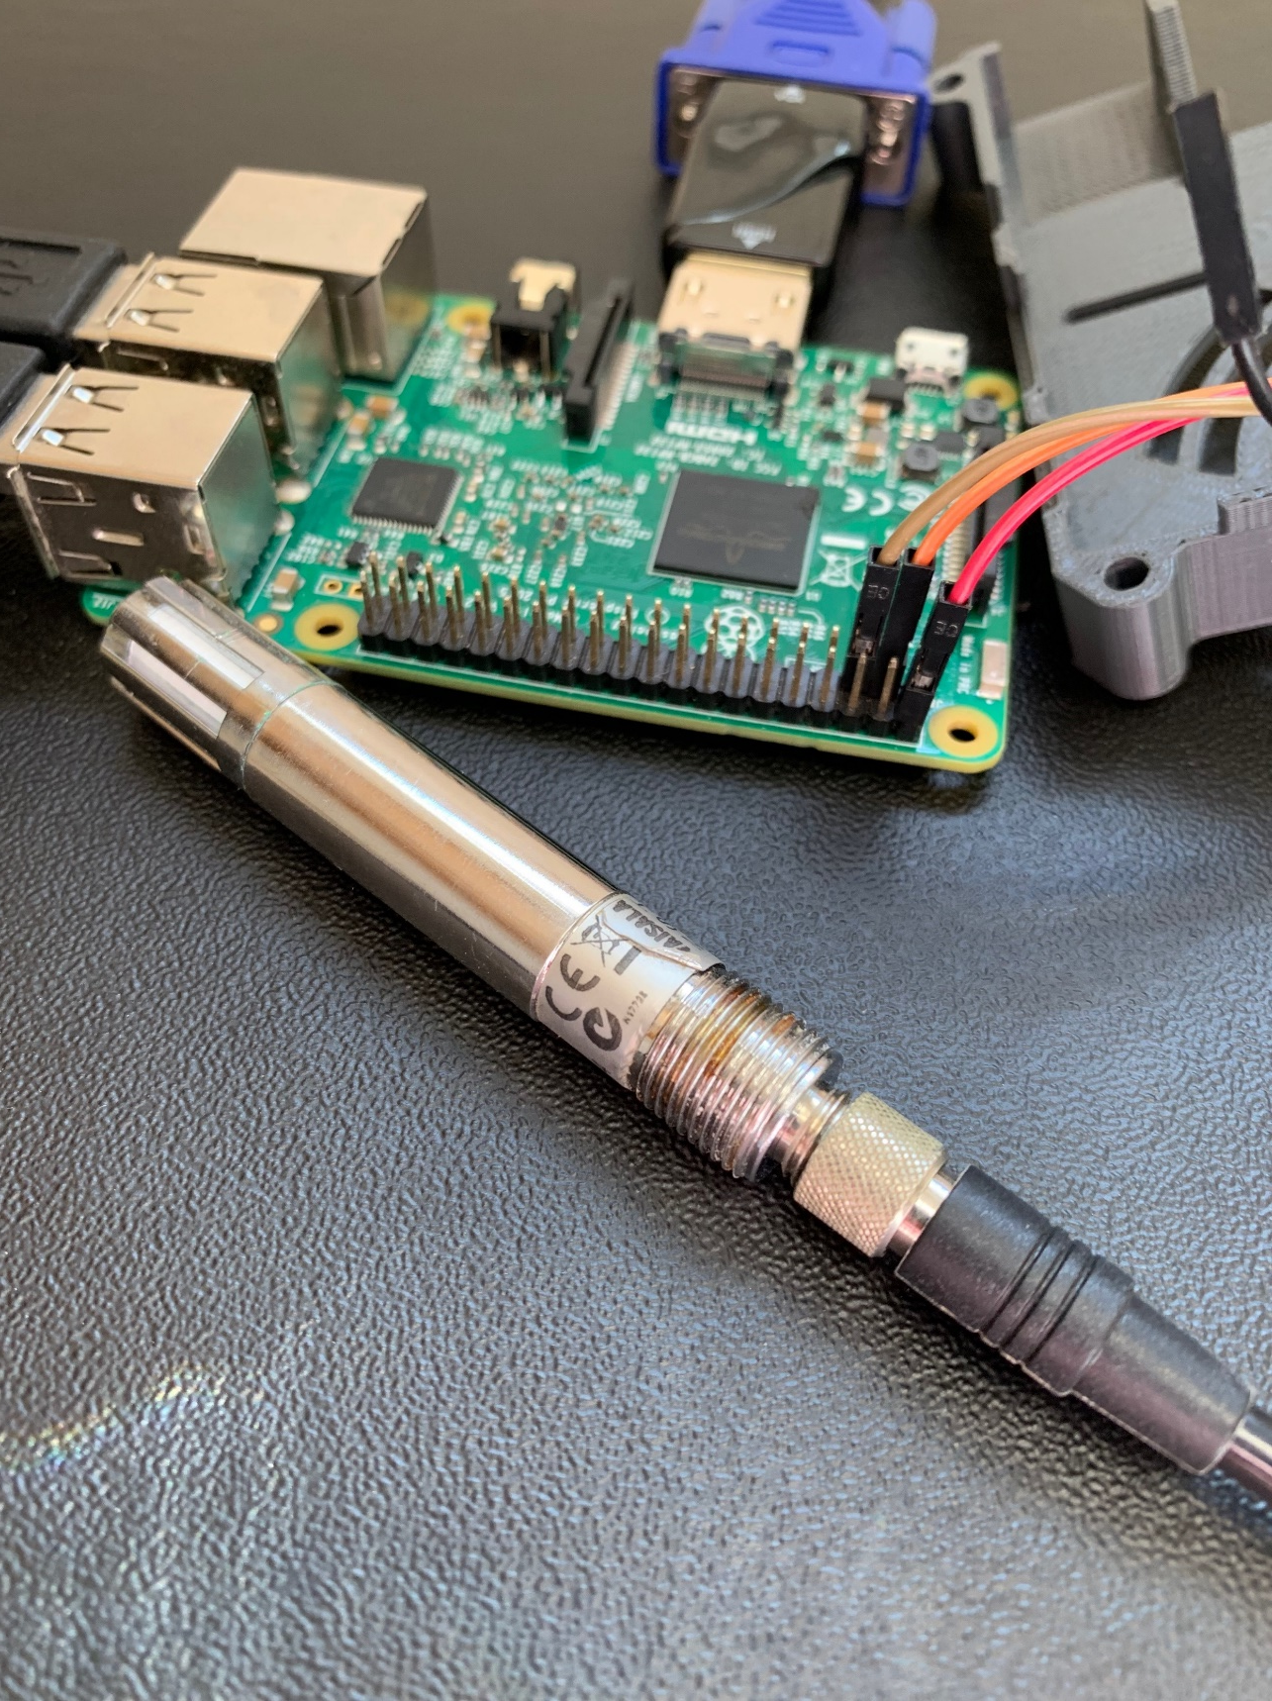
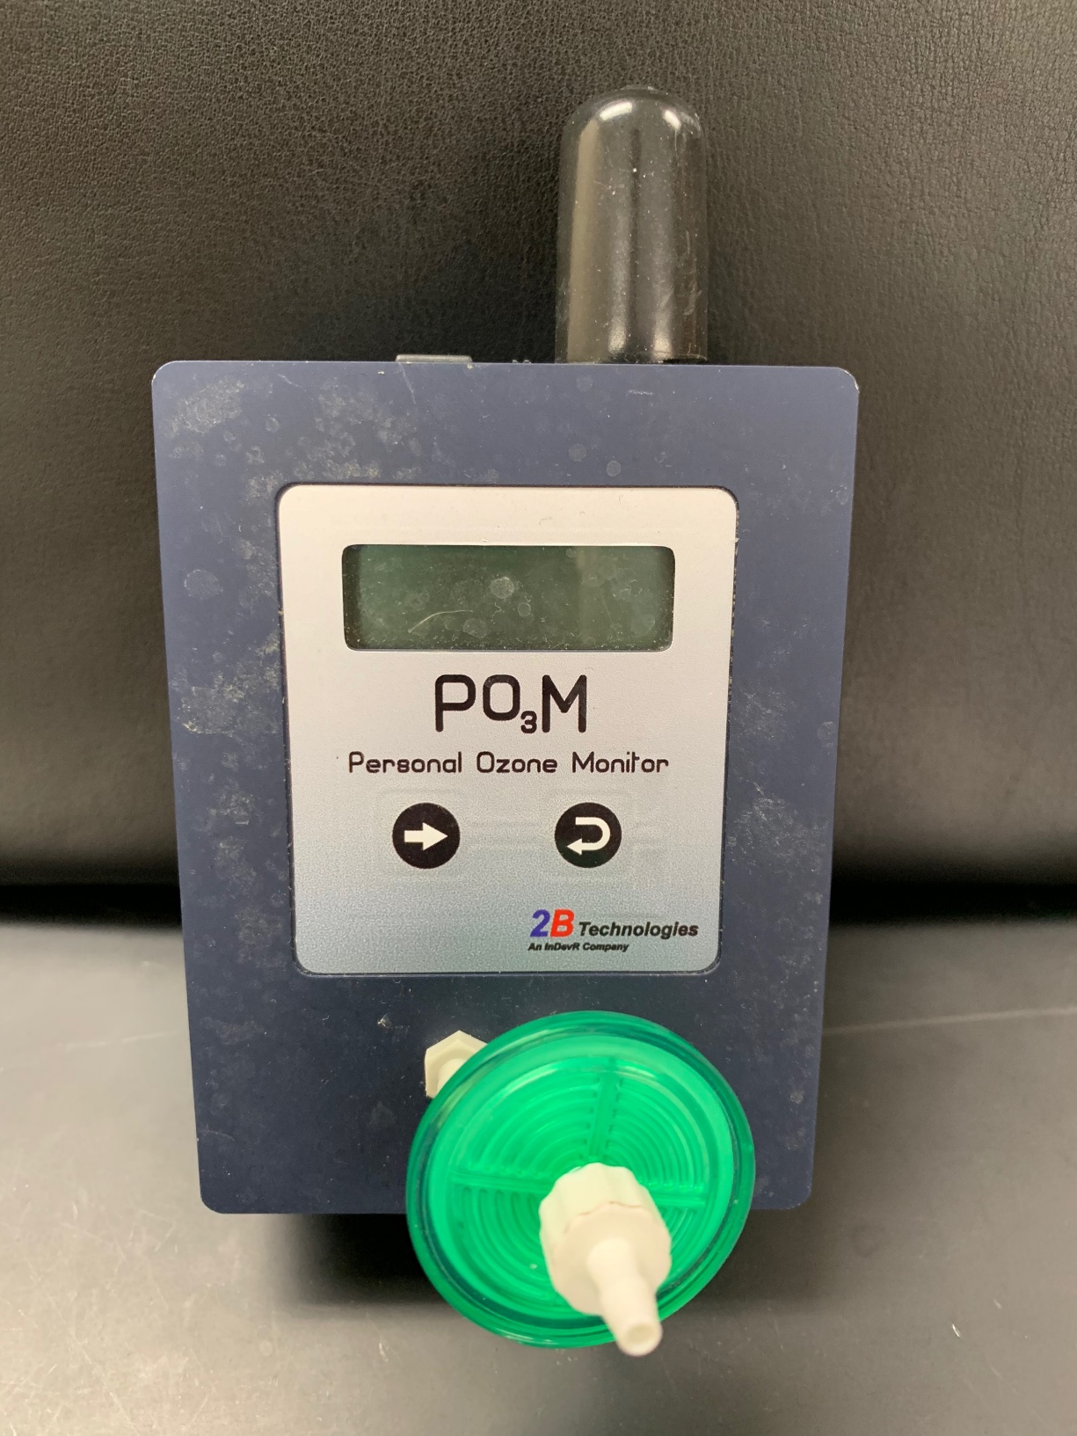
Integration of a 5-Hole Probe onto Unmanned Aerial System (UAS)
Justin Anderson, Caitlin Hedberg, Faculty Mentor: Dr. Patricia Cleary | Department of Chemistry
Abstract
5-Hole Probe
Drone Integration
The goal of this project is to integrate sensors onto an unmanned aerial system (UAS) to better profile meteorology and composition of the atmosphere. Specifically, we have focused on a five-hole probe with the intent of collecting air velocity vectors while mounted to a fixed-wing UAS. A LABVIEW program was written to record data from the microcomputer and was tested in a wind tunnel. This probe will be used in conjunction with a Personal Ozone Monitor and an HMP60 probe to study ozone levels on the shoreline of Lake Michigan.
Description
Callibrate and test the POM and HMP60 Sensors
Integrate POM and HMP60 sensors into Raspberry Pi system
The five-hole probe is connected to a micro air data computer (uADC) which reads and store air velocity data was well as angle of attack and the angle of side slip. The uADC is the connected to the onboard Raspberry Pi to store data to export for data analysis.
Introduction
Wire uADC and 5-hole probe to connect with the LabVIEW program
Integrate the Raspberry Pi system to the drone
These sensors will be integrated onto a fixed-wing drone used in the continuation of the 2017 Lake Michigan Ozone Study (LMOS), a collaborative, multiagency field campaign that ran from May 22, 2017 through June 22, 2017 in eastern Wisconsin and northeastern Illinois. The Eau Claire team collected ozone data through a Personal Ozone Monitor (POM) on the ground to investigate ozone gradients.
Wind tunnel testing of the 5-hole probe
Integrate the uADC and 5-hole probe system to the drone
Connection
The connection between the uADC and the USB connector to the computer running its LABVIEW program was previously run through a breadboard. Onboard the UAS, the uADC will use the USB cord to connect to the Raspberry Pi. To increase the durability of this connection, the breadboard was replaced with an RS232 connector port with a specified pinout for the uADC.
This project will move forward into Summer 2019 and the 2019-2020 school year. The uADC and 5-hole probe system will continue to be tested through LabVIEW and the wind tunnel. There will be a new drone introduced to the project: Typhoon H. Instead of being a fixed wing drone sich as the currently used Spectra and RV Jet, Typhoon H is a hexacopter. The Typhoon H’s battery life, maneuverability, and payload will be tested in Summer 2019. If successful, the Raspberry Pi system and the uADC system will be fully integrated onto the hexacopter and used to collect data along the shoreline of Lake Michigan.
Pin | Name | Description
3 | DGND | Signal (Digital) Ground
5 | TX+ | RS232 Output Data
6 | RX+ | RS232 Input Data
12 | VCC+ | uADC 12-15 VDC Power +
13 | SW1 | External Switch Contact 1
14 | SW2 | External Switch Contact 2
15 | AGND | Analog/Power Ground
To further this research, the Eau Claire team moved to integrate the POM, HMP60, and 5-hole probe onto a fixed-wing drone to enhance air data collection.
Other Sensors
Future Drone Options
Fixed Wing Jet |  | Hexacopter
Spectra | RV Jet | Typhoon H
Pros | Cons | Pros | Cons
Higher Battery Life | Maneuverability | Easier to Control | Lower Battery Life
Easier Sensor Integration | Takeoff and Landing Difficulty | Vertical Data Collection | More Difficult to Integrate Sensors
Personal Ozone Monitor
The Personal Ozone Monitor (POM) collects and records ozone in parts per billion (ppb)
5-hole probe testing: Wind Tunnel
Our goal was to be able to evaluate and test the effectiveness of the 5-hole probe with the long-term goal being to be able to implement the 5-hole probe onto our UAS. In order to accomplish this we have been constructing a cost-effective wind tunnel designed at the NASA Glenn Research Center. This wind tunnel is a simple yet efficient design created from everyday construction materials. We utilized construction grade wood, different sizes of plywood as well as a clear sheet of Plexiglas in order to construct the main body of this wind tunnel. Our probe will then be secured into the testing portion of the tunnel where it will be able to measure the different variables such as air velocity, angle of attack and angle of sideslip. Our wind tunnel is powered through a 4 inch 110 volt AC cooling fan that will provide us with the necessary wind flow needed in order to test the effectiveness of the probe The Plexiglas will then be sealed tightly to the wood frame of the tunnel in order to create an air tight space perfect for testing our probe.
Acknowledgements
The HMP60 is a relative temperature and humidity probe
We would like to thank ORSP Faculty/Student Research Collaboration, the Department of Chemistry, and Learning and Technology Services for supporting this research.
HMP60

