Slide 1
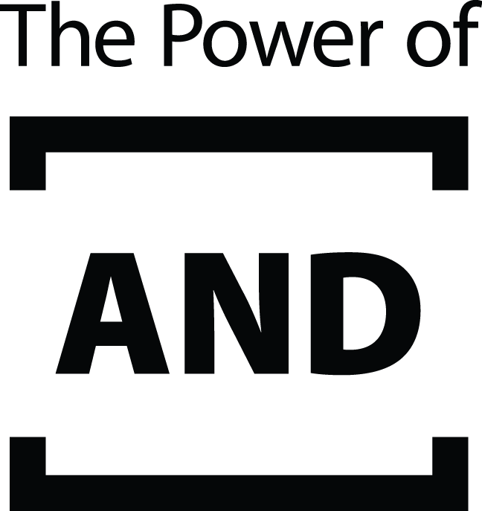

b
Motivated Numeracy:
How People Interpret Statistics about Gender Differences
Rian Drexler, Keith Jorgensen, and Katie Paulich  Faculty Mentor: April Bleske-Rechek
Department of Psychology  University of Wisconsin-Eau Claire
Background
Method
Discussion
Numeric problems, like those shown in the 2x2 matrices to the right, require people to calculate two proportions and then compare the proportions in order to get the correct answer. In general, thinking in terms of proportions and probabilities tends to be difficult for people, so problems that require calculation and comparison of two proportions tend to be even more difficult. They often evoke an automatic, heuristic-based (“Type I”) – but incorrect – response that must be overridden in order to answer correctly.
Typically, people who score higher on general numeracy problems are better able to reason analytically, and override their Type I processing response, to get the correct response in these 2x2 matrices.¹
However, research has shown that when people interpret numbers on topics they have a strong bias about, their ideological bias can trump their ability to reason carefully about the data. ^{1, 2} That is, general numeracy abilities only predict people’s ability to inhibit their intuitive response to a 2x2 matrix problem when the actual correct answer fits their beliefs about how the world works.¹ In the current study, we investigate this phenomenon in the context of a 2x2 matrix with numbers about men’s and women’s preferred work-family roles.
Participants completed a general numeracy scale of 11 items.³ These items assess how well people 1) assess risk using percentages and proportions, 2) convert percentages to proportions, 3) convert proportions to percentages, and 4) convert probabilities to proportions. Sample items are shown below:
We designed this study to determine if people’s numeracy abilities predicted their ability to override their Type I, heuristic-based processing response and use analytical reasoning to get the correct response in 2x2 matrices problems. We specifically provided fabricated data about historically-prevalent patterns of gender differences (i.e., men prefer the breadwinner role while women prefer the homemaker role in the family).
In terms of general numeracy abilities, our participants (students at UWEC) performed better than what has been documented among educated, middle-aged adults.³ Over 25% of students answered all but 1 question correctly, and another 24% answered all 11 correctly.
In terms of the primary task, 64% of participants correctly answered the 2x2 matrix problem (62% of women and 71% of men). When it comes to considerations of liberal arts goals for quantitative literacy, we wonder: Is 64% good…or bad?
As expected, participants with higher general numeracy skills were also more likely to answer the 2x2 matrix problem correctly. Contrary to expectation, however, general numeracy helped regardless of whether or not the matrix was set up to reinforce historically-prevalent gender differences in work-family roles.
We initially asked participants to fill out a questionnaire to assess their attitudes about gender differences (i.e., they were asked how much they agreed with statements such as, “Some types of work are just not appropriate for women.”). We wanted to investigate if people with stronger gendered ideologies would have a more difficult time with the 2x2 matrix problem when it was set up in such a way that the heuristic-driven response coincided with the historically-prevalent pattern of gender differences. However, data were strongly skewed toward low-gendered ideology scores. In other words, the vast majority of participants were highly gender egalitarian. Because of the low variability in gender attitudes, we could not further investigate the issue.
In the future, we would like to study motivated numeracy in the context of mate preferences. Previous research has indicated persistent and cross cultural sex differences in prioritization of certain mate characteristics. For example, men tend to place more emphasis than women do on physical characteristics and outward appearance, whereas women tend to prioritize ambition and potential for financial success. We suspect that men and women might have a difficult time with the matrix task when the numbers that reflect the traits men and women differentially prioritize are set up in such a way that coincides with the automatic, heuristic-based response.
In the ACME PUBLISHING SWEEPSTAKES, the chance of winning a car is 1 in 1,000. What percent of tickets to ACME PUBLISHING SWEEPSTAKES win a car? (Answer: .1%)
If the chance of getting a disease is 10%, how many people our of 1000 would be expected to get the disease?
(Answer: 100)
If the chance of getting a disease is 20 out of 100, this would be the same as having a ____% chance of getting the disease.
(Answer: 20)
Then, participants were given the following information:
Imagine that you are a researcher interested in men’s and women’s plans for balancing work and family. You know that some people lean toward prioritizing their career, some people lean toward prioritizing their family and career equally, and some people lean toward prioritizing their family. To understand people’s views, you conduct a study. In this study, you ask men and women to report which one they would choose if they were forced to choose just one option: would they be the breadwinner of their household or the homemaker of their household? In the table below, the number of men who chose each option is recorded and the number of women who chose each option is recorded. The total number of men and women in the study is not exactly the same, but this does not prevent assessment of the results.
Participants were presented with one of four possible versions of this 2x2 matrix.
 | Breadwinner | Homemaker
Men | 110 | 90
Women | 80 | 40
 | Homemaker | Breadwinner
Men | 110 | 90
Women | 80 | 40
Participants in these two conditions were then asked report the results of the study (order of options was counterbalanced):
Men were more likely to choose the breadwinner role than women were.
Men were more likely to choose the homemaker role than women were.
Intuitive response matches stereotypes
Intuitive response does not match stereotypes
Participants in the two conditions were then asked report the results of the study (order of options was counterbalanced):
Women were more likely to choose the breadwinner role than men were.
Women were more likely to choose the homemaker role than men were.
 | Homemaker | Breadwinner
Women | 110 | 90
Men | 80 | 40
 | Breadwinner | Homemaker
Women | 110 | 90
Men | 80 | 40
Hypotheses
Results
We predict that participants who answer the matrix problem correctly will score higher in general numeracy than will those who give the heuristic-driven, but incorrect answer to the matrix problem.
We predict that participants will be more likely to succumb to the Type I, heuristic-driven response (and hence less likely to come to the correct answer) when the heuristic-driven response matches the historically-prevalent pattern of gender differences (i.e., that men are more likely than women to choose the breadwinner role and women more likely than men to choose the homemaker role).
We predict that the link between general numeracy and success with the matrix problem will only occur when the matrix problem is set up so that a heuristic-driven interpretation of the numbers goes against the historically-prevalent pattern of gender differences (i.e., that men are more likely than women to choose the breadwinner role and women more likely than men to choose the homemaker role).
1. Students’ performance on the general numeracy scale was impressive, at least compared to reasonably educated community samples.³ The typical student answered 9 of 11 questions correctly, with 24% of the sample answering all 11 correctly. In confirmation of our first prediction, general numeracy was tied to performance on the 2x2 matrix task: those who answered it correctly had higher general numeracy scores than those who answered incorrectly.
Percentage of Participants
2. Our second prediction was that participants would be more likely to succumb to the Type I, heuristic-driven response (and hence less likely to come to the correct answer) when the heuristic-driven response matched the historically-prevalent pattern of gender differences. This prediction was not confirmed. A similar percentage of participants answered the matrix question correctly, regardless of whether the presentation of the data matched historic sex differences and stereotypes about work-family roles (i.e., breadwinner and homemaker roles).
Performance on the 2x2 Matrix Task
Participants
Participants were recruited from high-traffic areas around the UWEC campus; they completed the 10-minute questionnaire voluntarily.
A total of 319 UWEC students (231 women, 81 men, 7 no answer/other; M_{age} = 20.61 yrs; SEM = .20 yrs.) participated.
3. Our third prediction was that the link between general numeracy and success with the matrix problem would only occur when the matrix problem is set up so a heuristic-driven interpretation of the numbers goes against the historically-prevalent pattern of gender differences. We did not find support for this prediction. General numeracy was tied to better performance on the task, regardless of the setup of the task.
References
Acknowledgements
1. Kahan, D. M., Peters, E., Dawson, E. C., & Slovic, P. (2017). Motivated numeracy and enlightened self-government. Behavioural Public Policy, 1, 54-86.
2. Lewandowsky, S., & Oberauer, K. (2016). Motivated rejection of science. Current Directions in Psychological Science, 25, 217-222.
3. Lipkus, I. M., Samsa, G., Rimer, B. K. (2001). General performance on a numeracy scale among high educated samples. Medical Decision Making, 21, 37-44.
This research is supported by the Office of Research and Sponsored Programs at UWEC. We thank LTS for printing this poster, the many students across campus who participated in this research, and the faculty and staff who invited us into their classrooms for student participation: Dr. Jonathan Rylander, Dr. Stephanie Turner, Dr. Daniel Janik, and Dr. Stacy Thompson.

