Slide 1
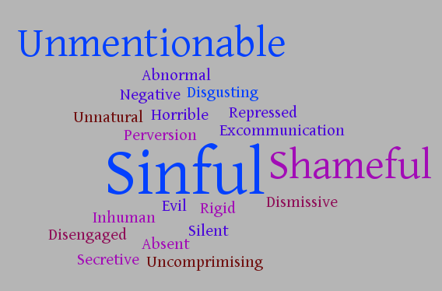
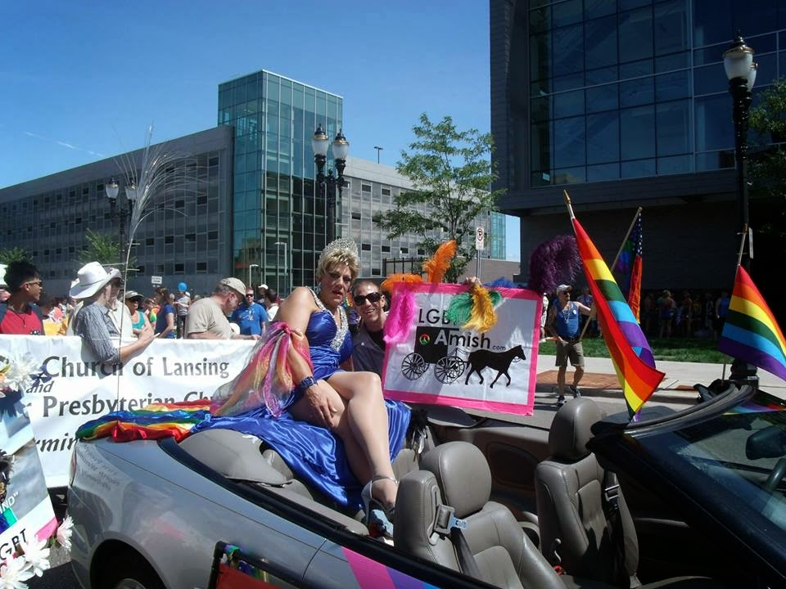
Gender & Sexuality Among Anabaptists
Hunter Herlitzke & Joshua Brown | Languages Department | Email: Herlithd3045@uwec.edu
Background
Qualitative Results
Critical Questions Answered
Adjectives associated with participants experience
Q1. Gender and sexuality in general are not expressed in the Amish communities. Everyone is assumed to marry the opposite gender, have children, and have a home within the community. They have also rarely been mentioned in scholarly literature. In the book “Stumbling Toward a Genuine Conversation on Homosexuality”, Norman Kraus, a Mennonite, makes a true yet abrasive claim. “It might be argued that it would be best if they just settled for a queer church like the blacks once settled for a black church. But the GLBTs insist on using words like inclusive and continue to entreat, almost wheedle, the denominations for recognition” (Kraus). This shows that they recognize the LGBTQ community of Amish and Mennonites out there, but it is not necessarily a warm welcome.
In June 2014, a group of Lesbian, Gay, Bisexual, Transgender, Queer-identifying ex-Amish individuals rode on a float with Miss Kalamazoo Pride LaDonna Divine in Michigan’s Pride Parade. This event was the first and only public gathering of LGBTQ Amish in the history of the nearly 500-year-old religion. The life stories of these individuals has been largely ignored and under-researched.
Amish settlements range from more liberal communities to more conservative. In liberal communities the Amish may have running water in their houses, use cellphones, or even use solar power. In conservative communities they may not even have running water or anything. But one thing they both have in common is that they do not sanction homosexuality. They barely even talk about sexual intercourse between a man and a woman.
When we emailed the Qualtrics survey one of the questions was “Write three adjectives to describe your childhood congregation's attitude toward homosexuality” This question sought to answer the critical question of “What are the experiences of LGBTQ ex-Amish and conservative Mennonites”.
“Though I always knew I was gay, I never considered it an option to come out. The fear of rejection and perceived loss of faith family and community kept me deeply repressed” -14A
Q2. The overall experiences of Amish and Mennonites are negative. Granted some did say they ended up finding their true sexuality or gender identity and believed it was god’s plan for them. Most faced ridicule and expulsion from their community while others ended up completely abandoned and left behind.
“Two gender sexuality was assumed, not discussed. Any same sex activity was categorized as a perversion of gender role, not a real orientation.” – 9A
The Purpose
“Hurt. I hid for years. I still struggle with shame and fully expressing my sexuality, even with my spouse. I feel I lost years of living my true self.” – 3A
Q3. One of the more common themes among these individuals is internalized homophobia and repression of identity. This is a sad unhealthy reality that most of these individuals are facing. Usually facing these challenges alone, and rejected by their close knit community.
The purpose of this research was to seek the answer to three critical questions. They are as follows:
Q1. How are gender and sexuality expressed in Amish society and how have they been discussed thus far in the scholarly literature?
Q2. What are the experiences of LGBTQ ex-Amish and conservative Mennonites?
Q3. How have their religious backgrounds impacted their expressions of sexuality?
“I strongly, strongly believe that God has led me to this beautiful place in my life. I believe that God was at work through all of the messy, painful, beautiful process that helped me to discover this about myself.” -7A
How has this affected their sexuality?
James Schwartz (ex-Amish) and LaDonna Divine (Ms. Kalamazoo) ride on a float in the Lansing, Michigan gay pride parade
When reading the accounts of many different Amish and Mennonites we needed to ask ourselves how their previous religious life has affected their current state. In general, most folks found difficulty moving on with their lives. Some sought different churches while others abandoned religion completely. With their sexuality some embraced it and ran away where as others fretted upon it and affected their work, social, and love life. Overall, one is not easily able to leave a tight knit and religiously strict community without having repercussions later in their life.
Method
We used several methods to collect the data we have.
Questionnaire; Used a Qualtrics survey to distribute to ex-Amish. Some come from a more conservative background and some come from a liberal background. Most are from the Midwest with a couple from Canada. They vary in age with the youngest being 25 to the oldest being 79.
Written Narratives; Found support group websites with stories from ex-Amish
Literature; Found limited information of written pieces of LGBTQ Amish
“All of our sexual identities were repressed by the closeness and consanguinity of the community and by our religion. In this sense, we all developed sexually-challenged identities. Sex and sexual identity are concepts generally confronted away from the community, perhaps at university, if at all.” - 10A
This statement shows the pain such a tight knit community can have on someone years after they leave
References
Kraus, C. Norman. "Pandora's Box or Fibber Magee's Closet." In Stumbling toward a Genuine Conversation on Homosexuality, edited by Michael A. King. Telford, PA: Cascadia Press, 2007.
Schwartz, James. "Michigan Pride 2014." http://literaryparty.blogspot.de/2014/08/.
Procedure
The questionnaire was distributed via email to a contact list of ex-Amish. After it was distributed we found online support groups with personal stories of ex-Amish that identify as LGBTQ. Each respondent to either the questionnaire or personal narratives were given a unique identifier and the stories were edited to convey the most important information.
More damagingly, this can cause internal hatred and homophobia
“Oh, it definitely hurt. The internal homophobia, or lack of empowerment over my own thoughts and body,... was a hellish experience.” -4A
Acknowledgments
We would like to thank the Office of Research and Sponsored Programs (ORSP) for supporting this study, as well as the Learning and Technology Services (LTS) for printing this poster.

