Slide 1

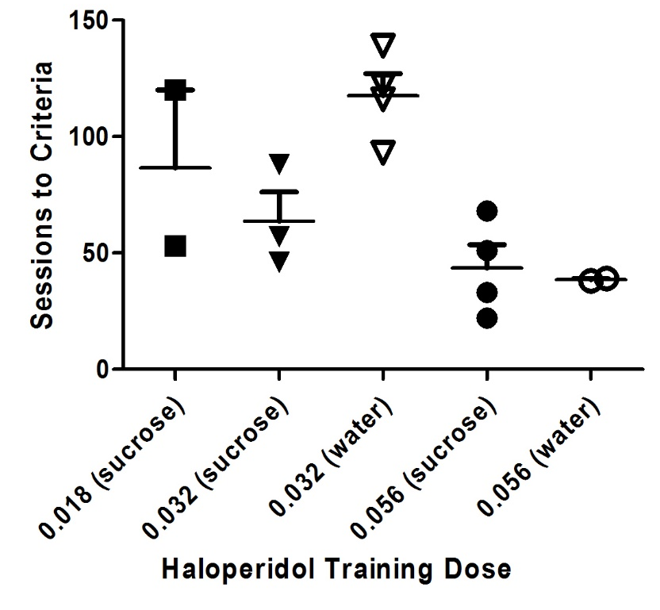
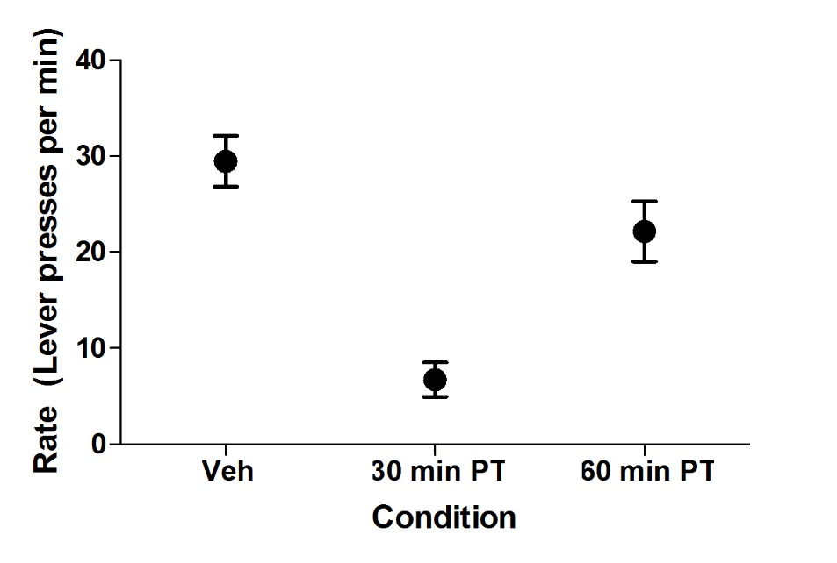
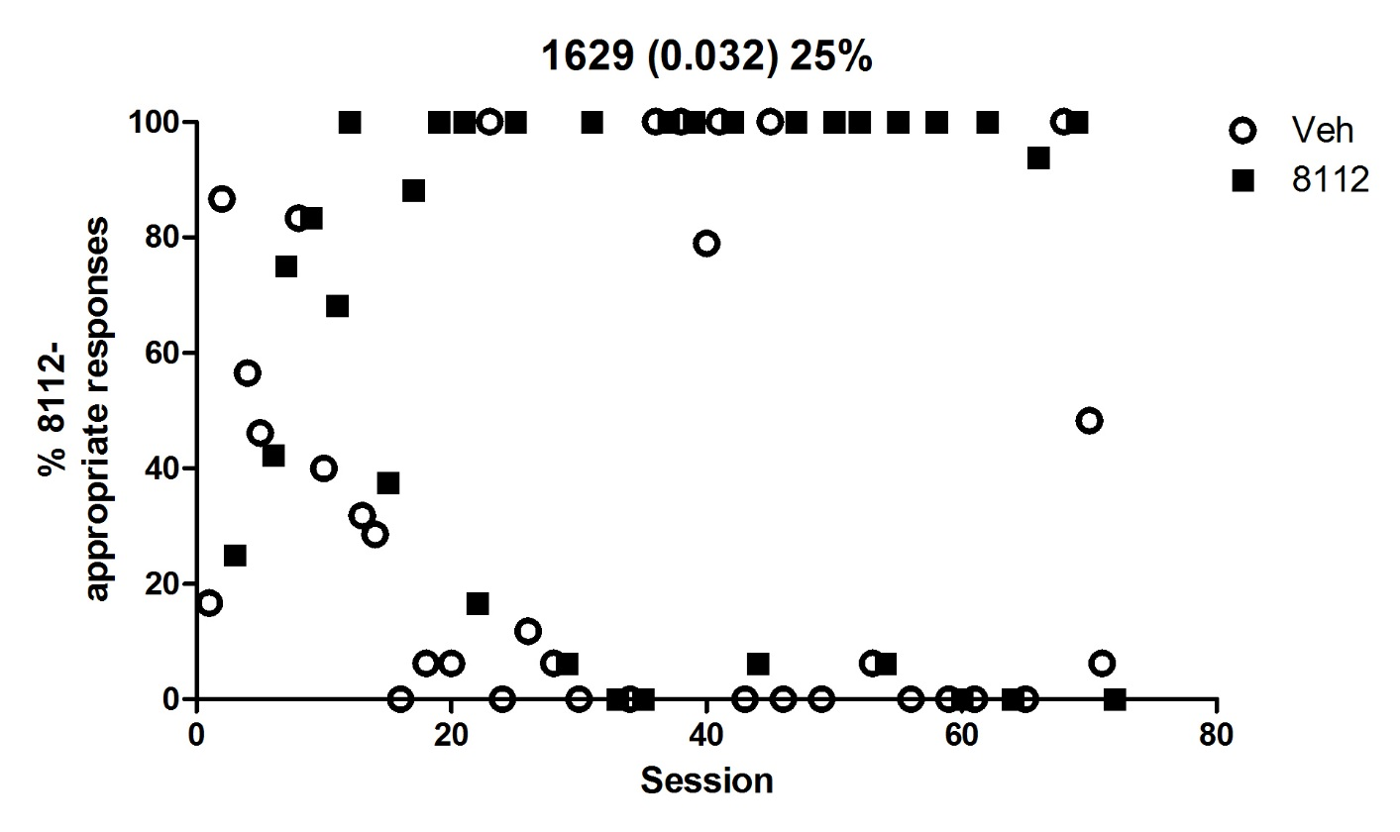
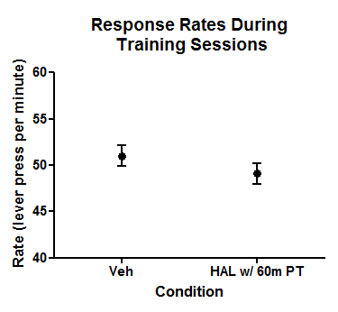
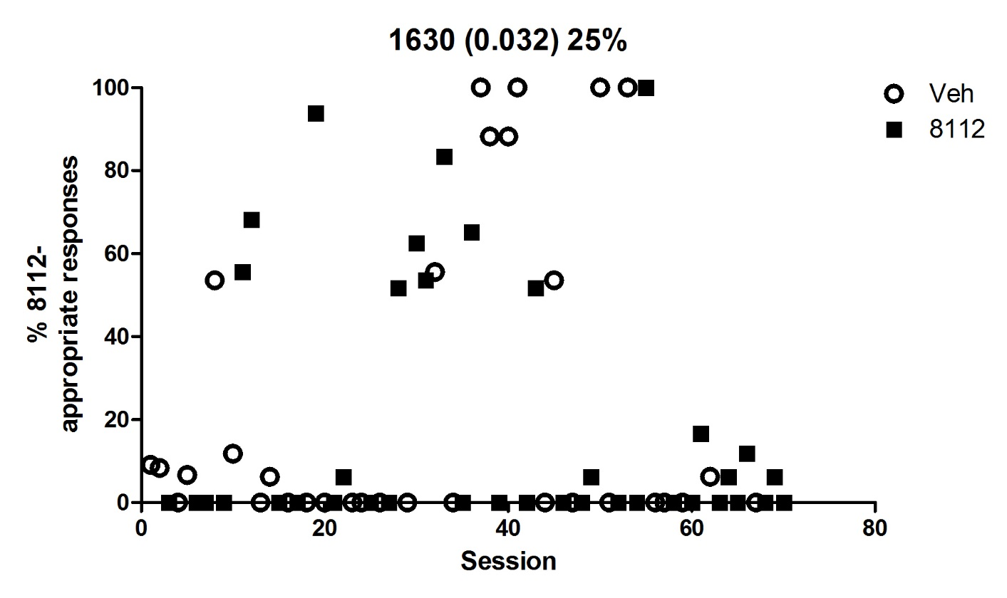
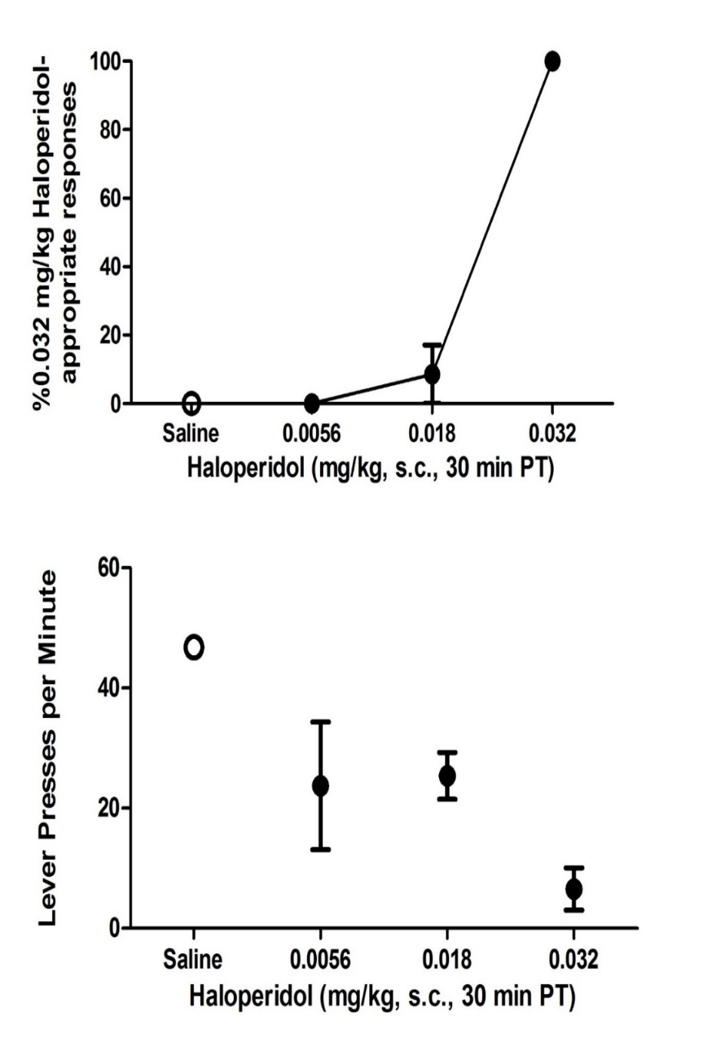
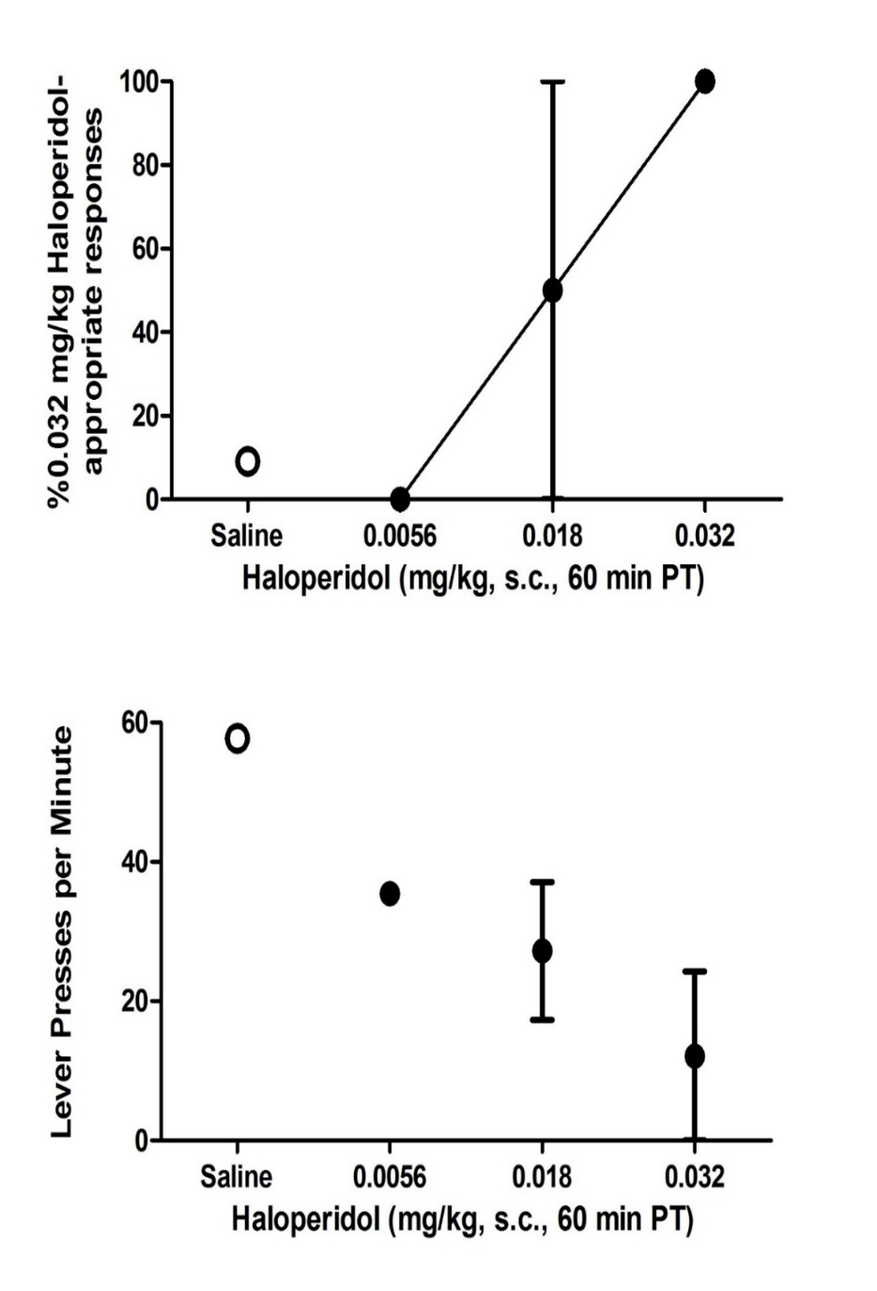
The Impact of Pretreatment Time on the Ability to Discriminate Haloperidol from Saline in Rats with Chronic Sucrose Access
SCHULZ, E., BRANDT L., BARTON, A., MAREK, M., ROTHBAUER, D., TRYHUS, A., GORRES, K.,
& JEWETT, D.
University of Wisconsin – Eau Claire | Psychology
Introduction
Subjects Discriminate Larger Training Doses of Haloperidol in Fewer Sessions
Rate Suppression
Discussion
Previous research has shown an increase in dopamine (DA) functioning following chronic, intermittent sucrose consumption.
Similar to O’Donnell’s (1989) findings, 0.056 mg/kg HAL resulted in rate suppression. Rate suppression may impact the discrimination acquisition by decreasing the number of completed training sessions.
To address this, we decreased the training dose to 0.032 mg/kg HAL, but rate suppression persisted.
PT was then increased from 30 minutes to 60 minutes. Training session rates increased significantly under 60 minute PT (M = 19.46) compared to 30 minute PT (M = 5.07) (p = .019), but rate suppression persisted slightly compared to the vehicle condition (M = 27.32) (p < .001) (Figure D below).
Haloperidol
Subjects acquired discrimination in fewer sessions (M = 42) at a larger TD. TD’s were decreased to 0.032 mg/kg and discrimination took longer to acquire (M = 128).
All subjects (n = 4) with sucrose access that were initially trained on 0.056 mg/kg HAL acquired the discrimination in fewer sessions (M = 38.5) than McElroy (1989) (M = 45). However, this dose led to rate suppression, hindering performance during training sessions. Fewer subjects (2 of 6) maintained under 24-hour water access acquired the discrimination.
At a smaller dose (0.018 mg/kg) the rate suppressing effects of HAL are minimal, but subjects were unable to acquire the discrimination.
Increasing the pretreatment time to 60 minutes significantly increased rate of lever pressing (Figure D). This could imply that some effects of HAL are less intense 60 minutes after the drug is injected, but other effects are still discriminable.
Haloperidol
McElroy (1989) was able to train rats to discriminate haloperidol (HAL; a D₂ antagonist; 0.05 mg/kg i.p.) in a mean of 45 training sessions. This discrimination was established without chronic sucrose consumption.
Since chronic, intermittent sucrose consumption increases DA function, we were led to believe that the consumption could cause the discrimination to be acquired more quickly.
A
Response Rate During Training Sessions
Method
X axis represents the number of subjects that acquired the discrimination, out of the total subjects training under that condition (Y).
(Sucrose) = 12-hour sucrose access
(Water) = 24-hour water access
CURRENT WORK
Due to issues with the HAL study, we have chosen to focus on training a discrimination between 1.0 mg/kg naltrexone and saline.
Male rats, maintained on 12-hour light/dark cycle, had either 12-hour sucrose/water access or 24-hour water access. Sucrose access began at the start of the dark cycle.
After one hour of sucrose access, subjects were subcutaneously injected with either haloperidol (HAL) or vehicle. Thirty minutes* later, discrimination training began.
Subjects were trained to discriminate between HAL (0.056 mg/kg or 0.018 mg/kg) and vehicle. After HAL injections, left lever responses were reinforced. Right lever presses were punished with 8 seconds of darkness. After vehicle injections, response contingencies were reversed. Each session continued until the subjects earned 10 reinforcers, or 30 minutes elapsed.
Rats were then returned to their home cage and sucrose access was continued for the remainder of the 12-hour period. Discrimination training continued until > 80% of the subject’s responses were correct for 8 out of the previous 10 training days.
After discrimination was acquired, generalization testing began. A single dose of HAL was administered 30 or 60 minutes before the test session. Testing ran until the subjects earned 10 reinforcers or 30 minutes elapsed. Subjects were required to meet discrimination criteria during at least two consecutive training sessions (one of each, vehicle and drug) before the next test session.
*In later sessions, PT was increased to 60 min.
Subject who Reacquired the Discrimination
RESULTS
Training session rates were not significantly different between HAL (M = 49.08) and the vehicle (M = 51.01) (p > 0.05), Figure G.
Five subjects with sucrose access reacquired the discrimination (M = 62). None of the subjects with water access reacquired. The subjects had 74 sessions in total.
Vehicle
D
30 min vs 60 min Pretreatment
Five out of 8 subjects training at 0.032 mg/kg HAL with access to sucrose solutions reacquired the discrimination between HAL and the vehicle following the change to 60 minute PT (M = 62). However, none of the 24-hour water subjects have reacquired the discrimination after 74 training sessions.
There were no significant changes in generalization results or response rates between a 30 minute PT and a 60 min PT (Figures E, F)
Response Rates During Training Session with 60 Minute Pretreatment Time
B
B
Subject who Did Not Reacquire the Discrimination
HAL 0.032 mg/kg
G
Vehicle
G
Results
Haloperidol
Acknowledgements:
Subjects with access to sucrose were able to acquire the discrimination in fewer sessions, whereas 24-hour water subjects either took longer to acquire the discrimination or failed to acquire (Figure A).
The University of Wisconsin-Eau Claire Summer Research Experiences for Undergraduates Grant
The University of Wisconsin-Eau Claire Faculty Sabbatical Leave Program
The University of Wisconsin-Eau Claire Research and Creative Activity Grant
Student Differential Tuition through the University of Wisconsin- Eau Claire’s Student Travel for the Presentation of Research Results Program
Minnesota Obesity Center
C
C
E
F

