Slide 1
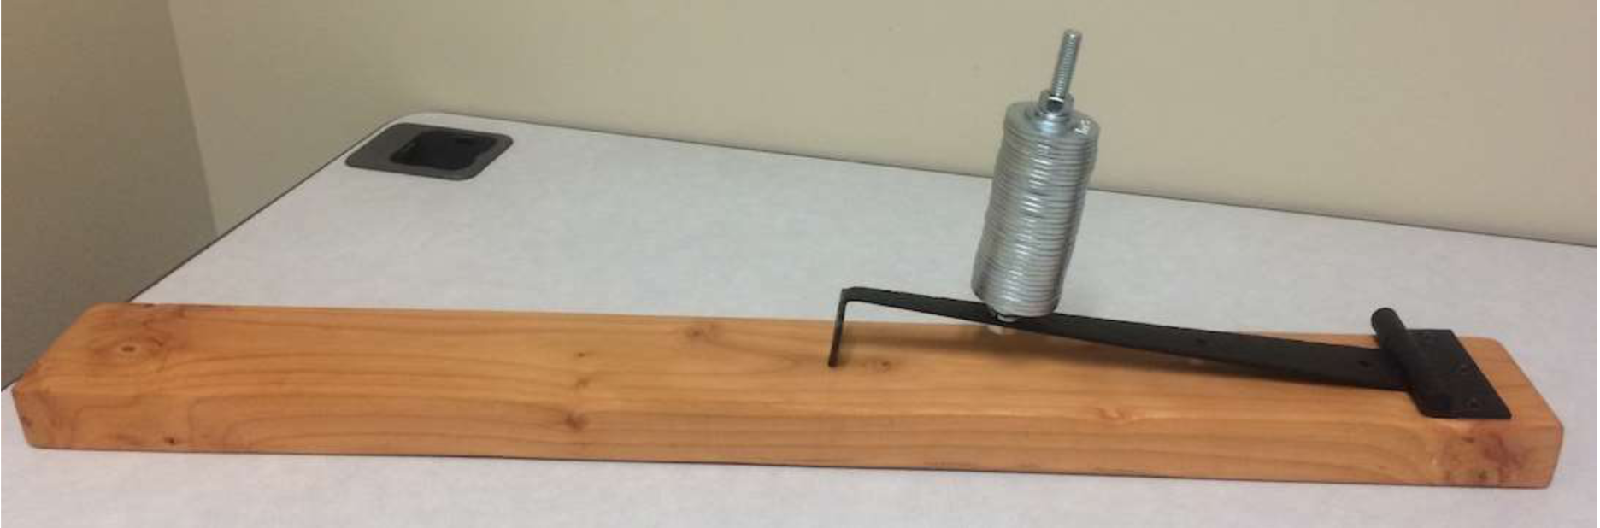
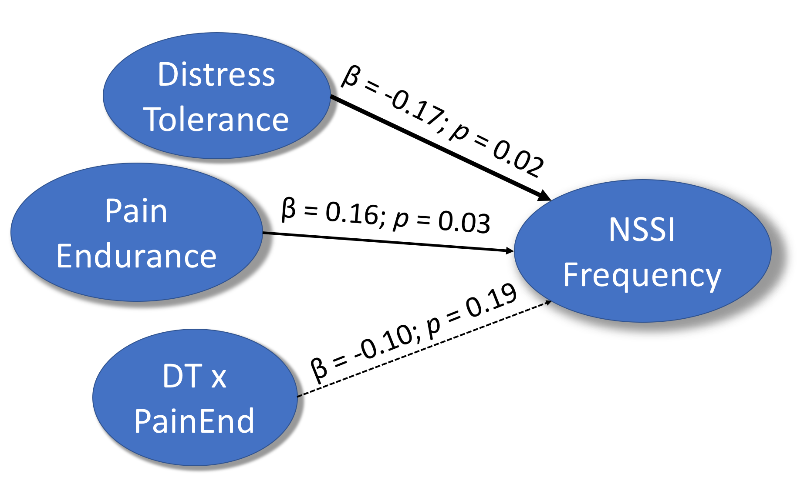
The Interaction of Distress Tolerance and Pain on the Frequency of Non-Suicidal Self Injury
Sparc Research Lab
Hadorn-Papke. D. J., Dortch, D. D., Faledas, B., Hagan, C. R. & Muehlenkamp, J. J. | Department of Psychology
Introduction
Procedures
Discussion
What is NSSI?
Undergraduate students recruited through SONA, from throughout the university, came into the lab and completed self-report measures on a computer in a private room. In between two sets of surveys, they completed the pain assessment. Participants were compensated with course credit.
Supporting Hypothesis I, there is a significant, but weak negative correlation between lifetime NSSI frequency and distress tolerance. This indicates that if an individual has low distress tolerance, they may have a higher frequency of NSSI.
Hypothesis II – We found significant main effects for both distress tolerance and pain endurance on lifetime NSSI frequency. This indicates that individuals with lower distress tolerance and higher pain endurance may have a higher frequency of NSSI.
The data did not support our hypothesized interaction between DT and PE on frequency of NSSI. This means that DT and PE explained a significant proportion NSSI frequency when analyzed independently; however, the interaction between DT and PE did not significantly increase the explained proportion of variance in NSSI frequency. This may be because there are many variables involved in NSSI. While both DT & PE are relevant to NSSI frequency, their co-occurrence does not appear to uniquely alter risk for NSSI.
Non-suicidal self-injury (NSSI) is the intentional damage to bodily tissues without intentions to die, independent of medically and socially approved procedures (piercing, surgeries).
Assessments
Many things contribute to NSSI behavior, one of which is low distress tolerance (DT). DT has been postulated as a foundation to NSSI. Multiple studies have linked NSSI with low distress tolerance, suggesting that NSSI is used as a coping mechanism for stress (Lin, You, Wu, & Jiang, 2017; Peterson, Davis-Becker, & Fisher 2014; Anestis, Pennings, Lavender, Tull, Gratz, 2013).
In addition, NSSI has been suggested as a habituation to suicidal behavior by willingly exposing oneself to painful and distressing behaviors as a form of habituation (Law, Khazem, Jin & Anestis 2017). Habituation is the reduction of a response due to repetitive exposure. Individuals that use NSSI have been shown to increase in their pain endurance (PE) compared with control populations (Law et al., 2017; Glenn, Michel, Franklin, Hooley, & Nock 2013; Germain & Hooley, 2013).
We utilized the following measurements:
Distress Tolerance Scale
Pressure Pain Algometer
Self-Injurious Thoughts and Behaviors Interview (SITBI)
This algometer was used to measure pain threshold (when the participants first experiences pain) and pain tolerance (when they could no longer tolerate the pain). Pain endurance = (Pain tolerance – pain threshold). The tip of the metal hinge is placed between the first joint of the index finger on the non-dominate hand.
Things To Improve
Hypotheses
Results
Small number of individuals that engage in NSSI
Many of these individuals had only engaged in NSSI once in their life. Focusing on those who have engaged in NSSI more recently and more than once may yield more representative results to the relevant population.
We predict there will be a negative correlation between DT and NSSI frequency.
We expect individuals with low DT and high pain endurance will engage in more frequent NSSI.
Hypothesis I - Correlation
There was a significant but weak negative correlation between NSSI frequency and distress tolerance
r = -.15, p = 0.04
Further Research
Method and Materials
Hypothesis II - Regression
Habituation to stimuli tends to be short lived. For individuals who have engaged in NSSI more than a year ago, habituation to pain may decrease their subjective pain tolerance. If Instead of using lifelong NSSI, if we look at recent NSSI, we may see a change in pain endurance and a stronger correlation with NSSI frequency.
Demographics
193 undergrad students from a large Southern university participated
76.7% identified as female and 23.3% as male.
Average age was 19.2 years (SD=2.4)
85% of students reported to be Heterosexual only
148 Students (76.7%) reported no history of NSSI
References
Anestis, M. D., Penning, S. M., Lavender, J. M., Tull, M. T., & Gratz, K. L.,
(2013). Low distress tolerance as an indirect risk factor for suicidal behavior: Considering the explanatory role of non-suicidal self-injury. Comprehensive Psychiatry, 54, 996-1002.
Germain, S. A., & Hooley, J. M. (2013). Aberrant pain perception in direct and indirect non-suicidal self-injury: An empirical test of joiner’s interpersonal theory. Comprehensive Psychiatry, 54, 694-701.doi:https://doi.org/10.1016/j.comppsych.2012.12.029
Glenn, J. J., Michel, B. D., Franklin, J. C., Hooley, J. M., & Nock, M. K. (2014). Pain analgesia among adolescent self-injurers. Psychiatry Research, 220, 921-926. doi:http://dx.doi.org/10.1016/j.psychres.2014.08.016
Hagan, C. R. (2016). Hopelessness regarding thwarted belongingness and perceived burdensomeness: A test of the interpersonal theory of suicide. Florida State University, Tallahassee, Florida.
Law, K. C., Khazem, L. R., Jin, H. M., & Anestis, M. D. (2017). Non-suicidal self-injury and frequency of suicide attempts: The role of pain persistence. Journal of Affective Disorders, 209, 254-261. doi: http://dx.doi.org/10.1016/j.jad.2016.11.028
Lin, M., You, J., Wei Wu, Y., & Jiang, Y. (2017). Depression mediates the relationship between distress tolerance and nonsuicidal self-injury among adolescents: One-year follow-up. The American Association of uicidology, 1-12. doi:10.1111/sltb.12382
Peterson, C. M., Davis-Becker, K., & Fischer, S. (2014). Interactive role of depression, distress tolerance and negative urgency on non-suicidal self-injury. Personality and Mental Health, 8, 151-160. doi: 10.1002/pmh.1256
There was a significant, negative relationship between DT and NSSI and a significant, positive relationship between Pain endurance and NSSI; the interaction term was not significant.
F(2, 188) = 4.56, p = 0.012; R² = 0.046

