Slide 1
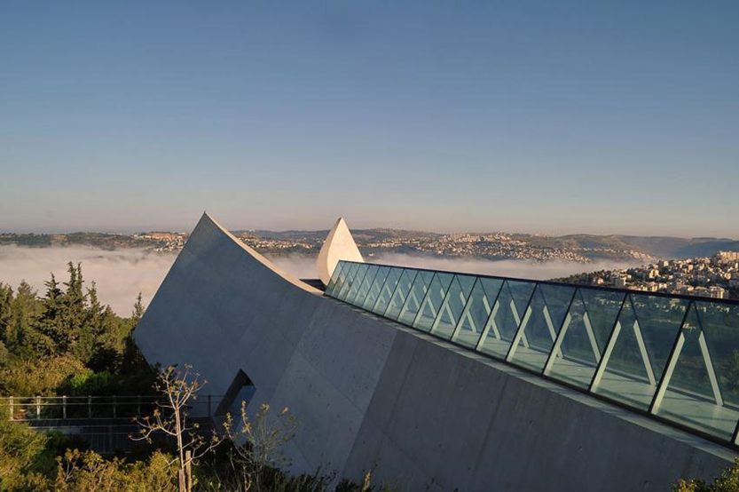
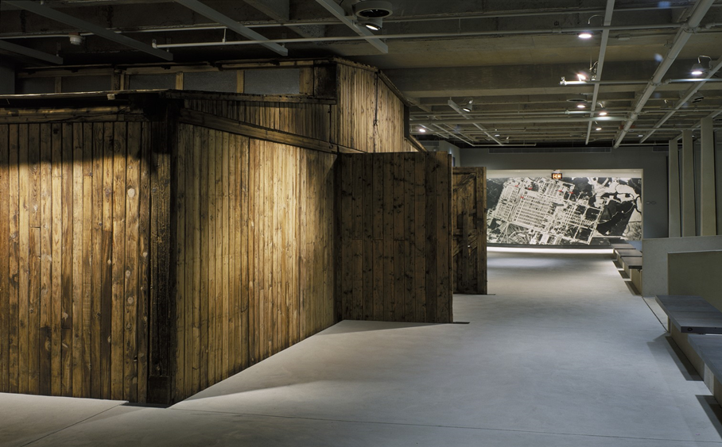
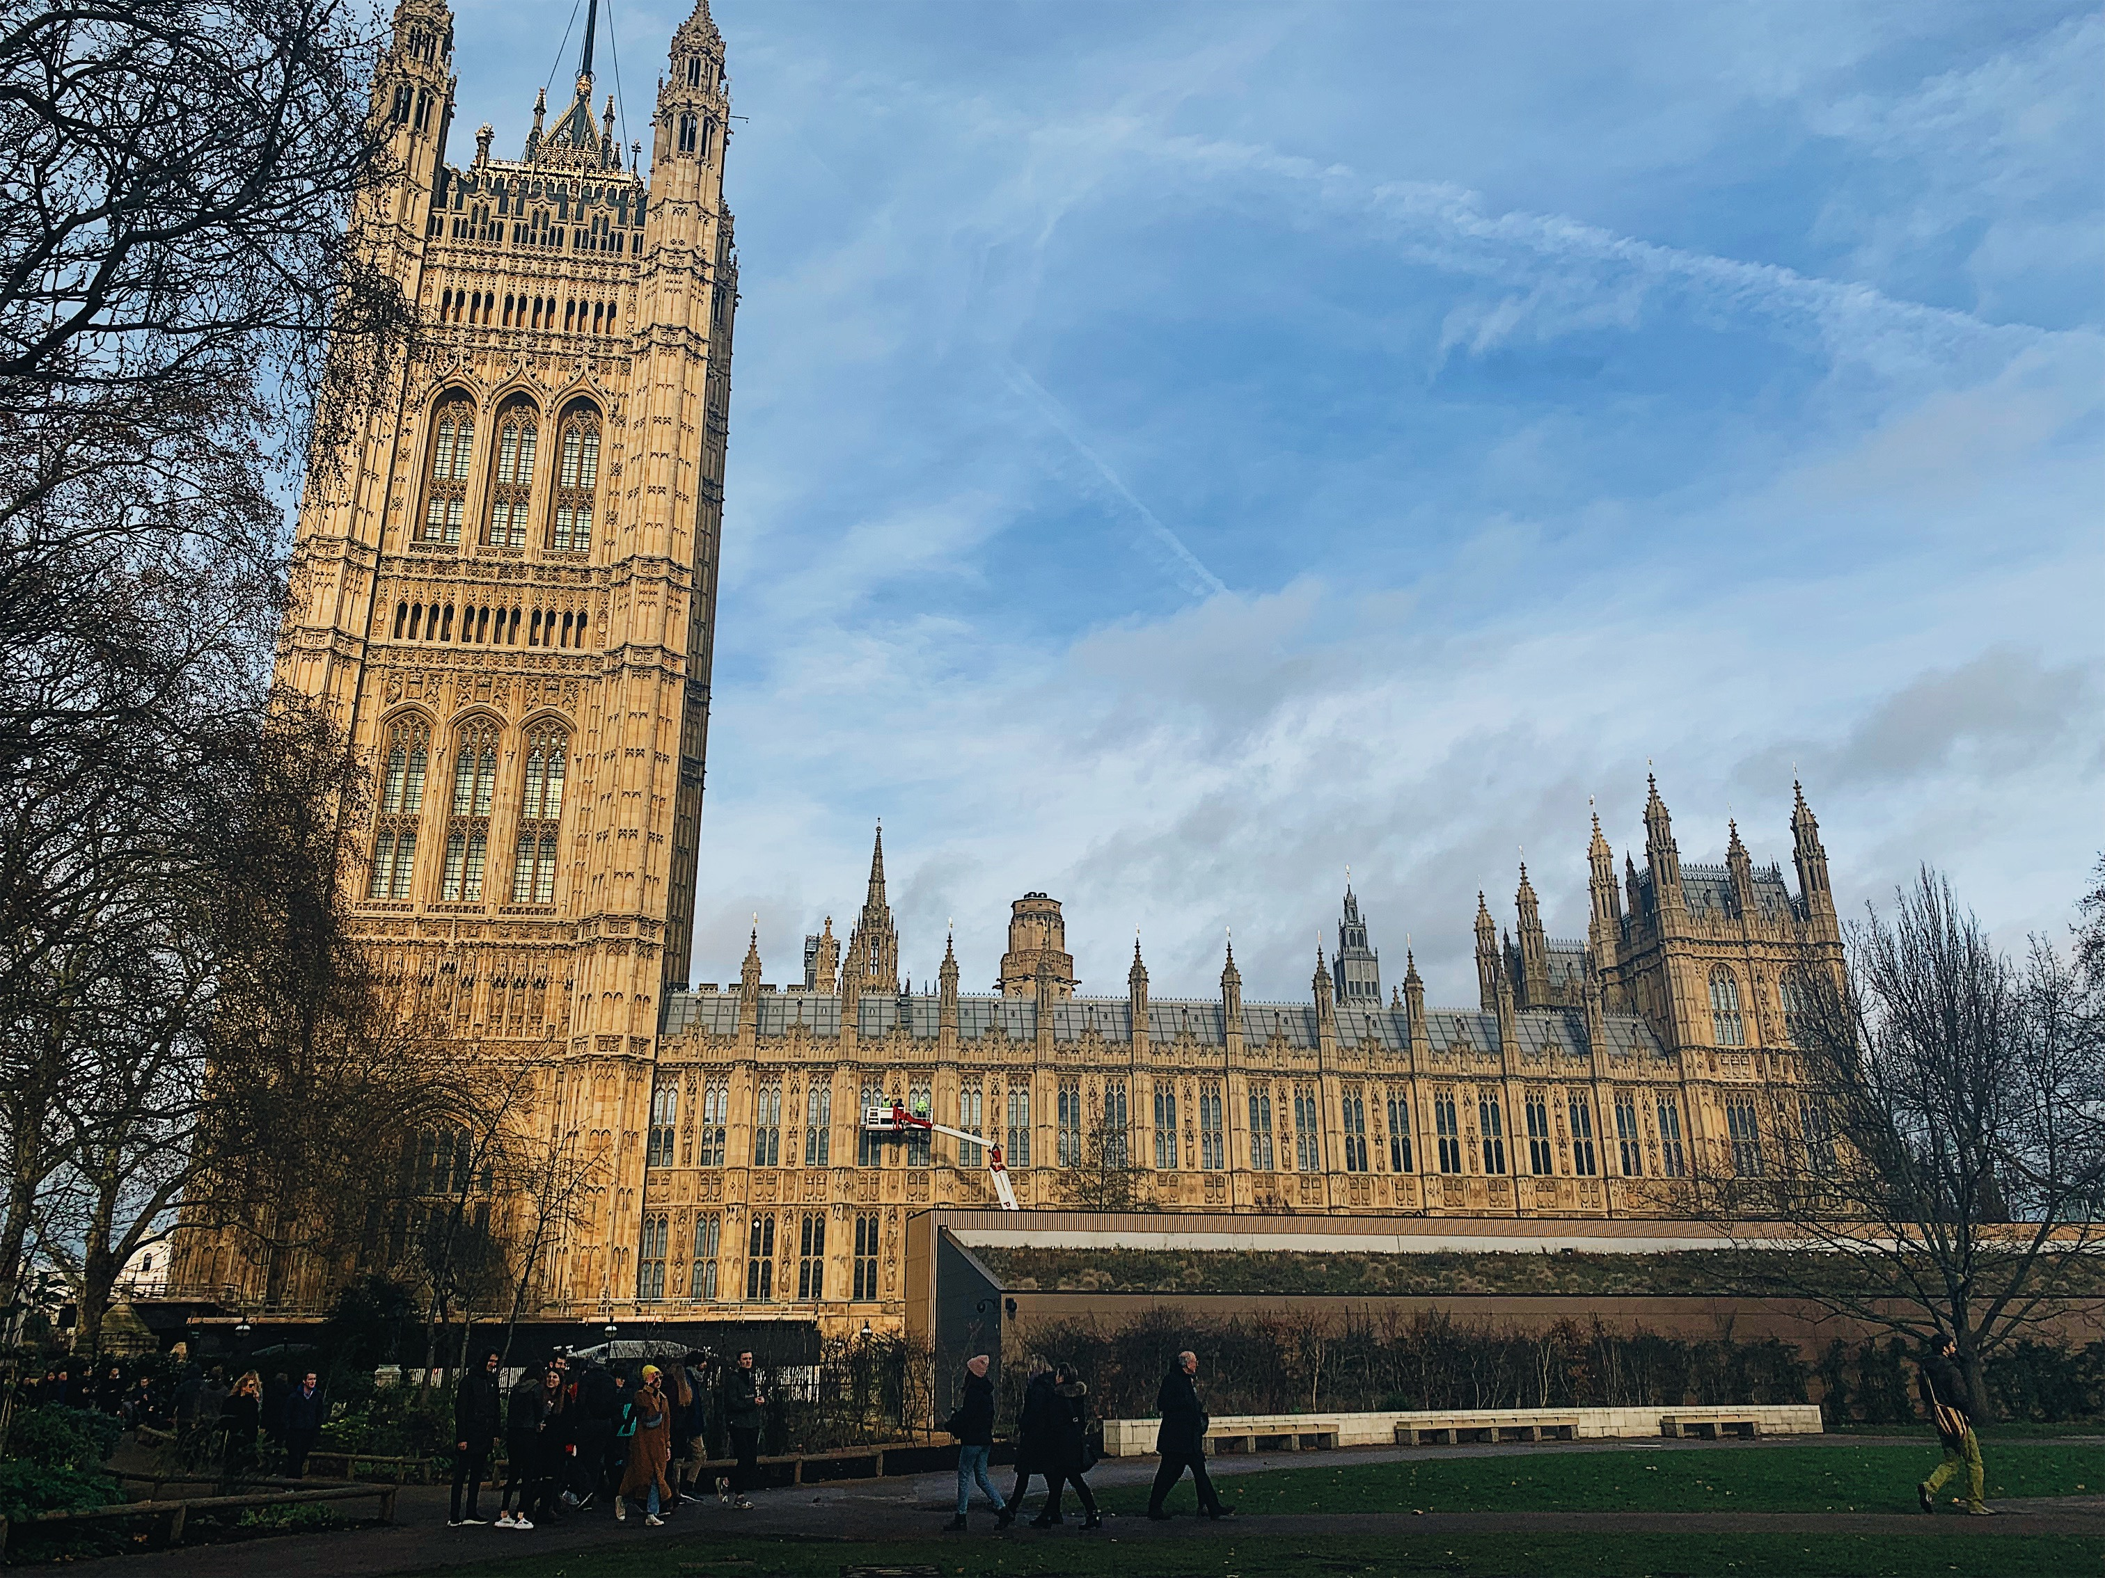
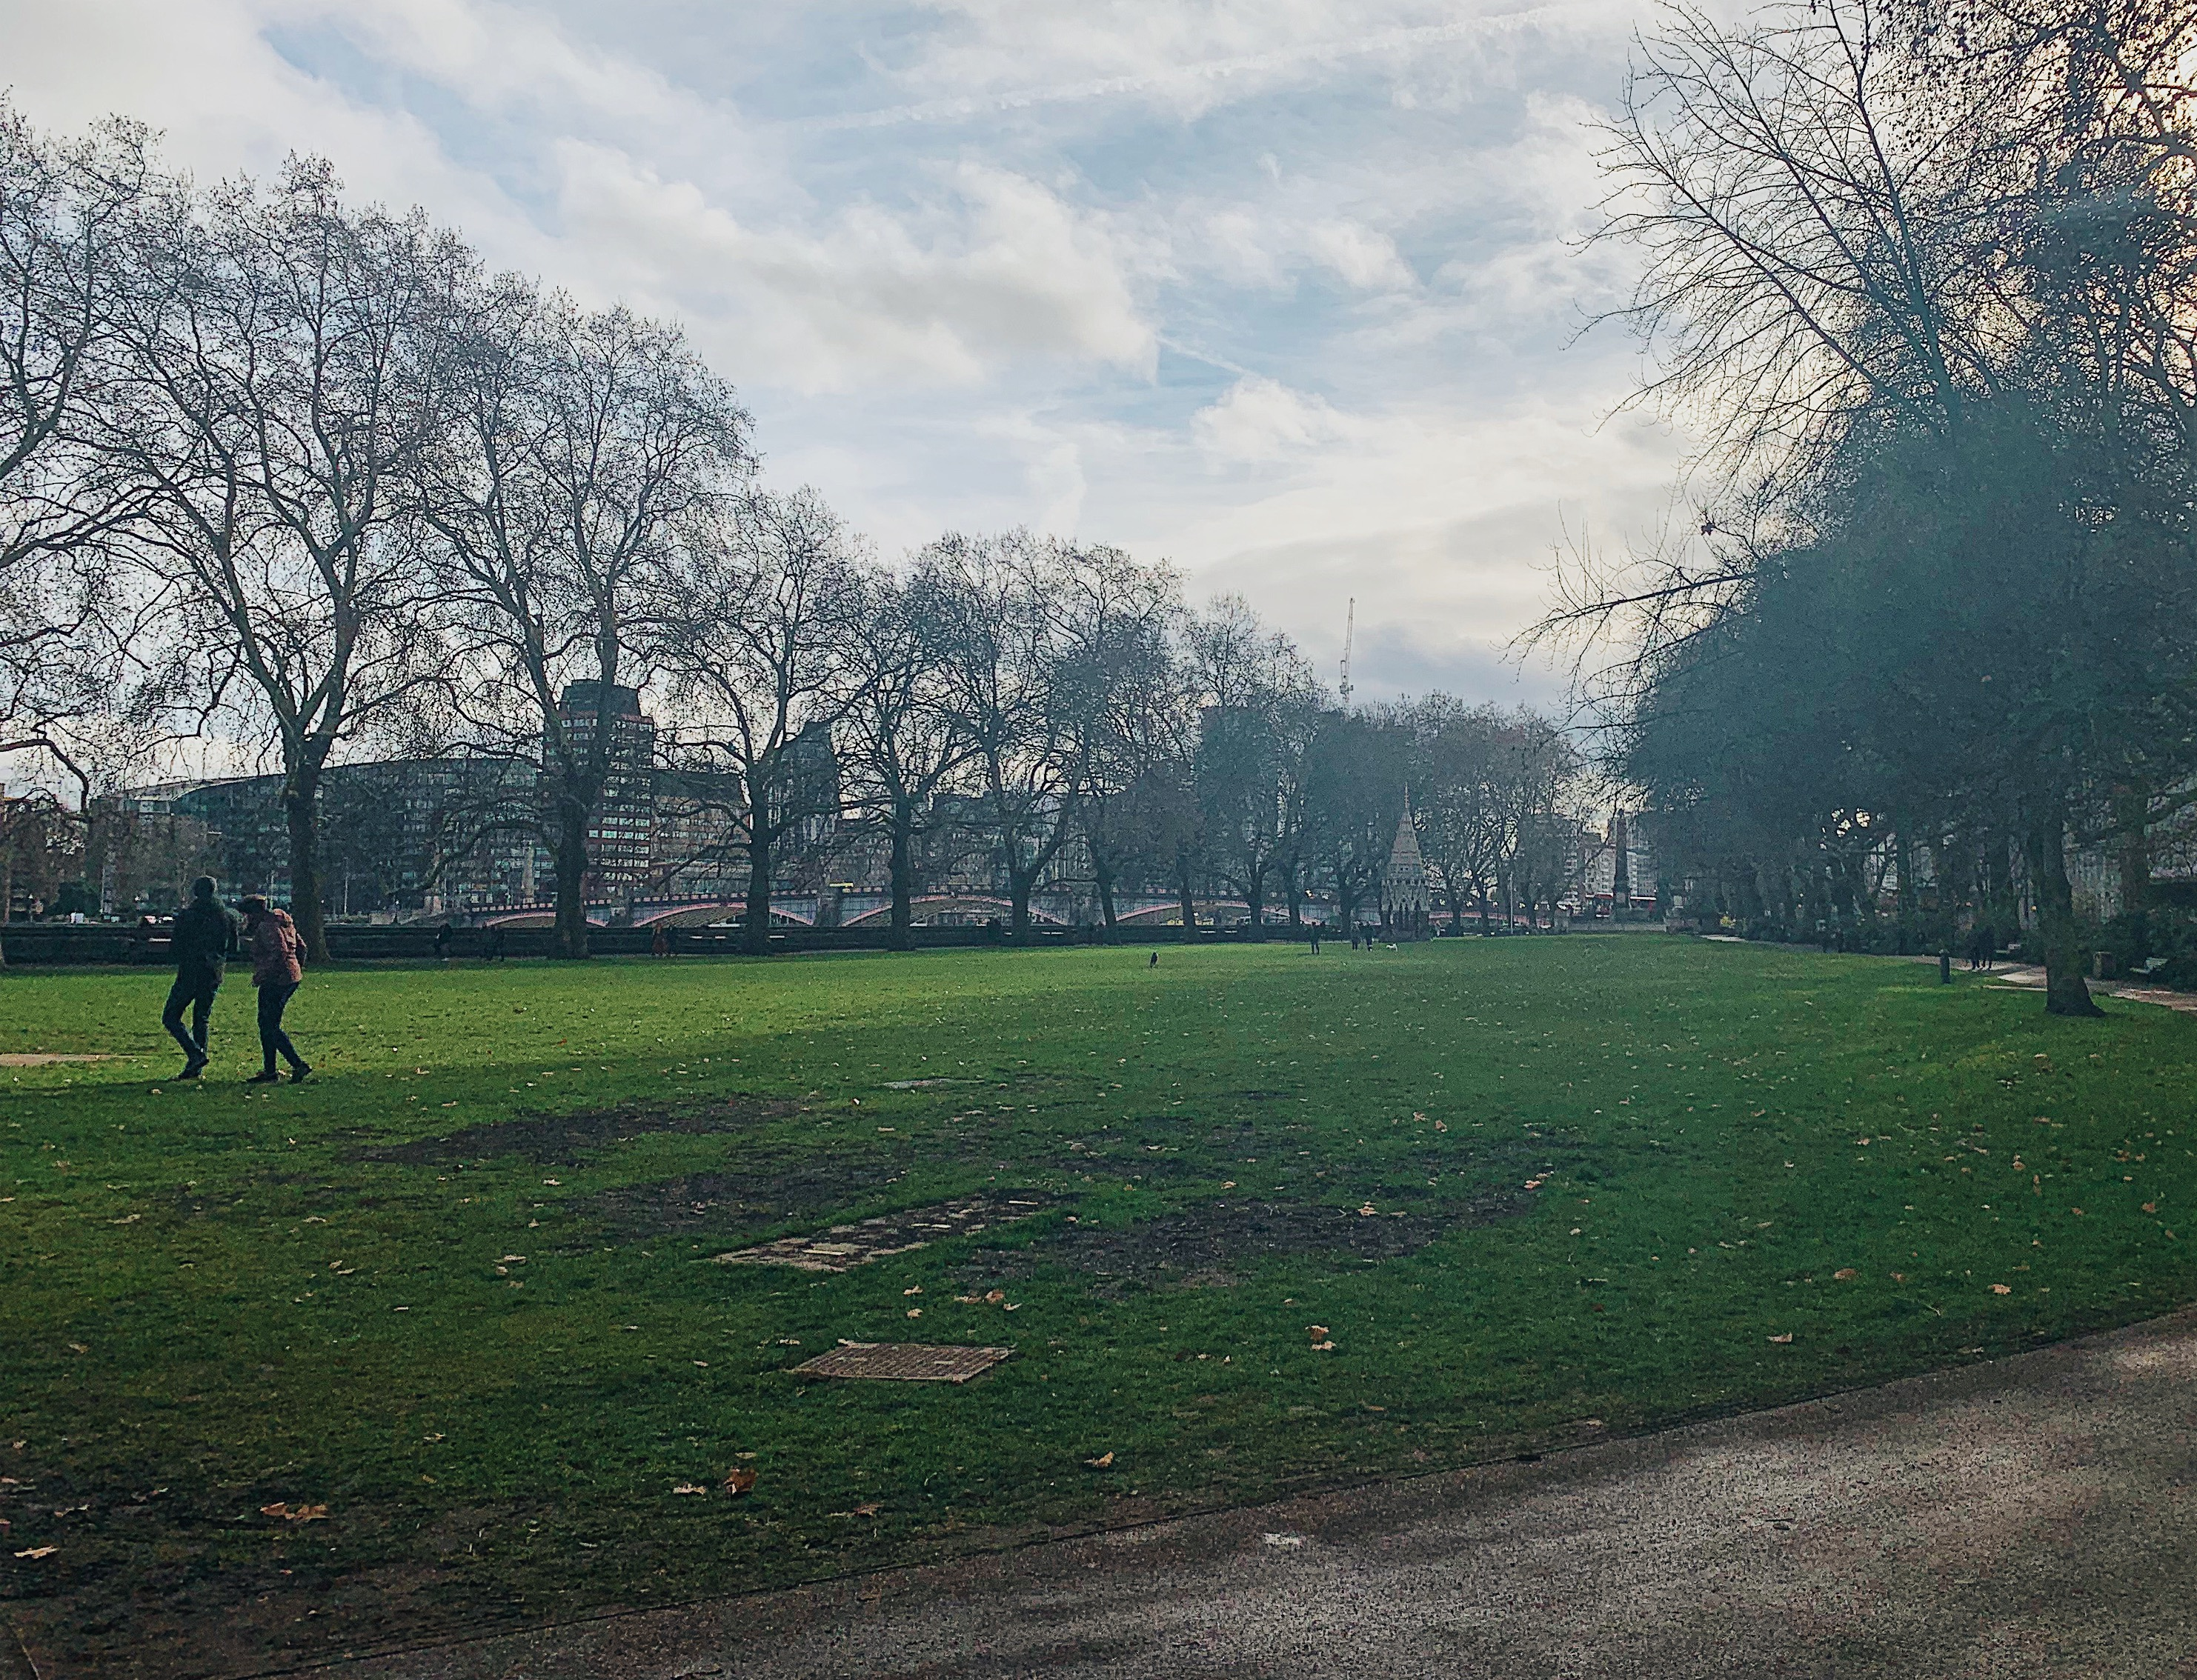
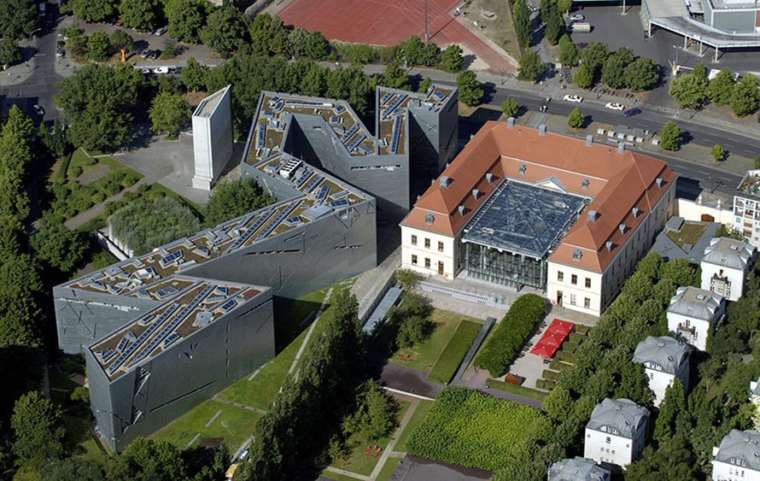
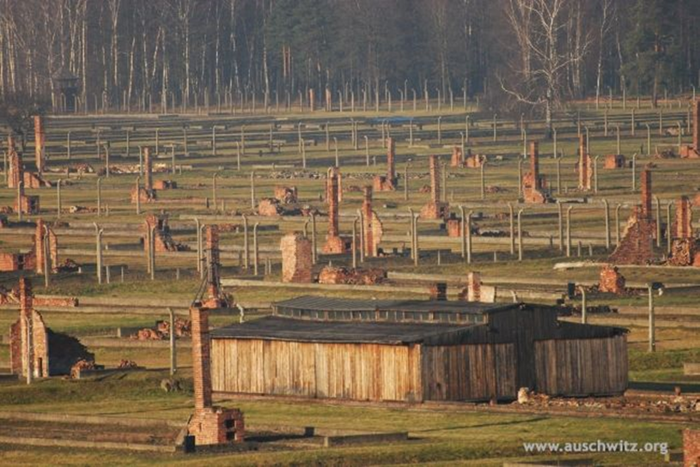
Holocaust Memory and Public History:
Examining Holocaust Museums from 1947-2001
Hannah M. Lahti | Teresa M. Sanislo, James W. Oberly
Abstract
YAD VASHEM WORLD HOLOCAUST REMEMBRANCE CENTER
SIGNIFICANCE
Holocaust museums and memorials are central features to Holocaust memory and education. The phrase “Never Again” continues to be a theme in Holocaust memory, which has led to support for Holocaust education. The Auschwitz-Birkenau Memorial and Museum, Yad Vashem World Holocaust Remembrance Center, United States Holocaust Memorial Museum (USHMM), and Jewish Museum Berlin (JMB) were established in different geographic locations and at different times since 1945. These museums are influenced by different factors, such as nationalism, religion, politics, and culture. Each museum teaches about the Holocaust similarly, but their unique exhibits are designed to evoke emotion and memory in different ways.
Public history allows historical content to be shared outside of a standard academic setting, encouraging the public to learn history outside of a classroom. For this reason, Holocaust museums have become some of the most important facilitators of Holocaust education. This study aims to examine the ways in which historical memory is reflected in four different Holocaust museums. Contextualizing and comparing these museums and their unique exhibits will further the understanding of Holocaust memory and representation over time and in different locations.
The Yad Vashem World Holocaust Remembrance Center was established in 1953 by the State of Israel with the passing of the Martyrs’ and Heroes Remembrance (Yad Vashem) Law 5713-1953. Like other Holocaust museums, Yad Vashem was to be a place of education and remembrance, but also a place of Jewish nationalism and religion.
Most Holocaust museums share common ideas surrounding how the Holocaust is to be remembered. Education, remembrance, research, and prevention of genocide remain the most consistent ideas among museums, however, the way in which the Holocaust is exhibited in museums has changed since the establishment of the Auschwitz-Birkenau Memorial and Museum in 1947. Holocaust museums continue to be established over seventy years after the liberation of the death camps.
Holocaust museums and memorials are not all alike, especially in how they choose to design their exhibits. Public historians work to provide educational and memorial exhibits in Holocaust museums, bearing in mind the violent and horrific history that they must portray. Museum visitors acquire Holocaust memory in museum spaces and at memorial sites, witnessing the photos, artifacts, historical documents, and film footage housed in those institutions.
In addition to the physical artifacts found in museum collections, Holocaust memory in museums often comes through the symbolism of art installations, exhibit layouts, and architecture. The memory is not fixed, and is shaped by the design of the exhibits, the historical narrative, and the artifacts displayed in the museums. It is important to form memory of the Holocaust and to understand the complexity and circumstances of memory, especially how that memory is shaped by public historians and museum visitors in Holocaust museums as the time approaches when there will be no survivors left to share their stories.
Holocaust History Museum at Yad Vashem.
The main museum of Yad Vashem, the Holocaust History Museum, is divided into exhibits that form a timeline of the Holocaust. While there are many artifacts and historic documents included in the exhibits, most of the Holocaust memory developed by the museum comes from symbolic architecture designed by Moshe Safdie. For example, at the end of the Holocaust History Museum is a platform surrounded by glass facing toward the hills of Jerusalem, symbolizing the emergence from darkness to the hope that life in Israel could offer.
While the Holocaust History Museum offers a chronological history of the Holocaust in exhibits, Yad Vashem also draws attention to the individual people and communities that were impacted by the Holocaust. The Hall of Names is the final exhibit in the Holocaust History Museum which includes a continually developed list with space for six million names of the Jews that died during the Holocaust. This is the memorial within the museum that focuses on the individual Jews that died.
Literature Reviewed
Public historians study Holocaust museums to understand how memory is shaped. Factors such as politics and religion can play a major role in how memory is exemplified in a museum. This includes how Holocaust museums change over time, whether it be in the context of shifting political ideologies in the geographical location, or how the additions of new exhibitions change the narrative of a museum.
In Oren Baruch Stier’s Committed to Memory: Cultural Mediations of the Holocaust, Stier analyzed the complexity of exhibiting the Holocaust in museums, particularly in terms of religion and culture. Stier argued that the use of symbolic artifacts in museums could memorialize exhibits and artifacts above Holocaust history. Michael Bernard-Donals expanded on this in “Synecdochic Memory at the United States Holocaust Memorial Museum.” He claimed that Holocaust history is often represented through metonymic memory; the use of an artifact to represent the larger history, whereas synecdochic memory is the representation of larger history to understand a specific idea.
Memory is not concrete, as was explained in “Representing Auschwitz,” where Sidra DeKoven Ezrahi asserted that representation of the Holocaust at Auschwitz was originally a memorial for victims of fascism, rather than to the specific memory of the six million Jews and other victims that died in the camp. As Pam R. Jenoff later added, the main issues surrounding the museum include the religious and ethnic ownership of the site and its history because many Poles recognize the camp as a site of national oppression, rather than “racial” oppression.
UNITED STATES HOLOCAUST MEMORIAL MUSEUM
“A New Holocaust Monument for London”
The United States Holocaust Memorial Museum (USHMM) was initiated in 1978 by President Jimmy Carter’s Executive Order 12093 - the President’s Commission on the Holocaust. In 1993, the USHMM opened with the intent of serving as a museum dedicated to the remembrance, research, and education of the Holocaust.
This study of Holocaust museums and memorials is continued in the project “A New Holocaust Monument for London,” in which researchers from the History Department of the University of Wisconsin-Eau Claire will study an upcoming Holocaust monument in London. This research will contextualize the political and cultural environment in which the UK Holocaust Memorial and Learning Centre was proposed which includes the impact of Brexit on Holocaust memory, the controversies surrounding the monument’s location in Victoria Tower Gardens next to Parliament, research the museum’s goals of becoming a national Holocaust memorial and the monument’s chosen design, and contextualize the proposed monument in the history of Great Britain’s Holocaust memory. The monument is set to open in 2022. This project is ongoing and will include future University of Wisconsin-Eau Claire history students.
Reconstructed barracks in the permanent exhibition of the USHMM.
Since the USHMM is outside of Europe, and therefore not the owner of the historical artifacts, the museum is trying to bring Holocaust memory to the United States with the use of historical objects and models of artifacts. The USHMM uses a model of camp barracks with the goal of shaping memory by allowing museum visitors to interact with a model of a historical artifact, without the issue of artifact displacement from their origins in Europe. Often the use of an artifact is used to portray a larger story, in this case, the barracks represent the living conditions in concentration camps. The danger with using one artifact to represent a larger historical context comes down to memory being shaped around objects rather than history. The barracks, nonetheless, are a powerful tool used to shape Holocaust memory within the context of the museum, especially because of the different concerns regarding artifact ownership compared to museums in Europe.
AUSCHWITZ-BIRKENAU MEMORIAL AND MUSEUM
One of the earliest Holocaust museums was established at the former death camp Auschwitz-Birkenau in 1947. Under the communist Polish government, the museum was intended to be a space of remembrance for victims of fascism, rather than to the specific victims that died there. This problematic concept included the focus on the nationalities represented in the camp, rather than the targeted groups of people murdered there, until the end of the communist government in the 1980s. When Poland was being considered for North Atlantic Treaty Organization (NATO) membership in 1997 the museum became more considerate to the remembrance of Jews.
The Auschwitz museum has been changed and adapted since its establishment in 1947, but the Birkenau memorial has largely remained the same. Auschwitz has artifacts and exhibits that help outline the timeline and history of the Holocaust. Birkenau exhibits what remains of the former death camp without the use of curated exhibits, yet the memorial’s expanse and history help define Holocaust memory.
As a museum, Auschwitz-Birkenau is unique because it is a museum on the site in which the history took place. Museums are often faced with the argument that artifacts in museums are taken out of their original places, and therefore taken out of context, thus complicating whether or not it is appropriate, or even ethical, for those objects to be housed in a museum. However, Auschwitz-Birkenau faces the issue of deciding what to include in exhibits due to the fact that all of the artifacts were stolen from former prisoners in the camp. While the inclusion of these artifacts develop Holocaust memory by humanizing its victims, it must be considered that many of the spaces and artifacts on exhibit were stolen or part of the lives of those that were murdered at the site.
Victoria Tower Gardens next to Parliament in London, Great Britain.
JEWISH MUSEUM BERLIN
BIBLIOGRAPHY
The Jewish Museum Berlin (JMB) began as the Jewish Museum in 1933. In 1938 the museum was destroyed by the Nazis and was established as the Berlin Museum in 1962. The museum became the JMB in 2001 with the addition of the Libeskind Building by architect Daniel Libeskind. The JMB is unique because it is not a national Holocaust museum, but a Jewish heritage and history museum, which includes the history of the Holocaust in the Libeskind Building.
Primary Sources:
Auschwitz-Birkenau Memorial and Museum, 1947-Present. http://auschwitz.org/en/ .
Ruins of wooden huts at sector BII, Auschwitz-Birkenau Memorial and Museum, accessed November 6, 2018, http://auschwitz.org/en/gallery/memorial/former-auschwitz-ii-birkenau-site/aerial-photographs,13.html .
Paweł Sawicki, One of the camp streets next to the fence. On the left there are blocks 1 and 12. On the right—the commandant office building, Auschwitz-Birkenau Memorial and Museum, accessed April 20, 2019, http://auschwitz.org/en/gallery/memorial/former-auschwitz-i-site/camp-blocks-and-buildings,2.htm.
Exterior of the Holocaust History Museum at Yad Vashem. The Holocaust History Museum, Yad Vashem, accessed November 14, 2018, https://www.yadvashem.org/museum/holocaust-history-museum.html.
Günter Schneider, Aerial View of the Jewish Museum Berlin, Old Building and Libeskind Building, Jewish Museum Berlin, accessed October 25, 2018, https://www.jmberlin.de/en/press-images.
Jewish Museum Berlin, 2001-Present. https://www.jmberlin.de/en.
Jimmy Carter. “Executive Order 12093 - President’s Commission on the Holocaust.” Presidential Papers (November 1, 1978).
Edward Owen, Exterior view of the reconstructed barracks from Auschwitz on display in the permanent exhibition of the U.S. Holocaust Memorial Museum, United States Holocaust Memorial Museum, Copyright United States Holocaust Memorial Museum, accessed November 1, 2018, https://collections.ushmm.org/search/catalog/pa1092937.
State of Israel. Martyrs’ and Heroes Remembrance (Yad Vashem) Law 5713-1953. Jerusalem (1953).
United States Holocaust Memorial Museum, 1993-Present, https://www.ushmm.org.
Yad Vashem - The World Holocaust Remembrance Center, 1953-Present, https://www.yadvashem.org.
Secondary Sources:
Bartov, Omer. "Chambers of Horror: Holocaust Museums in Israel and the United States." Israel Studies 2, no. 2 (1997): 66-87, https://www.jstor.org/stable/30246813.
Bauer, Yehuda. Rethinking the Holocaust. New Haven, Connecticut: Yale University Press, 2000.
Baum, Rob. "United States Holocaust Museums: Pathos, Possession, Patriotism." Public History Review 18 (2011): 26-46, https://epress.lib.uts.edu.au/journals/index.php/phrj/article/view/1016.
Bernard-Donals, Michael. "Synecdochic Memory at the United States Holocaust Memorial Museum." College English 74, no. 5 (2012): 417-36, https://www-jstor-org.proxy.uwec.edu/stable/23212923.
Chametzky, Peter. "Not What We Expected: The Jewish Museum Berlin in Practice." Museum & Society 6, no. 3 (2008): 216-45, https://journals.le.ac.uk/ojs1/index.php/mas/article/view/125/140.
Ezrahi, Sidra DeKoven. "Representing Auschwitz." History and Memory 7, no. 2 (1995): 121-54, https://www.jstor.org/stable/25618691.
Jenoff, Pam R. “Managing Memory: The Legal Status of Auschwitz-Birkenau and Resolution of Conflicts in the Post-Communist Era.” The Polish Review 46, no. 2 (2001): 131-153, https://www-jstor-org.proxy.uwec.edu/stable/25779250.
Lahti, Hannah. “Holocaust Memory and Public History: Examining Holocaust Museums from 1947-2001.” (2018).
Novick, Peter. The Holocaust in American Life. Boston: Houghton Mifflin, 1999.
Sodaro, Amy. "Memory, History, and Nostalgia in Berlin's Jewish Museum." International Journal of Politics, Culture, and Society26, no. 1 (2013): 77-91, https://www-jstor-org.proxy.uwec.edu/stable/42636436.
Stier, Oren Baruch. Committed to Memory : Cultural Mediations of the Holocaust. Amherst, MA: University of Massachusetts Press, (2003)
Stier, Oren Baruch. "Different Trains: Holocaust Artifacts and the Ideologies of Remembrance." Holocaust and Genocide Studies, Volume 19, Issue 1, (2005): 81–106, https://academic-oup-com.proxy.uwec.edu/hgs/article-abstract/19/1/81/656427.
Trice, Robert H. "Congress and the Arab-Israeli Conflict: Support for Israel in the U. S. Senate, 1970-1973." Political Science Quarterly 92, no. 3 (1977): 443-63, https://www-jstor-org.proxy.uwec.edu/stable/2148502.
Exterior of the Jewish Museum Berlin and the Libeskind Building.
The most prominent and symbolic feature of the Libeskind Building is its architecture. The museum describes the design and its impact on Holocaust memory, “For some people it brings to mind a broken Star of David; for others it is a bolt of lightning. Many people are left with a feeling of insecurity or disorientation.” The design was named “Between the Lines” and included “voids,” or spaces intended to be disorienting and empty. “Between the Lines” is exhibited as three axes; The Axis of Exile, The Axis of the Holocaust, and The Axis of Continuity. Each axis highlights the history of different parts of the Holocaust, beginning with Kristallnacht in The Axis of Exile and ending with life after liberation. This final exhibit ends with a long staircase interrupted by a blank white wall. The Axis of Exile does not end with a message of hope, but like the rest of the museum it does not have a resolution and demonstrates that the future was uncertain, reflecting the uncertainty that survivors felt after liberation.
Auschwitz-Birkenau Memorial and Museum Blocks 1 and 12.
Auschwitz-Birkenau Memorial and Museum wooden barracks and ruins.

