Slide 1


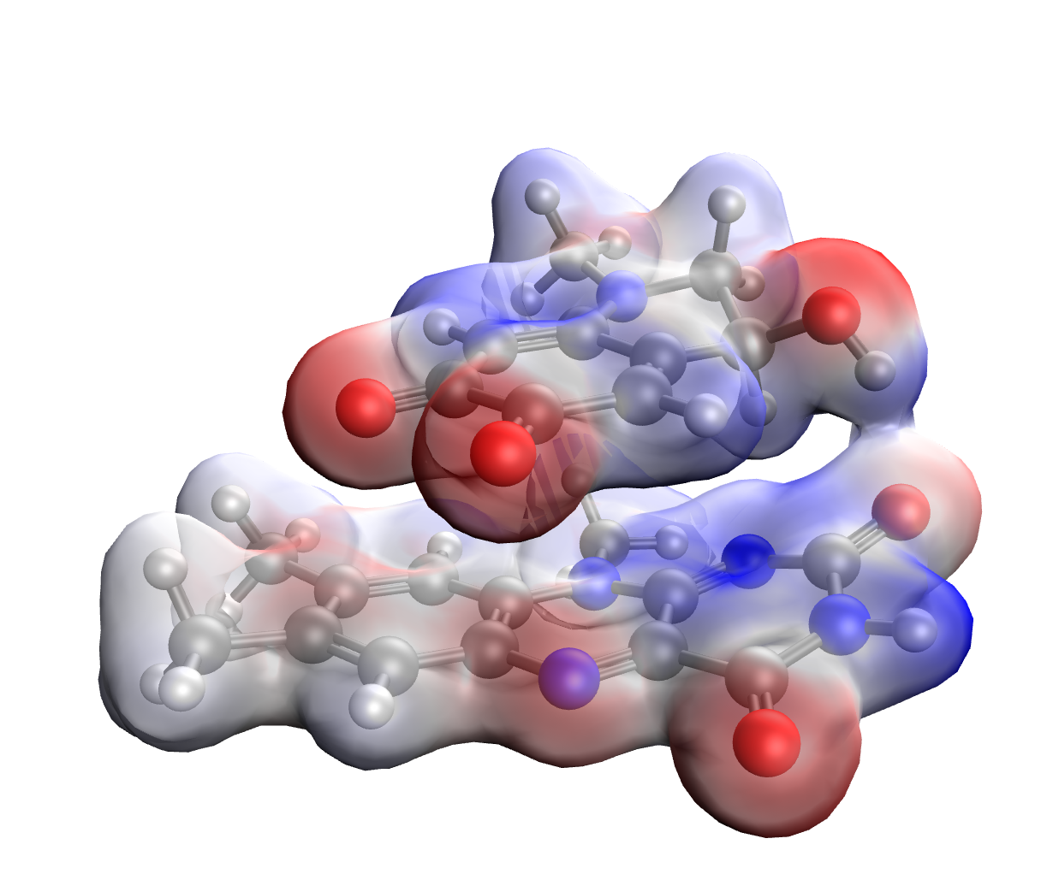
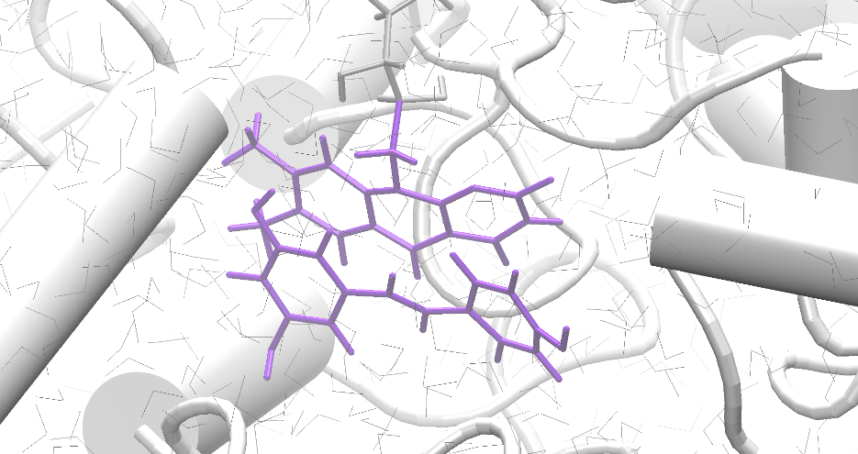
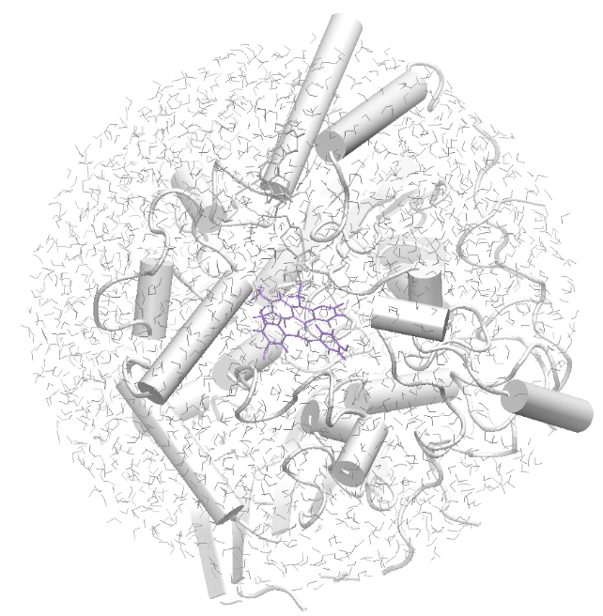
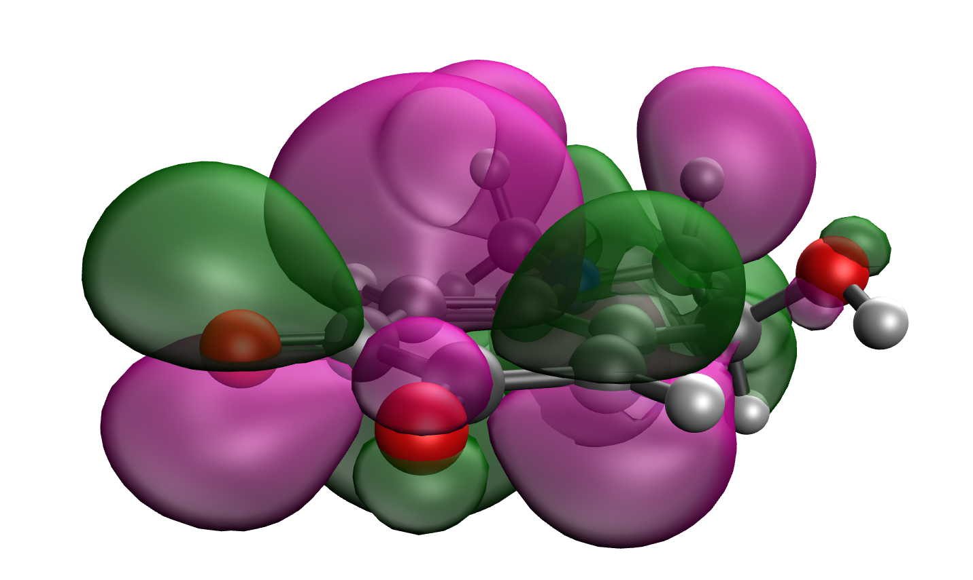
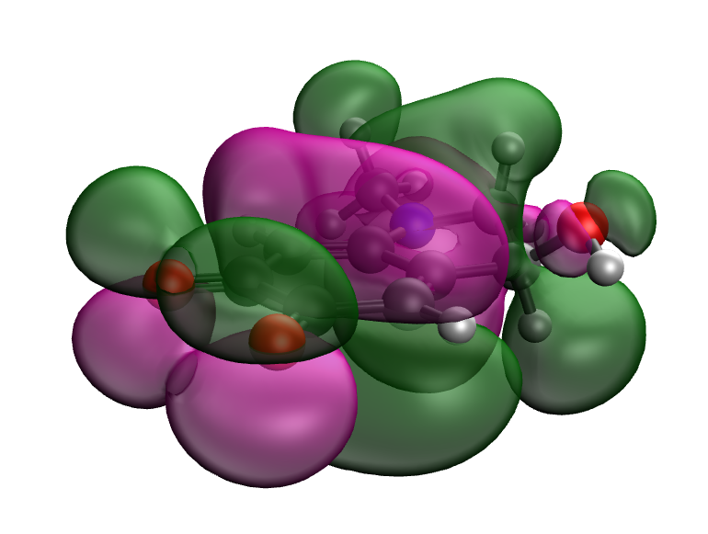
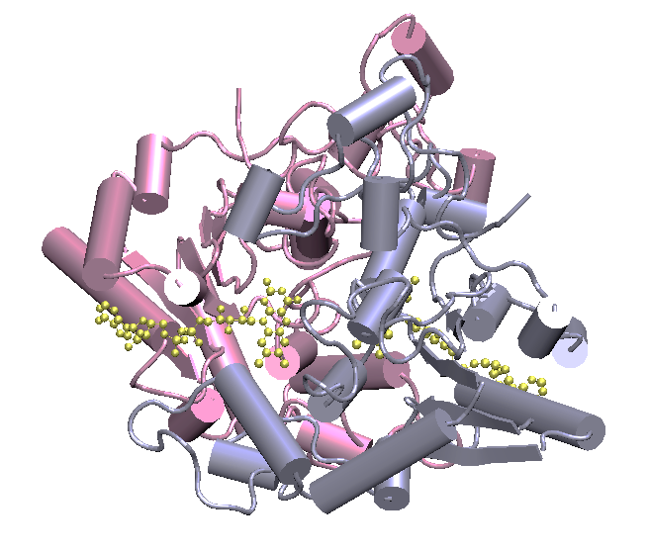
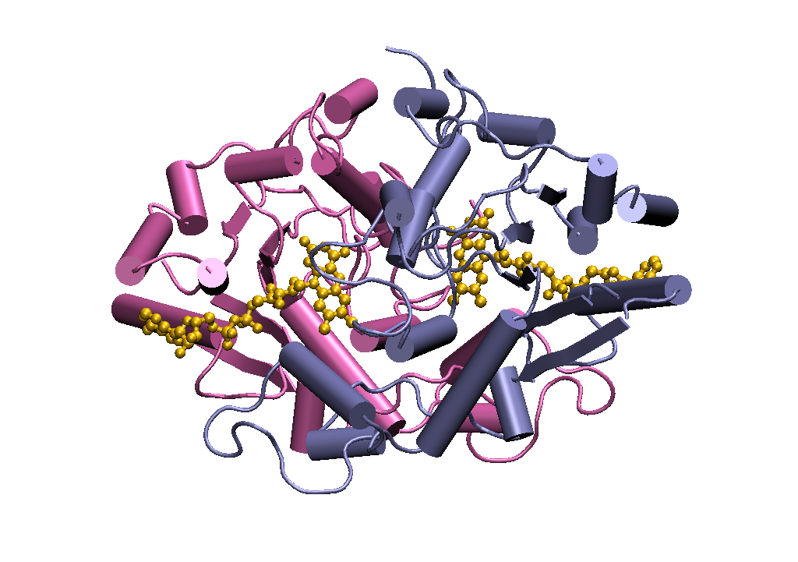
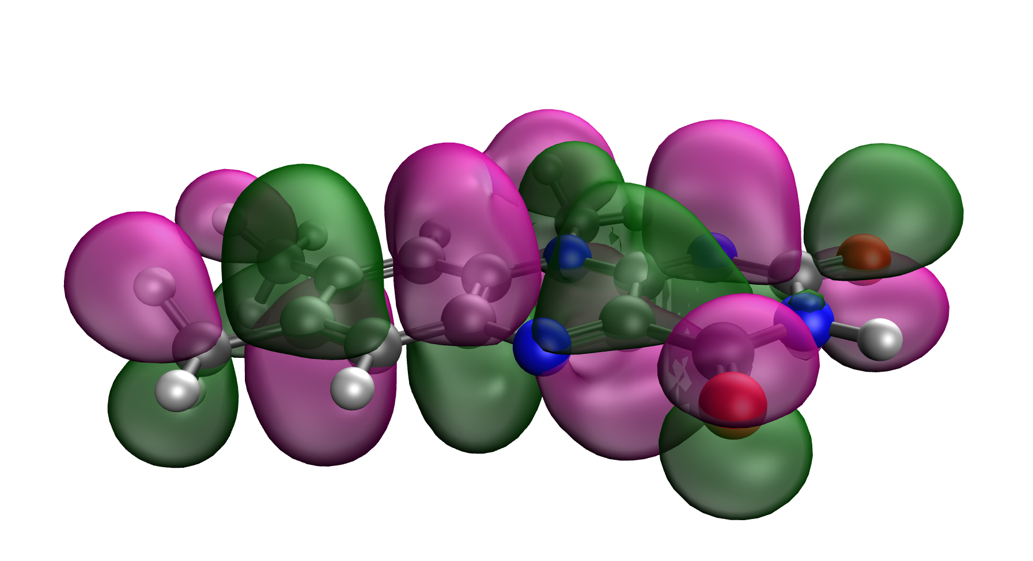
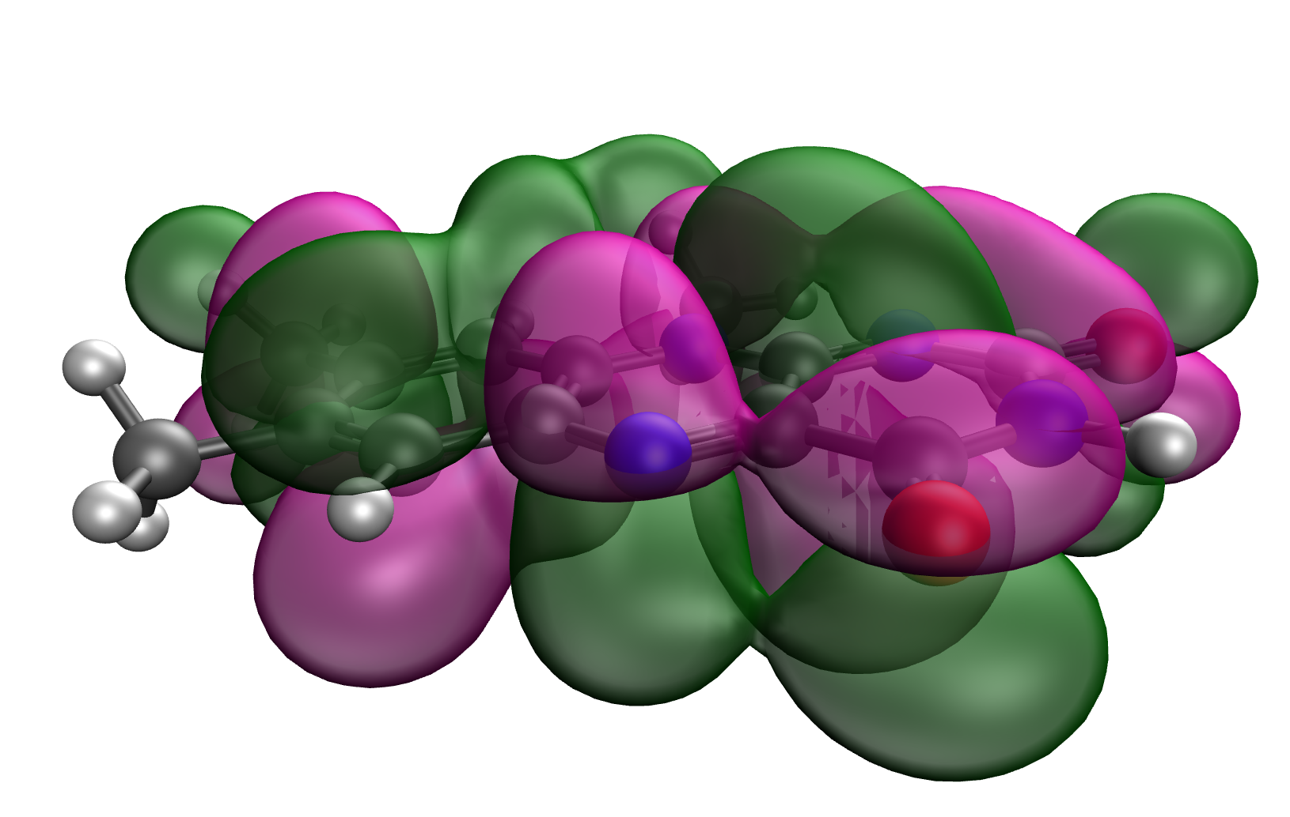
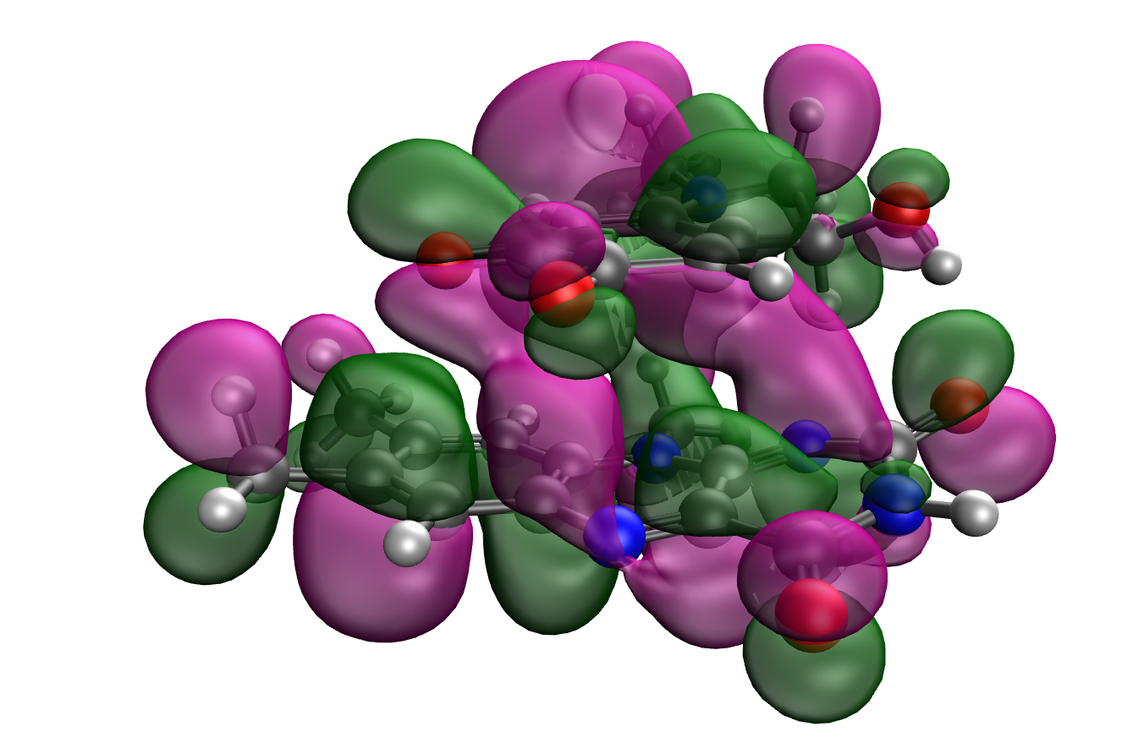
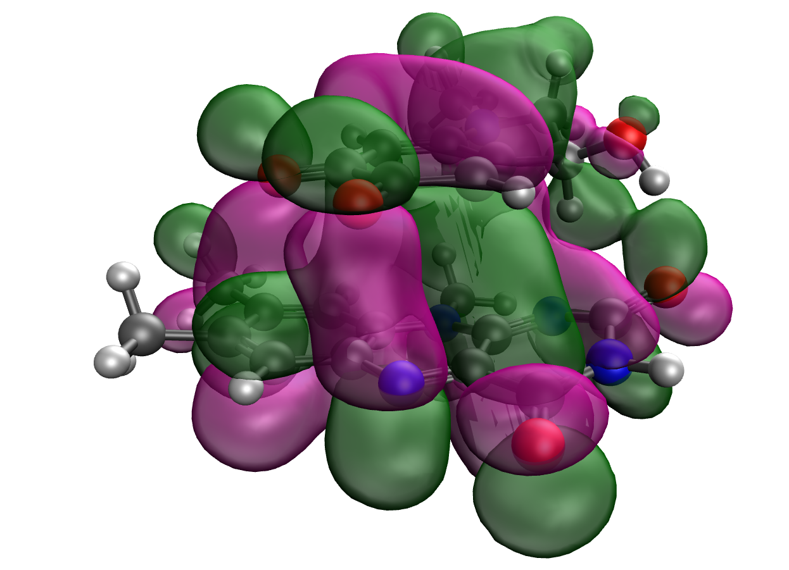
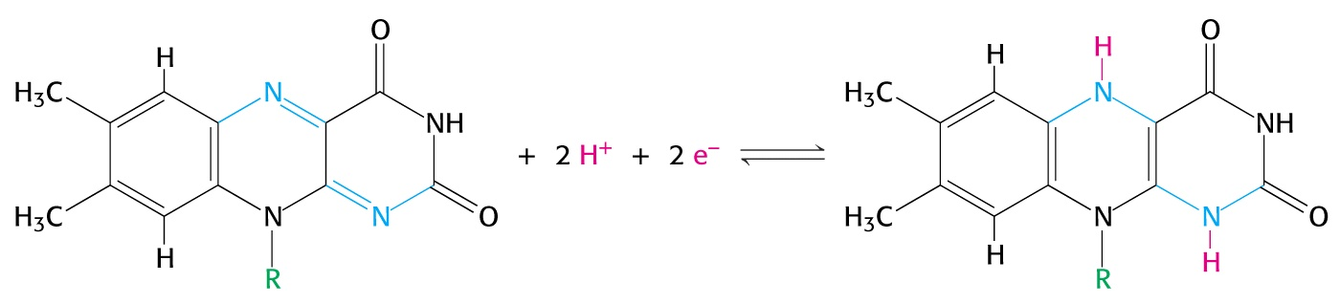
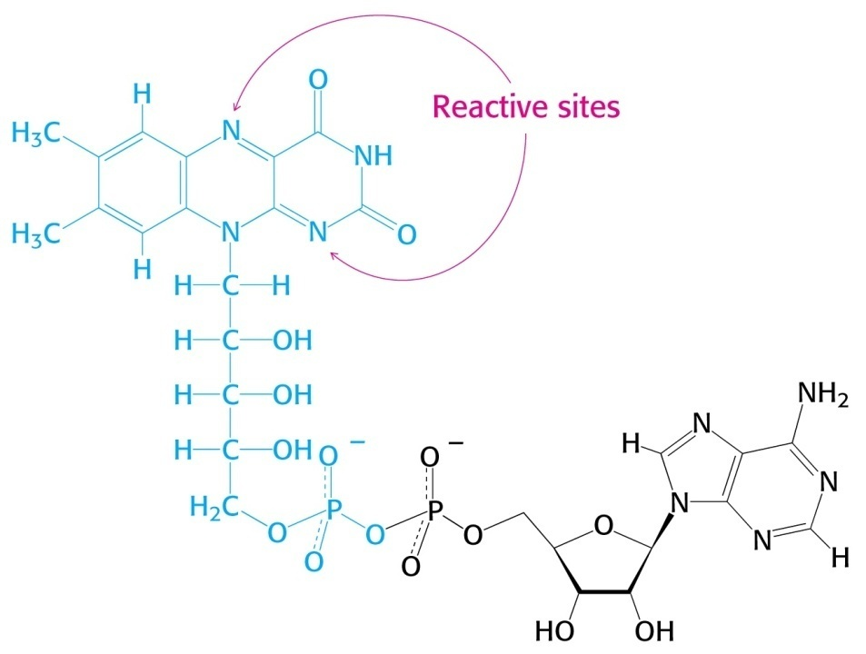
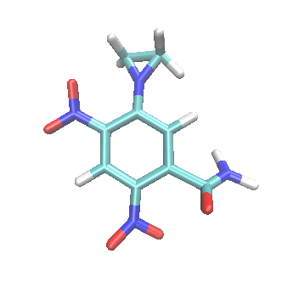
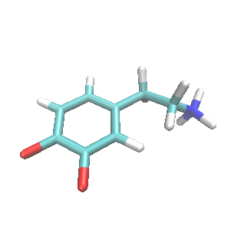
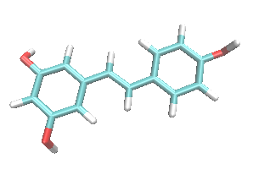
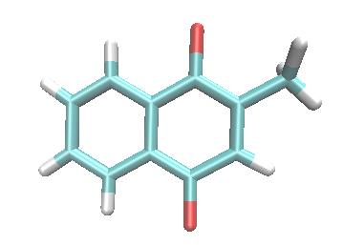
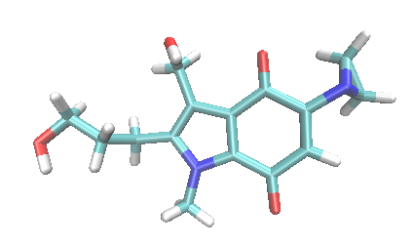
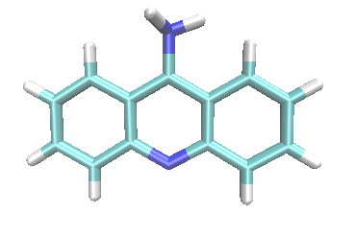
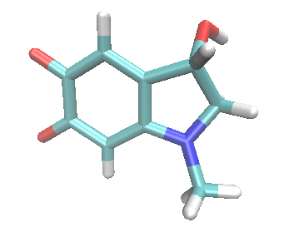
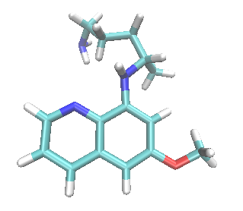
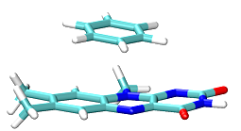
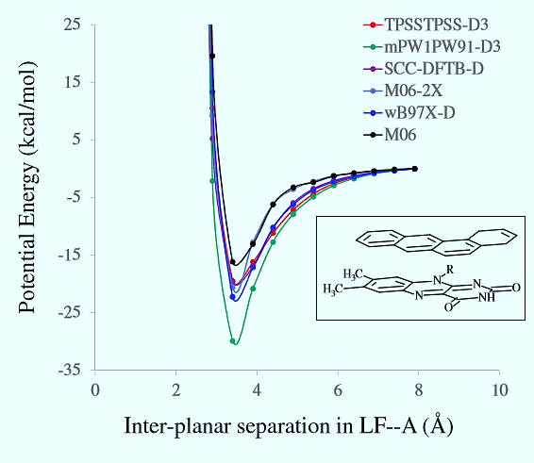
Towards Development of a Computational Screening Tool for Quinone Oxidoreductase Inhibitors
Nathan Barta and Sudeep Bhattacharyya
Department of Chemistry, University of Wisconsin-Eau Claire, WI 54702
Abstract
QM/MM Setup
Preliminary Results
NAD(P)H:quinone oxidoreductase 1 (NQO1) and its paralog NRH:quinone oxidoreductase 2 (NQO2) function by reducing quinones into hydroquinones via a two-electron reduction, which is mediated by the cofactor flavin adenine dinucleotide (FAD). These enzymes also catalyze a similar reduction of nitroaromatic compounds to produce cytotoxic drugs. This study details the development of a computational protocol designed to screen many molecules in order to accurately predict the binding orientations of various small aromatic molecules to NQO1 and NQO2. The protocol consists of geometric positioning of molecules on the flavin ring, calculating binding free energy, and scoring these ligand molecules bound to the active site. Electronic structure calculations were performed on small model system. In parallel, a larger model with enzyme was built up and treated by a hybrid quantum mechanical/molecular mechanical approach. This was done by applying approximated quantum mechanics only to the flavin ring and ligand atoms. The computational setup and preliminary results including the binding energies and predicted orientations is presented.
Treatment of Quantum Mechanical Atoms
Gibbs Free Energy Calculations using DFT
Primary Subsystem (PS):
Where the chemistry is occurring
SCC-DFTB-D
Secondary
Subsystem (SS):
Responding to the change
in the primary subsystem
SS
+
Within 24-30 Å
Langevin dynamics with increasing viscosity as one moves further from the PS
PS
flavin-bound adrenochrome
30 Å
Molecular Orbitals Visualizations
Beyond 30 Å
All atoms fixed. Generalized Born’s model of
continuum electrostatics was used
Highest Occupied Molecular Orbitals or HOMO
Lowest Unoccupied Molecular Orbitals or LUMO
Biological Significance of Quinone Reductases
Relative Binding Energy Calculation with Flavin
Ligand Displacement Reaction
Adrenochrome
S2(g)
+
Fl ::: S1 (g)
S1(g)
+
Fl ::: S2 (g)
Lumiflavin
NRH: Quinone Oxidoreductase 1 (QR1)
NRH: Quinone Oxidoreductase 2 (QR2)
S2(aq)
Fl ::: S1 (enz)
S1(aq)
+
Fl ::: S2 (enz)
+
Fl = F (oxidized flavin), S1 = hydroquinone, S2 = Inh
Flavin Adenosine Dinucleotide (FAD)
Stacked complex
Ligands of Interest
Oxidized form
Reduced form
Conclusions
Redox-active site contains the tricyclic 7, 8, 10-substituted isoalloxazine (flavin) ring
Vitamin K3 (menadione)
CB1954
Dopamine quinone
Resveratrol
The Gibbs’ free energy of binding in gas-phase between lumiflavin and adrenochrome is -5 kcal/mol
Strong overlap of orbitals (HOMO and LUMO) between lumiflavin and adrenochrome
FAD, the cofactor of QR2 serves an electron mediator capable of oscillating between two states by coupled electron proton additions
Electronic and Dynamic Effects in Binding
Future Directions
E09
(derivative of parabenzoquinone)
9-Amino acridine
Adrenochrome
Primaquine
Expand the calculations to include interaction energies for enzymes as well as in the aqueous phase
Analysis of the potential energy of the complex as a function of the distance between the lumiflavin ring and the bound ligand
Electronic Effects:
π-π stacking interactions
Electrostatic forces
Hydrogen bonding
Dynamic Effects
Change in active site conformation upon substrate binding
Change in collective motion upon substrate binding
Reinhardt, C. R.*, Hu, Q. H.*, Bresnahan, C. G.*, Hati, S., Bhattacharyya, S. ACS Catal. 2018, 12, 12015-12029.
Li, R.; Bianchet, M. A.; Talalay, P.; Amzel, L. M. Proc. Natl. Acad. Sci. U.S.A. 1995, 92, 8846.
(3) Bresnahan, C. G., Reinhardt, C. R., Bartholow, T. *, Rumpel, J. P., North, M. A., and Bhattacharyya, S. J. Phys. Chem. A 2015, 119, 172–182.
(4) North, M.A., Bhattacharyya, S.; Truhlar, D. G. J. Phys. Chem. B 2010, 114, 14907–14915.
(5) Miyamoto, S. and Kollman, P. A. Proteins. 1993, 6, 226–245.
(6) Calamini, B. et al. Biochemical Journal. 2010, 429, 273–282.
(7) Wu, K.; Knox, R.; et al. Arch. Biochem. Biophys. 1997, 347, 221-228.
Acknowledgements-
References-
-Office of Research and Sponsored Programs at University of Wisconsin Eau Claire.
Blugold Supercomputing Cluster and LTS at University of Wisconsin-Eau Claire.
Research Corp (CCSA 23223)

