Slide 1
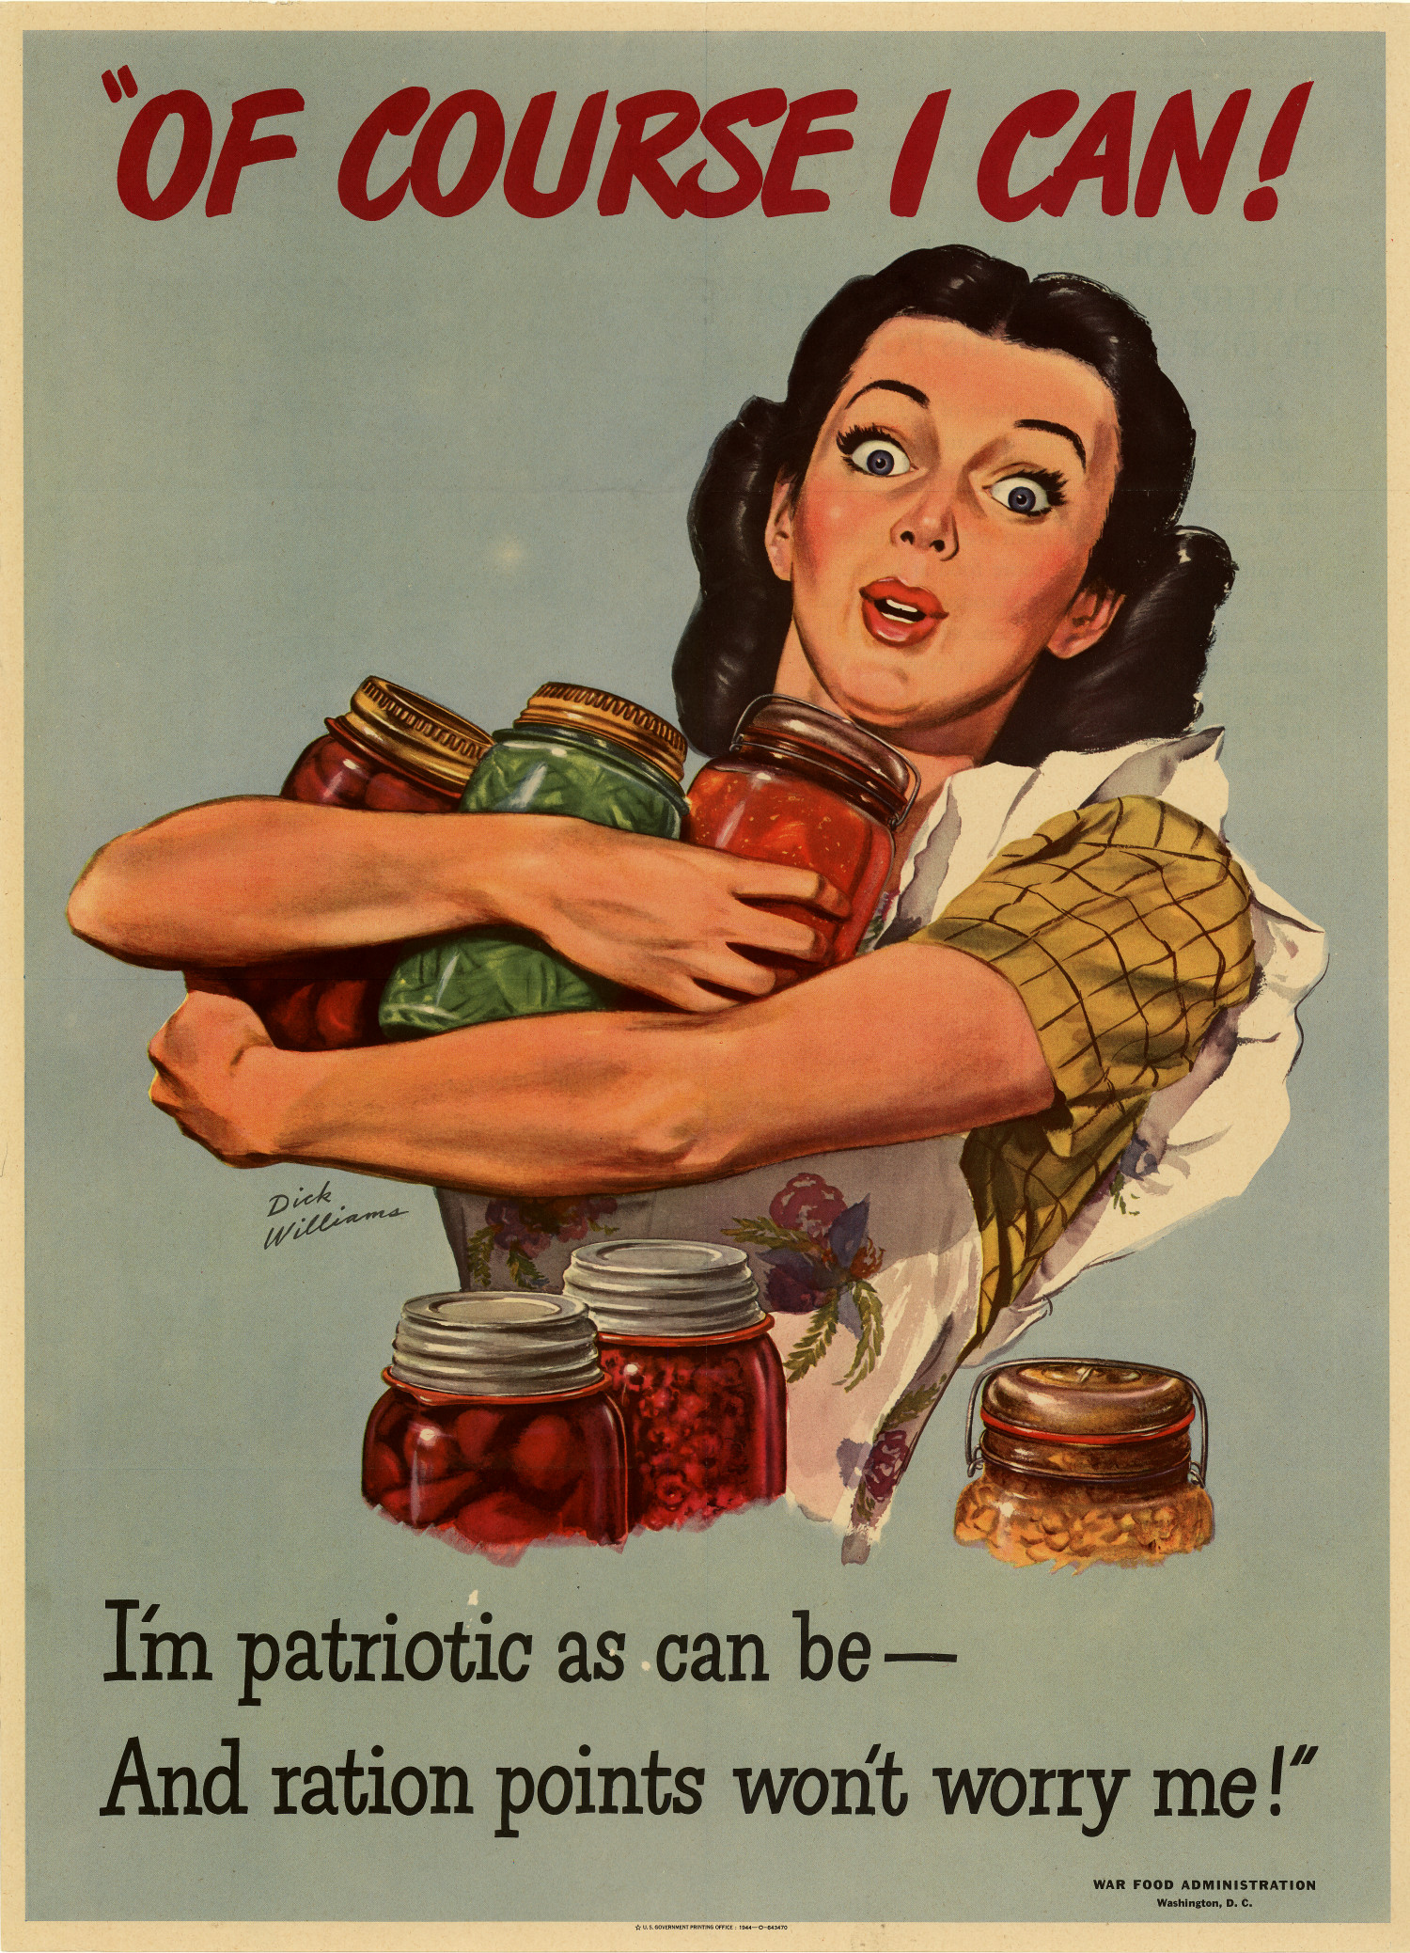
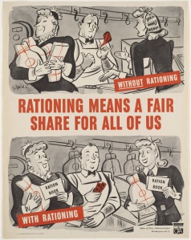
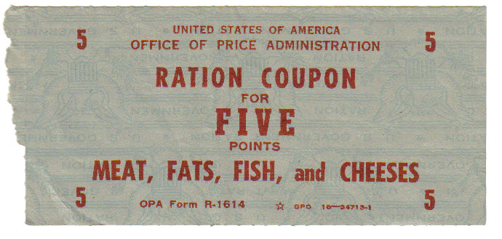
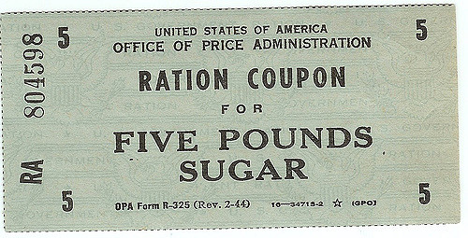
Were They Kitchen Patriots?
The American Woman And World War II Food Rationing
Kendra Polzin, Advisors: Dr. Andrew Sturtevant (Dept. of History), Dr. Daniel Ott (Dept. of History)| History
Abstract
The Government And Rationing
Conclusion
During World War II, the United States Government implemented a widespread, successful rationing program on the home front which enabled it to have ample supplies to send to American troops overseas. The marketing of this program targeted primarily women on the home front who were the homemakers and were thus in charge of the family’s food consumption.
Through large-scale campaigns via various media outlets, the government tried to enforce the idea that using food rations well was a political statement. A woman who knew how the point system worked and made the best with her rations was a true Kitchen Patriot.
Historians have researched rationing during WWII regarding women for decades. However, none have also considered the now recorded oral histories from the women who were homemakers during World War II. Studying the oral histories of these women is vital to understanding what they actually felt, thought, and understood about rationing.
This work includes research about the government and media’s involvement in the advertising of the rationing program but also involves oral histories from the Kitchen Patriots of World War II to uncover what was and wasn’t a success of the United States’ rationing program. It was found that when these oral histories are reviewed, the women did not feel that they were Kitchen Patriots. Food rationing was not a strong, patriotic act; it was simply what had to be done.
The United States Government focused their advertising efforts on the American housewife in the hopes of turning her into the Kitchen Patriot. Their efforts were headed primarily by the Office of Price Administration which oversaw the implementation of rationing and the valuing of foods via their complex point system.
Following World War I, women controlled food consumption in the home, so they became the target of ration marketing
Shortly before the United States entered the war, nutrition became incredibly important to ensure a healthy nation that was ready for war. The government assured its citizens that following rations would provide proper nutrition
When analyzing how the United States government and media advertised rationing during World War II, it is important to take into account what the target market experienced and thought. The government and media did their best to create the idea that rationing was a patriotic act that made women Kitchen Patriots. In reality, the housewives of World War II do not remember it that way. They rationed simply because it was what was done. Life had been, and could be, much harder, so rationing was not a terrible sacrifice to make by any means.
Had the government looked into what women thought of rationing and how they were reacting, they could have arguably saved the money from advertising and spent it on the war effort. Lives could have been saved and the war might have ended sooner if this had been done. It is incredibly important for this to be noted whenever the government is spending money to promote a program that is already generally accepted; the money spent on advertising could possibly be better spent somewhere else and have a stronger impact.
Extreme language was used in government publications to coerce or scare women into supporting the government and its rationing program
  “Sugarcane is needed to make molasses. Molasses is used in making industrial alcohol. Industrial alcohol is needed to make explosives. EXPLOSIVES ARE NEEDED TO BLAST THE AXIS.”
The government created the idea of the Kitchen Patriot
  This was based on the idea that using one’s rations wisely was a political statement of support for the government
The Media And Rationing
The media played a key role in assisting the government’s implementation of rationing and helping women to understand rationing’s complex point system.
Newspapers were vital for the government to get information to women promptly and accurately
  Provided instructions for the point system
  Updated point values for rationed products
  Published profiles on housewives, both famous and ordinary, to inspire and reassure readers that everyone was doing their part in rationing
Handbooks or pamphlets explained what women could do to help the war effort from the home front such as rationing, growing victory gardens, and buying war bonds
Large companies, such as Kellogg and Campbell’s Soup, worked to aid the rationing effort and keep themselves afloat during the rationing rather than being taken over by the government
Cookbooks, written by a variety of sources, were an important part of cooking with rations. They provided information that would help women get through the war and food rationing.
  Recipes were altered to accommodate rations, mostly sugar rations
  Explained the science behind using different forms of sugar substitutes
  Outlined the nutritional values of foods that were not commonly used before the war but became necessities during rationing
  Often contained forwards or passages which attempted to boost the patriotism behind rationing
Posters such as this were commonly produced by the Office of Price Administration to display how rationing was designed to give everyone a fair share and prevent some from hoarding too much of any one good.
Ration coupons such as these were turned in to grocers or salesmen in the appropriate point amounts which would then allow the customer to purchase the corresponding good.
What The Women Have To Say
Sources
Methodology
Overall, women do not remember rationing as a great patriotic act they did to help the war effort. While they read newspapers, used cookbooks, and were subjected to propaganda, American women did not internalize the idea that it was their patriotic duty to use rations well and become Kitchen Patriots.
Women felt that rationing was simply what was done and they could manage easily once they understood how to use the complex point based system
They did not have a choice in rationing, and they understood that sacrifices are made by everyone during the war
Most housewives during World War II had suffered through the Great Depression
  By comparison, rationing was not much of a sacrifice
There were countless harsh realities of war that minimized the difficulties of food rationing
  Fear of loved ones being enlisted
  Concern for those who were already serving overseas
“It was hard to figure out what to buy so that you wouldn't use all your ration stamps or tokens. I think the hardest thing was the meat, the meat situation. The rest of it was fine. We managed. I can't remember that we were ever completely short of ration stamps.” - Marie Cavanagh
Rutgers School of Arts and Sciences. "Rutgers Oral History Archives." 2016. Accessed April 05, 2018.
Rationing Coupons (images). Available from: https://uwsslec.libguides.com/c.php?g=416691&p=2851363 (Accessed on April 24, 2018)
Rationing Posters (images). Available from: https://uki16.wordpress.com/rationing-posters/ (Accessed April 24, 2018)
Saylor, Thomas. Oral History Interview with Marie Cavanagh. 2002, Minnesota’s Greatest Generation Oral History Project, Minnesota Historical Society Oral History Collection
United States Bureau of Human Nutrition and Home E. Victory Begins at Home! Recipes to Match Your Sugar Ration. U. S. Government, 1942.
Yang, Mei-Ling. "Creating The Kitchen Patriot: Media Promotion of Food Rationing and Nutrition Campaigns on the American Home Front During World War II." American Journalism Historians Association, Summer 2005: 55-75.
In order to take into account the opinions of women from multiple backgrounds, oral histories were reviewed from multiple locations across the United States. By collecting information from oral histories across the country it was also possible to get a national view of the perspectives women had on food rationing rather than the view of one small region. These oral histories were evaluated to see what was said regarding rationing during World War II, focusing on food rationing.
The thoughts of these women were looked at as individuals and as a group to gather conclusions on what women actually thought and felt during the war. It was found that housewives during the war were not as swept up in patriotism as it would seem if one only evaluated the government and media’s actions. While many women recalled moving into the workforce to help the war effort being a patriotic act, the patriotism behind the advertisement of rationing was not as internalized as the government and media would have hoped.

