Slide 1
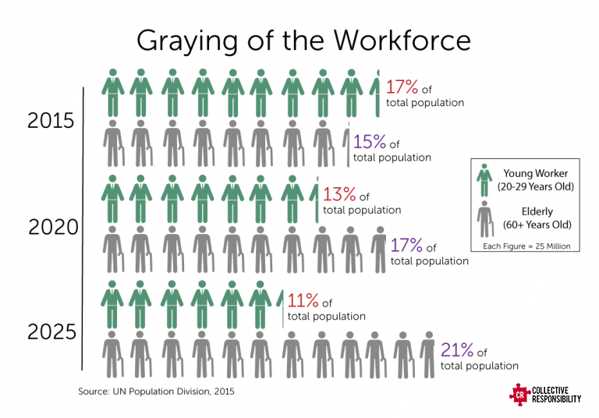
Chinese Elderly
Psychological Wellbeing and Social Supporting Resources
Jianjun Ji, Saffron O’Brien, Ciara Riley, and Zoya Lefler | Sociology Department
Relevance
Methods
Findings
With an increasing population of elderly in China due to improved living conditions, increased health technology, and the former One Child Policy, understanding how social resources affect this population is increasingly important for both families and government. As the ratio of elderly to young workers continues to increase (Graying of the Workforce) new policies may have to be implemented to support this growing population.
Data Source
Happiness, out of the four dependent variables, had the most statistically significant relationships with 7 of the 11 independent variables. The strongest relationship with Happiness was with the Self Resources specifically with Total Savings.
Filial Piety was the second most statistically significant relationship with 5 of the 11 independent variables being associated. The strongest relationship with Filial Piety was the Social Welfare Stipend resource.
Feel Lonely had 4 out of the 11 relationships showing significance. The strongest relationship with Feel Lonely was the Government Resource of State Stipend
Health Status had 3 out of the 11 relationships showing significance. The strongest relationship with Health Status was Personal Pension
2 of the 11 independent variables representing social resources, State Stipend and Social well-fare, show the strongest association with the psychological well-being, followed by Relative Support and Other Stipend.
The data is based on a national survey collected by “the China Research Center on Aging” (CRCA) in 2006, covering 16 provinces
The study is based on a sample size of 1980 respondants, a 10% of the total of respondants of 19,800 urban and rural elderly aged 60 years and above
Measures
Dependent Variables: Psychological Wellbeing
Health Status
Feel Lonely
Filial Piety
Happiness
Independent Variables: Social Supporting Resources
Government Resources
  State Stipend
  Community Stipend
  Social Welfare Stipend
Family Resources
  Children Support
  Relative Support
Control Variables:
Age
Children
Marital Status
Family Harmony
Self Resources
  Personal Pension
  Monthly Income
  Total Savings
Other Resources
  Buying Medical Insurance
  Enterprise Stipend
  Other Stipend
Theoretical Perspectives
Social Resources Theory
This study uses Social Resources Theory to study the impact of social resources on psychological wellbeing. This theory argues that as people age their social resources will decline since they are no longer actively gaining resources or avoiding losses. Consequentially, the decline in social resources will have a negative impact on psychological well-being.
Results
Hypotheses 1 and 2 were supported by the data collected in this study
  The psychological wellbeing varies among the Chinese elderly due to differences in health, feeling lonely, filial piety, and happiness
  Social supporting resources in China were found to benefit some of the elderly but were not available to others
Hypotheses 3 through 6 were partially supported by the data
  Psychological wellbeing is associated with self, family, state, and other resources; however, there is a stronger association between psychological wellbeing and state resources as opposed to the other three social supporting resources
Framework of Psychological Wellbeing
The Framework of Psychological Wellbeing states that a person’s wellbeing is developed over a lifetime based on their perception of their purpose in life. This study uses this theory to explain how the elderly’s psychological wellbeing will be effected by changes in social resources.
Statistical Methods
Research Questions
Percentage Frequency Distribution
to show variability of the perception on the health status, filial piety, feel lonely, and happiness
Chi-Square test
to seek the significant relationship between psychological wellbeing's and social resources
Kendall's Tau-B & Tau-C
to demonstrate the strength of association for ordinal variables
Cramer’s V
to show the strength of association for nominal variables
How do the Chinese Elderly perceive their psychological wellbeing?
How do the Chinese elderly feel about their health status, loneliness, filial piety, and life happiness?
What are the social resources currently available to the Chinese elderly?
Is the psychological wellbeing of the Chinese elderly associated with their social resources?
Discussion & Conclusion
Hypotheses
Since state resources have the strongest association to psychological wellbeing there may be a need for policy change. As the Chinese population continues aging, we will see the continued lack of state resources such as social welfare, which will have an effect within China. Government policies involving social welfare programs, and stipends from the state and community, will need to be considered if they want to meet the demands of this ever growing aging society.
The results stimulate further effort on the same topic for examination and confirmation
More effort is needed to explore the concepts of the dependent variable in terms of psychological wellbeing in a Chinese social context
Researchers might need to re-examine the re-coded variables, such as health status and feeling lonely, which might give a new light to the findings
The perception on the psychological wellbeing varies among the Chinese elderly.
Social supporting resources vary among the Chinese elderly.
The health status of the Chinese elderly is associated with social supporting resources, after controlling for the effects of age.
The perception on filial piety of the Chinese elderly is associated with their family resources, after controlling for the effects of children.
The perception on feeling lonely of the Chinese elderly is associated with their social resources, after controlling for the effects of marital status.
The perception on happiness of the Chinese elderly is associated with their social resources, after controlling for the effects of family harmony.
State Stipend No Yes Total
Health Status
Not Good 24.5 (444) 39.8 (66) 25.8 (510)
Average 49.1 (889) 42.8 (71) 48.6 (960)
Good 26.4 (477) 17.5 (29) 25.6 (506)
Total 100.0 (1810) 100.0 (166) 100.0 (1976)
Chi-Square=19.609, df=2, p<.001, Cramer’s V=.10
State Stipend No Yes Total
Feel Lonely
Yes 25.7 (459) 49.7 (82) 27.7 (541)
Hard to Say 8.2 (146) 8.5 (14) 8.2 (160)
No 66.2 (1183) 41.8 (69) 64.1 (1252)
Total 100.0 (1788) 100.0 (165) 100.0 (1953)
Chi-Square=45.463, df=2, p<.001, Cramer’s V=.153

