Slide 1


The Price is Wrong!
The library spends a good deal of money to support research on campus.
Here's how the cost of license fees stacks up to other purchases.
American Chemical Society journals
UW System bundle
Ten 2013 Corvette Coupes
Can you guess which costs more?
You can help fight spiraling expenses by supporting open access publications.
Come learn more this Friday, during Open Access Day @ UW-Milwaukee!

Slide 2
The Price is Wrong!
The library spends a good deal of money to support research on campus.
Here's how the cost of license fees stacks up to other purchases.
American Chemical Society journals
UW System bundle
$507,000
Ten 2013 Corvette Coupes
$496,000
You can help fight spiraling expenses by supporting open access publications.
Come learn more this Friday, during Open Access Day @ UW-Milwaukee!

Slide 3
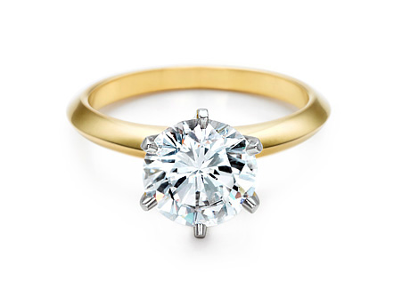
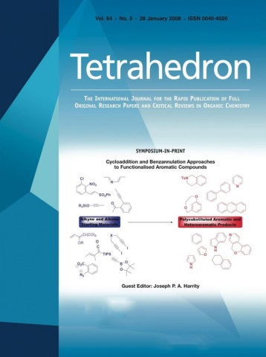

The Price is Wrong!
The library spends a good deal of money to support research on campus.
Here's how the cost of license fees stacks up to other purchases.
Tiffany 2-Carat Diamond Ring
Tetrahedron & Tetrahedron Letters
Can you guess which costs more?
You can help fight spiraling expenses by supporting open access publications.
Come learn more this Friday, during Open Access Day @ UW-Milwaukee!

Slide 4
The Price is Wrong!
The library spends a good deal of money to support research on campus.
Here's how the cost of license fees stacks up to other purchases.
Tiffany 2-Carat Diamond Ring
$34,100
Tetrahedron & Tetrahedron Letters
$38,861
You can help fight spiraling expenses by supporting open access publications.
Come learn more this Friday, during Open Access Day @ UW-Milwaukee!

Slide 5


The Price is Wrong!
The library spends a good deal of money to support research on campus.
Here's how the cost of license fees stacks up to other purchases.
International Journal of Production Research
One Year of UWM Resident Tuition
Can you guess which costs more?
You can help fight spiraling expenses by supporting open access publications.
Come learn more this Friday, during Open Access Day @ UW-Milwaukee!

Slide 6
The Price is Wrong!
The library spends a good deal of money to support research on campus.
Here's how the cost of license fees stacks up to other purchases.
International Journal of Production Research
$9,509
One Year of UWM Resident Tuition
$9,186.72
You can help fight spiraling expenses by supporting open access publications.
Come learn more this Friday, during Open Access Day @ UW-Milwaukee!

Slide 7


The Price is Wrong!
The library spends a good deal of money to support research on campus.
Here's how the cost of license fees stacks up to other purchases.
Journal of Materials Science
Thoroughbred Race Horse
Can you guess which costs more?
You can help fight spiraling expenses by supporting open access publications.
Come learn more this Friday, during Open Access Day @ UW-Milwaukee!

Slide 8
The Price is Wrong!
The library spends a good deal of money to support research on campus.
Here's how the cost of license fees stacks up to other purchases.
Journal of Materials Science
$12,168
Thoroughbred Race Horse
$10,000+
You can help fight spiraling expenses by supporting open access publications.
Come learn more this Friday, during Open Access Day @ UW-Milwaukee!

Slide 9
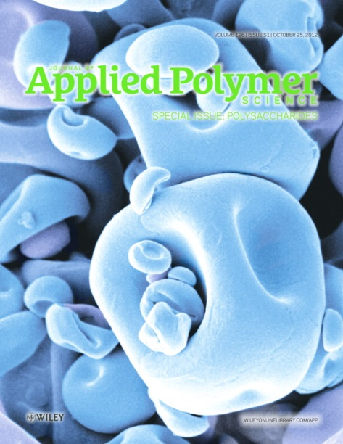

The Price is Wrong!
The library spends a good deal of money to support research on campus.
Here's how the cost of license fees stacks up to other purchases.
Heifer International Gift of Transformation
Journal of Applied Polymer Science
Can you guess which costs more?
You can help fight spiraling expenses by supporting open access publications.
Come learn more this Friday, during Open Access Day @ UW-Milwaukee!

Slide 10
The Price is Wrong!
The library spends a good deal of money to support research on campus.
Here's how the cost of license fees stacks up to other purchases.
Heifer International Gift of Transformation
$25,000
Journal of Applied Polymer Science
$26,714
You can help fight spiraling expenses by supporting open access publications.
Come learn more this Friday, during Open Access Day @ UW-Milwaukee!

