Slide 1
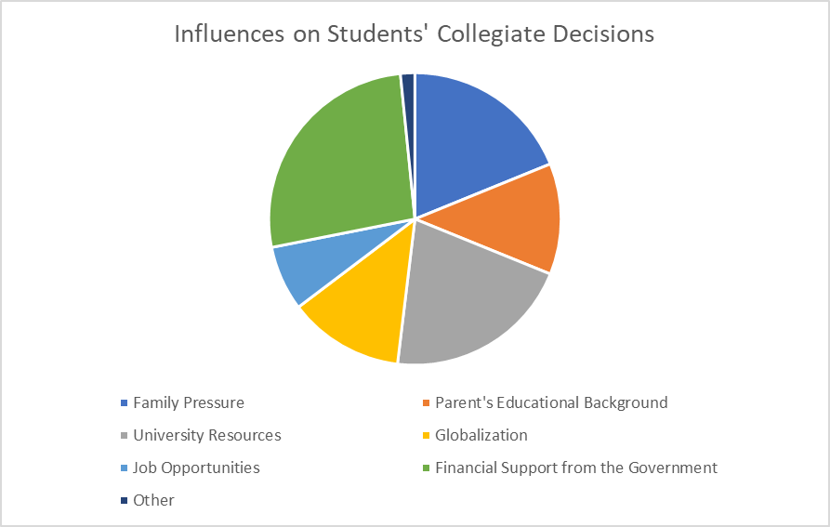
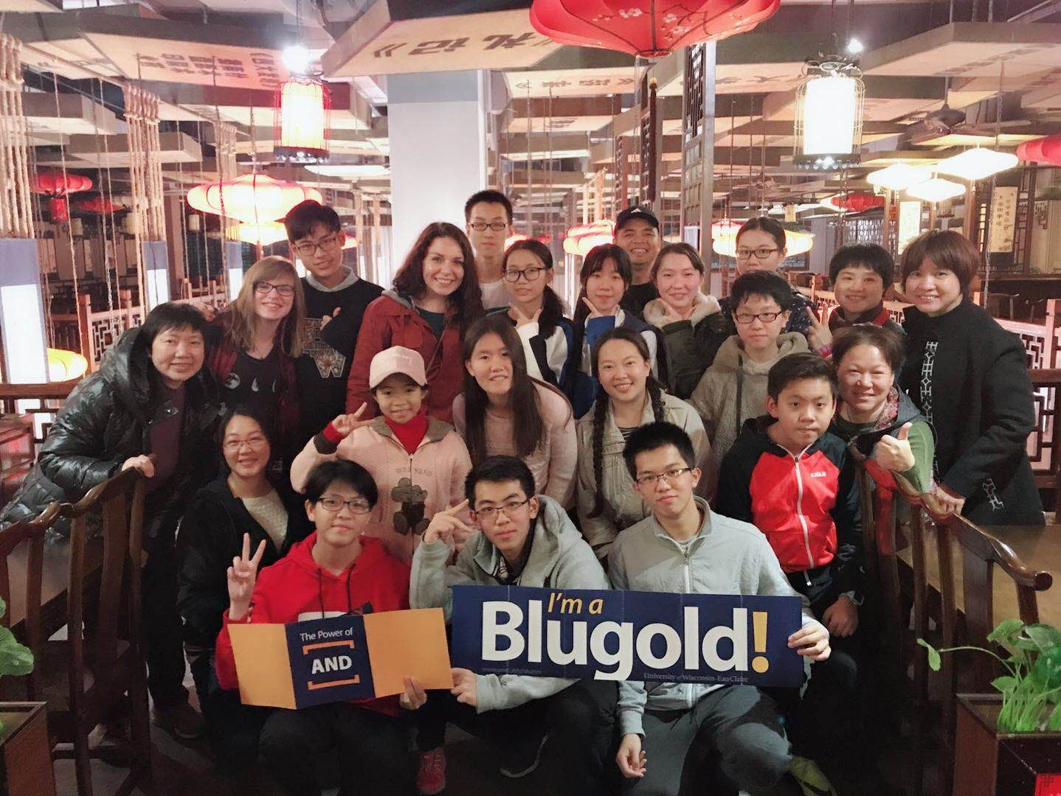
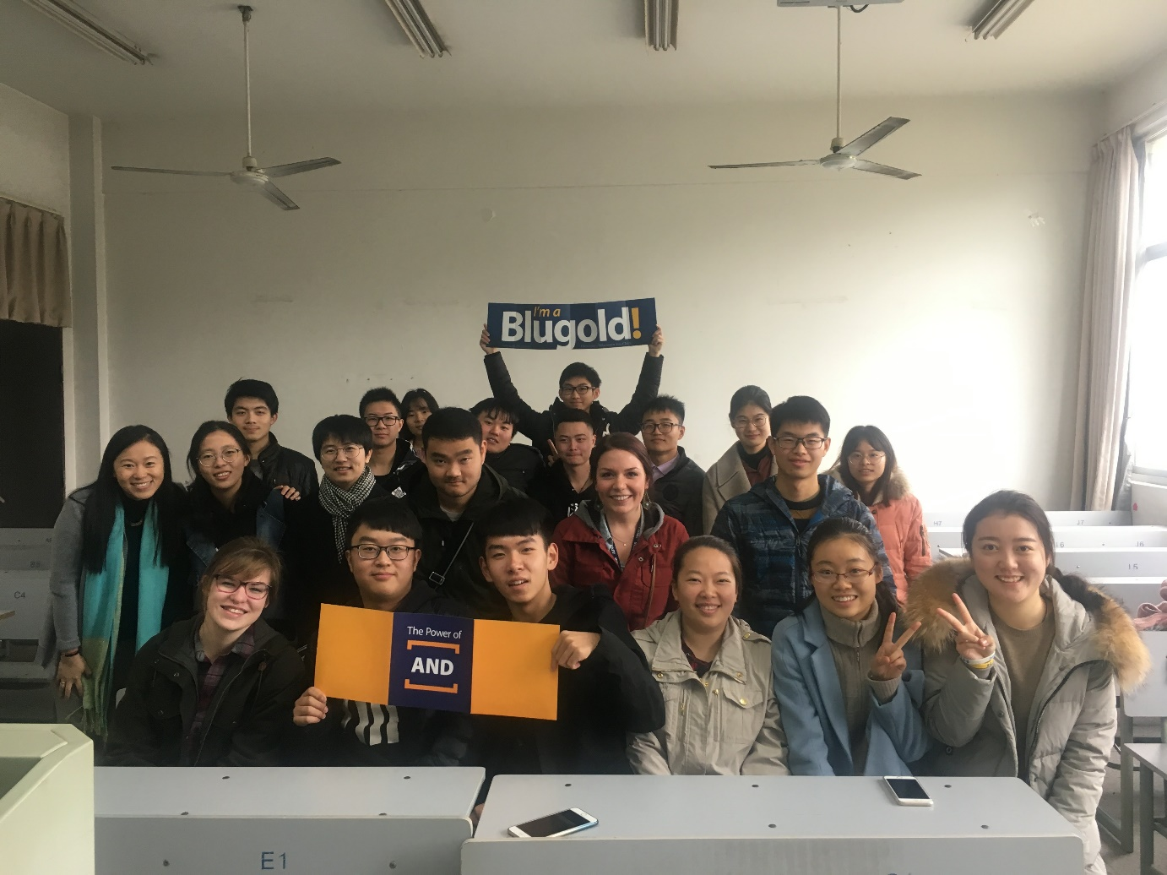
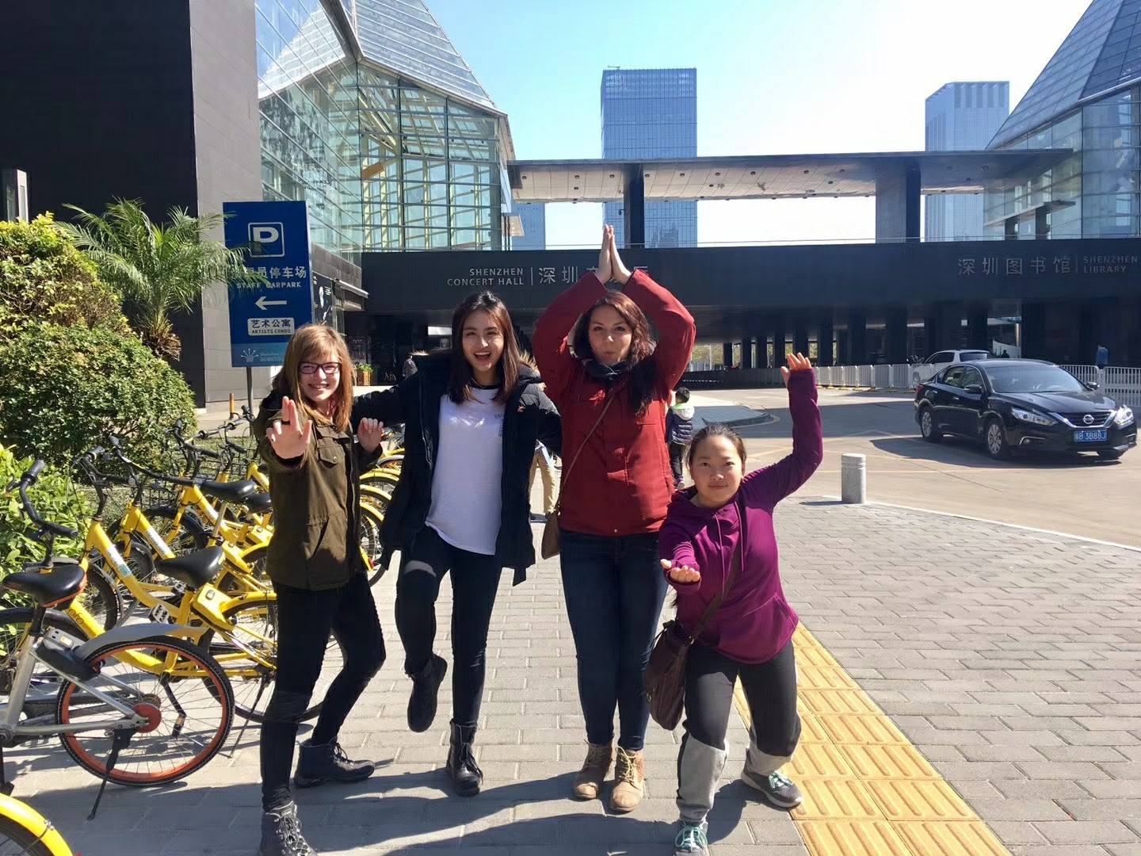
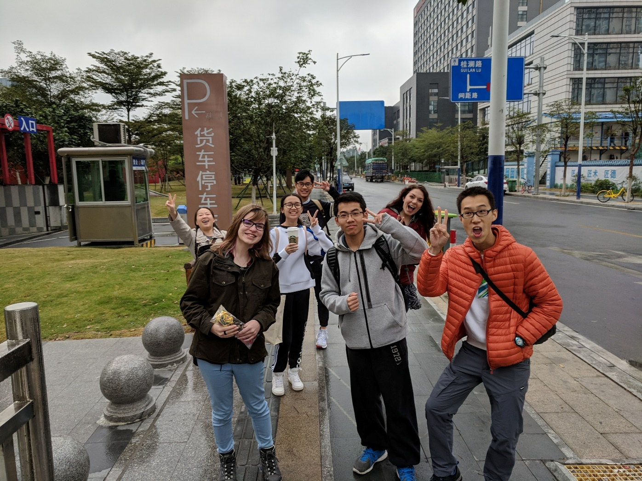
How Chinese Sociocultural Perspectives on Education Inform Students' Educational Decisions
Caitlin Hedberg, Katelyn Kannel, Youa Xiong, Advisor: Dr. Kaishan Kong | Department of Languages
Purpose
Discussion
This study aims to investigate which sociocultural factors influence the educational decisions undertaken by students, parents, and faculty members in China’s university system. Through this examination we will gain insights on the influencing factors on China’s next generation of economic and political leaders.
Chinese students continue to make their educational decisions based on the benefit it will have on their families-particularly how that decision will affect their ability to support their parents financially. Additionally, there is a change in China’s academic culture that allows students to indulge in hobbies and extracurricular activities without the intent of improving academic performance. This shift accounts for a cultural shift in awareness of students’ mental wellbeing.
Research Questions
How do Chinese students, parents, and faculty view education?
How do their perspectives inform their educational decisions?
Are there any regional differences in the educational resources within China?
Conclusion
This research study provides insight into regional differences in education, as well as societal pressures that affect educational decisions. Research on this topic is important because:
Students in the current Chinese education system will be China’s economic future
The students experiences will affect business relations around the world
By learning their educational culture, individuals can gain insight into what is important to those students
Methods
Themes
Semi-structured interviews with students, parents, and faculty
Surveys
Application of Constant Comparative Method
Family and Gender Influences
“It’s our responsibility to support [our parents] that’s why we should…work hard, study, get high salaries, so we can treat them well.”
“I don’t want to be a teacher …but after GaoKao my parents said…the work is much more stable and this is suitable for a girl to work in a school.”
Future Research
Biggest influences: choosing a job to provide a stable income for the family, and jobs that seemed suitable for their gender status.
This experiment will be expanded on in the future through support of the Blugold Fellowship. Future research will be an expansion of the sports and education theme to explore in-depth the culture shift present in China in the awareness of student mental wellbeing.
GaoKao
“People often say that Gaokao is the only way for children to change their life. Like me, my family is not very rich, so GaoKao is a way for me, if I want to get a much better life.”
Contact Information
Dinner at a traditional tea house
Students interviewed at Changshu
GaoKao was often referred to as the most stressful memory participants had, as well as being a potential life changing event.
To find out more information about our research, contact us via email at:
hedberce0125@uwec.edu
kannelkl@uwec.edu
xiongy@uwec.edu
Background
Regional Resource Disparities
“Because it’s in the inner land [inner province], and the living conditions are much more underdeveloped, so very talented teachers won’t teach there.”
Traveling and activities
This study was set in a three-week immersion program, focusing on the educational culture of China. To gain a better educational perspective, researchers visited several different colleges, as well as high schools, middle schools, and primary schools. These schools ranged across China, starting in Changshu, our sister university, to Shenzhen. In each location, researchers also learned about the history, including field trips to different historical sites, to understand regional effects on education as well.
Schools in rural regions are at a systemic resource disadvantage to their urban counterparts.
Sports and Education
“My friends just sleep 5 hours one day and the rest of the time they use about 4 hours to have lunch and dinner or just spare time doing their hobbies… Then the rest of the time they use to study.”
China is undergoing a cultural shift in the inclusion of extracurricular activities such as music and sports in addition to exam preparations.
Shenzhen Concert Hall
Guangzhou Walking Tour
The generous support for the project came from Student Blugold Commitment Differential Tuition funds through the University of Wisconsin-Eau Claire Summer Research Experiences for Undergraduates program.

