Slide 1
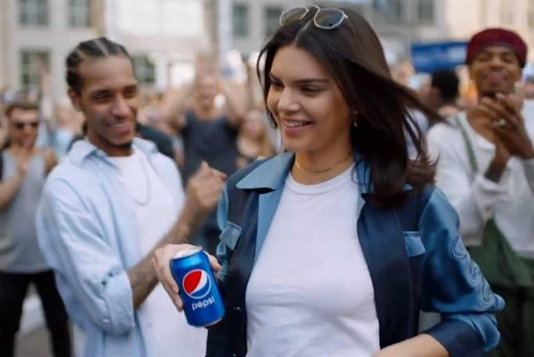
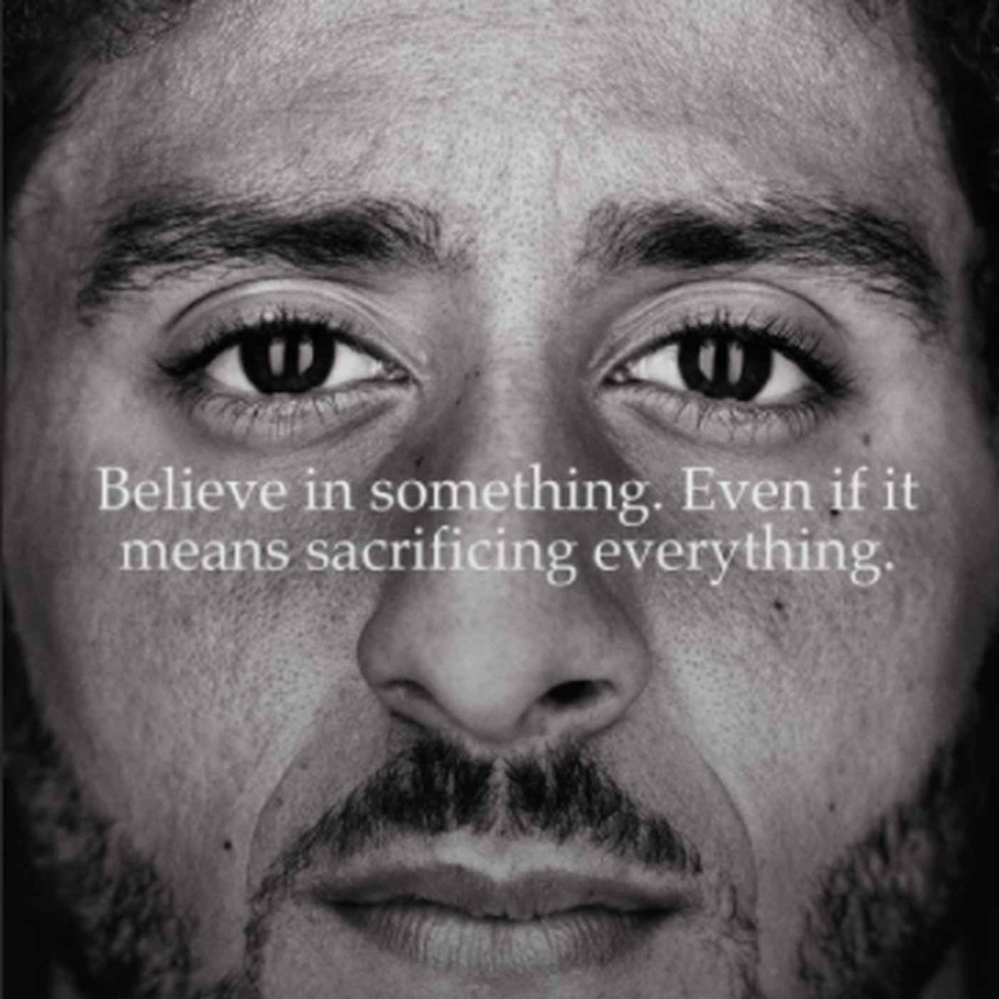
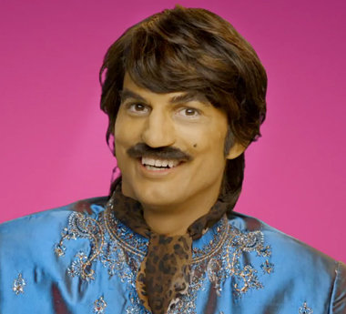

Controversial Messages From Celebrity Influencers
Analyzing Consumer Attitudes and Purchase Intentions
Alyssa Addleman, Allison Hassemer, Amber Karn, Megan Roth, Jordan Stelzer | Department of Communication and Journalism
Faculty Mentor: Dr. Martha Fay
Introduction
RQ₁: Can controversial messages of celebrity influencers affect consumer attitudes and purchase intentions?
As Organizational Communication Majors in a CJ Capstone Class, we decided to investigate the impact of celebrity influencers on buyers’ attitudes and decisions. We did this in order to understand more about how messages can affect perceptions of celebrities and brands.
Correlations
 |  | A controversial message I agree with, sent by a celebrity I like, affects my attitude towards a brand they promote. | A controversial message I disagree with, sent by a celebrity I like, affects my attitude towards a brand they promote. | A controversial message I agree with, sent by a celebrity I like, influences my decision to purchase products from the brands they endorse. | A controversial message I disagree with, sent by a celebrity I like, influences my decision to purchase products from the brands they endorse.
A controversial message I agree with, sent by a celebrity I like, affects my attitude towards a brand they promote. | Pearson Correlation | 1 | .708** | .793** | .577**
 | Sig. (2-tailed) |  | .000 | .000 | .000
 | N | 140 | 140 | 140 | 140
A controversial message I disagree with, sent by a celebrity I like, affects my attitude towards a brand they promote. | Pearson Correlation | .708** | 1 | .648** | .598**
 | Sig. (2-tailed) | .000 |  | .000 | .000
 | N | 140 | 141 | 141 | 141
A controversial message I agree with, sent by a celebrity I like, influences my decision to purchase products from the brands they endorse. | Pearson Correlation | .793** | .648** | 1 | .708**
 | Sig. (2-tailed) | .000 | .000 |  | .000
 | N | 140 | 141 | 141 | 141
A controversial message I disagree with, sent by a celebrity I like, influences my decision to purchase products from the brands they endorse. | Pearson Correlation | .577** | .598** | .708** | 1
 | Sig. (2-tailed) | .000 | .000 | .000
 | N | 140 | 141 | 141 | 141
**. Correlation is significant at the 0.01 level (2-tailed).
Abstract
Leveraging the new age of social media, many consumer brands have ramped up the use celebrity influencers to enhance brand awareness and increase sales (Thomas & Fowler, 2015). Research has shown that celebrities increase awareness of a company’s advertising and create positive feelings toward brands (Schlecht, 2003). Conversely, a consumer can also have negative attitudes toward a message or source if they are conveyed improperly (Ogunsiji, 2012). For example, research has shown that consumers’ attitudes toward endorsers become negative after a brand transgression occurs; however, studies suggest that celebrities may be able to overcome negative effects that result from their relationship with the brand by dispatching appropriate responses (Thomas & Fowler, 2016). However, whether controversial actions by celebrities impact consumer perceptions of the brand they represent has not been studied. Utilizing the Social Identity Theory, this study explores potential associations between consumer attitudes toward a brand and their purchase intentions, and controversial messages produced by a liked celebrity (Lam, Ahearne, Hu, & Schillewaert, 2010). Results may help brand managers in deciding among celebrities to represent their brand and in mitigating potential negative effects of their liked celebrities’ transgressions.
Kendall Jenner for Pepsi (2017)
Colin Kaepernick for Nike (2018)
Celebrity Influencers
The three images to the right represent the celebrity influencers we highlighted in our study. Each influencer participated in marketing campaigns that generated controversial messages among the public. The messages portrayed in each scenario stimulated either a favorable or unfavorable response. The celebrities who took part in these campaigns are: Kendall Jenner, Colin Kaepernick, and Ashton Kutcher.
I Care About the Issue
Conclusion
Ashton Kutcher for Pop Chips (2012)
Scenario 1 indicates that 46.8% of individuals care about the issue 28.4% do not.
Scenario 2 indicates that 73.8% of individuals care about the issue and 12% do not.
Scenario 3 indicates that 51% of individuals care about the issue and 19.8% do not.
Previous research has suggested that controversial messages would adversely affect ad campaigns and the celebrities that endorse brands. Due to these findings, we expected to see a negative attitude and a decline in purchase intention toward each brand we examined. Past research has found that a celebrity associated with a controversy or ill-behavior has been found to cause a negative impact to an endorsement (Ogunsiji, 2012). While focusing our research specifically on controversial messages within digital ad campaigns, we predicted to see similar results.
Overall, the results we found were not consistent with our predictions. The results of our study may encourage businesses to take risks, knowing that more often than not, the use of celebrity influencers won’t negatively impact consumer brand perceptions.
Through this study we learned that controversial messages do not greatly influence attitudes and purchase intentions of consumers. Therefore, these results can benefit researchers in the future with regard to how much control influencers have on consumers within the messages they send.
Method
Data was collected from 141 participants using convenience sampling. Participants were adults above the age of 18 who use digital media. Participants were sent an online link asking them to participate in a survey. The main outlet to solicit participants was through Facebook.
The majority of the survey consisted of three scenarios of different ad campaigns advertised on digital media. The ads all received backlash after they were released because they were perceived as controversial. After reading each scenario, participants were asked to answer the same set of questions about how much they care about the issue, their attitude towards the brand, and if their purchase intention had changed. We measured these variables on a Likert scale.
The survey was designed to cover all facets of the study in regard to digital media use and how messages affect consumers. The variables are outlined by the controversial messages sent by celebrity influencers of a particular brand, the participant’s attitudes towards the messages sent in various ads, and how it affects their purchase intentions In order to keep the survey uniform, the questionnaire included thirty-three questions total: thirty questions that were Likert-scale ranging from strongly disagree to strongly agree, and three demographic questions defining age, ethnicity, and biological sex.
Scenario Negatively affects attitude of the Brand
Scenario 1 indicates that 21.9% of people have a negative attitude toward the brand and 51.8% do not.
Scenario 2 indicates that 22.7% of people have a negative attitude toward the brand and 58.9% do not.
Scenario 3 indicates that 49.7% of people have a negative attitude toward the brand and 25.5%
Scenario Would Encourage Consumers to purchase Other Brand’s Products
Scenario 1 indicates that 16.3% of people would be encouraged to purchase other brands products and 44.6% would not.
Scenario 2 indicates that 18.4% of people would be encouraged to purchase other brands products and 55.3% would not.
Scenario 3 indicates that 29.8% of people would be encouraged to purchase other brands products and 33.3% would not.

