Slide 1


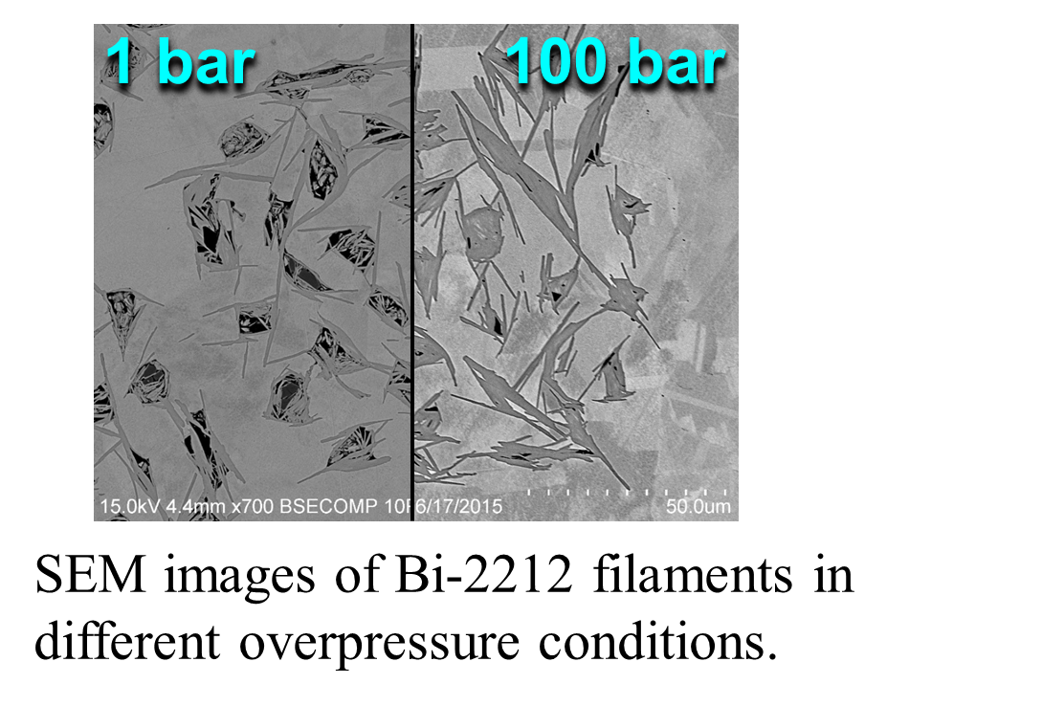
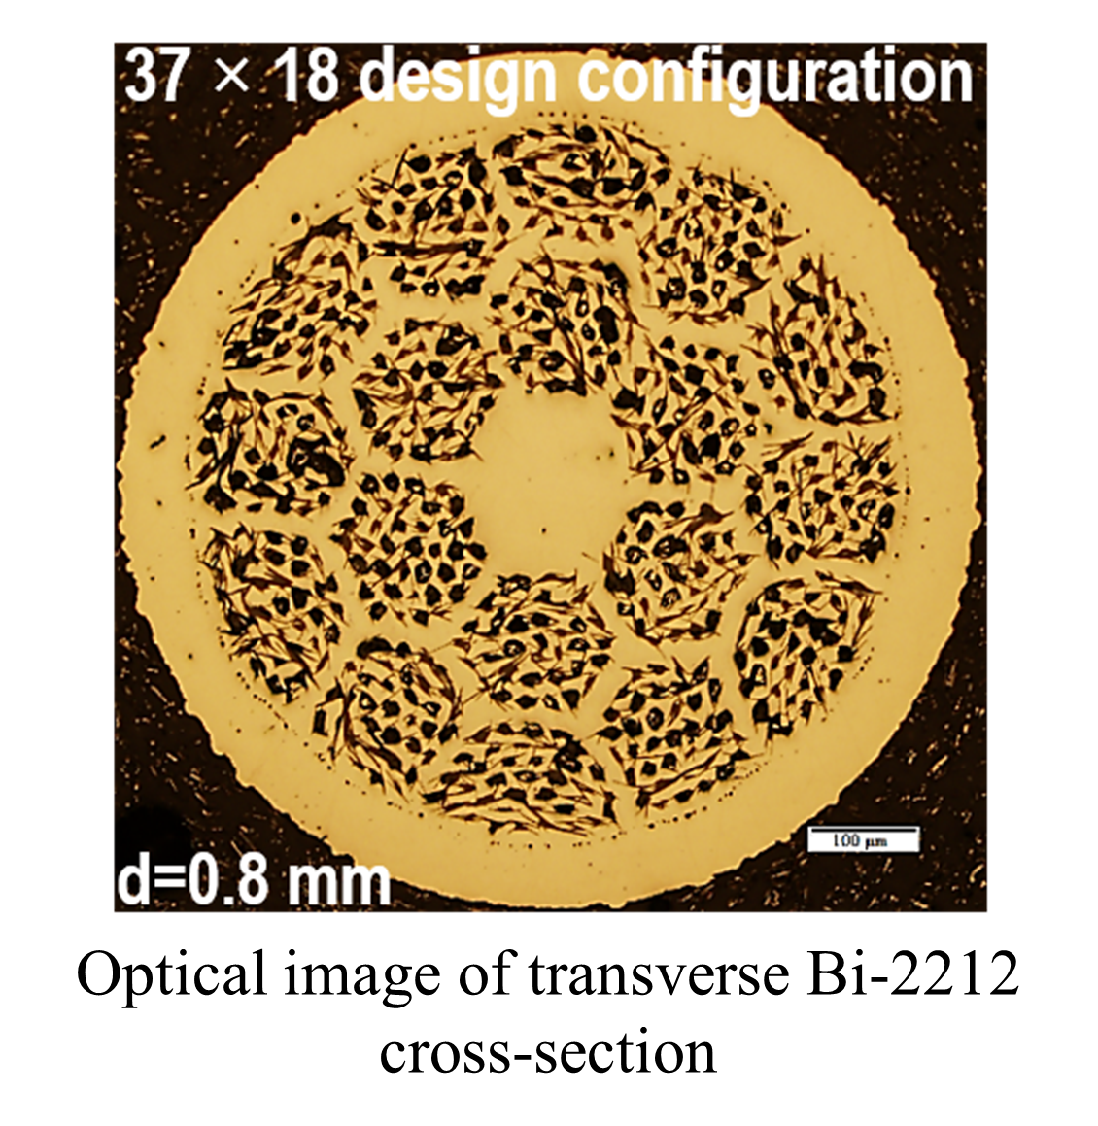
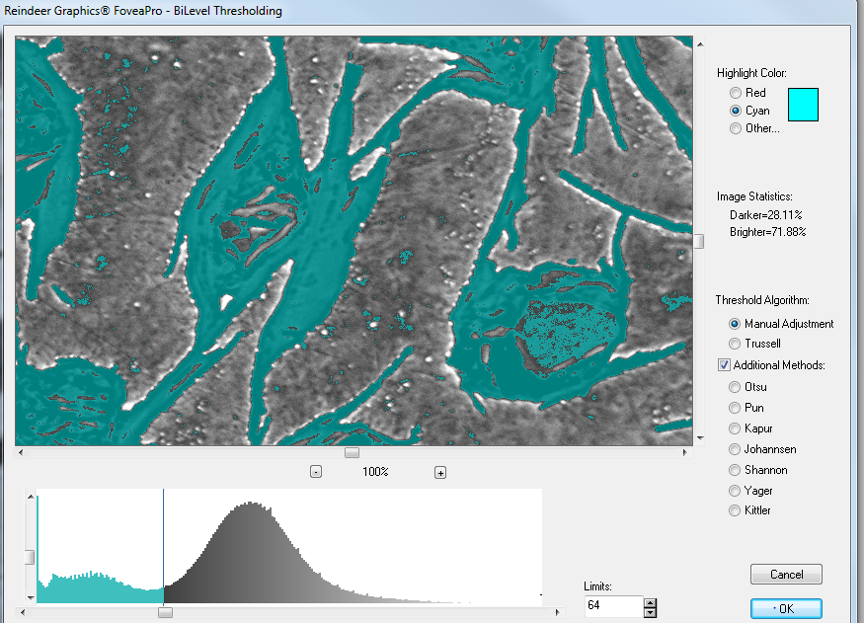
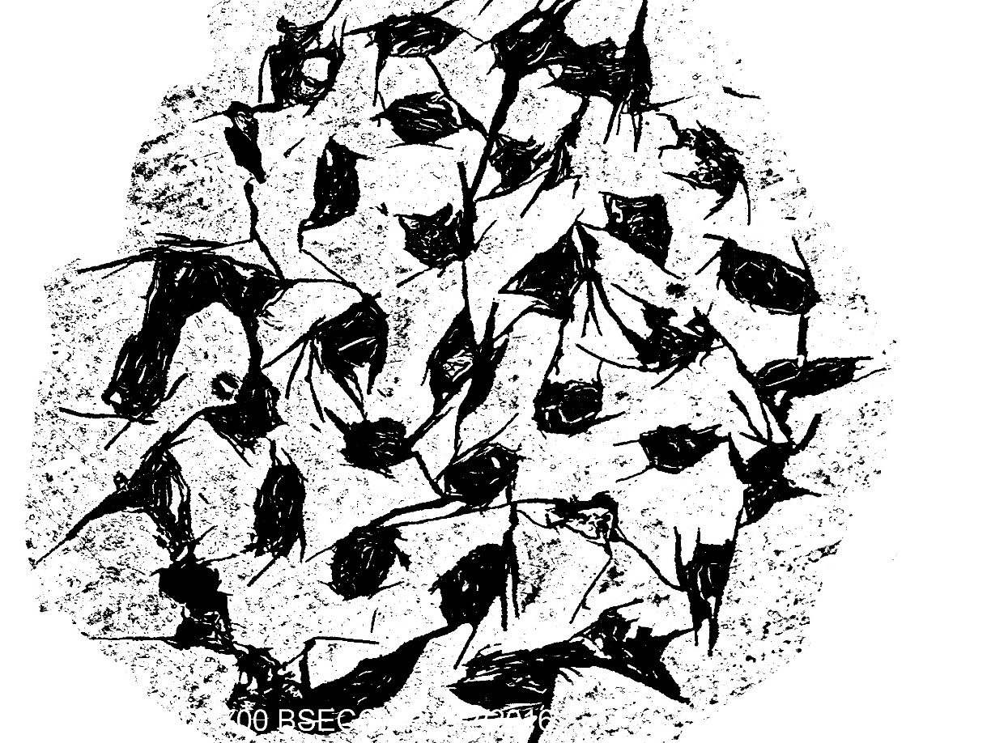

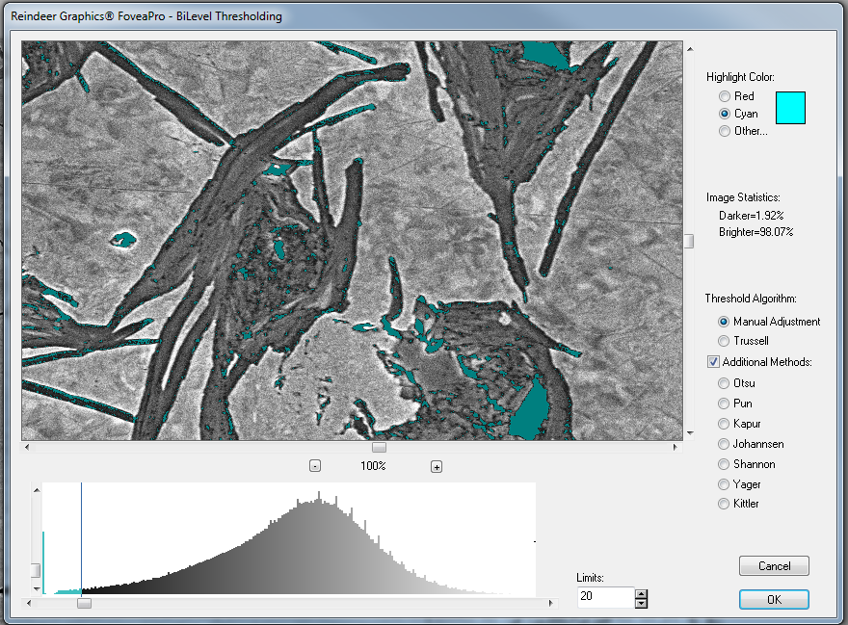
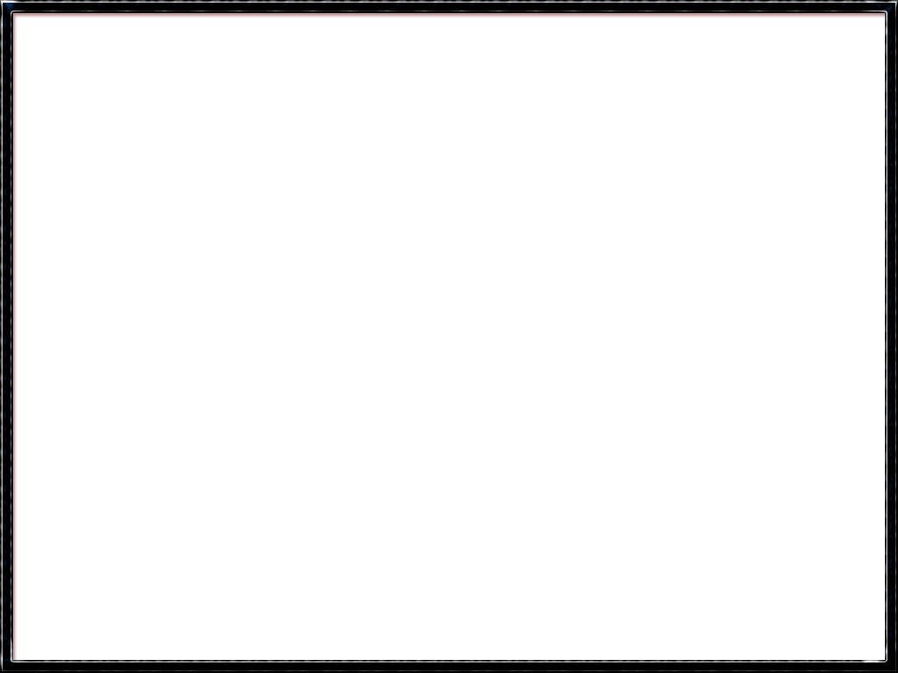


Effects of Overpressure Conditions on the Porosity of Bi-2212 Superconducting Wires
Grant Hawkins, Chris Hopp, Alexandra Putney, Dr. Matthew Jewell
Materials Science & Engineering Program University of Wisconsin – Eau Claire
Introduction
Acknowledgements
Bi₂Sr₂CaCu₂O_{(8+X)}, abbreviated as Bi-2212, has shown promise as a high-temperature superconducting material for use in powerful magnets.
Because of its brittle nature, additional study is necessary to better understand the microscopic properties of Bi-2212.
One area of note is how the properties of Bi-2212 wires change after different pressure conditions are applied to them during heat treatment.
This project used image analysis software and techniques to analyze SEM images of Bi-2212 wire samples that had been exposed to 10, 20, 50, and 100 bar overpressure conditions.
A study of reinforced square wires was also conducted, to find the differences inherent between these and the round wires.
This work was financially supported by the U.S. Department of Energy (DoE), Office of High Energy Physics, award DE-FG02-13ER42036, and benefited from the Materials Science and Engineering Center at the University of Wisconsin - Eau Claire. This study was supported by the UW-Eau Claire Blugold Fellowship Program which is jointly funded by Differential Tuition and the UWEC Foundation.
Nonsilver Thresholding
Overview images
Results and Analysis
In the nonsilver thresholding, a Scanning Electron Microscope (SEM) was used to capture images of Bi-2212 wires at the 700x magnification.
The Bi-2212 sub-bundles were isolated from the silver matrix by bilevel thresholding with a plugin in Adobe Photoshop, using a method developed by the research group.
Photoshop tools were used to clear the noise that the process generated.
The nonsilver thresholding was by far the more time-consuming of the thresholds. Therefore, it is the primary target of research into automation.
ROUND WIRE
SQUARE WIRE
ImageJ open-source software was used to measure the area of all objects for all thresholds.
Graphs were constructed with Microsoft Excel
Optical image of Bi-2212 Square Wire cross section, reinforced for durability
The tend of the porosity percentage shows that the porosity decreases as overpressure increases, before eventually levelling off at the 50 bar point. The 20 bar samples deviate for the trend noticeably here.
This is is the original 1 bar image taken with the SEM.
This is the thresholding interface, set to nonsilver settings
This is the initial bilevel threshold, where high levels of noise can be seen.
This is the completed bilevel threshold, where the noise has been removed
Porosity Thresholding
The Porosity threshold was similar to the nonsilver threshold in terms of technique used.
Porosity areas in Bi-2212 wires are much darker than the surrounding bundle’s material.
A secondary phase called Alkaline Earth Cuprate (abbreviated AEC) had to be removed with Photoshop tools, as it appears completely black in many SEM images.
This graph shows that the standard deviation also varies with overpressure, becoming smaller with increasing overpressure conditions before becoming flat.
This is the thresholding interface for porosity.
This is a completed porosity threshold with the AEC objects removed. Because of the small size of the involved objects, porosity thresholding has the highest potential for error of any step.
2-sided square wire
This is the original 10 bar image taken with the SEM.
This is a porosity threshold in which AEC Objects (large, featuring straight lines) are still extant
1-sided square wire
Conclusion
Bi-2212’s porosity is greatly reduced as overpressure is increased. The nonsilver area is reduced less dramatically
This understanding helps us to interpret the electrical and mechanical test results that we obtain from the wire.
Using the data gathered here, we can ascertain whether overpressure treatment has succeeded or failed, as we can see in the square wire data.
This graph shows the average porosity percentage for the square wires. The 2-sided wire (green dot) is comparable to the 1-bar round wire, while the 1-sided wire (red dot) is roughly equivalent to 10 or 20 bar round wire. While the square wire was thought to have been processed at 50 bar, the data reveals incomplete densification compared to the expected results
Celebration of Excellence in Research and Creative Activity (CERCA) April 30-May 4, 2018
The authors thank the UWEC Office of Research and Sponsored Programs for student support at CERCA 2018.

