Slide 1
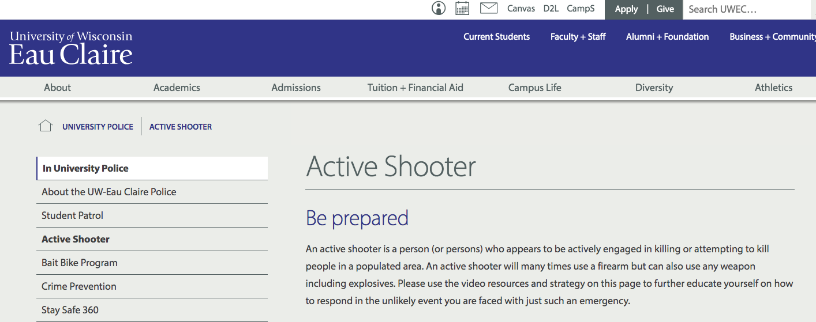
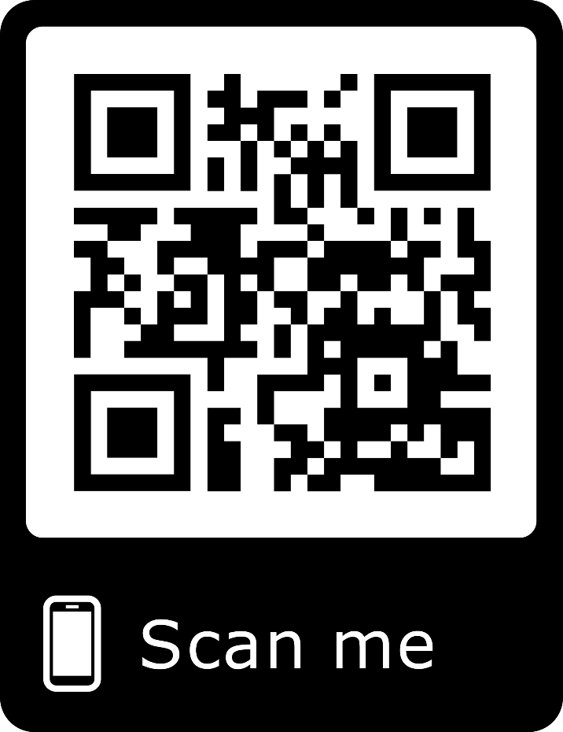
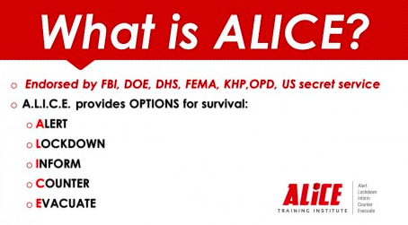
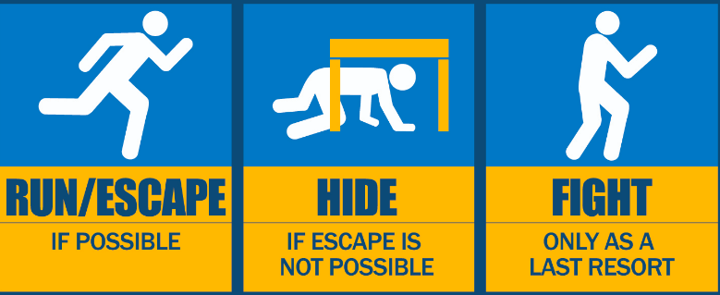
UW-Eau Claire Campus Safety
Online Resource Accessibility: Active Shooting Threats
Maddie Forrest, Janel Riegleman and Dr. Mary Worley
Communication and Journalism Department
Research Questions
Results Cont.
R₁: How accessible are active shooter training resources on college and university websites?
R₂: What type(s) of active shooter training resources are available on college and university websites?
R₃: What type(s) of emergency alert communications are available on college and university websites with regard to active shooter threats?
Abstract
The unfortunate reality of active shootings on college campuses has increased campus safety communication and the types of resources provided for students, faculty and staff. The current study uses content analysis methodology to examine online resources from 293 colleges and universities across the United States. Results from this study highlight ease of resource accessibility as well as the types of content and sources made available: videos, written documents, emergency notifications, and in-person/online training. Results from this study can be used to better understand how colleges and universities communicate about active shooting preparedness and whether or not resources are easily accessible to students, faculty, and staff.
Methods
293 institutions that exceeded a total enrollment of 2,000 students were examined to evaluate active shooter training and resource accessibility. The institutions included public, private and community colleges in either rural, suburban, urban, college town or other locations. The research only pertained to active shooting resources, not emergency resources related to natural disasters or other human-caused crises (e.g. sexual assault or crime).
Data was analyzed using qualitative content analysis methods by two coders. Variables included search accessibility, search ease, presence or absence of video, written, training, and emergency notification content, and the source of present content.
Literature Review
Results
Discussion
Most often surrounds emergency response to an active threat as opposed to preparedness and training (Booker, 2014; Gow et al., 2009; Gregory, 2012; Knott, 2014; McGee & Gow, 2012)
We need to build “cultures of preparedness” that are long-term and sustainable (Kupuku & Khosa, 2013).
Campus communities should “co-produce” communications related to active shooting threats, which would involve a collaborative process among students, faculty, staff, and emergency personnel (Berkes, 2009; Canhoto et al., 2016; Williams et al., 2016).
As the rise of active shooting continues, the need for readily-available resources will increase. Universities, including UW-Eau Claire, will need to advance their efforts in implementing training resources online and in-person.
It is imperative that universities provide links on their webpage to these resources so that they can be easily accessed both in the event of an emergency and in everyday life.
Research like this should be continued to help the surrounding community foster a safer environment.

