Slide 1

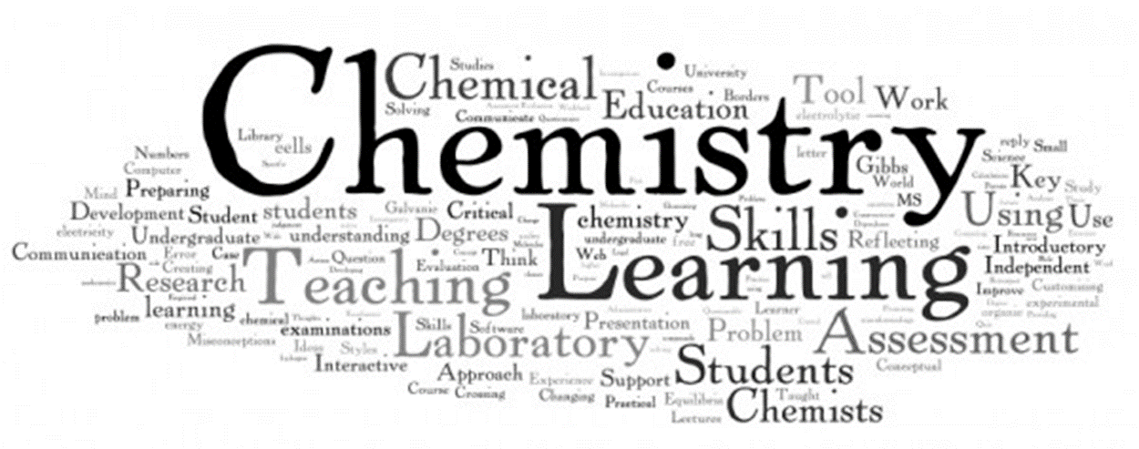

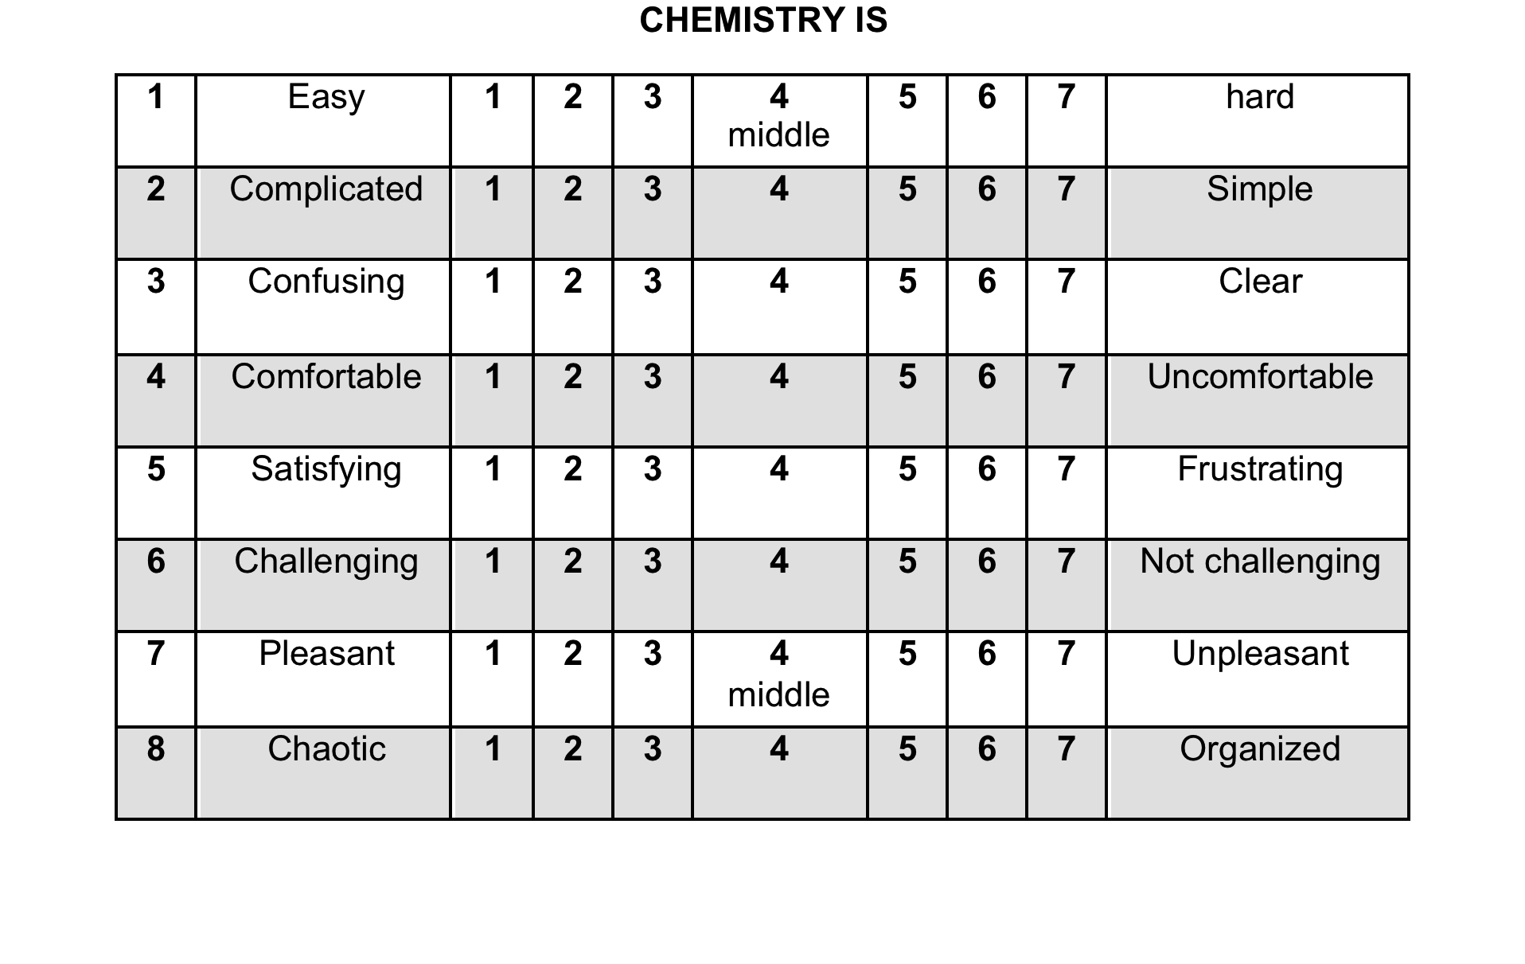
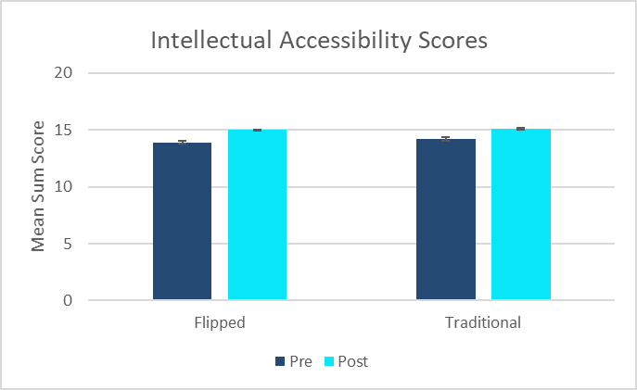
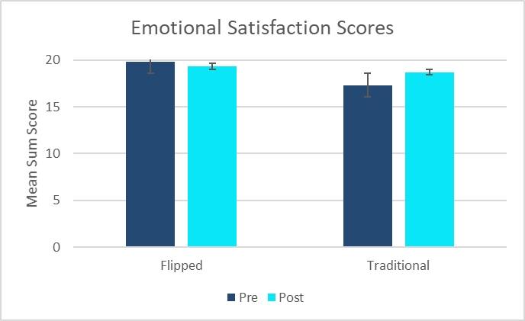
Flipping the General Chemistry Laboratory Lecture: Increasing Student Engagement
By Enhancing Self-Directed Learning
Katrina Idárraga, Hannah T. Nennig, and Dr. Roslyn M. Theisen
Department of Chemistry, University of Wisconsin- Eau Claire
Project Overview
Population Studied
At the University of Wisconsin – Eau Claire, two combined lecture and lab sections of a first-term General Chemistry course were studied.
Fall 2014 – General Chemistry I (CHEM 103) – control section
Fall 2016 – General Chemistry I (CHEM 103) – flipped section
Professor Theisen was the lecture instructor of both courses.
The flipped and control courses were designed to achieve equivalent expectations.
Strengthening instruction in STEM fields can benefit student learning as well as foster positive attitudes towards the sciences. This project tries to answer the question whether there is a measurable difference in understanding of and attitudes towards chemistry of two groups: students who complete a General Chemistry course where the laboratory lecture is in a flipped format and students who complete a General Chemistry course where the laboratory lecture is in a traditional lecture format.
Figure 1 (Seery)
Statistical Analysis
Using IBM SPSS Statistics, a software package used for statistical analysis, the two subscales IA and ES from the ASCIv2 survey were compiled and processed for statistical significance by the independent samples t-test. The t-test measures the degree to which two groups/experiments have the same average value. When p> 0.05, statistical analysis indicates that the difference between groups is not significant. The American Chemical Society standardized final exam scores for General Chemistry (with a raw score out of 70) were processed for statistical significance by the independent samples t-test. The means and standard deviations of this assessment were also evaluated as well as final course percentage.
In this study, flipped and traditional student attitudes and understanding will be assessed by several quantitative and qualitative measures. A published, validated and reliable attitude survey on the subject of chemistry will be given to student participants (the ACSI V2) at the beginning and at the end of the course. To quantitatively assess student understanding of General Chemistry of all groups, standardized final exam scores were examined and statistically analyzed.
Goals
  Gather information about the impact of flipped or traditional teaching modes on student learning
  Measure student understanding of General Chemistry
  Measure student attitudes towards the subject of chemistry
Hypothesis
Our hypothesis is that students who are enrolled in the flipped curriculum course will have a higher measurable outcome of understanding of and attitudes towards chemistry.
Why Flipped Learning?
A flipped course combines the best features of face-to-face teaching with those of the online learning environment. This learning style is a pedagogical approach in which direct instruction moves from the group learning space to the individual learning space, and the resulting group space is transformed into a dynamic, interactive learning environment.
Timeline of Events
Assessment of Attitude
Attitudes are an important non-cognitive factor in science literacy that science educators emphasize. The assessment of both academic achievement and non-cognitive values are an essential component of science education.
Part | Description | Data Collection Fall 2014 and Fall 2016
1 | Pre-Course Attitude Survey | ASCIv2 attitude survey was given to participating students on the 6th week of the course. Bonus points were awarded for participation.
2 | Lab and Lecture Delivery | All groups covered the same topics in lab and lecture and were given similar assessments, but differed in lab lecture content delivery mode (flipped or traditional).
3 | Post-Instruction Final Exam | The same standardized final exam was given to all students
4 | Post-Course Attitude Survey | ASCIv2 attitude survey was given to participating students after the 15th week of the course. Bonus points were awarded for participation.
The Attitude Toward the Study of Chemistry Survey (ASCIv2) is a semantic differential survey created by Xu and Lewis (2011).
Flipped Learning Involves:
1. Flexible learning environments
2. Student-centered classrooms
3. Just-in-time teaching
4. More intentional instruction
While flipped lectures courses have appeared throughout the undergraduate curriculum, flipped laboratory experiences are more rare.
Items 1, 4, 5 and 7 needed to be re-coded in order for higher scores to represent positive aspects of students’ attitudes.
The ASCIv2 has two subscales, intellectual accessibility (IA) and emotional satisfaction (ES).
Items 1, 2, 3 and 6 load on the IA subscale and items 4, 5, 7 and 8 load on the ES subscale.
Data and Results
π
Flipped vs Traditional Pre and Post ASCIv2
Final Exam Average and Final Course Average
 | ACS Raw Score Out of 70 | Course Grade Percentage
Traditional Group Mean | 32.8 | 77.9
Std. Dev. | 8.0 | 5.5
N | 87 | 87
Flipped Group Mean | 33.3 | 83.6
Std. Dev. | 7.8 | 12.9
N | 65 | 67
The average final exam score (out of 70) for the traditional group is 32.8 and for the flipped group is 33.3. There was no significant difference in final exam scores between the two groups (p = 0.68). We can say we did no harm to students understanding of chemistry by flipping the laboratory lecture.
The average course percentage for the traditional group was 77.9% and for the flipped group the average course grade percentage was 83.6%. There was a significant difference in course grade percentage (p = 0.006) which indicates that students in the flipped class room did better overall in the course than the traditional group.
There was a significant difference (p<0.001) between the flipped and traditional for the overall course percentage and there was not a significant difference between the raw scores between the two group
Items 1, 2, 3 and 6 were summed to represent Intellectual Accessibility (total possible 4 to 28) and items 4, 5, 7 and 8 were summed to represent Emotional Satisfaction (total possible 4 to 28).
When comparing the pre- and post-IA scores for the students in the traditional group and the flipped group, both IA scores increased. However, neither of these values are significant (p = 0.105 for traditional IA, p = 0.137 for flipped IA), because of this, we cannot reject the null hypothesis.
Students in both the flipped and traditional groups showed comparable intellectual accessibility sum scores at the beginning and at the end of the semester.
When comparing the pre- and post-ES scores for students in the flipped group, there is a decrease in ES sum score. The p value found is 0.583. This value is not significant, and because of this, we cannot reject the null hypothesis. In comparing the pre- and post-ES scores in the traditional group, there is an increase in ES sum score. This increase is statistically significant where p = 0.041, which means we can reject the null hypothesis.
Students in the traditional course show a statistically significant increase in emotional satisfaction, where students in the flipped group show no net change in emotional satisfaction.
Attitude and Final Exam Score
Both Emotional Satisfaction and Intellectual Accessibility (measured by the post-ASCIv2 survey) at the end of the semester was significantly correlated with ACS exam raw score, r = .48 for ES and r = .44 for IA, for the flipped group (all ps < .001).
Both Emotional Satisfaction and Intellectual Accessibility (measured by the post-ASCIv2 survey) at the end of the semester was significantly correlated with ACS exam raw score, r = .11 for ES and r = .16 for IA, for the traditional group (all ps NOT < .001).
References
  Bauer, C. F. Attitude toward Chemistry: A Semantic Differential Instrument for Assessing Curriculum Impacts. J. Chem. Educ. 2008, 85 (10), 1440–1445.
  Exploring the Pros and Cons of Online, Hybrid, and Face-to-face Class Formats. (2013, January). University of Washington. Retrieved from www.washington.edu/provost/files/2012/11/edtrends_Pros-Cons-ClassFormats.pdf.
  Field, A. Discovering Statistics Using SPSS, Third Edition.; Sage Publications Ltd: London, 2009.
  González-Gómez, D. et al. Performance and Perception in the Flipped Learning Model: An Initial Approach to Evaluate the Effectiveness of a New Teaching Methodology in a General Science Classroom. J. Sci. Educ. Technol. 2016, 25 (3), 450–459.
Hibbard, L.; Sung, S.; Wells, B. Examining the Effectiveness of a Semi-Self-Paced Flipped Learning Format in a College General Chemistry Sequence. J. Chem. Educ. 2016, 93 (1), 24–30.
Ryan, M. D.; Reid, S. A. Impact of the Flipped Classroom on Student Performance and Retention: A Parallel Controlled Study in General Chemistry. J. Chem. Educ. 2016, 93 (1), 13–23.
  Schultz, D.; Duffield, S.; Rasmussen, S. C.; Wageman, J. Effects of the Flipped Classroom Model on Student Performance for Advanced Placement High School Chemistry Students. J. Chem. Educ. 2014, 91 (9), 1334–1339.
  Seery, M., Wordle of University Chemistry Education Titles Volumes 1-8. Retrieved from http://michaelseery.com/home/index.php/2011/11/chemistry-education-research-and-practice/
  Smith, J. D. Student Attitudes toward Flipping the General Chemistry Classroom. Chem. Educ. Res. Pract. 2013, 14 (4), 607–614.
Sturtevant, H. G.; Weaver, G. C.; Design, Implementation, and Evaluation of a Flipped Format General Chemistry Course. J. Chem. Edu. Online 2015, 92, 1437-1448.
  Theisen, R. Was Approved to Work on This Project by the UW-EC Institutional Review Board (IRB) for the Protection of Human Subjects under the Category of Exempt (IRB Number THEISERM6702012). August 2012.
  Xu, X.; Lewis, J. E. Refinement of a Chemistry Attitude Measure for College Students. J. Chem. Educ. 2011, 88 (5), 561–568.
Acknowledgments
April Bleske-Rechek (UW-Eau Claire, Psychology) Consultant on Data Analysis and Jason Halfen (UW-Eau Claire, Chemistry) for teaching some of the laboratory sections associated with these courses.
Office of Research and Sponsored Programs, the Department of Chemistry and Learning and Technology Services at the University of Wisconsin - Eau Claire
Student Blugold Commitment Fund through the CETL Summer SOTL Grant Program (RMT)
Wisconsin Alliance for Minority Participation (WiscAMP) Small Grants Program through UWEC, supported by the National Science Foundation (Grant No. 1400815) (KLI)

