Slide 1


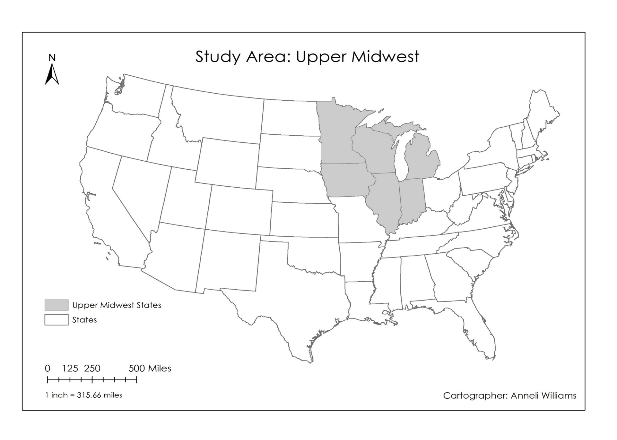
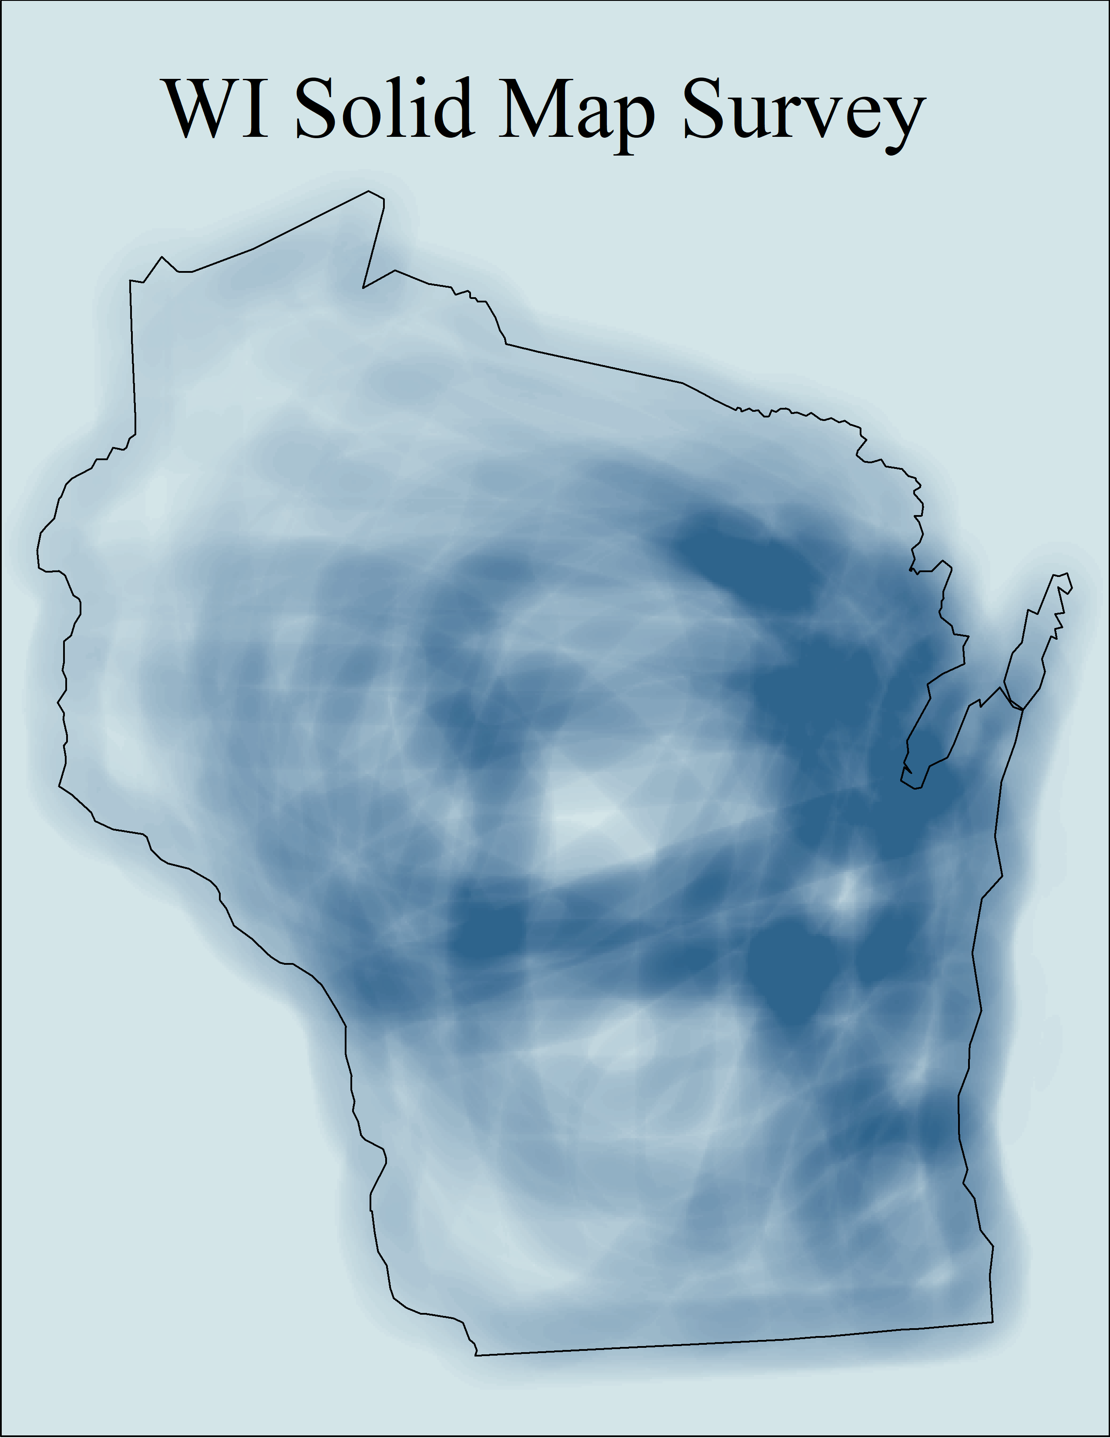
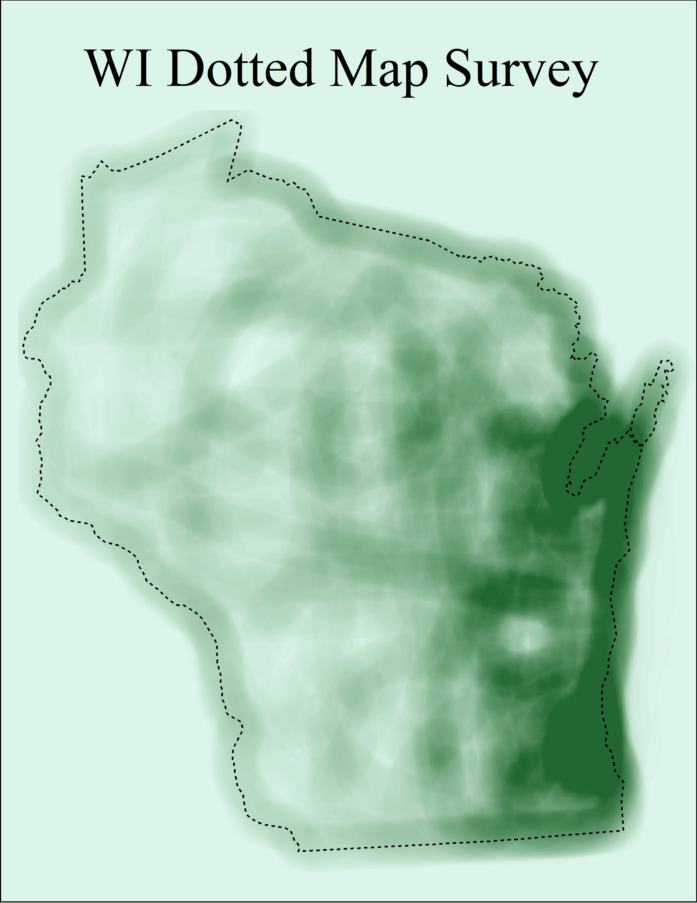
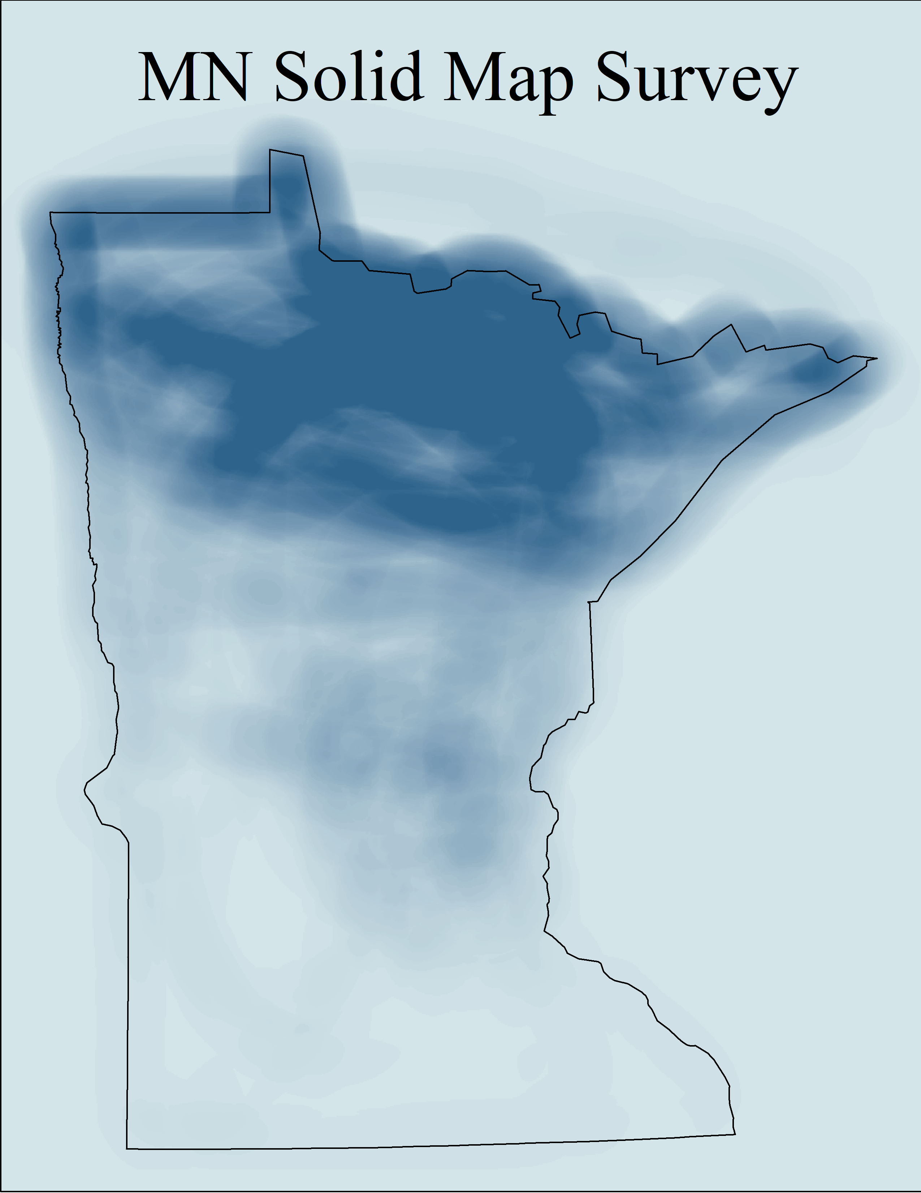
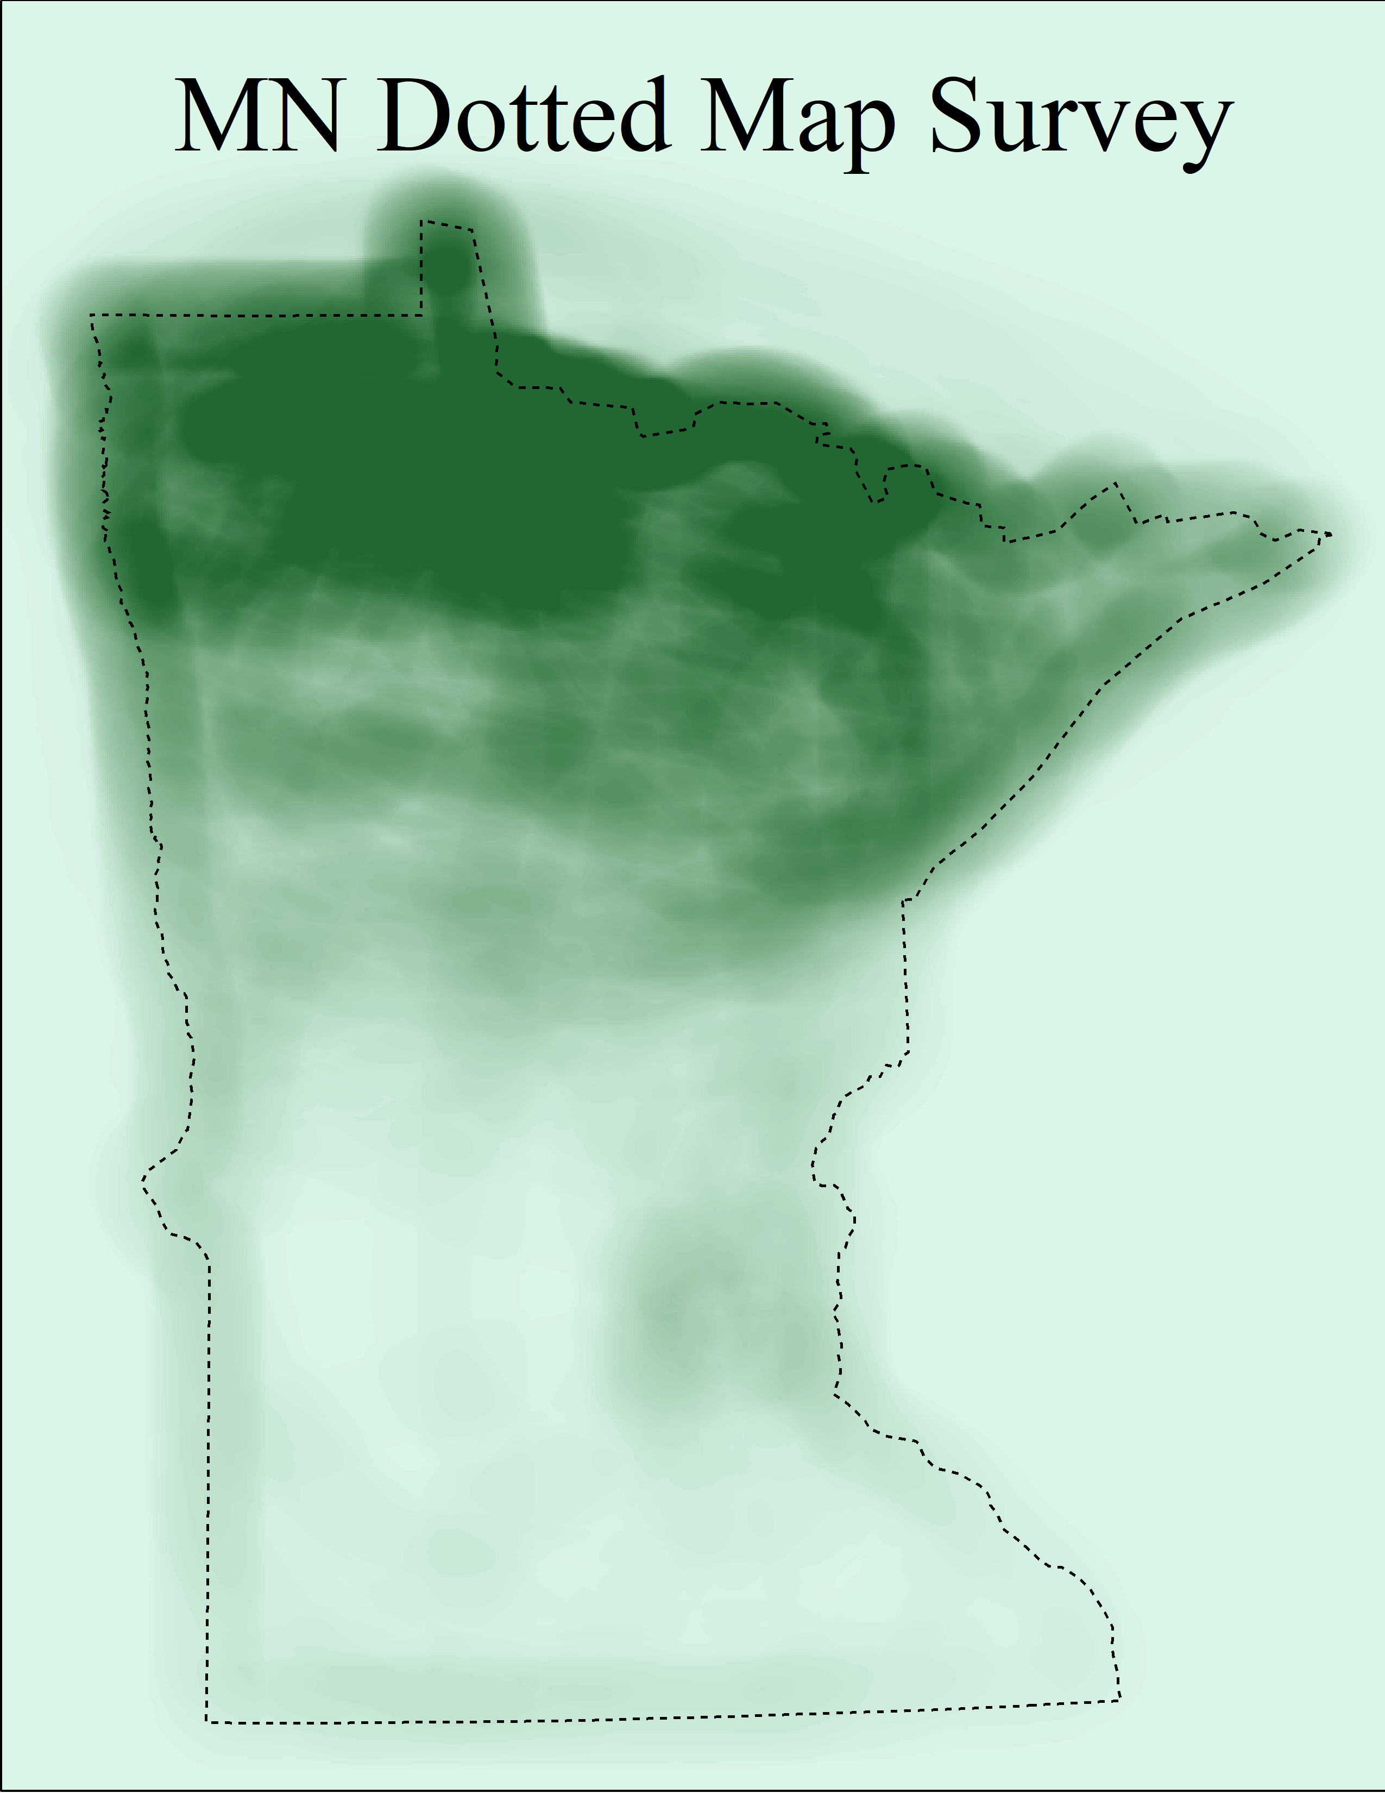
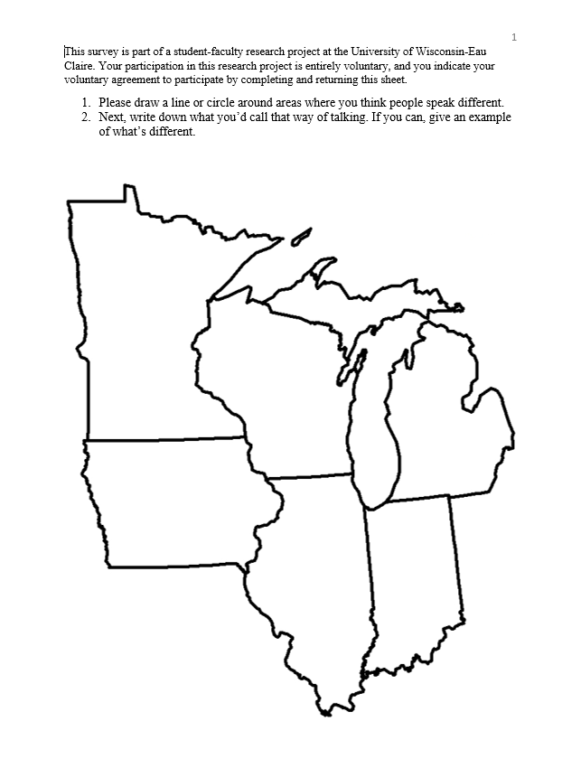
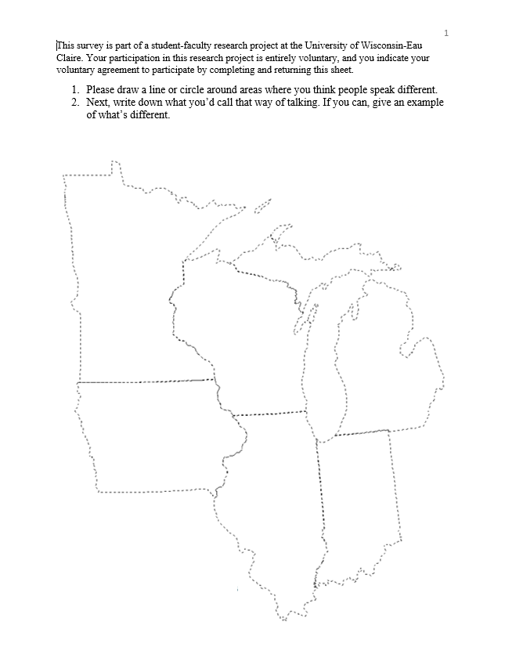
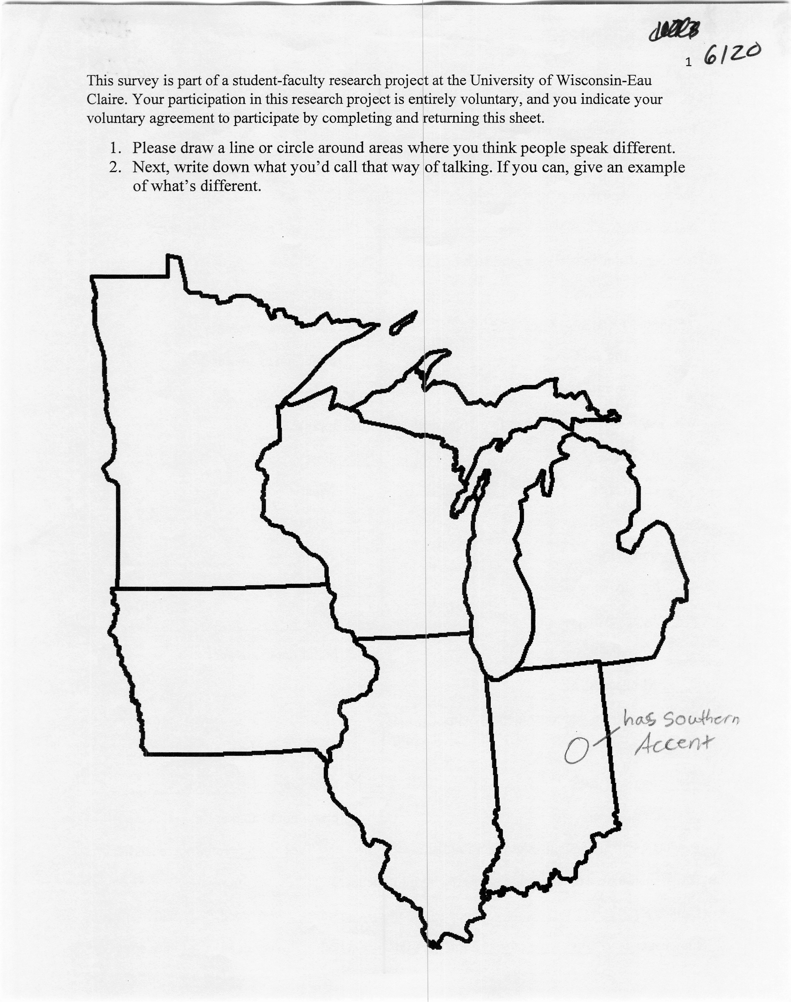
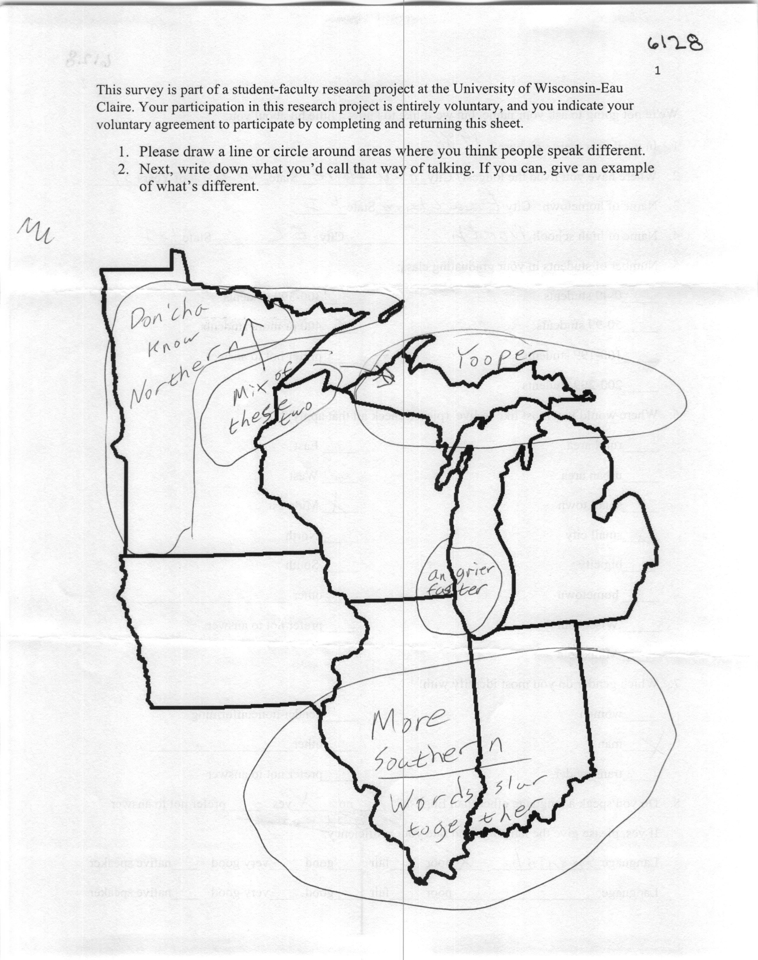
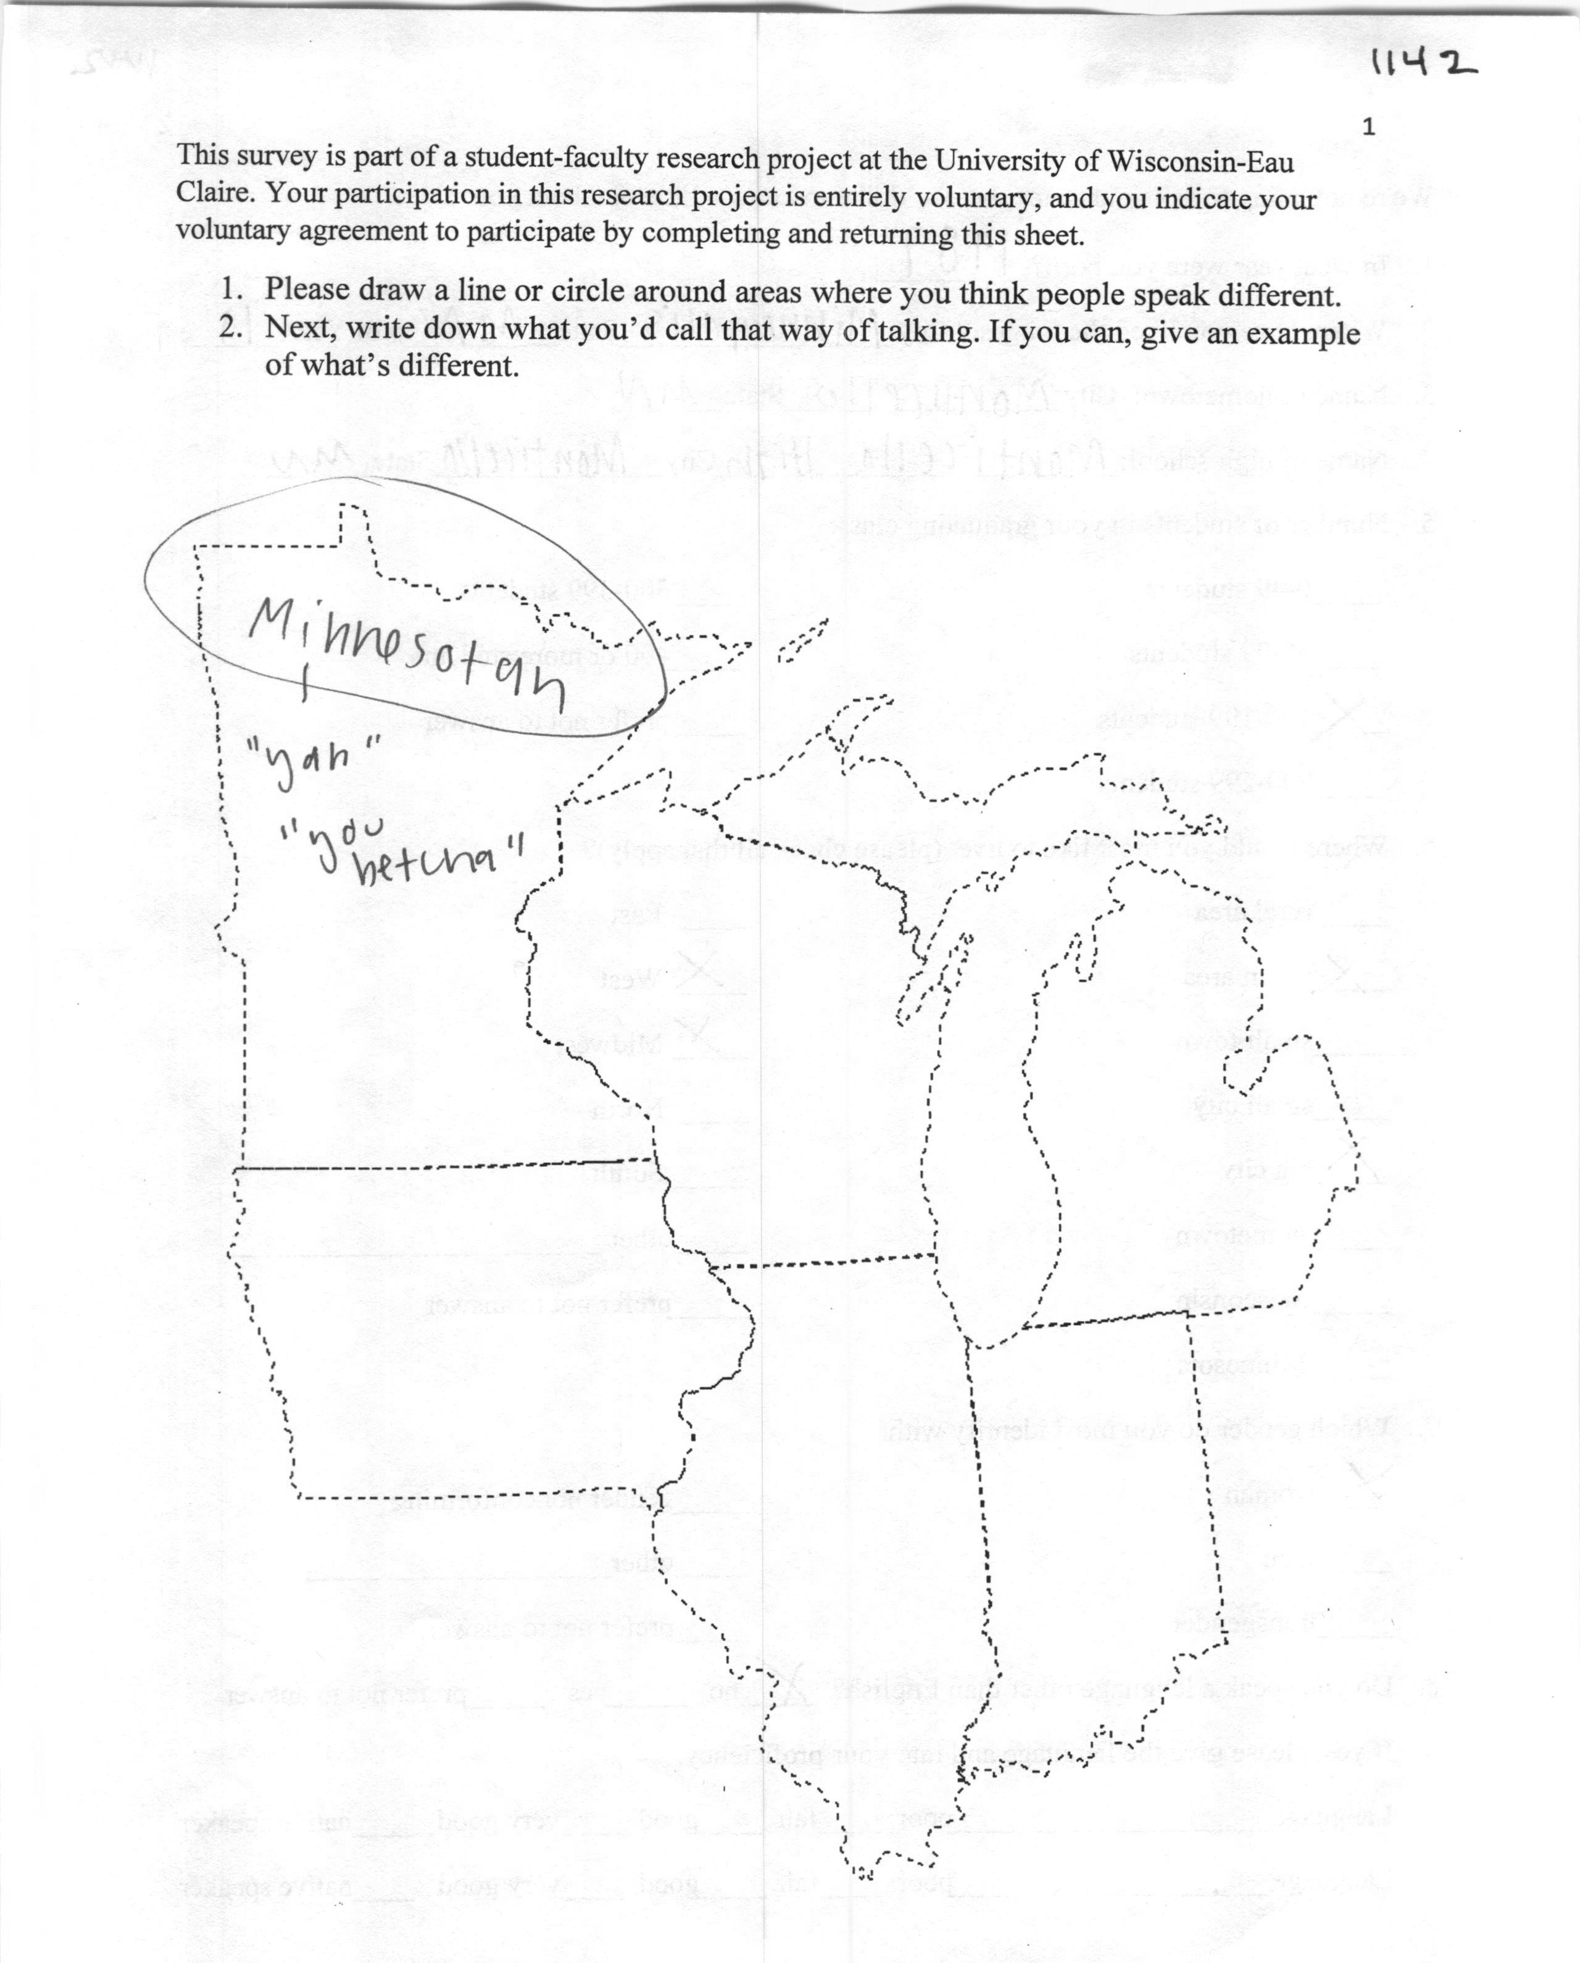
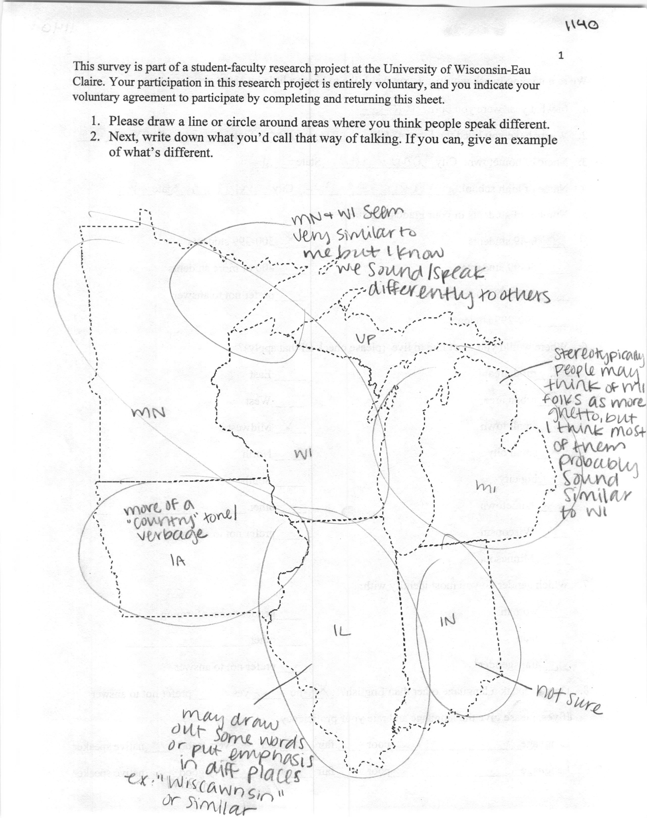
Investigating Language Perceptions in the Midwest with GIS
Anna Khan, Anneli Williams, and Dr. Erica Benson, Departments of Geography & Anthropology and English
ABSTRACT
The Midwest has a rich linguistic landscape but has been largely understudied within the realm of perceptual dialectology, which is what nonlinguists think about the language in a particular region. This research aims to address the question of how respondents respond differently to solid map survey boundaries compared to dotted map survey boundaries. We hypothesize that respondents will draw more multi-state polygons/dialect areas on dotted survey maps and more single-state polygons/dialect areas on solid survey maps. Furthermore, we consider what states are more commonly included in the single or multi-state polygons, alongside the variation in survey types overall. In this project, we combine linguistic research methods with Geographic Information System (GIS) technology to explore these issues.
Focus of Poster
METHODS: SURVEYS
& RESPONDENTS
PRELIMINARY RESULTS
Examine how respondents respond differently to solid map survey boundaries compared to dotted map survey boundaries and what states are more commonly included in the single or multi-state polygons in the region of the Midwest shown in Figure 1.
Total survey collection was 342; 207 were from students at UWEC
Excluded 26 surveys from analysis:
8 were incomplete or respondents were born and/or raised outside of the U.S.
18 were excluded because they had no polygons/dialect areas drawn on them
Pivot tables were created in Excel to tally the number and means of single vs. multi-state polygon/dialect areas drawn by respondents for each map type, shown in Tables 3-4
SPSS frequency tests were used to determine which states were most often included in single state (Table 5) and multi-state (Table 6) polygon/dialect areas.
Figures 9 and 10 show images of the density of polygons/dialect areas drawn in WI on solid and dotted-line surveys
Figures 11 and 12 show images of the density of polygons/dialect areas drawn in MN on solid and dotted-line surveys
Surveys contained demographic data such as home state and gender, as shown in Figure 2 and Table 1, respectively
Count | Single State | Multi State | All Totals
Dotted | 370 | 224 | 594
Solid | 275 | 148 | 423
Total Count | 645 | 372 | 1017
Mean | Single State | Multi State | All Totals
Dotted | 2 | 1.21 | 3.21
Solid | 2.1 | 1.13 | 3.23
Total Mean | 2.04 | 1.18 | 3.22
Table 3. Number of single vs. multi state polygons/dialect areas drawn
Table 4. Mean of single vs. multi state polygons/dialect areas drawn
State | Dotted Single % | Solid Single % | Total Single %
MN | 26.2 | 28.5 | 27.3
WI | 28.9 | 27.4 | 28.1
MI | 13.5 | 15.5 | 14.3
IA | 8.6 | 10.5 | 9.3
IL | 15.4 | 13 | 14.3
IN | 6.5 | 5.4 | 6
Total Count | 370 | 277 | 645
State | Dotted Multi % | Solid Multi% | Total Multi %
MN | 48.9 | 41.8 | 45.8
WI | 69.3 | 66.4 | 67.5
MI | 40.9 | 42.5 | 41.5
IA | 28.4 | 28.8 | 28.6
IL | 50.7 | 56.2 | 52.1
IN | 38.7 | 44.5 | 40.2
Total Count | 224 | 146 | 377
Figure 1. Map of study area
LITERATURE REVIEW
The Midwest has a rich linguistic history and is currently at the center of language changes in progress. Few studies have examined the awareness and perceptions of language differences in this area. Montgomery & Stoeckle (2013) argue for the use of Geographic Information System (GIS) in perceptual dialectology studies, and Evans (2011) combines GIS with Preston’s (1981) pioneering “draw-a-map” task in Washington. We apply those methods here. Studies of perceptions have examined some demographic information and map annotations, but this is the first to investigate the representations of state boundaries as an influencing factor.
Figure 2. Home State data
Table 5. States included in Single polygon/dialect areas %
Table 6. States included in Multi-polygon/dialect areas %
Gender | Total | %
Self-identified as Man | 133 | 42.1
Self-identified as Woman | 177 | 56
Self-identified as Non-binary/no response | 6 | 1.9
Table 1. Gender Makeup
SURVEY TYPES
Participants were given one 1 of 2 different map types: a map with solid (Figure 3) or dotted (Figure 4) state boundaries
A total of 316 respondents engaged in drawing polygons/dialect areas as shown in Table 2 for each map type. Sample surveys are shown in Figures 5-8
METHODS: GIS WORKFLOW
Figure 9. WI Solid
Figure 10. WI Dotted
Figure 11. MN Solid
Figure 12. MN Dotted
Survey maps scanned as jpeg files
Created Geodatabase along with solid and dotted feature classes
Feature classes’ field and domain set for attributes (mapcode, label, general comments, multi-state, individual state name, and notes)
Jpeg images georeferenced with Midwest reference map
Map annotations digitized and attributed
Solid and dotted datasets merged into one file and exported to an excel table (for statistical use)
Polygon to Line tool used to convert polygon feature class to line feature class
Dot Density tool was used to create raster images
DISCUSSION
As shown in Tables 3 and 4, there are slightly more multi-state polygons/dialect areas on the dotted-line surveys than the solid-line surveys and vice versa for the single state polygons
Tables 5 and 6 show that the areas included in the most polygons/dialect areas are WI and MN, and the least are IA and IN. This may be due to the respondent make up and with IA and IN being periphery states on the map. MI, for instance, was mostly annotated in the U.P. than the mainland
As shown in Figures 9 and 10, there are more dialect areas drawn in the Central and Eastern half of WI in the solid map surveys compared to the Eastern half of WI in the dotted map surveys
Figure 11 and 12 illustrate perceived dialect areas in MN being located in the Northern third of the state
Future analysis will further investigate possible reasons for these patterns and will test for statistical correlations with the demographic data, map types, and polygons/dialect areas
Figure 3. Solid Survey
Figure 4. Dotted Survey
Figure 5. Ex. Solid Survey 1.
Figure 6. Ex. Solid Survey 2.
Figure 7. Ex. Dotted Survey 1.
Figure 8. Ex. Dotted Survey 2.
REFERENCES
Survey Type | Dotted | Solid | Total
Participants | 185 | 131 | 316
Evans, Betsy. 2011. ‘Seattletonian’ to ‘Faux Hick’: perceptions of English in Washington state. American Speech 86. 383-414.
Montgomery, Chris & Philipp Stoeckle. 2013. Geographic Information Systems and perceptual dialectology: A method for processing draw-a-map data. Journal of Linguistic Geography 1(1). 52–85.
Preston, Dennis. 1981. Perceptual dialectology: Mental maps of United States dialects from a Hawaiian perspective. H. Warkentyne (ed.). Papers from the Fourth International Conference on Methods in Dialectology. Victoria, British Columbia, 192-198.
Table 2. Survey data

