Slide 1

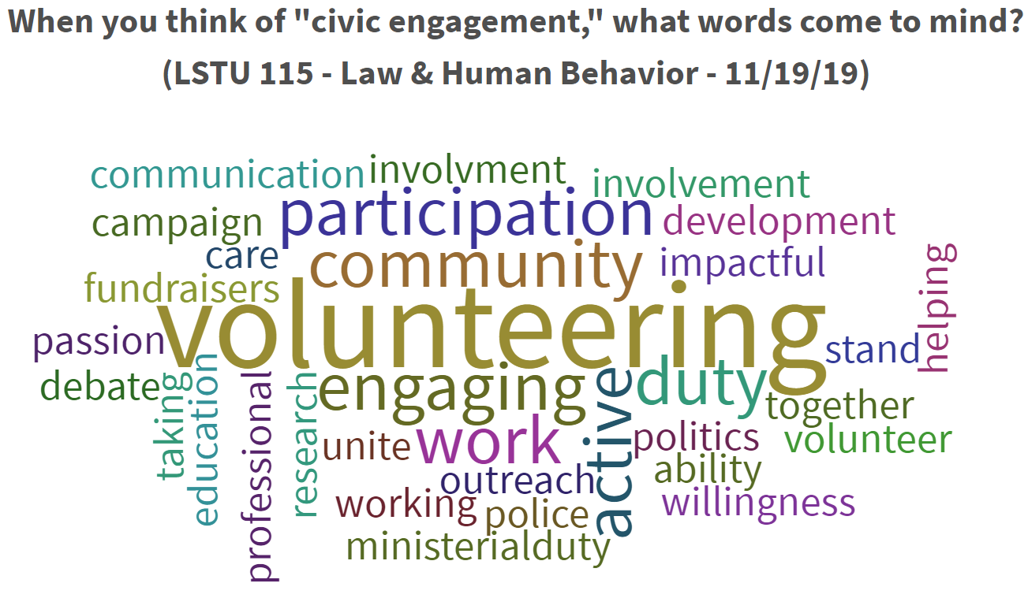
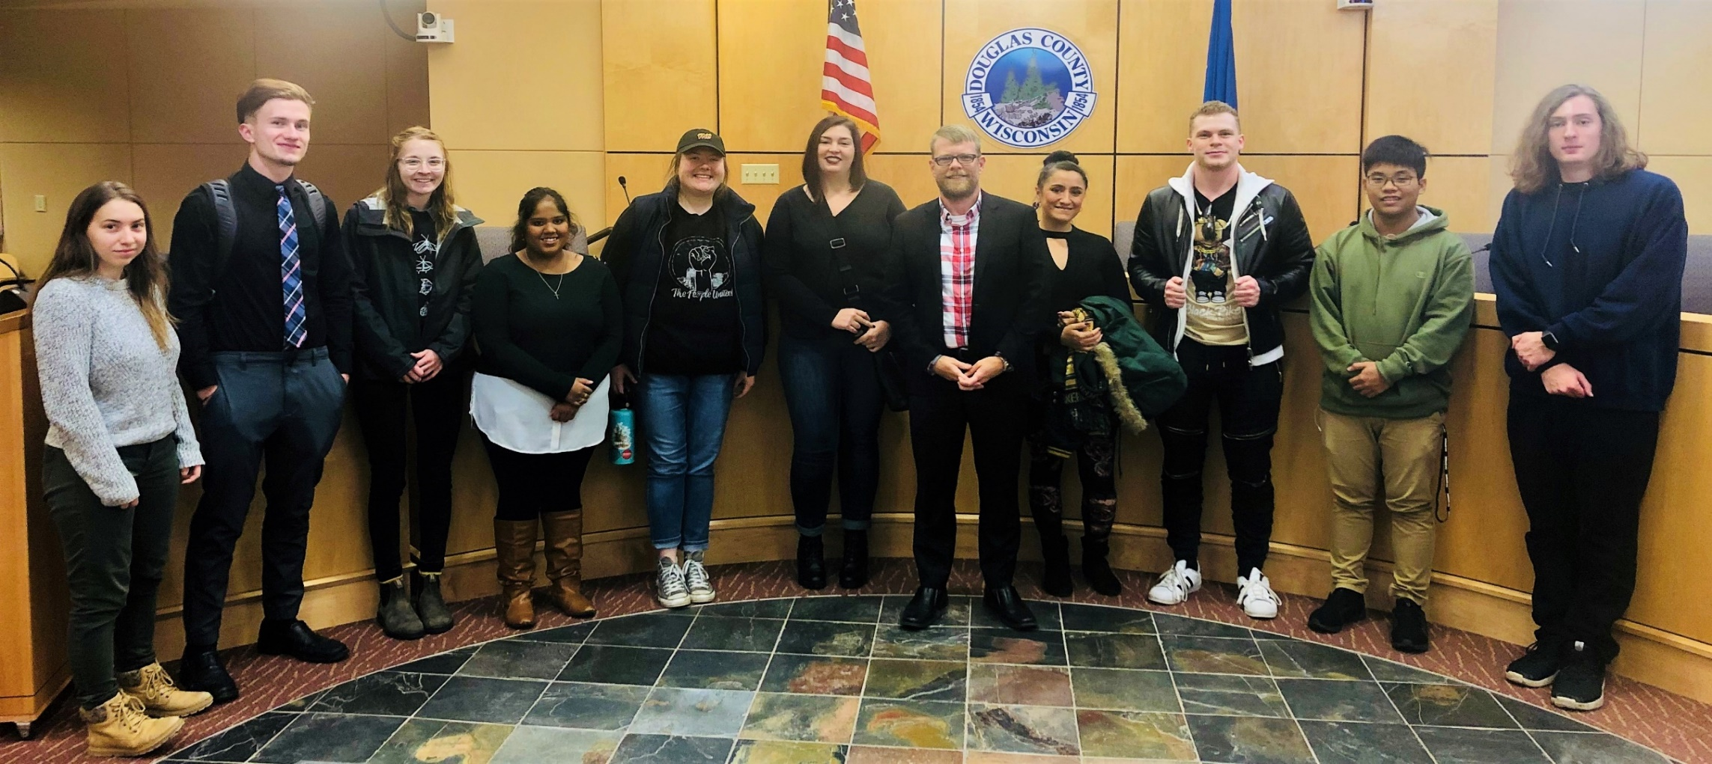
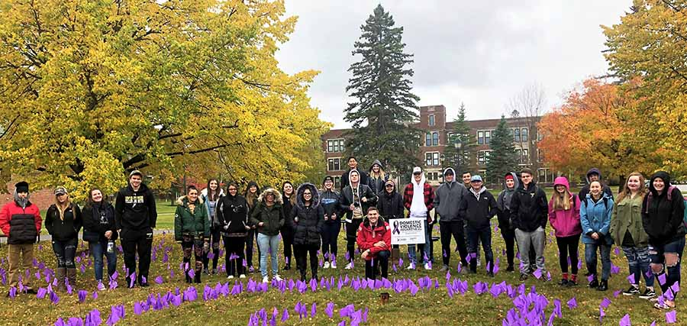
Thawing the Resistance: Identifying Origins of Student Antipathy Toward Service-Learning & Civic Engagement Senior Lecturer Nathan N. LaCoursiere, Legal Studies & Criminal Justice Program (HBJD) nlacours@uwsuper.edu
ABSTRACT
Fostering student civic and community engagement through high-impact teaching practices such as Academic Service-Learning (AS-L) is a key component of the UWS mission. Legal Studies incorporates AS-L in several classes. As an instructor, I often observe student reluctance, aversion or anxiety when introducing and applying service-learning. Using qualitative research methods coupled with a national survey, this Phase I project sought to identify origins of reluctance to service learning and gather suggestions for alleviating. Phase II: incorporate findings into future course design in LSTU 233 and LSTU 115.
Intro & Key Instructor Takeaways
Findings & Student Suggestions
This project focused qualitative research efforts on LSTU 233 (Law, Citizenship & Civic Engagement), secondarily on LSTU 115 (Law & Human Behavior).
RQ1/RQ2 and the CIRCLE Civic Engagement Survey will be administered in future 115 and 233 courses to build statistically relevant data.
Based on current findings, future courses will employ expanded sociopolitical learning models (Beaumont 2011) and opportunities for students to “meet people who make society better” (Metzger et al. 2015) in order to thaw pre-course antipathy to engagement.
Good News! Both LSTU 233 & LSTU 115 Outpace 2006 Civic & Political Health of Nation Survey!
LSTU 233: 70% Dual Activists; 10% Civic Specialists; 20% Disengaged but Civic Specialist
LSTU 115: 38% Civic Specialists; 33% Disengaged; 29% Dual Activists
No. 1 Barrier: Time Pressure/Stress (close behind: lack of invitation; pathways; knowledge; identity with others engaging; larger-group collaboration).
Jane Doe 233: Older male official to female student:
“You don’t know what you’re talking about.”
Student Suggested Remedies?
UWS Day of Engagement (Community Campus)
First-year cohort – fun crash course in engagement
Incentivized group, campus, program-led pathways to engagement. KEY: Strength in Numbers!!!
Qualitative Methodology + Survey
Step 1: Administer the Tufts Univ. CIRCLE Civic Engagement Survey in LSTU 233 & 115.
Step 2: In-class discussion re: survey results; use Poll Everywhere Word Association to examine student concepts of engagement; class discussion and submitted reflections examining student civic confidence, knowledge and sense of efficacy prior to course (Beaumont 2011).
Step 3: Use Poll Everywhere interactive Question & Answer to identify origins of student reluctance and anxiety relating to service-learning/engagement.
Step 4: Collectively brainstorm ideas and student suggestions for improving service-learning design to alleviate reluctance/anxiety.
Step 5: Launch and run group AS-L Projects.
Step 6: Final class reflections; administer post-survey.
LSTU 233 Students with Mayor Paine.
Research Questions
LSTU 115/CASDA DVAM Community AS-L Project
RQ1: What factors cause student reluctance, aversion or anxiety related to service-learning, civic engagement or volunteer work?
RQ2: What suggestions do students have for instructors or the campus as a whole for alleviating said reluctance or anxiety?

