Slide 1
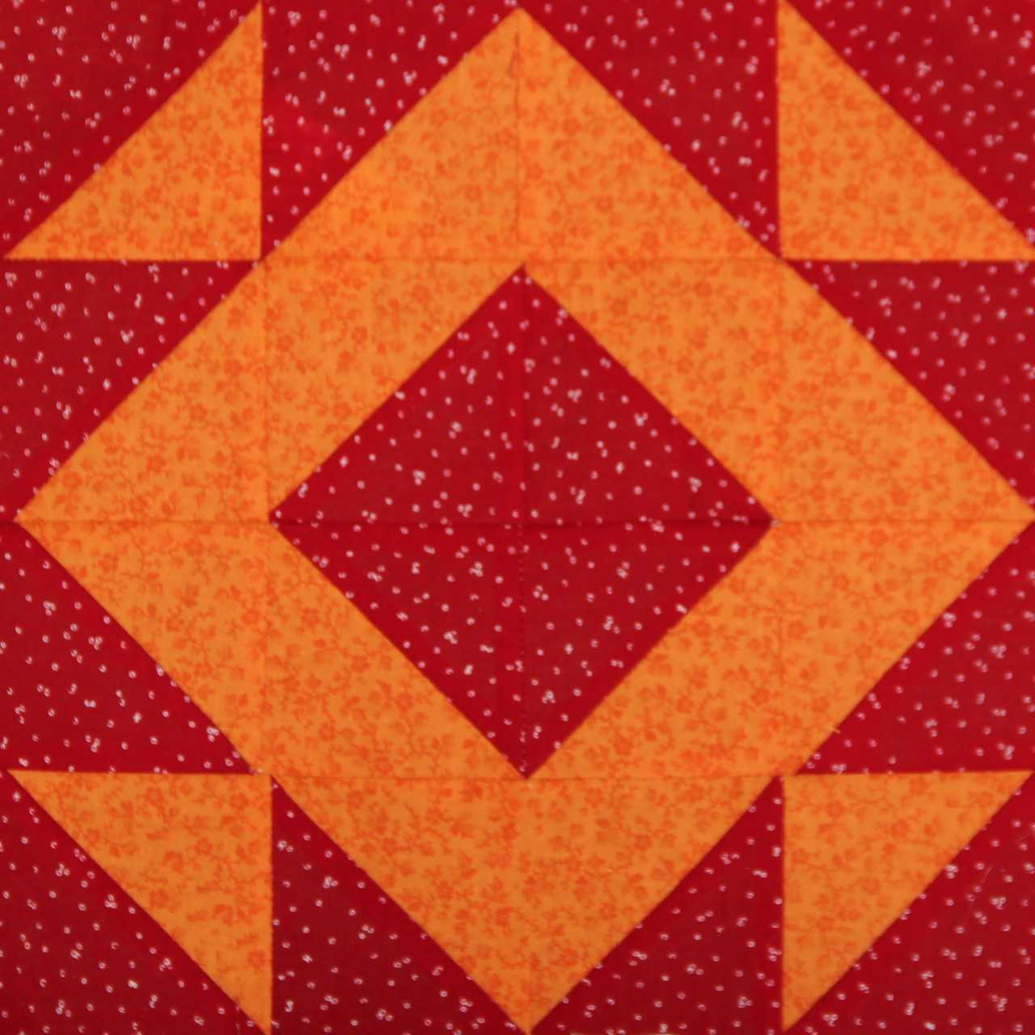
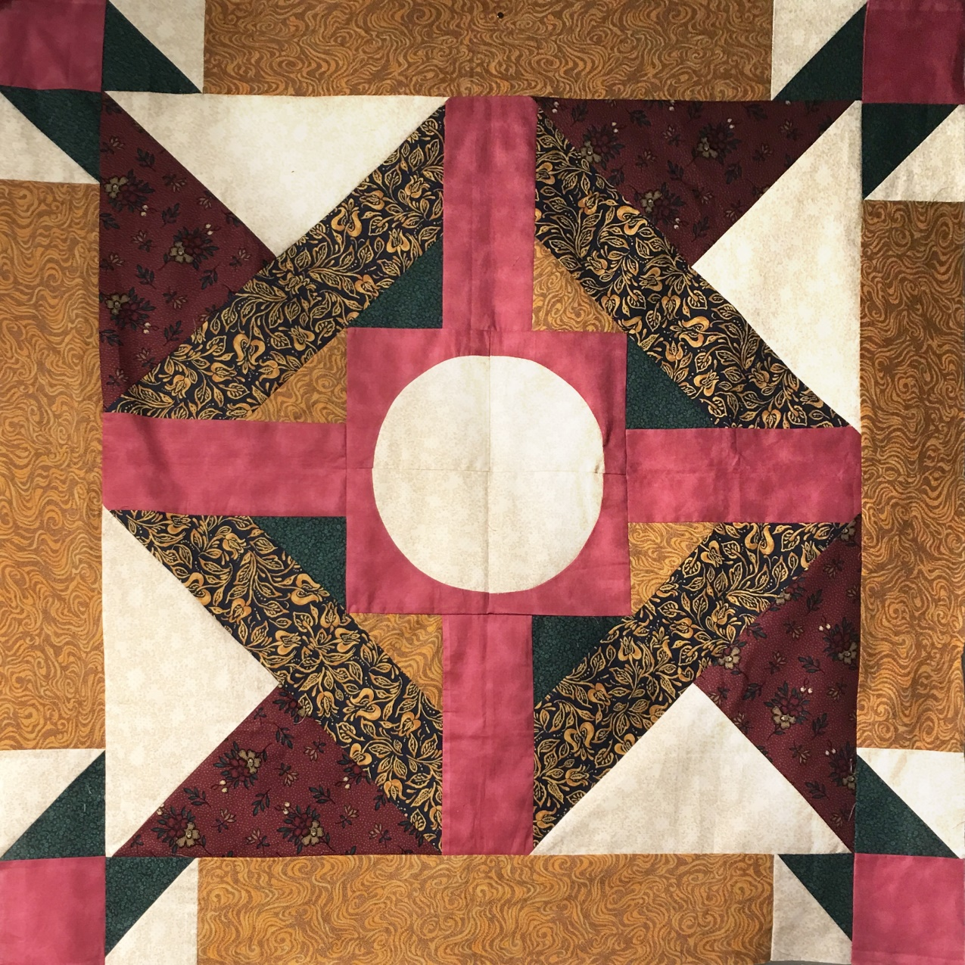
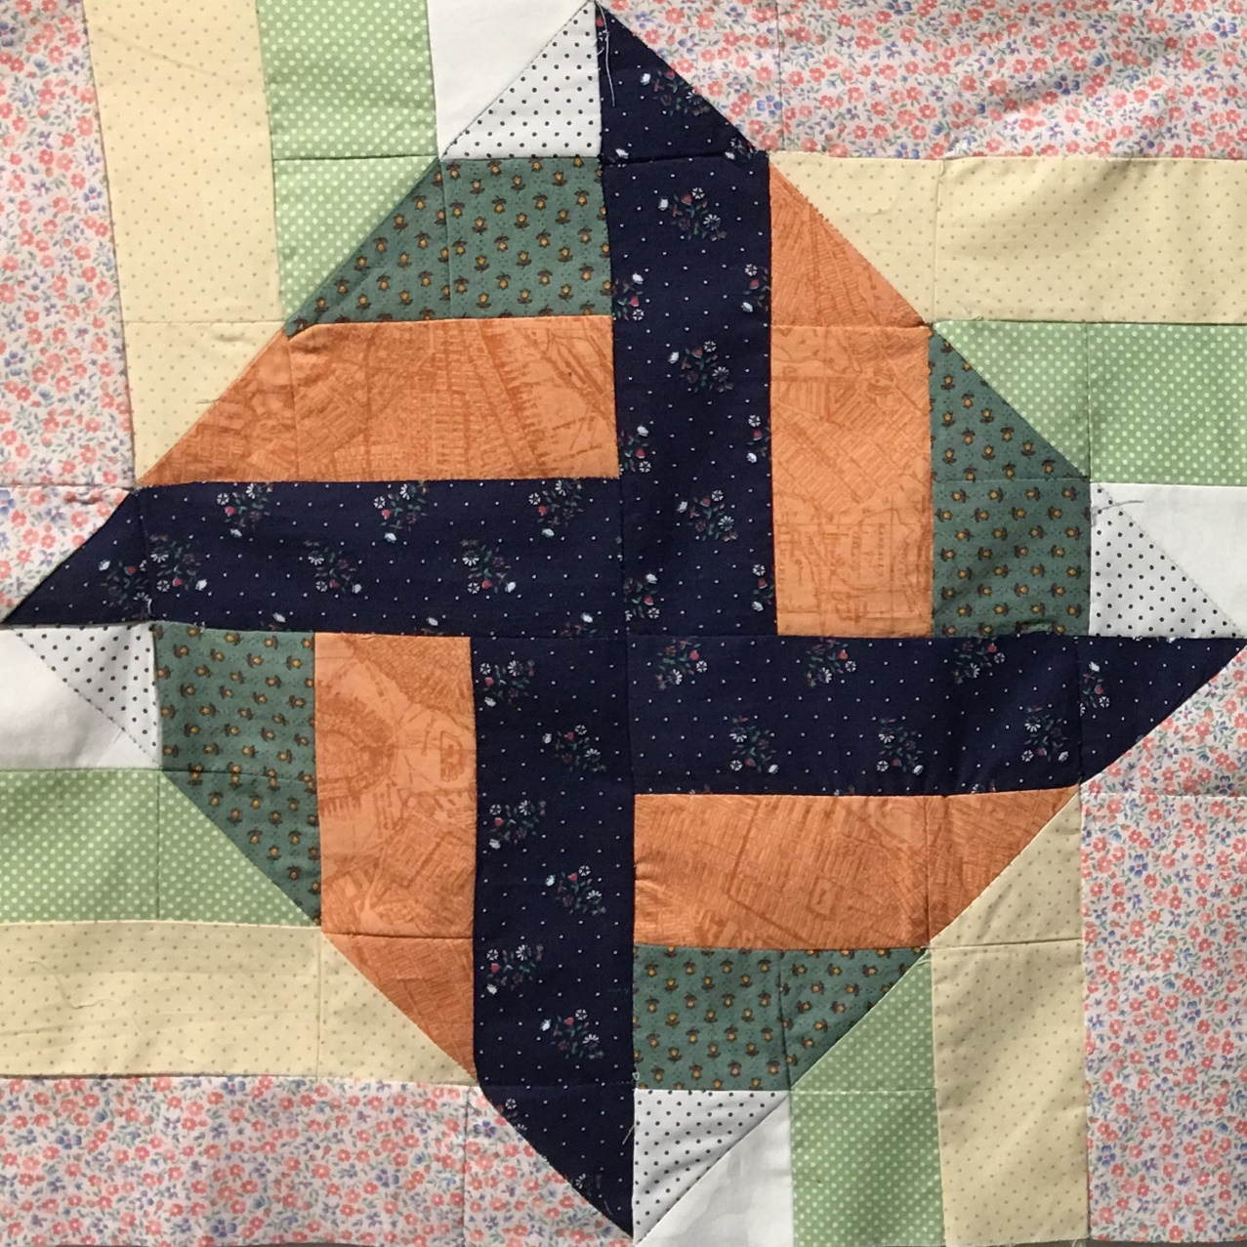
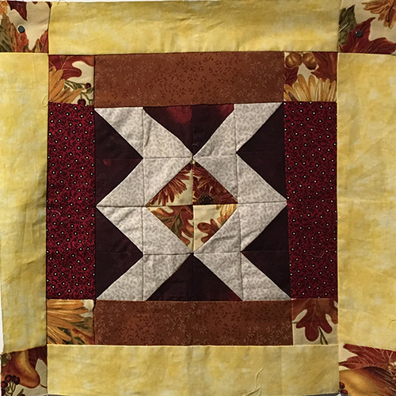
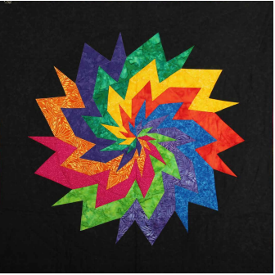
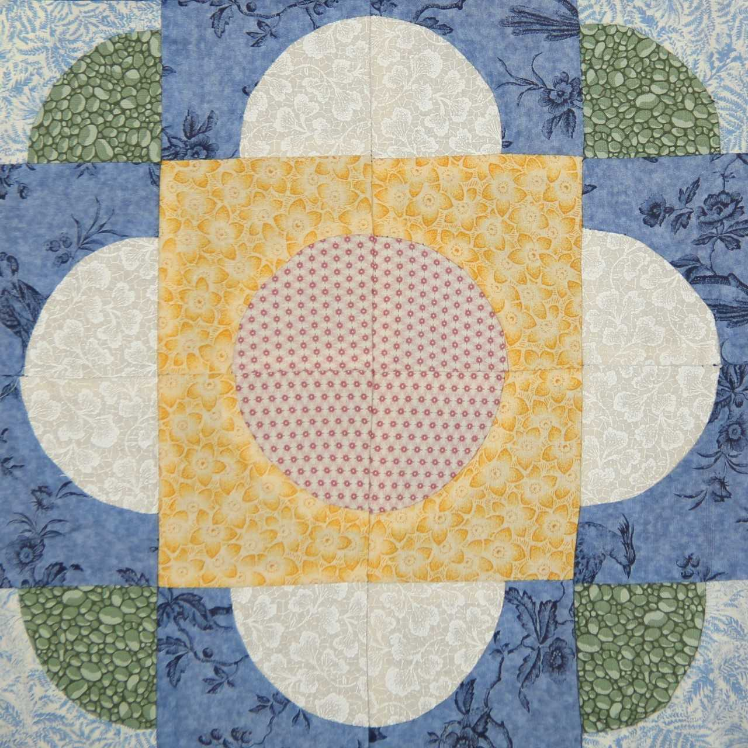
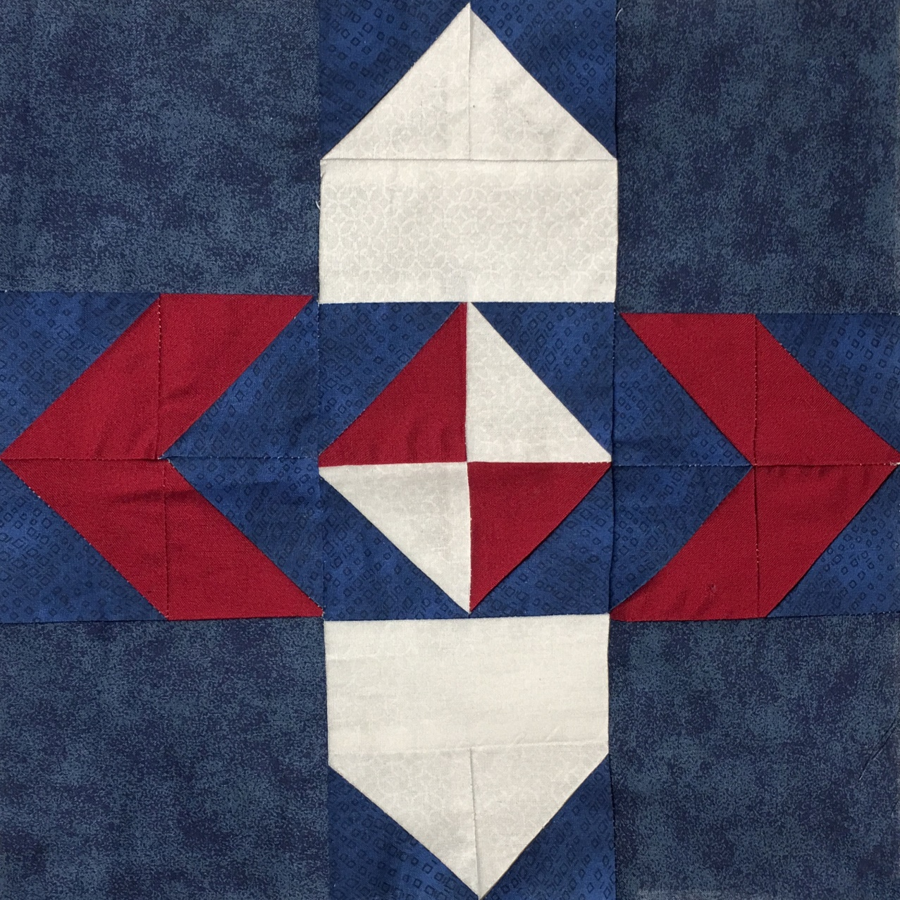
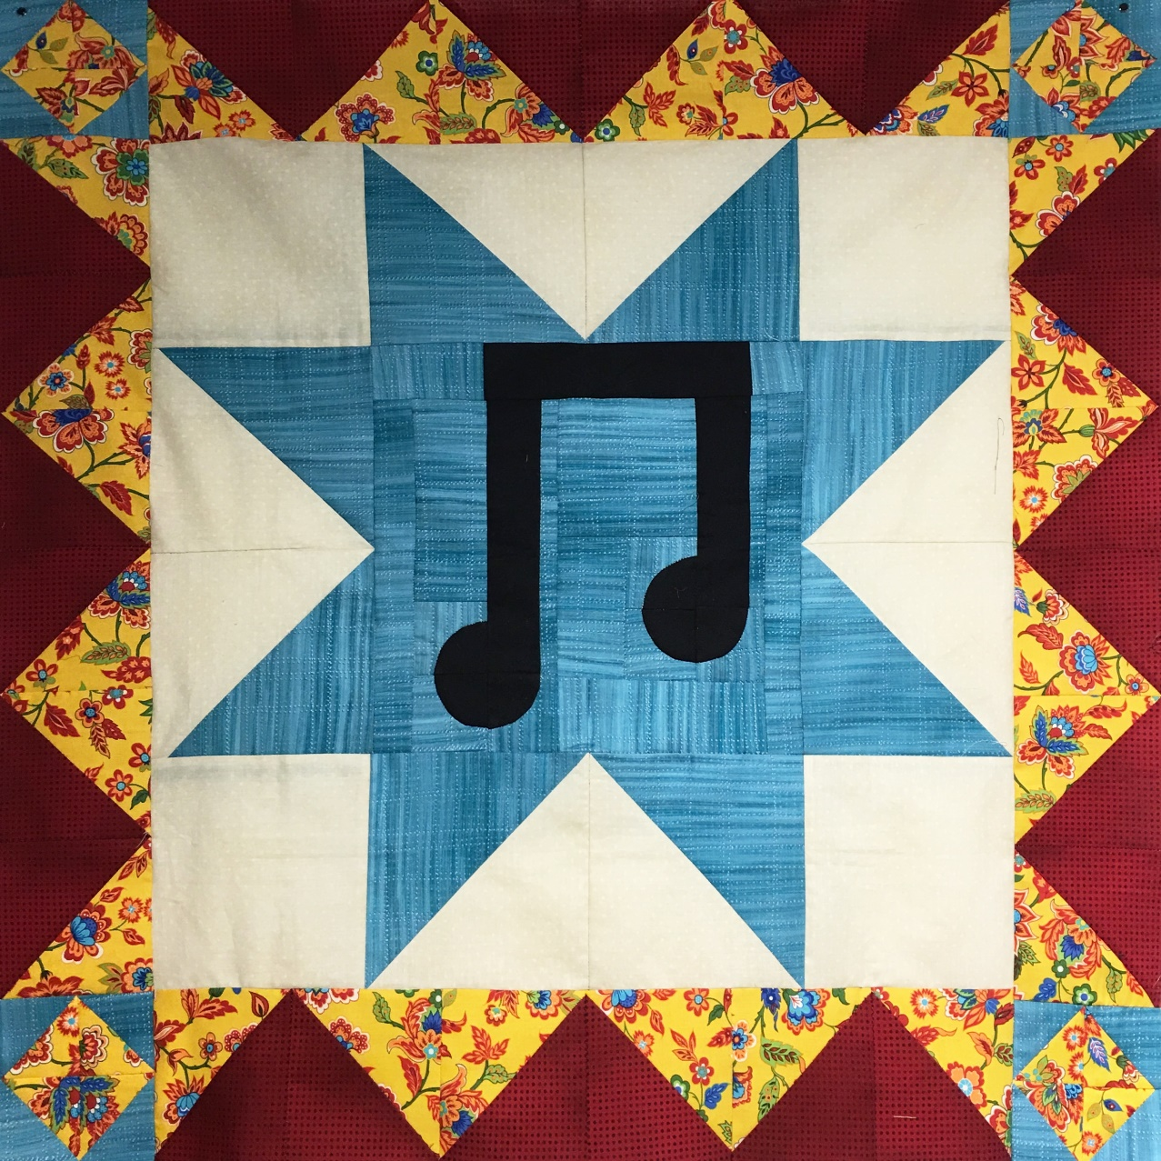
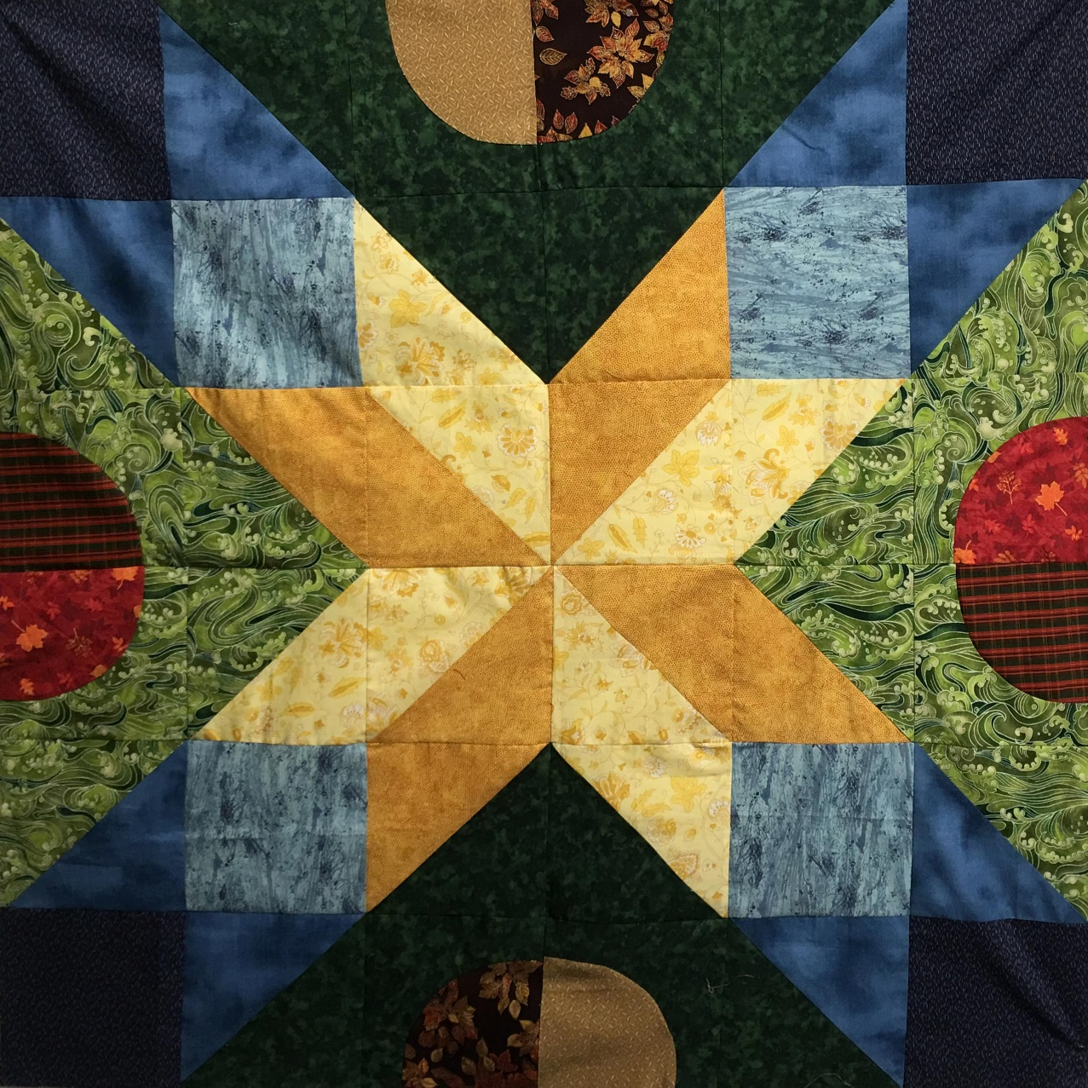
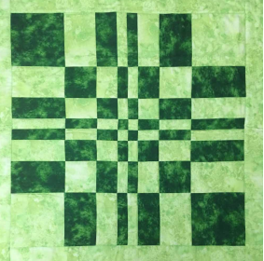
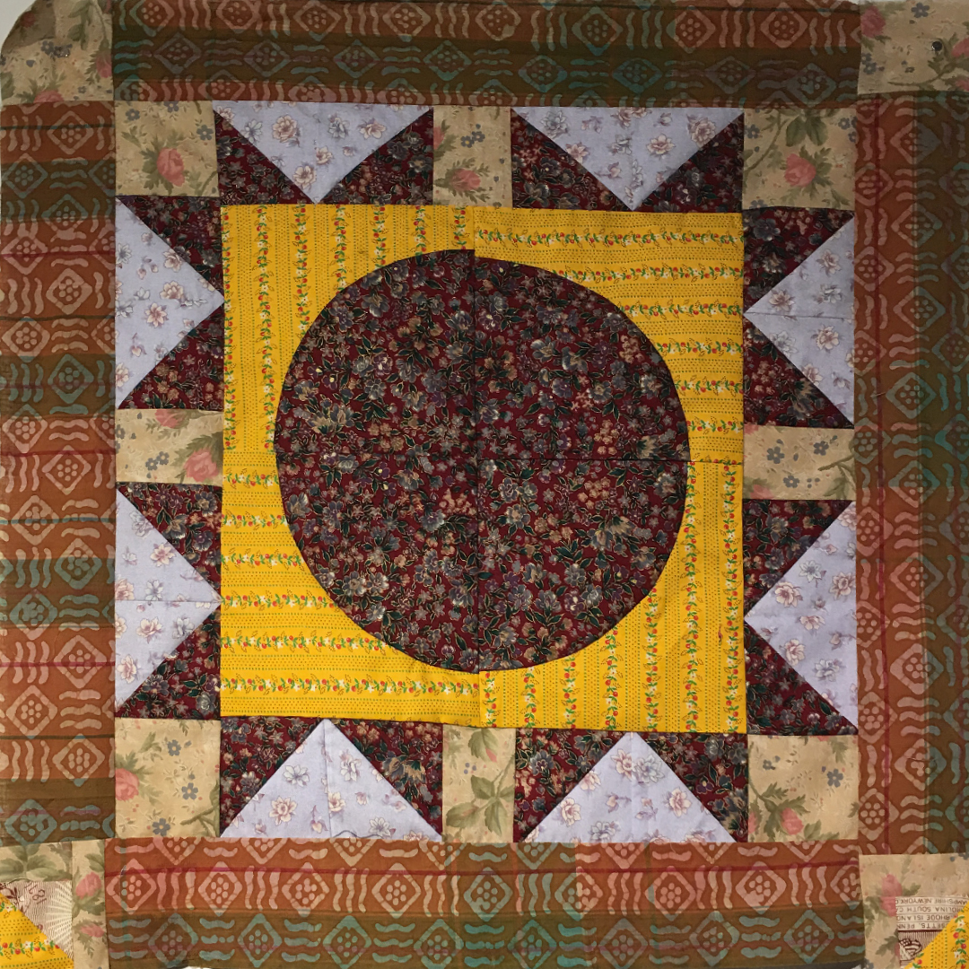
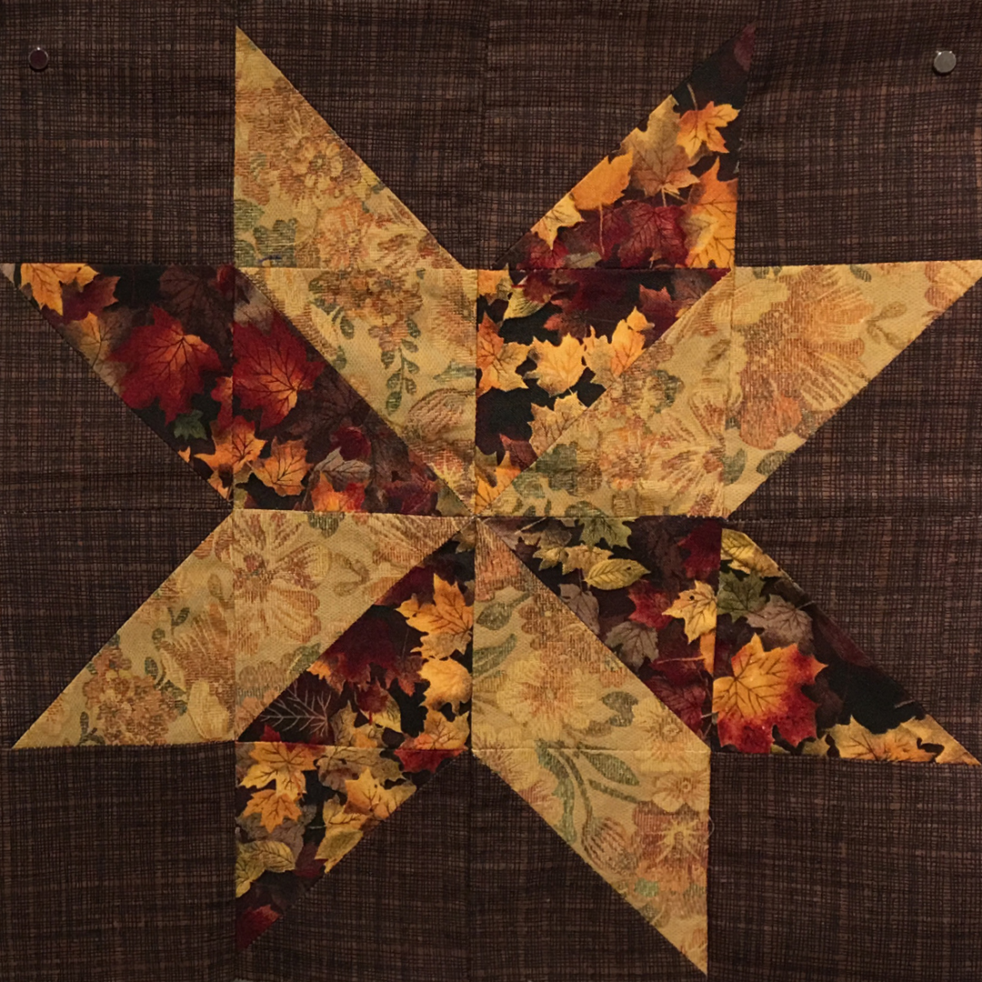
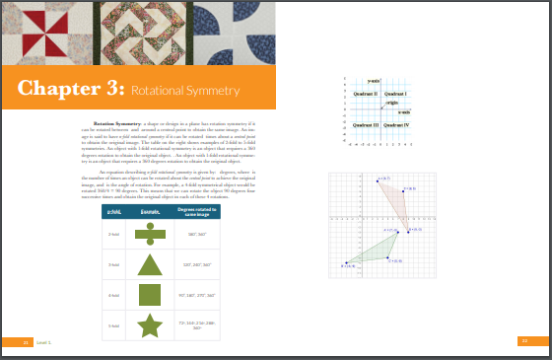
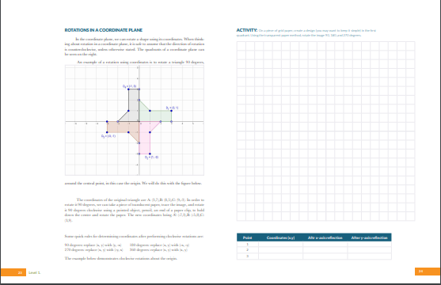
Mathematics in Artistic Design
Teaching Mathematics In Inventive Ways
Dr. Simei Tong, Dr. Charles Bingen, Skyler Hanson, Roslyn Cashman | Mathematics Department
OBJECTIVE
Using our combined knowledge of mathematics, quilting, and artistic design, our research team created an inventive way of learning mathematics for those who may not share our enthusiasm for the subject. Together we created Mathematics in Artistic Design: a textbook about the unique ways that mathematics and artistic design intersect, specifically pertaining to quilting.
METHOD
Tessellation quilting block
First, we developed curriculum that would teach geometry lessons which would be helpful in creating a complete design :
Translational symmetry
Reflectional symmetry
Rotational symmetry
Tessellations
Golden mean
Fibonacci Sequence
Properties of circles
LAYOUT
In our textbook, we decided to lay out each chapter in an order that made it easy for the student to learn the concept and apply it to design simultaneously. In each chapter, there is an example of a quilt which makes use of the concept of the chapter. From there, the student will learn the mathematics portion of the book. This includes activities and challenges to test understanding.
After the student has been introduced to the concept of the chapter, it is their turn to turn that concept into a creative design of their own. In class, that student will apply their practical math skills in creating a work of art with their own hands.
Radial symmetry quilting block
Fibonacci sequence quilting block
Helpful Information
IMPLEMENTATION
Our textbook, Mathematics in Artistic Design, was the course textbook for Dr. Simei Tong’s MATH 104 course in fall 2017. Students worked individually and in groups on projects that paralleled those in the book. Through implementing the lessons in the textbook and through a hands-on approach to learning, we found that students were able to learn mathematical skills, design skills, and even sewing skills. This was beneficial because it provided new ways of learning to students who don’t think of themselves as mathematically inclined.
The students in Dr. Tong' were challenged in making 6 projects throughout the semester corresponding to the 6 chapters in the text. They worked on these projects in class and in a sewing lab, giving each student ample time to figure out the complicated, rewarding process of designing and creating a quilt to be proud of. Their work
was shown to quilting clubs around the city of Eau Claire, and each student was able to learn from multiple experienced quilters and mathematicians. All of these factors combined are what make this research so unique.
Through implementing our textbook, we found that this novel approach to learning allowed for students to use their own creativity and use mathematics in practical ways. The effect of this is two-fold: students discover that mathematics is useful and they develop the new and useful skills of sewing and quilting along the way.
The success of Mathematics in Artistic Design as a course textbook is an indication that it is important and necessary to begin to teach difficult subjects to students in novel, interesting ways.
These images were taken from Mathematics in Artistic Design

