Slide 1

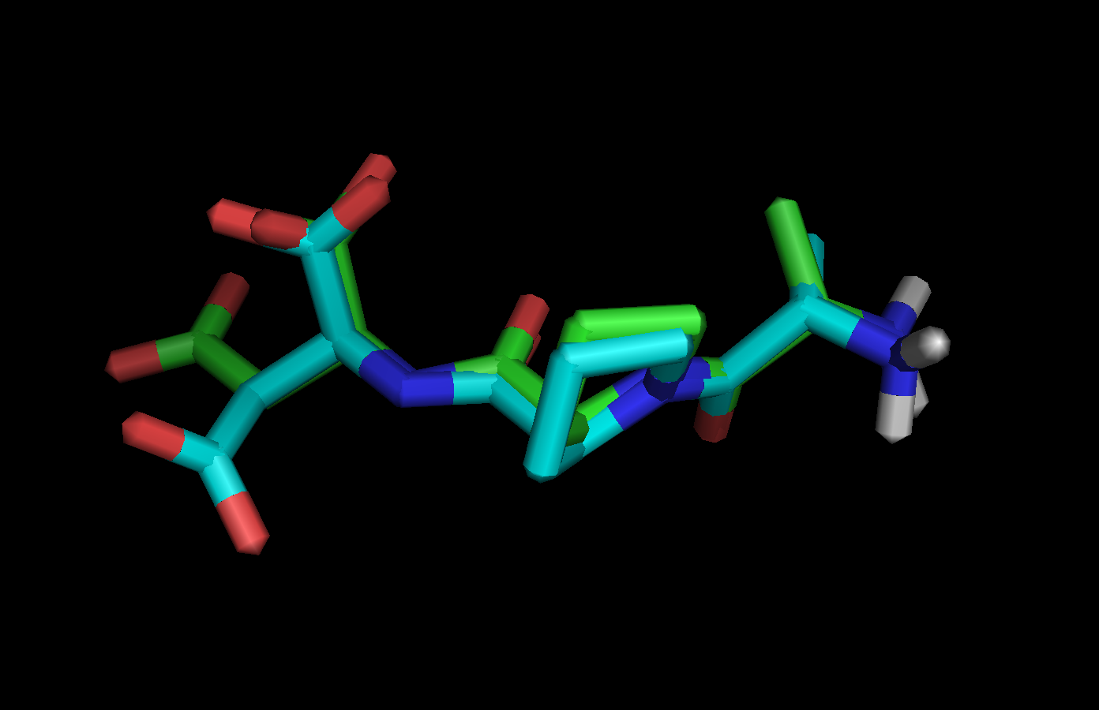
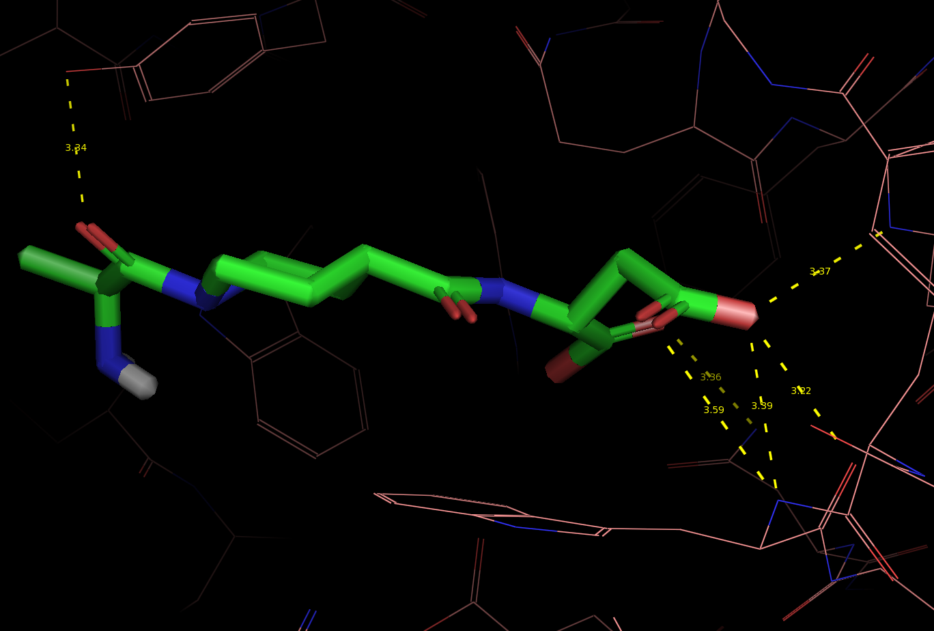
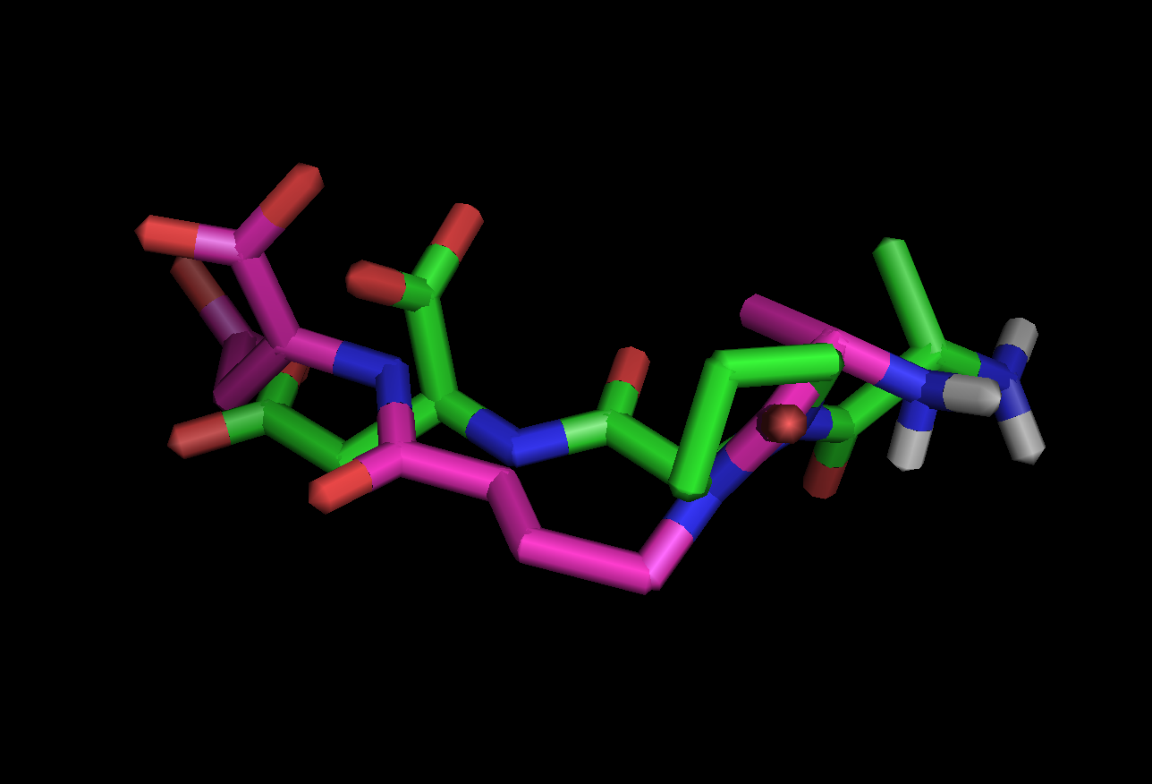
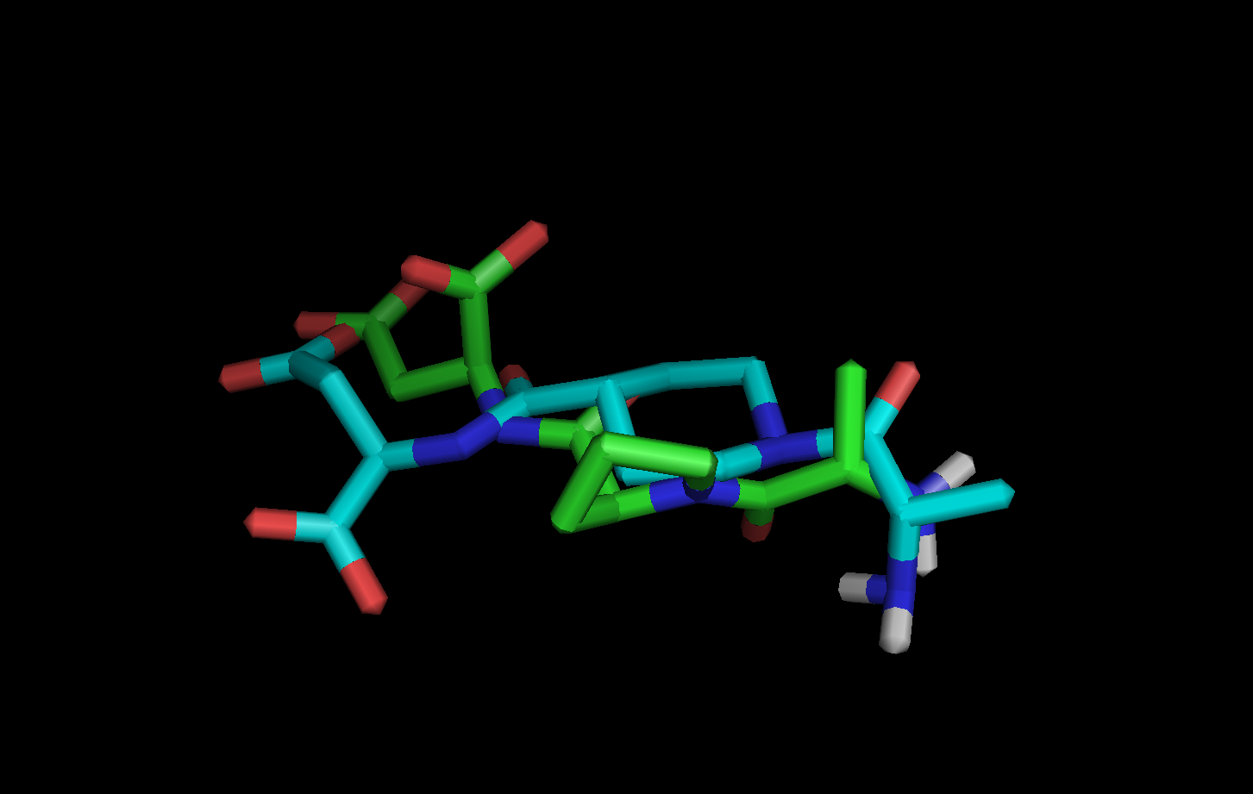
Computational Docking of Mucin Peptide Derivatives with SM3 Antibody Lysengkeng Her and Thao Yang Department of Chemistry, University Wisconsin-Eau Claire, Eau Claire WI Celebration of Excellence in Research and Creativity Activity (CERCA) Apritl 30th to May 4th 2018
Abstract
Objective
Methods
Results
The crystal structure of the mucin monoclonal antibody SM3 complexed with a 13 amino acid MUC1 mucin peptide was determined. The high selectivity of the SM3 antibody to the aberrant carbohydrate cancer mucin peptide suggests that it could be a model for studying different ligand binding as a potential target against certain tumors. This study focusses on the computational modeling and docking of the SM3 antibody complexed with MUC1 mucin epitopes to determine the binding properties. The program Autodock is used to perform the dockings of the ligand to the SM3 antibody in order to determine the affinity values of the complex. We specifically docked and studied the three amino acids APD from the MUC1 mucin peptide (GVTSAPD). On the MUC1 epitope structures, the proline (P) residue was substituted with aromatic residues such as tyrosine, and phenylalanine. In addition, we’ve also substituted the proline with unnatural amino acids such as gamma-aminobutyric acid (GABA), D-α-phenylglycine (D-PHG), L-α-phenylglycine (PHG) and beta-alanine (β-Ala). The structures of the docked ligands were then analyzed with Pymol to determine the interactions between the SM3 antibody and the peptide derivatives. Results showed that the epitopes containing aromatic residues have the higher affinity.
The purpose of this study is to use computational technique to perform “docking” of multiple compounds with structures similar to MUC1 peptide (APD) that could bind to the SM3 complex and possibly show binding. Docked derivatives with high affinity, and similar alignment with the crystal structure was viewd using Pymol (5).
All peptides for this study were manually created with the Spartan software applying equilibrium geometry to each structure, using the PDB file of SM3 fragment with the 13-amino acid peptide downloaded from Protein Data Bank. The whole MUC1 peptide was not docked but instead only the residues APD was chosen to perform dockings. The 13-amino acid MUC1 peptide was obtained by deleting everything but the amino acid atoms (e.g. atom coordinates). The structures of docked MUC1 peptide derivatives were obtained by using Autodock Vina software (4). Docking techniques was used to determine mode of binding, interactions, root-mean-square deviation (RMSD) and the binding energy value.
Molecule | Affinity Energy (kcal/mol) | Structure (best fit) | RMSD
APD | -5.5 | Mode 2 | 2.222, 6.734
Size | Center
x=16 | x= 23.639
y=16 | y= -5.638
z=16 | z= -4.994
Table 1 : Grid Box and dimensions used for all dockings.
Results
Figure. Structure of crystal structure APD (green) overlay with best fit docked structure (teal). Docked structure shows significant alignment with the crystal structure.
Below are results of MUC1 peptide derivatives of APD. Based on affinity values, aromatic compounds displays a higher affinity values than non-aromatics. Phenylalanine and Tyrosine dockings displayed modes with high affinity values but no significant alignment with crystal structure. Affinity values itself doesn’t determine whether these peptides can’t potentially bind or not. These results were only based on one mode of binding.
Conclusions
Introduction
Molecule | Affinity Energy (kcal/mole) | Structures (Best fit) | RMSD
AFD | -6.5 | Mode #5 | 1.154, 2.743
AYD | -6.7 | Mode #7 | 2.595, 5.249
AphgD | -6.4 | Mode #5 | 2.756, 6.174
AisnD | -6.3 | Mode #2 | 2.363, 8.262
AgabaD | -5.5 | Mode #4 | 1.217, 2.829
AβAD | -5.0 | Mode #9 | 2.257, 6.835
All MUC1 peptide structures were successfully docked and shows potential binding to the SM3 antibody. Most structures also displayed at least one binding mode similar to the crystal structure (APD). Docking results also indicates aromatics are capable to bind with a higher affinity value than non-aromatics compounds. Further work is required to determine interactions of other substituted peptides. In addition, it is preferred to consecutively dock more than five consecutive runs to determine more consistent docked results.
The mucin monoclonal antibody SM3 consist of three light and heavy chain variable domains (1,2). SM3 recognizes aberrant glycosylated epithelial mucin MUC1, and has potential as a diagnostic tool such as developing peptides mimics that could be used to target tumors. The MUC1 mucin is a transmembrane glycoprotein with an extracellular domain consisting of multiple 20-amino acid tandem repeat domains (TRD). Its main functions include cell-cell signaling, lubrication and protection of the cell surfaces. The MUC1 mucin produced by tumor cell is aberrantly glycosylated. The MUC1 mucin stripped of carbohydrate chains can cause an immune response producing antibody against it. The crystal structure of the antigen binding domain of one of such antibodies (monoclonal antibody SM3) complexed with a 13-amino acid MUC1 mucin peptide has been determined (see Fig. 1) (3). High selectivity of the SM3 antibody to the stripped carbohydrate mucin suggests a potential target for designing treatment against certain tumors (e.g., breast cancer).
References
Table 2: Affinity values of best fit structures. Affinity values increases with aromatic groups at substituted proline position. Dockings were docked five times consecutively roughly 3/5 of dockings displayed similar results.
Figure 2. Polar interactions of AisnD MUC1 peptide. With hydrogen bond distances approximately 3.20Å -3.60Å. Pymol was unable to determine the interaction of ISN structure from this mode of binding. In previous study STD-NMR displayed binding of ISN to the antibody.
1. Apostolopoulos, V., Stojanovska, L., and Gargosky S.E., “MUC1 (CD227): a multi-tasked
molecule.”(2015) Cell Mol Life Sci., Dec;72(23):4475-500. doi: 10.1007/s00018-015-2014-z.
Epub 2015 Aug 21.
2. Hollingsworth, M. A., and Swanson, B. J. “Mucins in cancer: protection and control of the
cell surface.” (2004) Nat Rev Cancer, 4 (1), pp. 45-60.
3. Dokurno, Pawel. “Crystal Structure at 1.95 Å resolution of the breast tumor-specific antibody
SM3 complexed with its peptide epitope reveals novel hypervariable loop recognition.” (1998) J.
Molec Biol, vol. 284, no. 3, pp.713-728.
4. O. Trott, A. J. Olson, AutoDock Vina: improving the speed and accuracy of docking with a new scoring function, efficient optimization and multithreading, Journal of Computational Chemistry 31, 455-461, (2010).
5. The PyMol Molecular Graphics System, Version 1.8, Schrodinger, LLC. http://pymol.org/educational
Figure 1. SM3 antibody bound with MUC1 peptide (13 amino acids). Light and heavy chains are labeled as colored.
Figure 3. Overlay of docked GABA substituted peptide (pink) with original crystal structure (APD). Structure represents best fit mode of GABA peptide. The docked GABA structure preferably bend when docked in Autodock Vina.
Figure 4. Overlay of docked ISN substituted peptide (Teal) with original crystal structure (APD). Structure represents best fit mode of ISN peptide.
This study focusses on the binding properties of MUC1 epitopes to the SM3 antibody using computational techniques such as Spartan and saturation transfer difference- nuclear magnetic spectroscopy (STD-NMR). In this study we performed dockings of ligands containing three amino acid residues, APD of the MUC1 peptide GVTSAPD. Autodock Vina was used to perform dockings of MUC1 derivatives by replacing the proline residue with either a aromatic (tyrosine) or a unnatural amino acid (GABA). Pymol then was used to view interactions of MUC1 peptides.
Acknowledgements
I would like to thank the UWEC Office of Research and Sponsored Programs (ORSP) for providing the Diversity Mentoring Program grant to support this research, the UWEC Chemistry Department for use of the Autodock Vina software, National Science Foundation (NSF) and also the Blugold Commitment for printing this poster.

