Slide 1
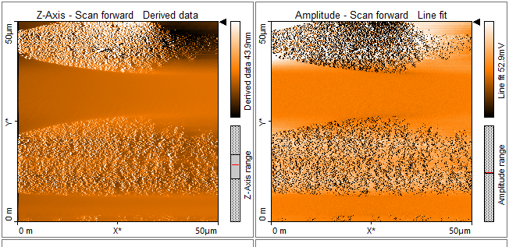
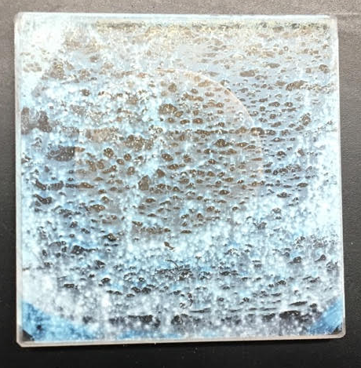
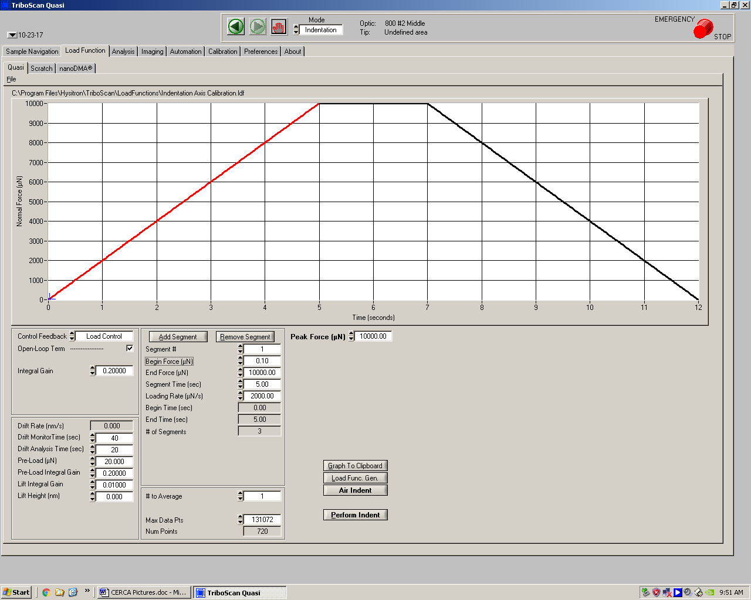
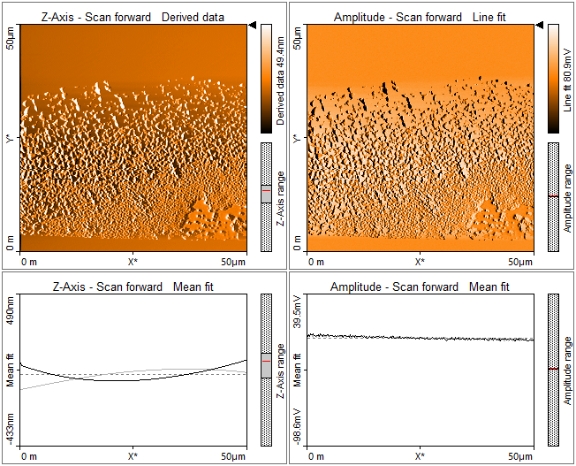
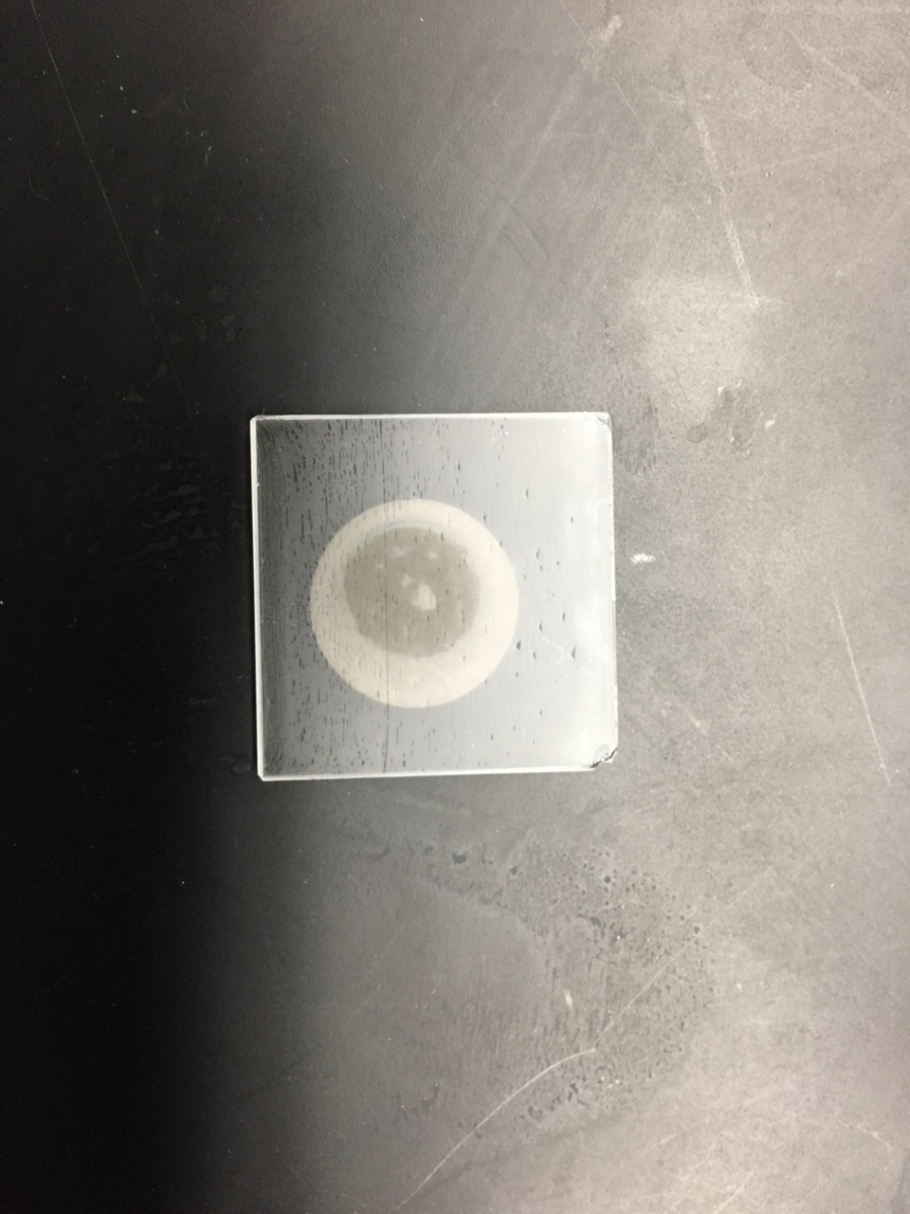
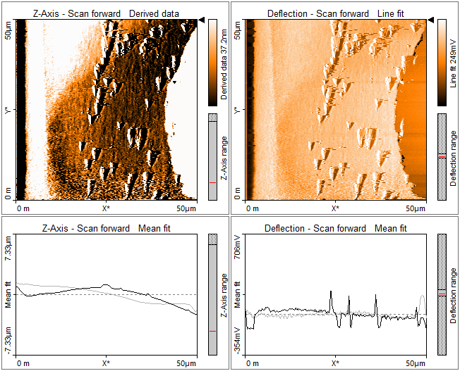
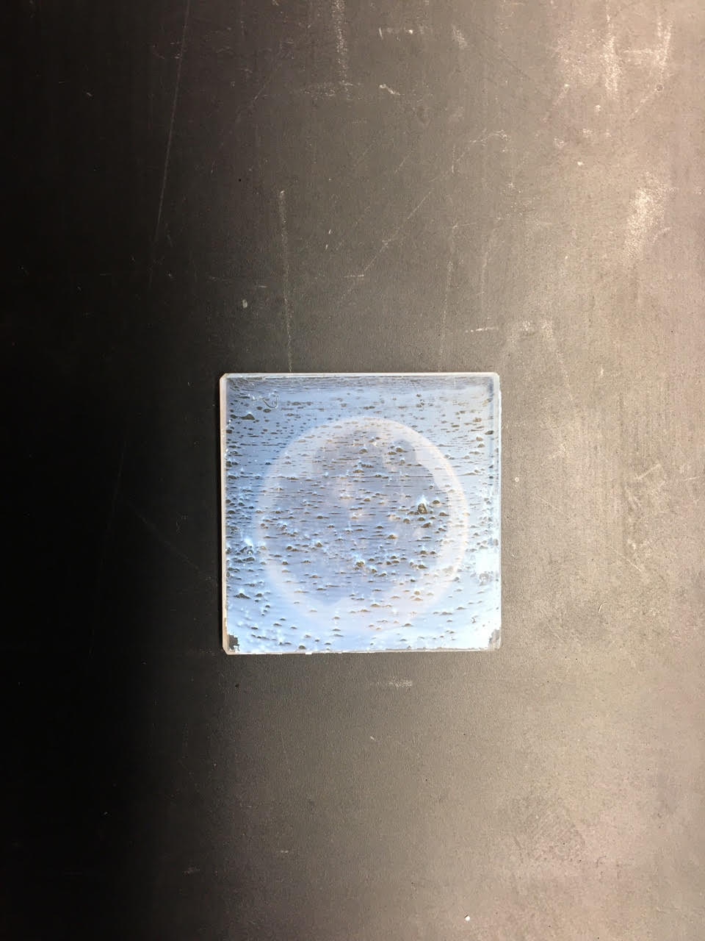
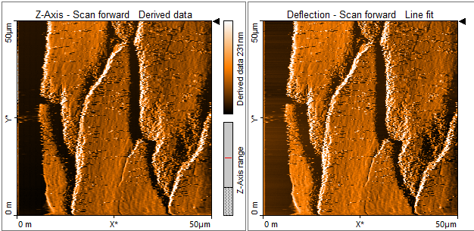
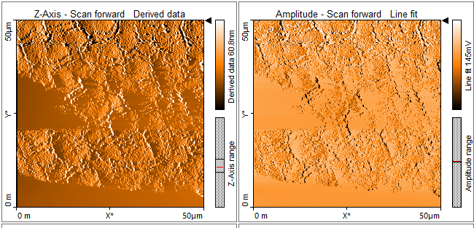
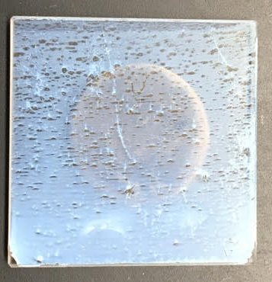
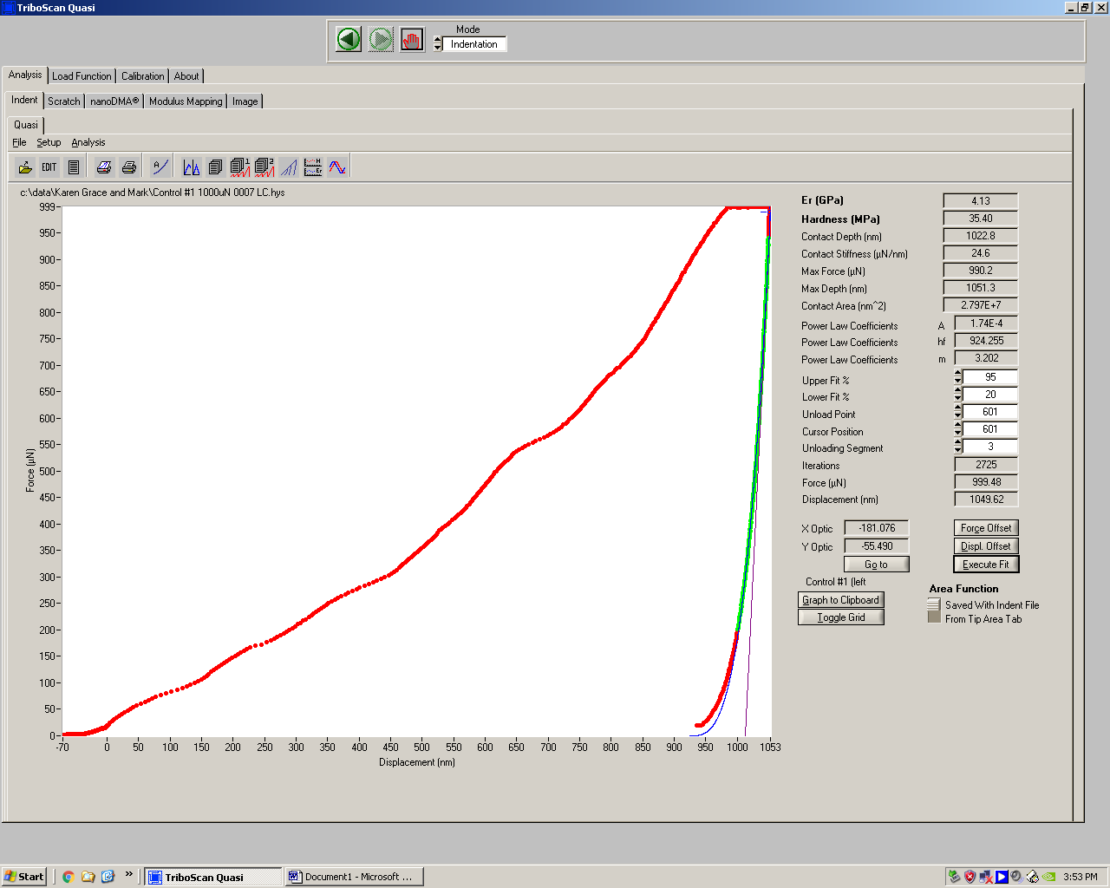
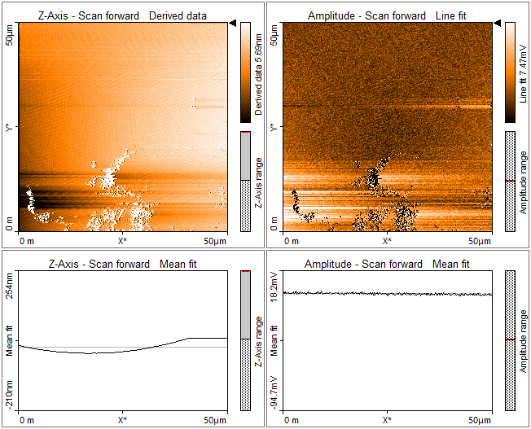
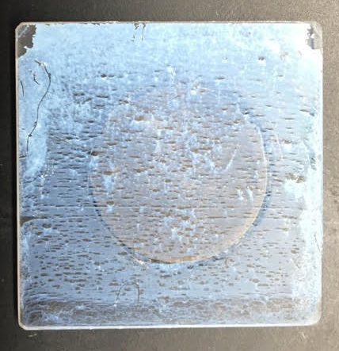
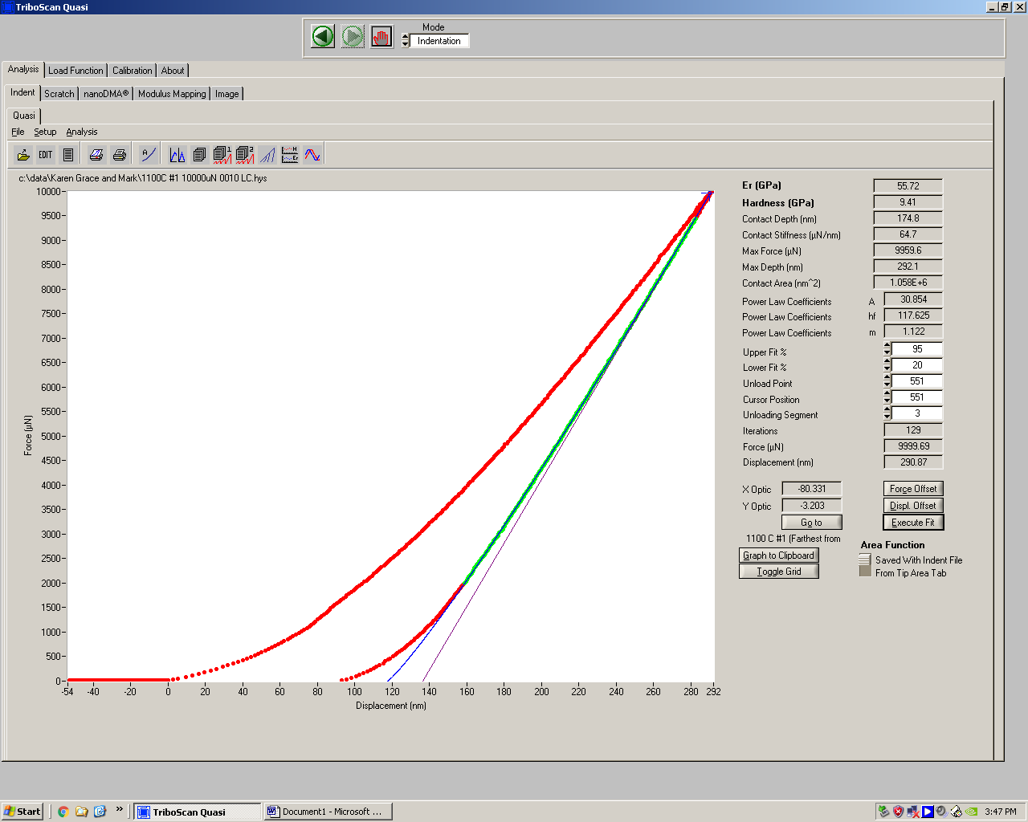
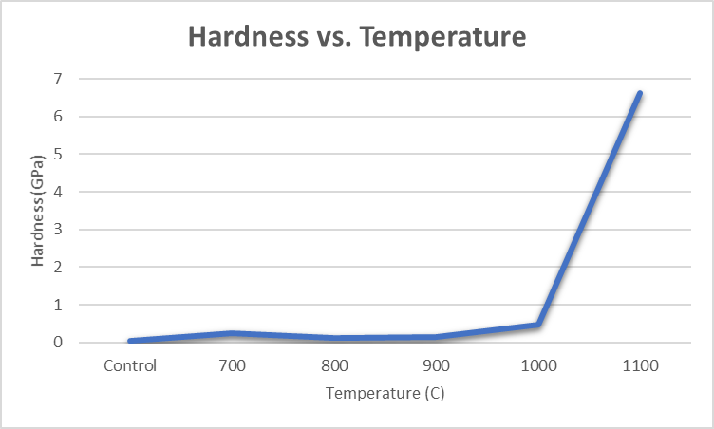
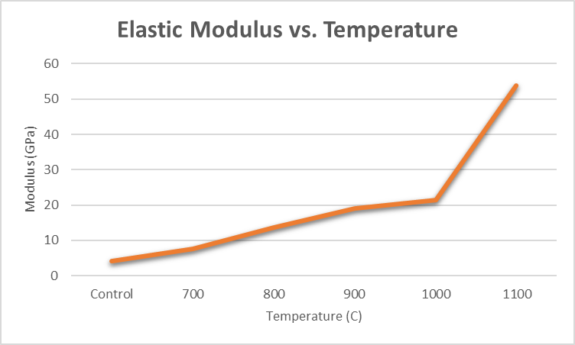
Nanoindentation of Silica Colloid Thin Films Sintered at Various Temperatures
Karen Knoke, Grace Baker, Mark Fiori, and Dr. Doug Dunham, Materials Science UW-Eau Claire, Eau Claire, WI
Matthew Koviekis, Spencer Bingham, and Dr. John Kirk, Chemistry Department, Carthage College, Kenosha, WI
Introduction
Methods
Results
A Hysitron nanoindentor was used to test the hardness and reduced modulus of several two sample groups. These samples consisted of silica colloids deposited onto glass slides that were sintered at various temperatures. Students prepared silica colloid samples of comparable properties, one set was sent to the company Hysitron from UW-Stout in 2009, the other was sent to UW-Eau Claire from Carthage College in 2017. The aim for this project was to confirm data found by Hysitron. The ongoing project at Carthage needed confirmation that the way the samples were prepared were consistent with previous methods. Our findings indicated that the samples sintered at higher temperatures had a higher hardness and reduced modulus, which was also determined by Hysitron. The goal of this was to show that the process of creating the samples were reproducible and accurate.
Using the Hystiron Nanoindentor, a load function of five second approach, two second hold, and five second unload was used for each of the samples.
Control
Average
Collected Data Modulus: 4.168 GPa Hardness: 0.035 GPa Contact Depth: 1090.029 nm | From Hysitron Report: Modulus: 5.592 GPa Hardness: 0.156 GPa Contact Depth: 244.069 nm
1100 C
Average
Collected Data Modulus: 53.894 GPa Hardness: 6.619 GPa Contact Depth: 173.373 nm | From Hysitron Report: Modulus: 53.853 GPa Hardness: 5.580 GPa Contact Depth: 244.238 nm
1000 C
Average
The 1100 C, 1000 C, 900 C, and 800 C samples were tested at a maximum load of 10,000 µN. The 700 C maximum load was 2,500 µN. The Control maximum load was set at 1,000 µN.
On each sample we tested 15 points in a concentrated area. We then tested five to eight points on various spots on the sample, making sure to stay over the area of the magnet to ensure a stable surface for the diamond tip to approach.
Collected Data Modulus: 21.325 GPa Hardness: 0.467 GPa Contact Depth: 961.454 nm | From Hysitron Report: Modulus: 22.960 GPa Hardness: 0.695 GPa Contact Depth: 305.343 nm
900 C
Average
Collected Data Modulus: 19.039 GPa Hardness: 0.147 GPa Contact Depth: 1625.050 nm | From Hysitron Report: Modulus: 14.783 GPa Hardness: 0.286 GPa Contact Depth: 609.311 nm
800 C
Average
Collected Data Modulus: 13.535 GPa Hardness: 0.124 GPa Contact Depth: 1784.800 nm | From Hysitron Report: Modulus: 10.323 GPa Hardness: 0.278 GPa Contact Depth: 427.550 nm
Next Steps
700 C
Average
Data on the thickness of the silica layer will be collected. We have received a new set of samples that were produced by a method of spin coating the silica onto glass slides. Research will continue over the summer.
Collected Data Modulus: 7.579 GPa Hardness: 0.245 GPa Contact Depth: 511.738 nm | From Hysitron Report: Modulus: 8.242 GPa Hardness: 0.197 GPa Contact Depth: 514.967 nm
Control
Acknowledgments
UW-Eau Claire Materials Science Program
Dr. Anthony Wagner
1100 C

