Slide 1


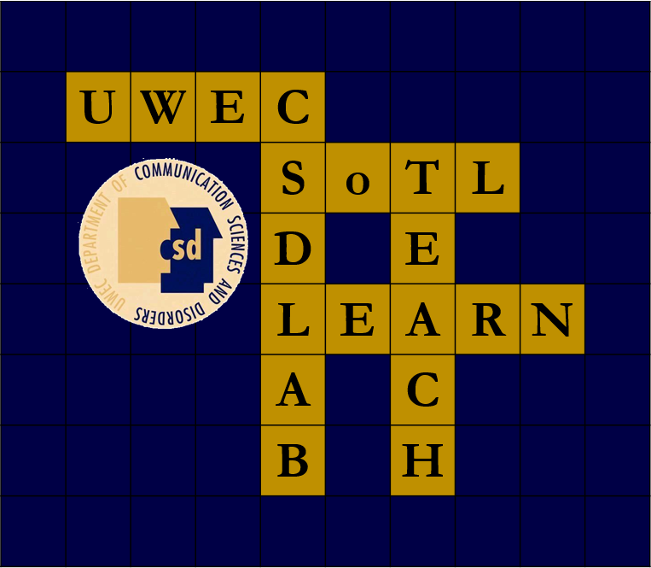



The Impact of Instructional Interns from a Student Perspective: A Qualitative Study
Natalie Taufen, Sophie Grelson, & Erin Zigler
Faculty Mentors: Abby Hemmerich, Ph.D., CCC-SLP, & Jerry Hoepner, Ph.D., CCC-SLP
University of Wisconsin-Eau Claire | Communication Sciences and Disorders
Additional resources provided
(13)
Student Results
Introduction
Comfort
(11)
The Big Picture
Purpose
To discover the impact of teaching assistants on students, specifically within the discipline of Communication Sciences and Disorders at UW- Eau Claire
Background
Long term goal
(5)
The increase in the use of teaching assistants can be attributed to budget cuts, forcing professors to have bigger class sizes
The impact of teaching assistants on students has been studied, but has rarely been examined within the Communication Sciences and Disorders (CSD) discipline
Previous studies in other disciplines have shown a positive correlation between teaching assistants and students’ performance
Student
benefits
Bridging Gap
(7)
Availability of resources
(8)
Unique to Students Benefits
Research Questions
1. How do teaching assistants’ interactions with students impact their overall outlook on academia and self-confidence when added to the classroom environment?
2. What changes or impacts have students reported regarding the inclusion of teaching assistants in the classroom?
Pedagogy
(1)
II
benefits
Availability of resources
(8)
Comfort
(11)
Building relationships between cohorts
(3)
Additional resources provided
(13)
Method
Instructor
Student
Instructional Intern
Benefit vs. Disadvantage
Descriptive
Codes
Qualitative focus groups
Understanding complexity of grading
(1)
Student focus group (n=5)
Facilitated by student researchers & campus teaching & learning coordinator
Semi-structured interview based on findings from survey
Building relationship between cohorts
(3)
“They are a great resource of information or just questions you don’t feel comfortable asking your professor about. It’s nice because they’ve taken it before.”
Qualitative Data Analysis
Strengthens resume
(1)
Transcription of student focus group
Identification of codeable units
Assignment of descriptive codes
Thematic analysis
“I think they provide a lot of support… things like tips on how to study for the class and kind of helping you know what you need to know for that class.”
Conclusions/Implications
“Sometimes information can get misconstrued. You’re trying to tell them something and maybe you’re not explaining it the right way so the students get confused.”
”More information about the time commitment when you’re applying because I waited until my senior year to apply. But I think I could have done it earlier.”
Students reported more positive impacts when enrolled in courses with Instructional Internships
Students perceive the largest impacts of II’s in providing comfort and giving additional resources when needed
Instructional Interns bridge the gap between students in the course and faculty teaching the course while providing Instructional Interns valuable teaching experiences
While students value the input of instructional interns, their knowledge is not equivalent to the course instructor’s knowledge
Grading
(1)
Student
Disadvantages
Unique to students Disadvantages
Balance of Power
(1)
Inaccurate information
(4)
Limitations/Future directions
Stability of II
(1)
The views towards Instructional Intern benefits are dependent on only one sampling of CSD students
II’s may not have the same type of knowledge or experience as a faculty member; further study of training options is warranted
Future research may include an evaluation of any long-term effects on students who are Instructional Interns and if there is a relation to clinical and student interest in pursuing doctoral degrees
II
disadvantages
Commitment Process
(4)
Hesitancy towards asking questions
(1)
Lack of II focus
(1)
References
1 ASHA. (2002). Crisis in the discipline: a plan for reshaping our future. American Speech-Language-Hearing Association and Council of Academic Programs in Communication Sciences and Disorders: Report of the joint ad hoc committee on the shortage of PhD students and faculty in communication sciences and disorders.
2 Green, J.L. (2010). Teaching highs and lows: Exploring university teaching assistants’ experiences. Statistics Education Research Journal, 9 (2), 108-122.
3 Harland, T. (2001). Pre-service teacher education for university lectures: the academic apprentice. Journal of Education for Teaching, 27 (3), 269-276. doi:10.1080/02607470120091597
4 Hemerich, A.L., Hoepner, J.K., & Samelson, V.M. (2015). Instructional Internships: Improving the teaching and learning experience for students, interns, and faculty. Journal of the Scholarship of Teaching and Learning, 15(3): 104-132. doi: 10.14434/josotl.v15i3.13090
5 Adler, P.A. (1993). Personalizing mass education: The assistant teaching assistant (ATA) program. Teaching Sociology 21, 172-176. doi:10.2307/1318639
6 Anderson-Darling, C. & Earhart, E.M. (1990). A model for preparing graduate students as educators. Family Relations, 39, 341-348. doi:10.2307/584882
7 Fingerson, L., & Culley, A.B. (2001). Collaborators in teaching and learning: Undergraduate teaching assistants in the classroom. Teaching Sociology 29, 299-315. doi:10.2307/1319189
8 Froelich, A.G., Duckworth, W.M., & Stephenson, W.R. (2005). Training statistics teachers at Iowa State University. The American Statistician, 59 (1), 8-10. doi:10.1198/000313005X24138
9 Gaia, C.A., Corts, D.P., Tatum, H.E., & Allen, J. (2003). The GTA Mentoring Program: An interdisciplinary approach to developing future faculty as teacher-scholars. College Teaching, 51(2), 61-65. doi:10.1080/87567550309596413
10 Socha, T.J. (1998). Developing an undergraduate teaching assistant program in communication: Values, curriculum, and preliminary assessment. Journal of the Association for Communication Administration, 27, 77-83.
11 Chapin, H.C., Wiggins, B.L., & Martin-Morris, L.E. (2014). Undergraduate science learners show comparable outcomes whether taught by undergraduate or graduate teaching assistants. Journal of College Science Teaching, 44(2): 90-99.
12 Kassab, S., Abu-Hijleh, M.F., Al-Shboul, Q., & Hamdy, H. (2005). Student-led tutorials in problem-based learning: educational outcomes and students’ perceptions. Medical Teacher, 27(6): 521-526. DOI: 10.1080/01421590500156186
13 Glynn, L.G., MacFarlane, A., Kelly, M., Cantillon, P., & Murphy, A.W. (2006). Helping each other to learn – a process evaluation of peer-assisted learning. BMC Medical Education, 6(18). doi:10.1186/1472-6920-6-18
14 Lockspeiser, T.M., O’Sullivan, P., Teherani, A., & Muller, J. (2008). Understanding the experience of being taught by peers: the value of social and cognitive congruence. Advances in Health Science Education, 13: 361-372. DOI 10.1007/s10459-006-9049-8

