Slide 1
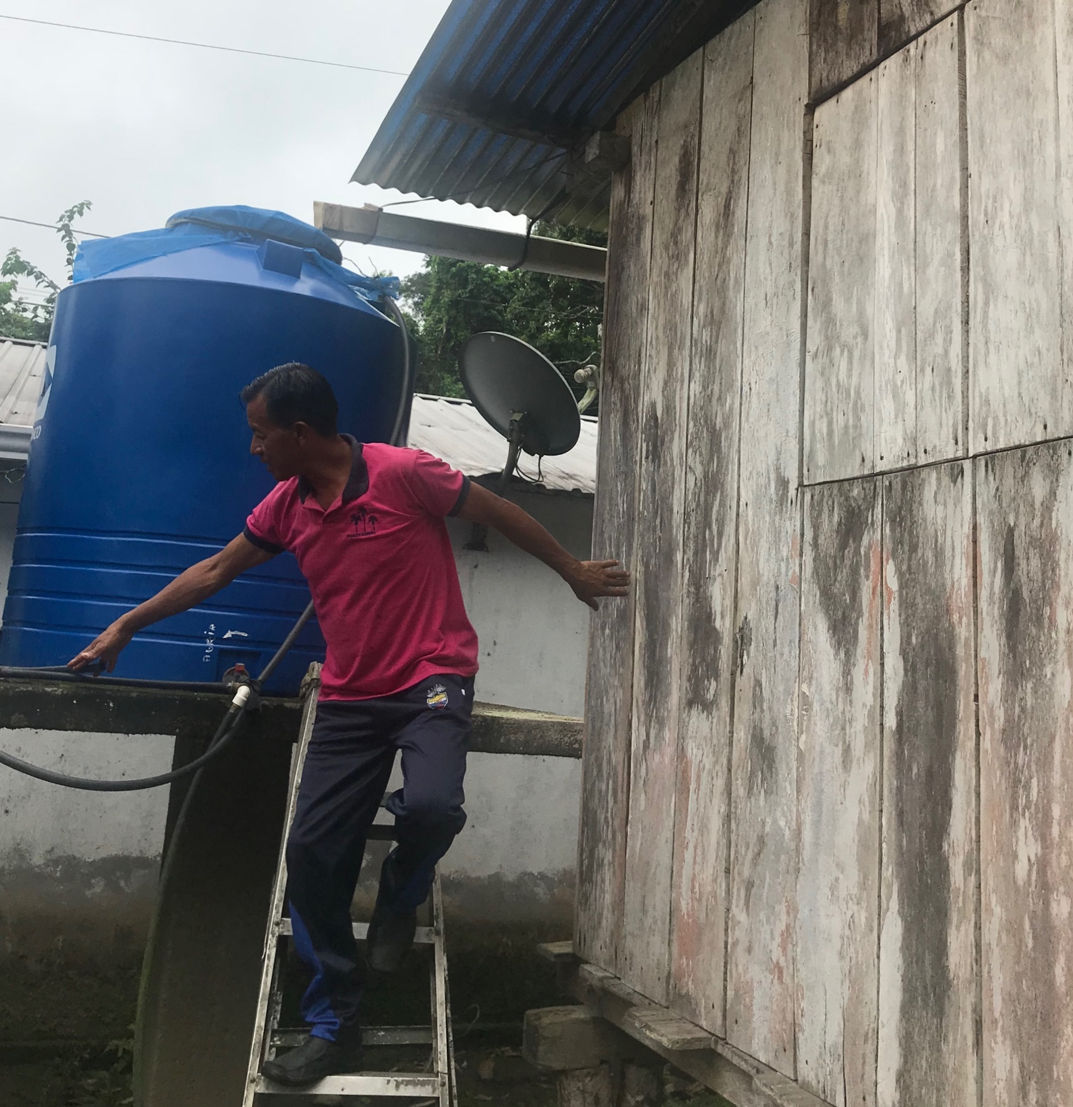
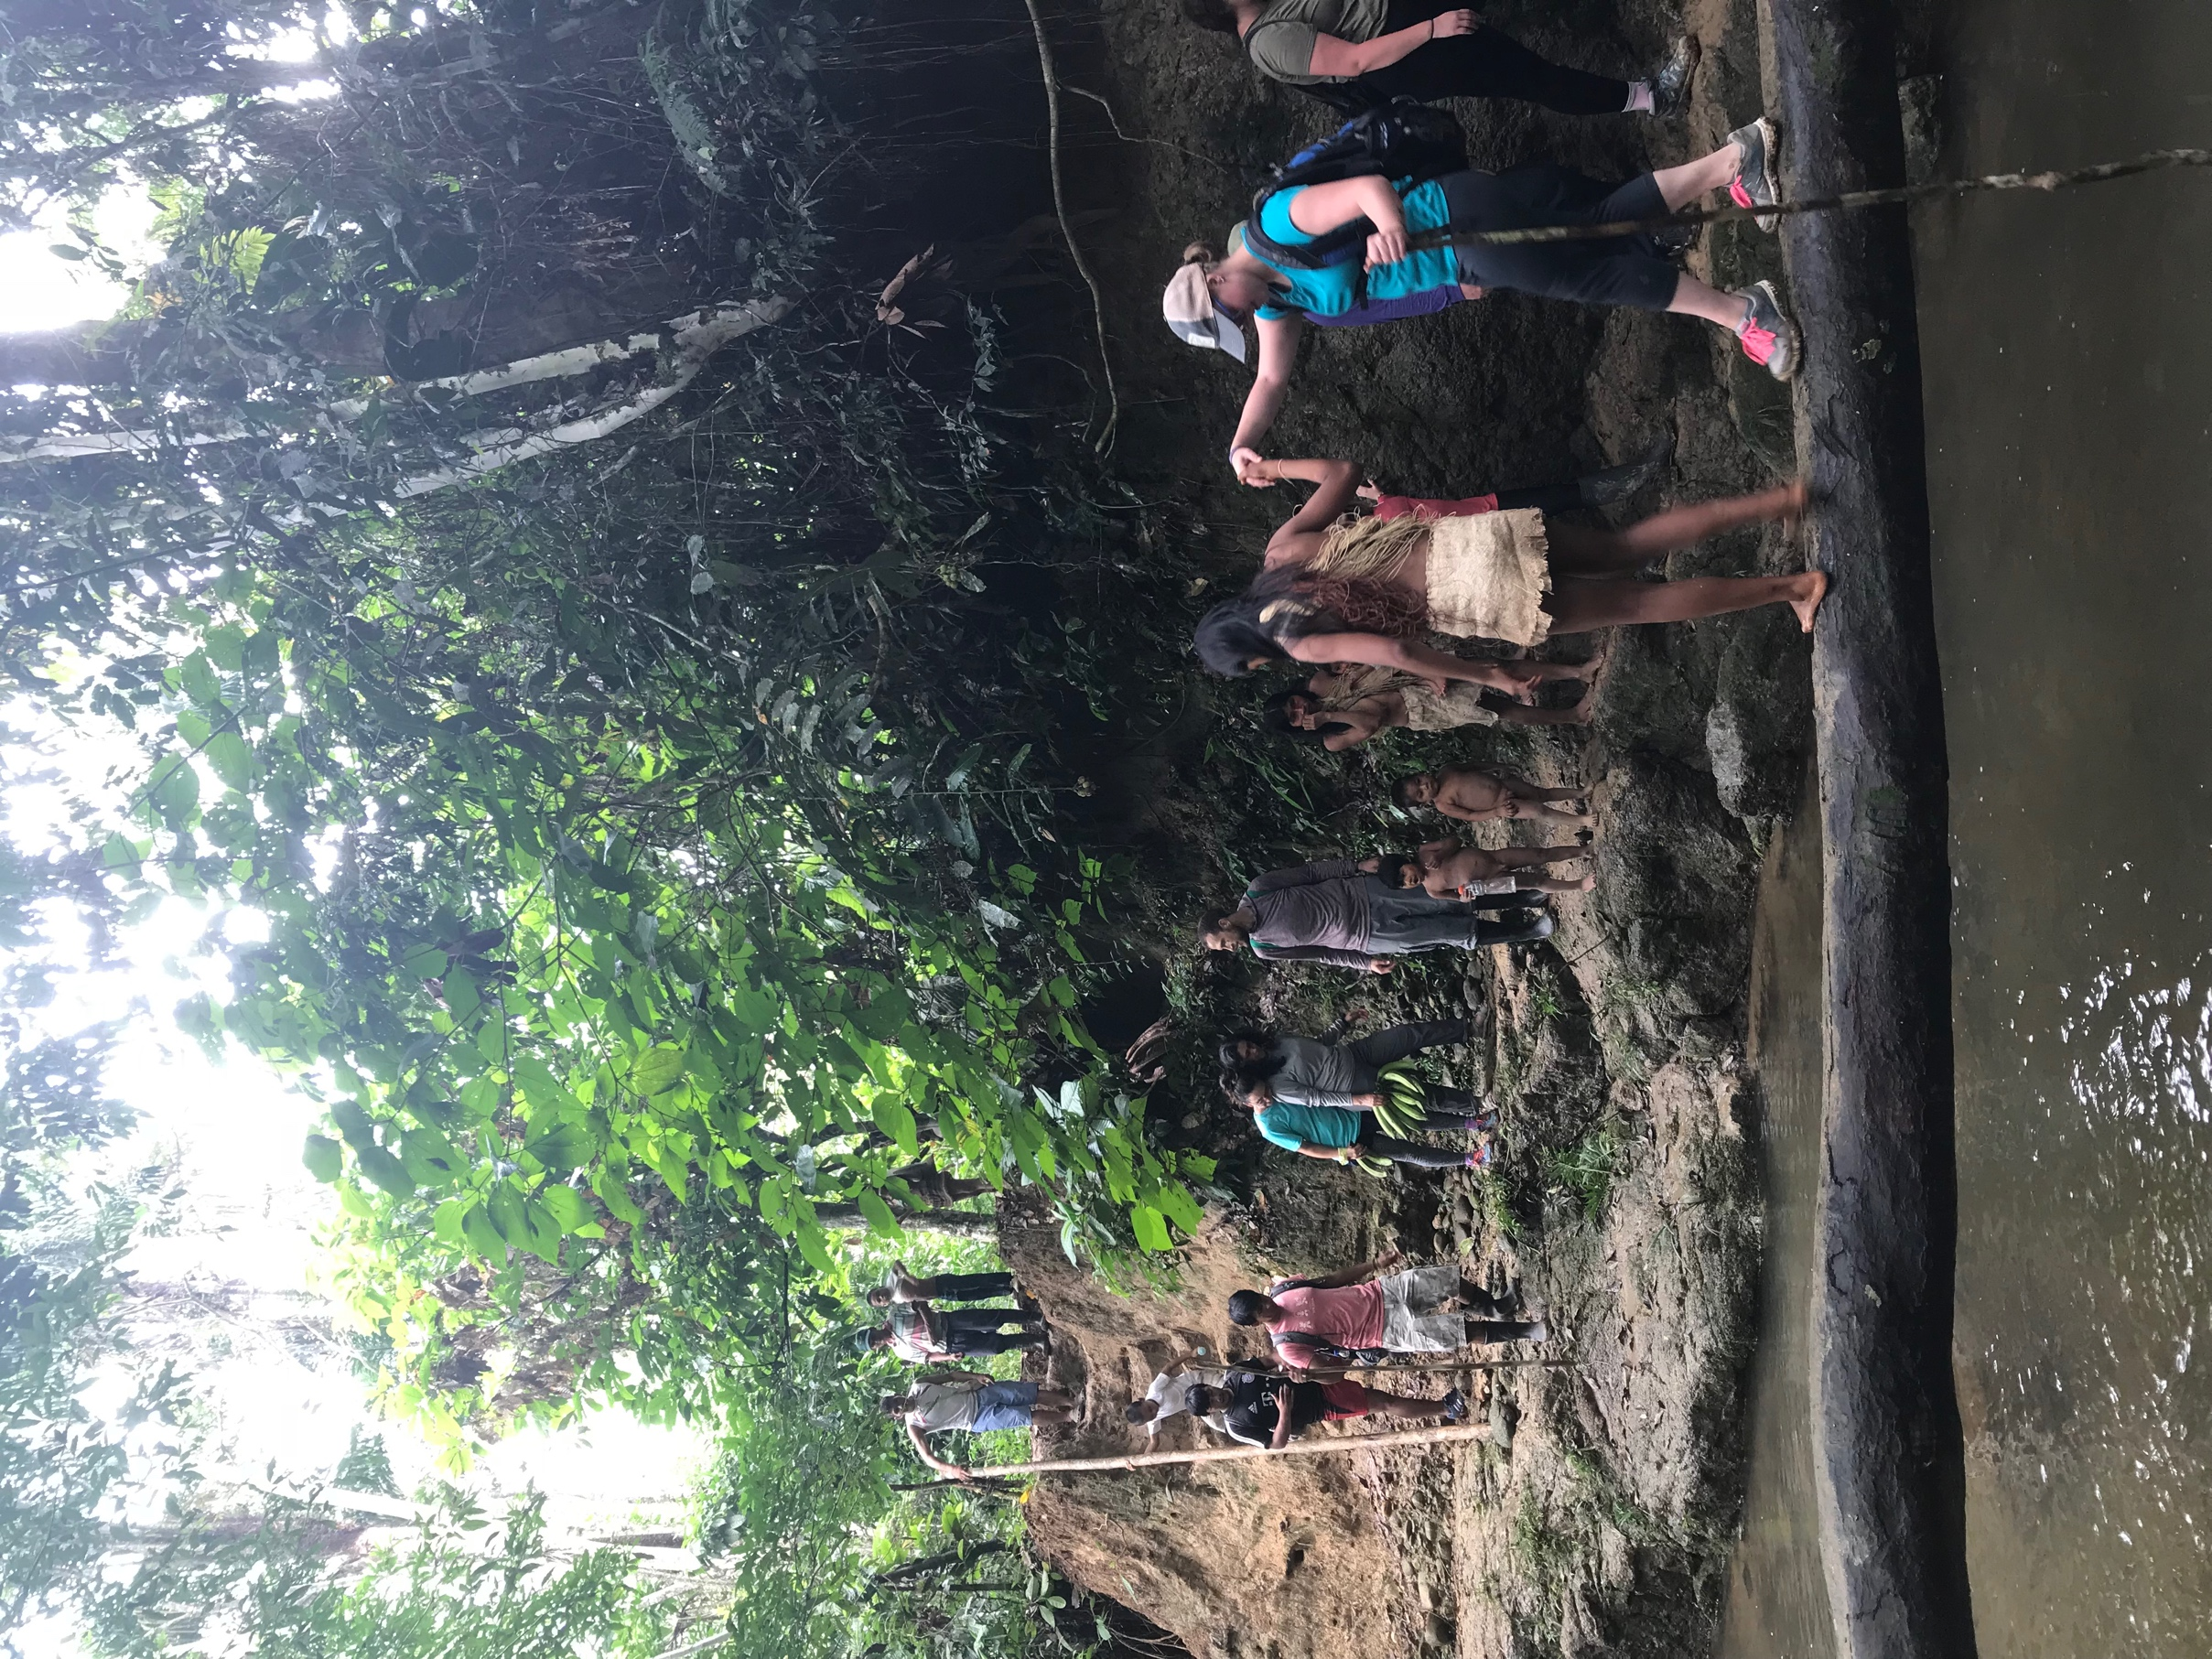
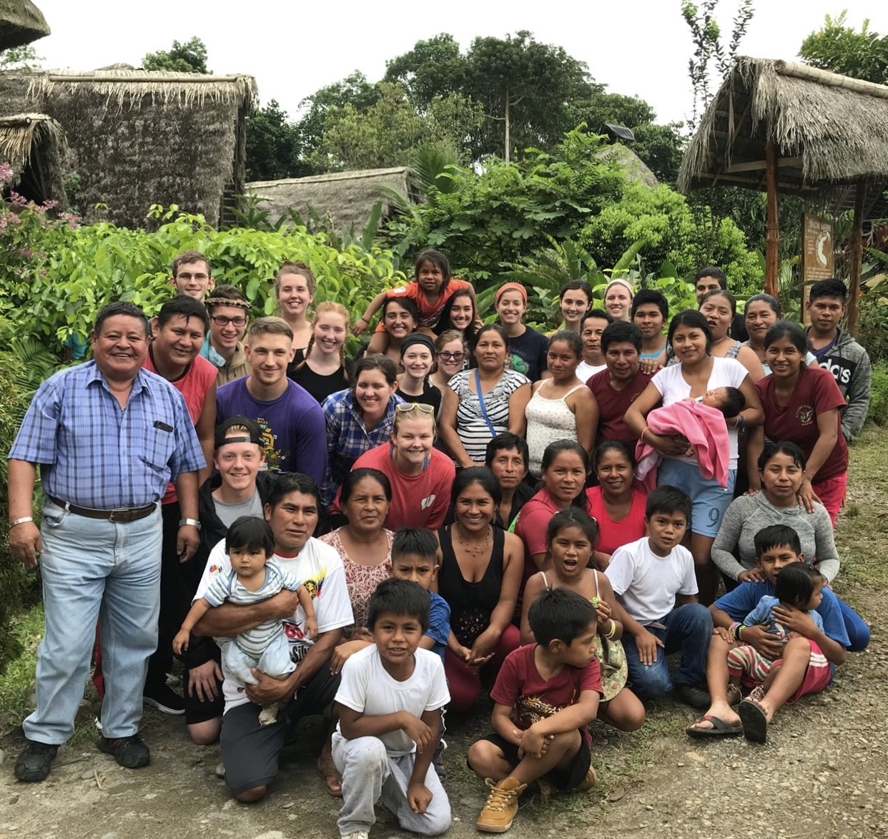
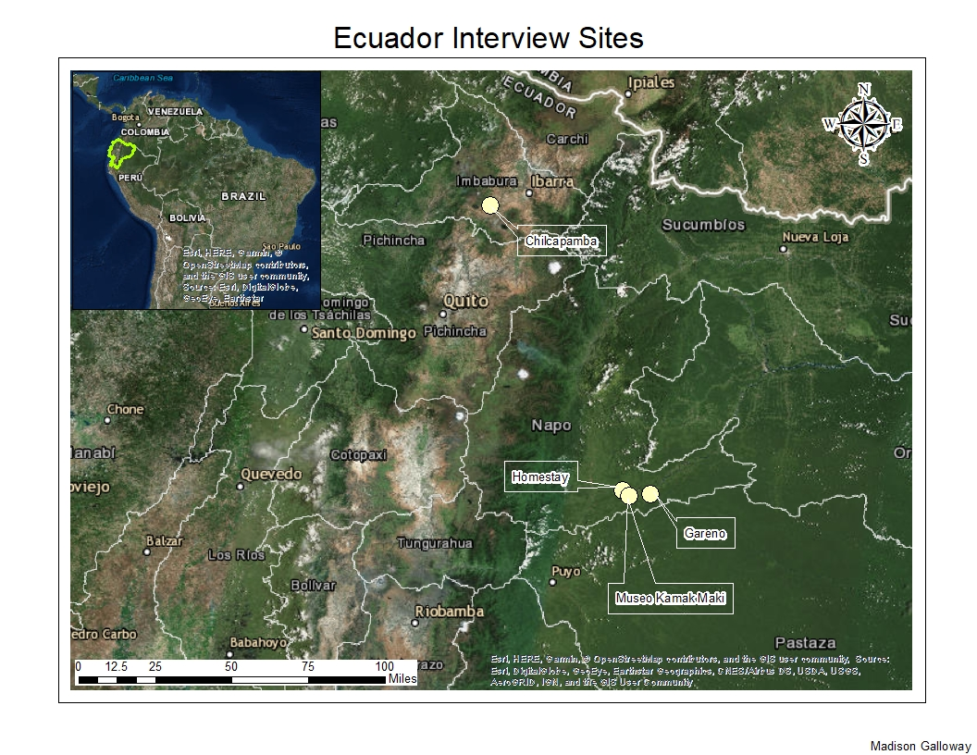
Water Quality Concerns Among Rural Indigenous Communities in Ecuador
Madison Galloway, Dr. Karen Mumford, Shanti Freitas | Watershed Institute for Collaborative Environmental Studies and Academic Affairs
Introduction
Methods
Residents also indicated the barriers to clean drinking water. Barriers to better drinking water included lack of funds and perceived disinterest from the government.
Government abandons rural community’s needs. -Sofia
[We] pay taxes yet no help for rural communities. -Hector
[It is the] fault of the government… There have been discussions at
town meetings but no action. -Janeth
When residents were asked to provide solutions to water challenges, the perceived lack of interest by government led them to suggest assistance from outside and non-governmental groups:
If [the] Ecuador government does not help, then we will resort to outside organizations and oil companies [for aid]. -Sofia
Need outside resources (international organizations or government) to get the water to rural homes. -Hector
[We need] infrastructure for mountain water… [Chloride]… filter[s], [and] getting attention from institutions to fund projects. -Becker
Without water there is no life. -Sofia
Open-ended questions were developed to investigate sources of drinking water, water quality concerns, and strategies to improve water quality and access among rural indigenous community members. Seven interview questions were disseminated in Spanish. Spanish transcripts were then translated to English and reviewed to categorize and synthesize information shared by participants.
According to the Pan American Health Association, Ecuador has one of the highest rates of disease associated with poor drinking water in Latin America. This is especially acute among indigenous rural communities where funding and infrastructure is lacking. To examine water quality concerns among indigenous rural Ecuadorians, we conducted in-person interviews of Kichwa and Huaorani residents living near Tena and Otavalo, Ecuador. This study was conducted as part of the 2018 Geography and Culture of Ecuador Winterim Immersion Program at the University of Wisconsin-Eau Claire. The broader goal of the immersion program was to experience and learn firsthand how global forces impact the environment in remote areas of the Andes Mountains and Amazon jungle basin. As part of this immersion experience, the perspectives on water were examined among rural indigenous people in Ecuador.
Jamie Alvarado displays his blue water tank which collects rainwater that falls from his roof. This water flows through a pipe into his kitchen for drinking and cooking purposes.
Results
Of the nine individuals interviewed, seven were Kichwa and two were Huaorani; and of these, three were female. Sources of drinking water included rooftop rainwater, mountain springs, and nearby rivers. Water quality concerns focused on health implications; although flooding and droughts were also reported. One family member noted that poor water quality caused:
…damage to the family due to fever and illness. -Saulo
In addition, residents noted problems with parasites and irregular access:
Some kids get parasites from the water. -Alfonso
Less rain [occurs] in the summer which makes water difficult to get;
drought, climate change [make the] rain… unpredictable. -Apak
Another concern focused on lack of access to clean drinking water and/or infrastructure problems.
[We face the] impossibility of getting water, [it is] far away and unreliable… [we] can access the river water but it’s dirty. -Janeth
…water quality is not the problem. Access is the problem. [There is a] lack of monetary resources to pump water to higher elevated communities. -Alfonso
Finally, community members were very concerned with future generations:
River water is contaminated… [we are] concerned with children’s health and [the] future of the community. -Piedad
Health of younger generations is key. -Janeth
Strategies current residents employ to address water quality problems include boiling or filtering water or purchasing bottled water, however this is very expensive. In addition, residents were skeptical of the nature of bottled water:
Bottled water is dead water. -Alfonso
A Huaorani woman helps UWEC students cross the Gareno River, which is their community’s main source of drinking water.
Background on Ecuador
Ecuador has a population of nearly 16.5 million people and is located on the western coast of South America along the Equator. Nearly one-third of the population lives in rural areas. With 14 separate indigenous groups living in Ecuador, this study focused on the Kichwa and Huaorani communities living in communities of Tena, Puerto Misahualli, Gareno, and Otavalo (Figure 1).
Host families of Sinchi Warmi Ecotourism Lodge with UWEC students.
Study Implications
Interviews with community residents indicated a strong awareness of the water challenges facing the rural communities and strategies to improve drinking water. There was strong frustration by the lack of support and aid from the government. Non-governmental organizations who wish to assist rural Ecuadorians in addressing their water issues need to engage directly with community members to identify appropriate strategies and technologies that will succeed and be sustained into the future. The program provided a unique opportunity to observe firsthand and learn directly about the barriers and responses to water issues. Interacting with the indigenous communities provided me with the opportunity to reflect on my personal water usage and the need for all communities to have access to clean drinking water. I deeply value the direct conversations with community members and recommend that future students continue this work.
Acknowledgements
This research was made possible as part of the the 2018 Geography and Culture of Ecuador Winterim Immersion Program. The Ecuador immersion program was funded by Blugold Commitment Funding. We thank the following for their assistance and participation in this research: Cora Cornett, Museo Kamak Maki, the families of Sinchi Warmi Ecotourism Lodge, the Alvarado-Rivadeneyra family, the Community of Chilcapamba, and the Community of Gareno.
Figure 1.

