Slide 1
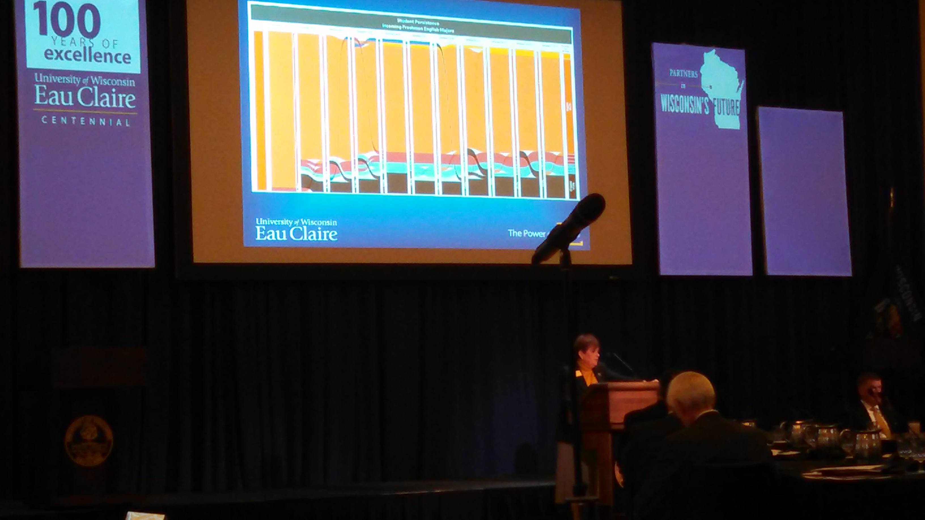
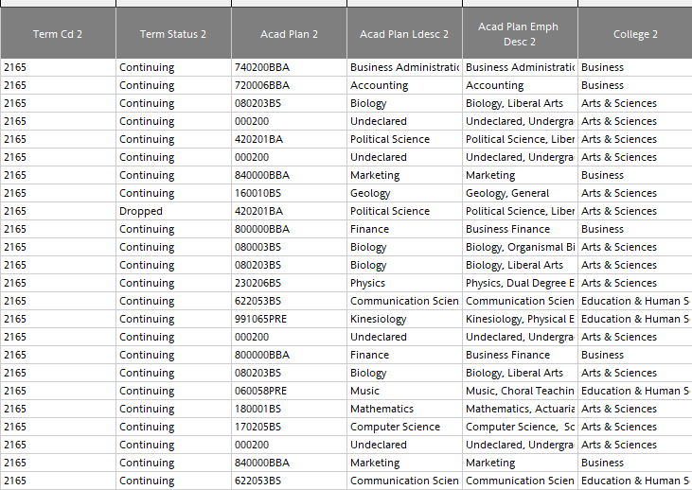
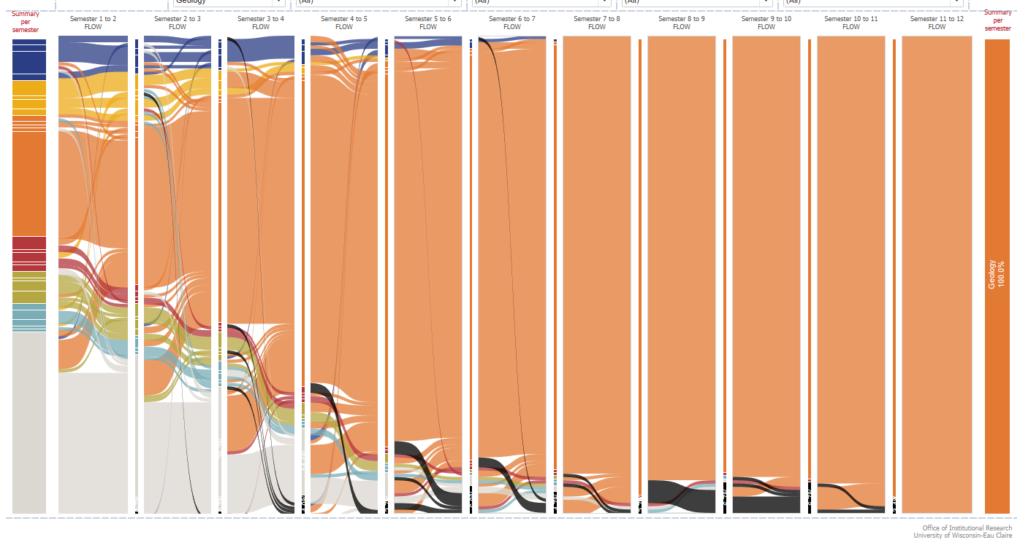
Major Changers: Using Sankey Diagrams for Student Retention & Graduation
Lance Cieslewicz, Nicole Kraft and Kari Herbison | Institutional Research
Introduction
Building the sankey
The University of Wisconsin-Eau Claire is always looking for ways to improve retention and graduation rates. The Office of Institutional Research completed a project focusing on student movement with the goal of following student major changes from term to term. Previous “Major Changers” projects attempted to analyze this data in a tabular format which was difficult to read and understand. A Sankey diagram was used to better visualize this data. The Sankey diagram is an innovative way to visualize the flow of data between points in time. These diagrams have not been very widespread in higher education due to the complexity of creating the graphic. Additionally, many universities do not have organized retention and graduation data to complete a Sankey diagram.
The Sankey is DELICATE!
  Excel model tab
  Types of Sankeys
  Sigmoid function & flow size
  Min & Max position formulas
  Curve formulas
University Feedback
Retention and Graduation Data Model
Worked hard with IT department to build permanent custom data model
One row per student
Has 12 terms per student (six years)
Calculates Time to Degree and Credits to Degree
Now contains 234 columns
Easily join retention and graduation data to anything we want
Output was still difficult to work with
Provost Kleine (above) referencing the Sankey diagram in a presentation to the UW System Board of Regents in October 2016.
Application
Looking from the perspective of a graduating major, this view shows the majority of students who graduate in this major start elsewhere.

