Slide 1
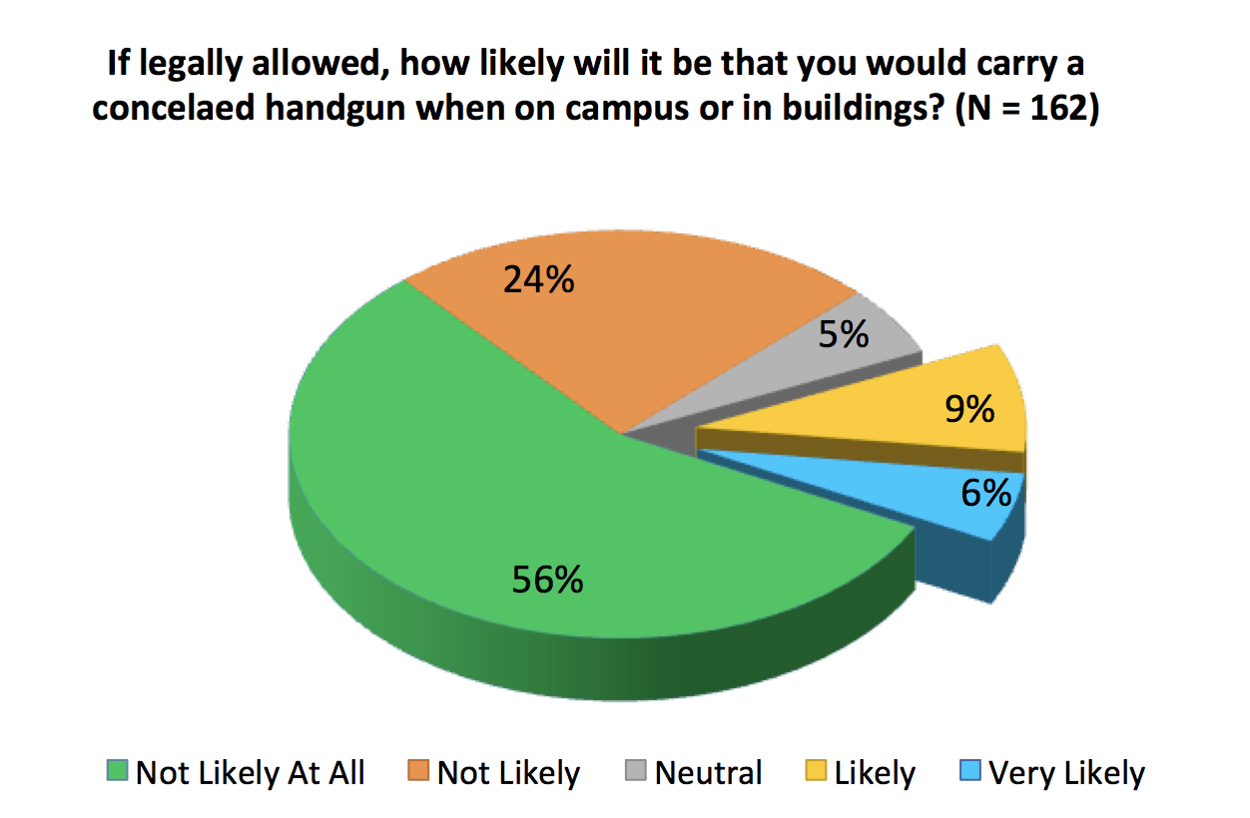
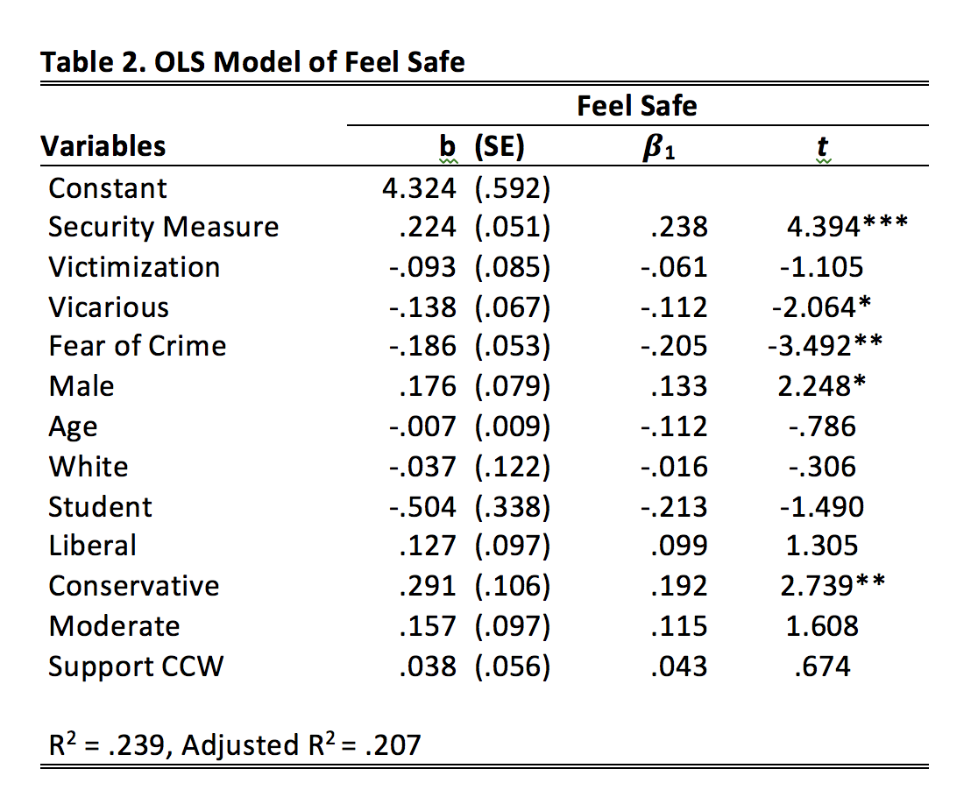
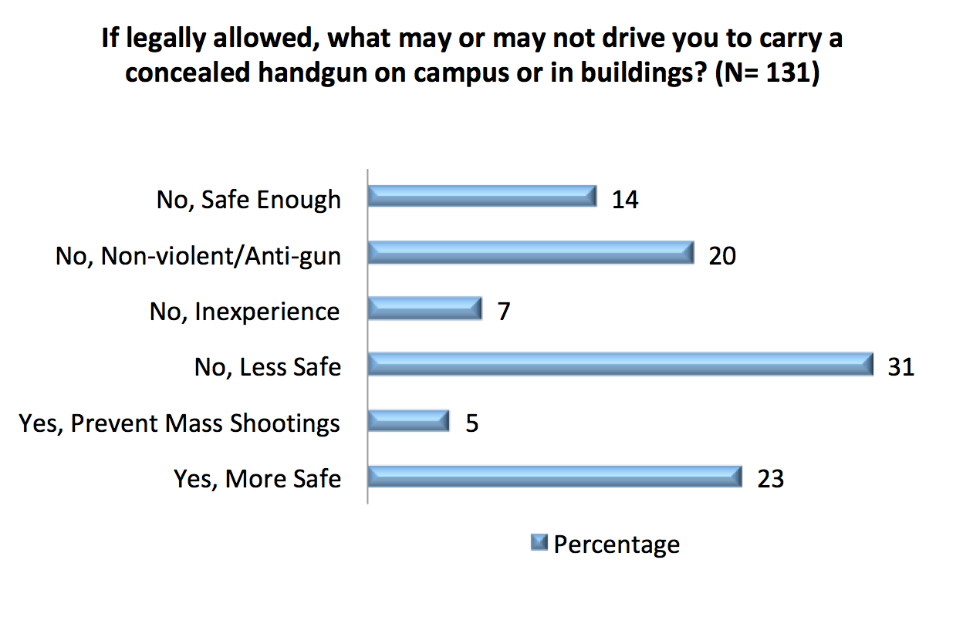
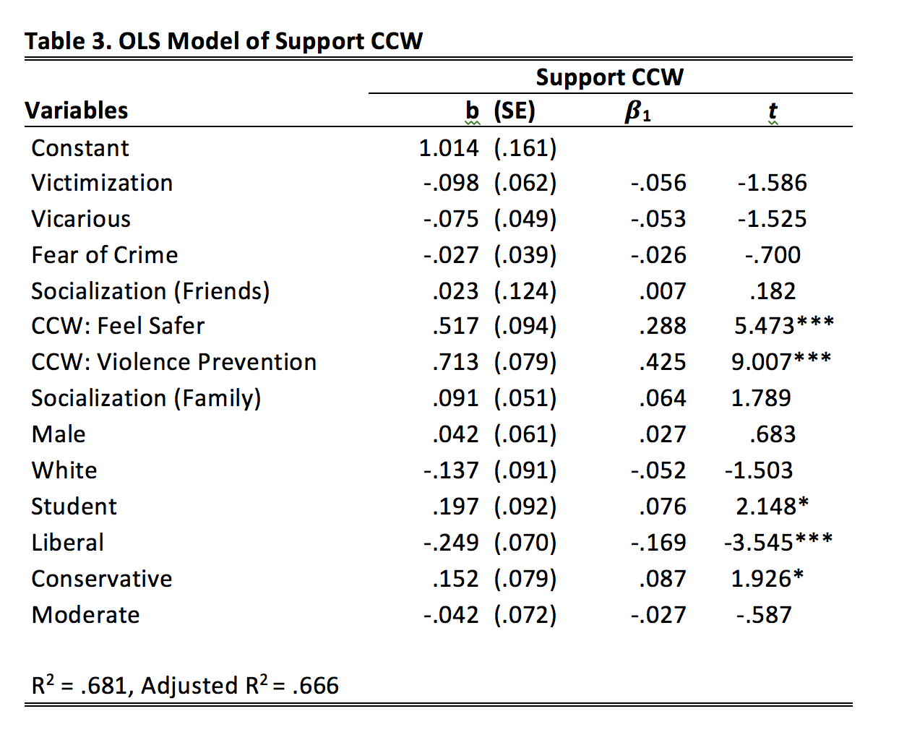
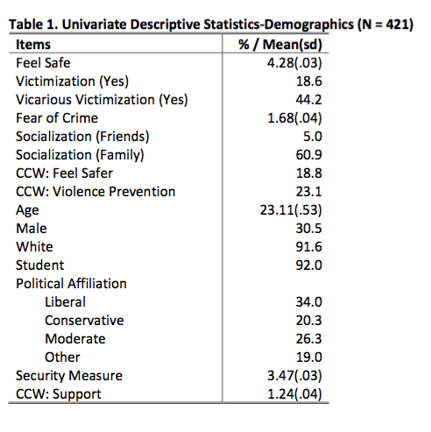
Concealed Weapons On Campus
Do They Make People Feel Safer?
Haley Alger, Angelina Mort, Brady Seidlitz | Criminal Justice Program
Faculty Mentor: Dr. Ming-Li Hsieh
Introduction
Given the recent proliferation of firearm-related violence on American campuses, perceptions of the prevalence of crime on college campuses and concerns for student safety have increased in the past two decades. Many states have responded to this issue by passing new legislation on carrying concealed firearms either on or in campus buildings. UWEC members were asked to share their perceptions on a variety of these polarizing questions.
The current study primarily seeks to understand how perceptions of campus safety are related to physical institutional features, potential victimization, fear of crime, and attitudes toward concealed handguns on campus.
Research Questions
1. Does perception of physical safety features affect feelings of safety on campus?
2. Do carrying concealed firearms on campus make people feel safe on campus?
3. Will students and faculty carry firearms on campus if concealed carry is legally allowed?
Methods
A total of 2,500 anonymous online surveys were sent by using a simple random sample strategy with a response rate at 17 percent (N = 421). Content analysis and multivariate analysis were used to address research questions.
Findings
Individual’s perception about security measure, vicarious victimization, fear of crime and their political affiliation would significantly affect their perception of safety on campus.
Respondents who are students, conservative-oriented, and indicated that carrying a firearm would increase their perceptions of safety and prevent mass shootings are more likely to support carrying a concealed weapon on campus or buildings if legally allowed.
Respondents recommended increased outdoor lighting, stricter access control to buildings, and CCTV installation could be done to make the UWEC campus safer.
Respondents indicated that improved student education of safety measures available to them (e.g. escort services, Bait Bike sticker, student patrol) would ease safety concerns and help them to better protect themselves from potential future victimizations.
About 80% of respondents stated that even if legally allowed, they were unlikely to carry a concealed handgun on campus.
Discussion
The current study found that permitting concealed weapons on campus is unlikely to accomplish the goal of increasing students’ feelings of safety. An increased sense of fear and feeling unsafe were also found if it were legal to permit students and faculty to carry concealed weapons on campus. Both student and faculty recommended that UWEC should improve lighting in pathways surrounding HAAS, HSS, Phillips, HFA, around the dorms on upper campus, and in parking lots. Respondents also suggested implementation of access control for educational buildings on campus, and an emphasis on educating the UWEC community on safety resources.
Limitations
The popularity of media report on gun violence
Limited sample size and response rate
Perception bias

