Slide 1

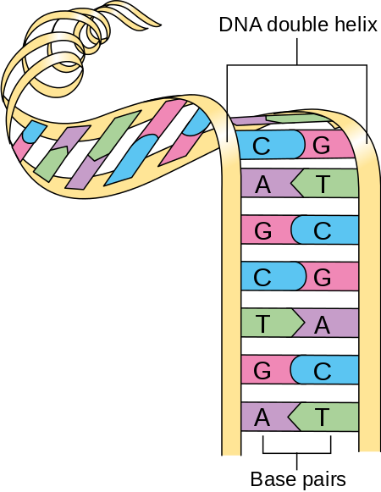
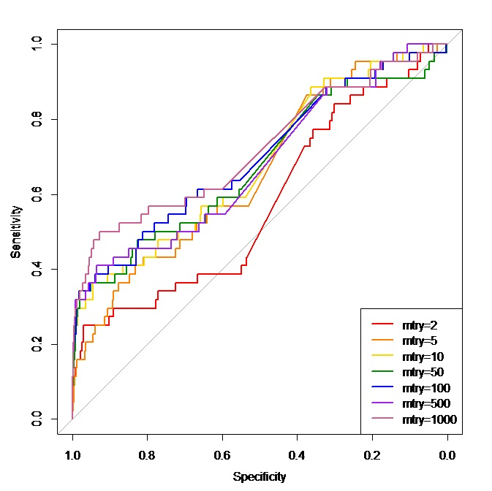
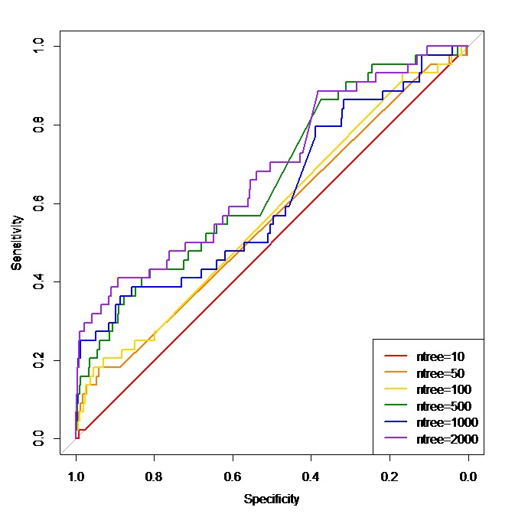
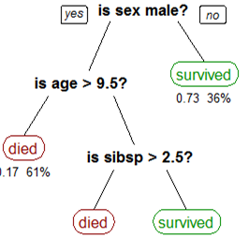
Using Random Forest to Uncover Missing Heritability
Jack Lazowski and Molly Petersen
Faculty Mentor: Dr. Abra Brisbin
University of Wisconsin-Eau Claire
Introduction
Simulation Results
Optimal Forest
Definitions
One of our goals before moving onto real data was finding the optimal forest to run. We can control the number of variables that are considered at each split, MTRY, and the number of trees in the forests.
Using ROC curves to graph the effectiveness of our forest the best models have an area under the curve of 1 and the model with an area of under of curve of 0.5 would not be better than random chance.
Genotype: the genetic constitution of an individual organism - what an organism’s gene codes for.
Phenotype: the set of observable characteristics of an organism, a result of the interaction of genotype with the environment
Single Nucleotide Polymorphisms: SNP, changes to a single base pair in the DNA
We first used Linear Regression to do a conditional analysis on the SNPs. We then removed the SNPs that were significantly affecting the phenotype.
Using the random forest function we had the SNPs that were not removed as the predictors and the phenotype as the values we are predicting.
Next we compared the effectiveness of random forests and two linear models. One of the linear models was used to remove the obvious SNPs and another was used to predict the phenotype. We found that the random forests was indeed better at predicting the patients phenotype than the linear regression.
We did some experimentation for the conditional analysis and compared removing SNPs with p-values less than 0.05 divided by the number of SNPs and those with p-values less than 0.01 divided by the number of SNPs. We did not find a significant difference in the fitness of the forests with more or less predictor variables.
Missing Heritability
Figure 1: Double Helix of DNA
MTRY
Genetic sequencing technology has provided us with the information to show a correlation between some genetic variants and diseases. However, single genetic variations cannot account for much of the heritability of diseases, behaviors, and other phenotypes. This large amount of our genetic makeup that is unaccounted for is a problem known as missing heritability.
Knowing what gene is correlated with a disease can help in both treatment and prevention of disease. For example, Leber’s Congential Amaurosis is an eye disorder that can cause visual impairment. If this disease was caused by the gene RPE65, this disorder can be treated through gene therapy. However, if the disease was caused by any of the 13 other genes known to be associated with the disease, this treatment would be ineffective.
We found that considering 1000 SNPs at each split is best because it was not significantly longer than any of the other forests considered. But 1000 MTRY was significantly better than 2 and 5 MTRY.
Figure 2
Number of Trees
Logistic Regression Analysis
We found that 1000 trees was the best forest. 2000 trees was about twice the time and was not significantly better than 1000 trees. 1000 trees was also significantly better than forests with 100, 50 and 10 trees.
Objectives
Oftentimes, data is presented in a qualitative form. However, for our analysis, it is often preferred to have quantitative data. To confer this information in a quantitative way, we used a generalized linear model. As a binary model, this model allowed us to represent an outcome as either a 0 or a 1. ​
For example, if the data given relayed that the patient either had a symptom or did not have a symptom, we could assign the presence or absence of a symptom to that of a zero or one – converting this qualitative variable to a quantitative one.
Our goal is to develop statistical methods to condition our analysis on genes already known to be associated with a disease. Achieving this will allow us to focus on identifying genetic variants not already known to be correlated with the disease - helping to piece together the puzzle of missing heritability.
Figure 2: A higher proportion of students reported experiencing frustration with worked examples.
Random Forests
Future Work
Random Forests is a function from R that uses a machine learning technique to do regression and classification. Random Forests creates decision trees for a single variable for our phenotype. The algorithm chooses optimal splits on the decision tree to minimize residual sum of squares.
Our research team has applied for real data through dbGap. We have also gone through all of the IRB requirements to handle and analyze this data. Specifically, we applied for studies based on Age Related Macular Degeneration and Breast Cancer. We chose these diseases because based on past research we know that they are genetically linked.
We have also done research on the SNPs that have already been associated with these disease so we will know what to condition on. Know all that needs to be done is run the random forest with the parameters we found best and the technique based on the type of phenotypic data we have.
References
[1] Al‐Aama JY, Shaik NA, Banaganapalli B, et al. (2017). Whole exome sequencing of a consanguineous family identifies the possible modifying effect of a globally rare AK5 allelic variant in celiac disease development among Saudi patients. PLoS One, 12(5): e0176664. http://journals.plos.org/plosone/article?id=10.1371/journal.pone.0176664
[2] Cancer Research UK. 30 July, 2014. Diagram showing a double helix of chromosome CRUK 065.svg. Accessed Feb 2018. https://commons.wikimedia.org/wiki/File:Diagram_showing_a_double_helix_of_a_chromosome_CRUK_065.svg
[3] Goldstein BA, Polley EC, and Briggs FBS. (2011). Random forests for Genetic Association Studies. Stat Appl Genet Mol Biol, 10(1): 32. https://www.ncbi.nlm.nih.gov/pmc/articles/PMC3154091/
[4] Hunter DJ, Kraft P, Jacobs KB, et al. (2007). A genome-wide association study identifies alleles in FGFR2 association with risk of sporadic postmenopausal breast cancer. Nature Genetics, 39, 870-874. https://www.nature.com/articles/ng2075
[5] Katta S, Kaur I, and Chakrabarti, S. (2009). The molecular genetic basis of age-related macular degeneration: an overview. Journal of Genetics, 88(2), 425–449. https://doi.org/10.1007/s12041-009-0064-4
[6] Lynch M and Walsh B. (1998). Genetics and Analysis of Quantitative Traits. Sinauer Associates, Sunderland MA.
[7] Manolio TA, Collins FS, Cox NJ, et al. (2009). Finding the missing heritability of complex diseases. Nature, 461, 747‐753. https://www.nature.com/nature/journal/v461/n7265/full/nature08494.html
[8] Sergejeva O, Botov R, Liutkevičienė R, et al. (2016). Genetic factors associated with the development of age-related macular degeneration. Medicina, 52(2), 79-88.
http://www.sciencedirect.com/science/article/pii/S1010660X16000227
[9] van ‘t Veer LJ, Dai H, van de Vijer MJ, et al. (2001). Gene expression profiling predicts clinical outcome of breast cancer. Nature, 415, 530-536. https://www.nature.com/articles/415530a.pdf
Figure 2: Example of a Decision Tree
Random Forests then uses bagging or bootstrap aggregation. Bagging takes a bootstrap sample from the phenotypic data and builds a tree based on the SNPs to predict the sample of phenotype values. Then the function estimates the phenotypic values that are not included in the sample with the decision tree. This is done many times to create many trees or a forest. Random Forests then averages the estimates for each data value when it was not included in the bootstrap sample.
Acknowledgments
UWEC Office of Research and Sponsored Programs
R Statistical Programming Software and Powerpoint
UWEC Learning and Technology Services
Notes:
For graphs: las = 1 will turn the y-axis labels horizontal, cex.axis = 1.2 resizes labels (default is 1)
44 inches wide of content – 2 inch spacing btwn columns, 42/3 = 14 inches per col >> -22: -8, -7:7, 8:22
All data set references? R package ref? leave out ref of non referenced
Ref: Radel, Palacios, Kreider/Lofquist, Argys, Barth

