Slide 1
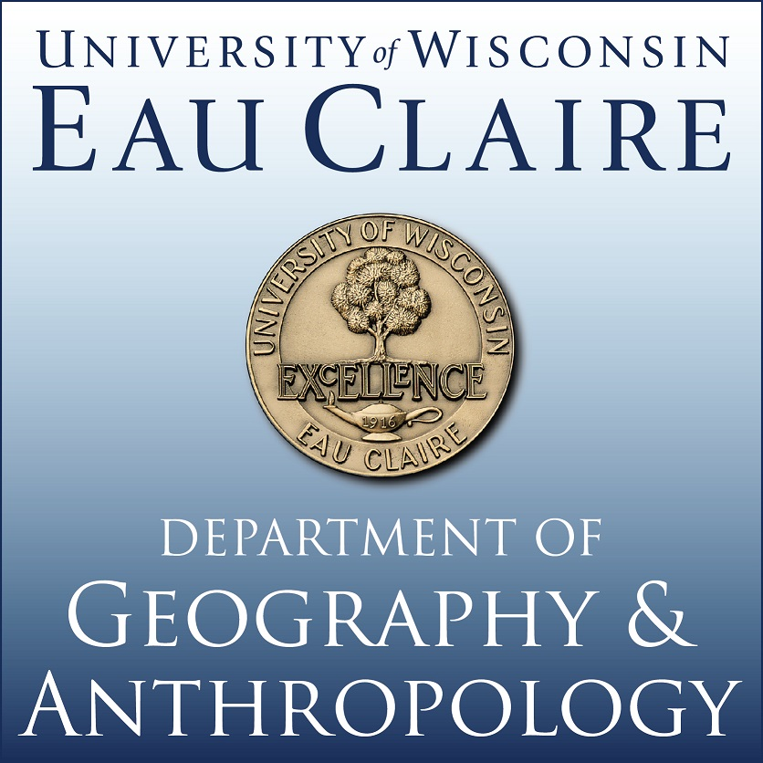
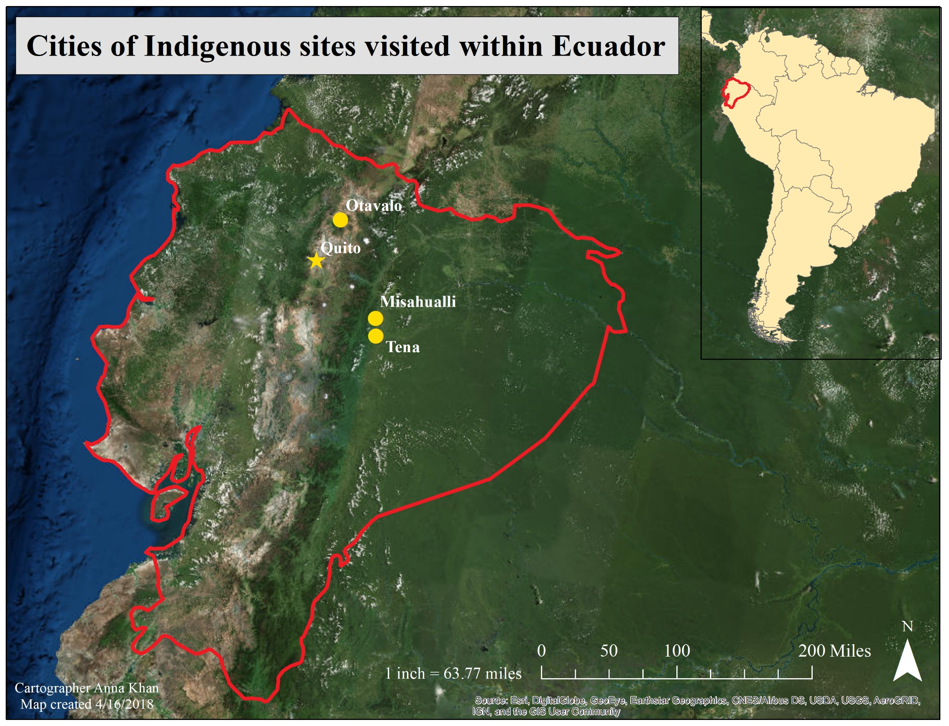
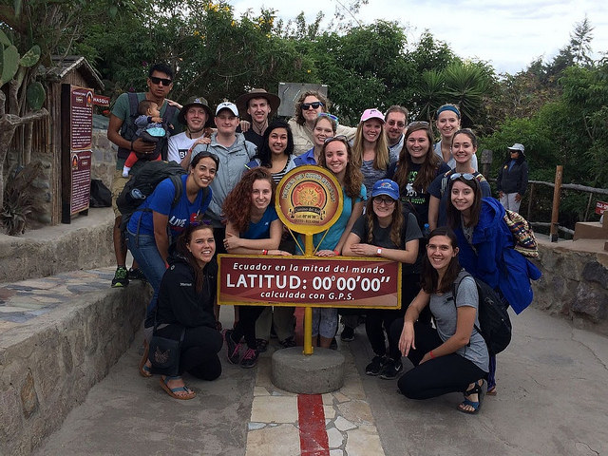
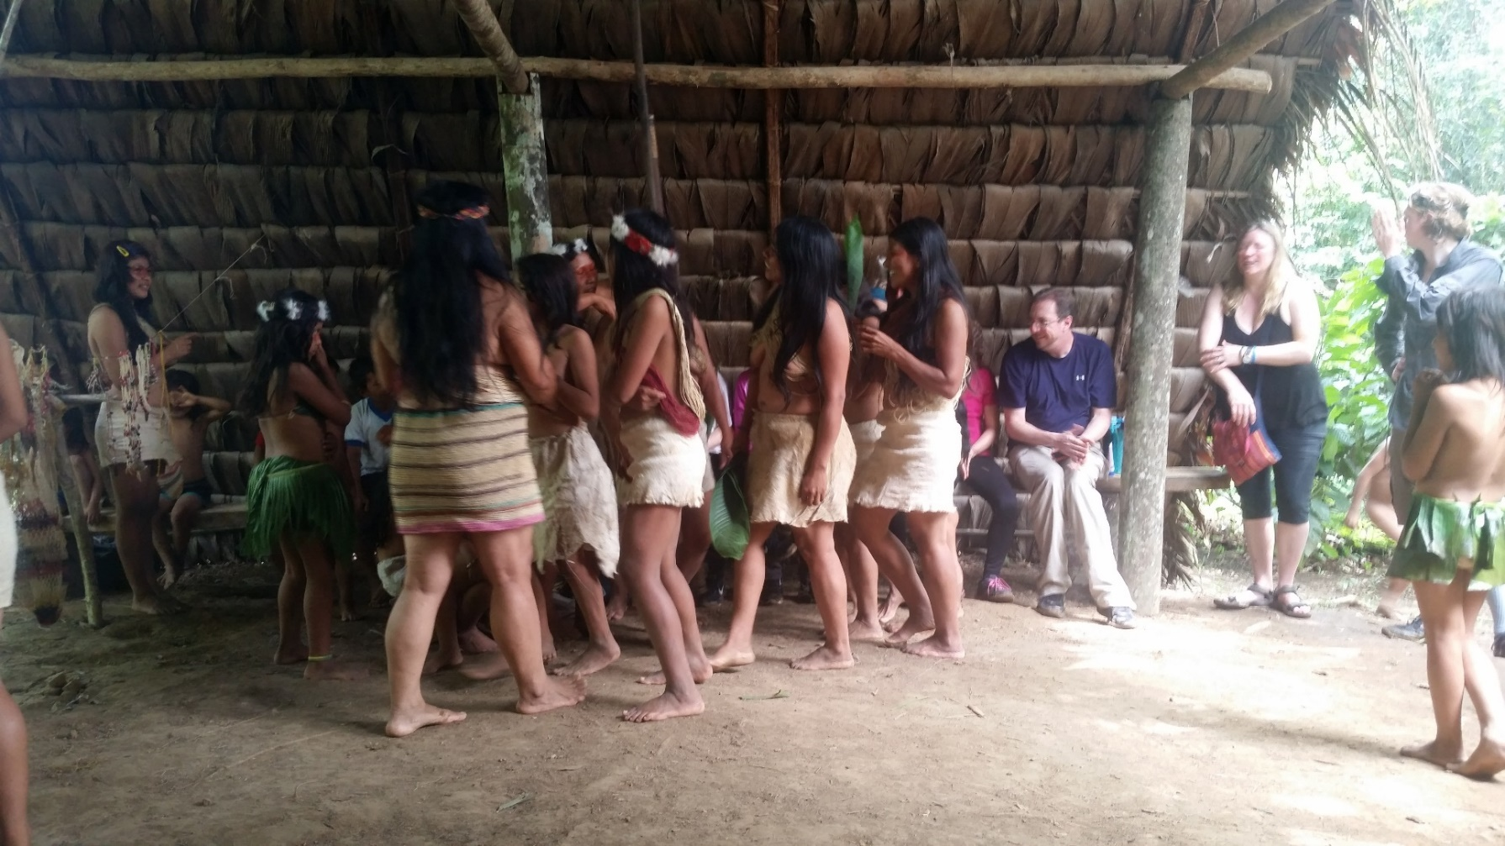
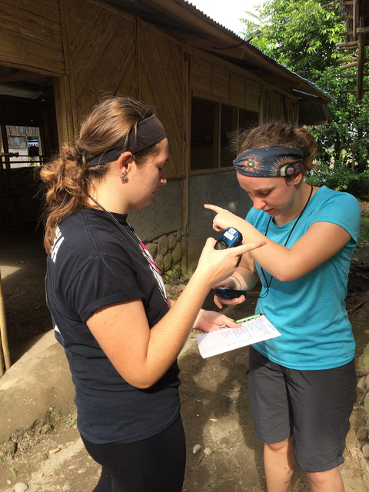
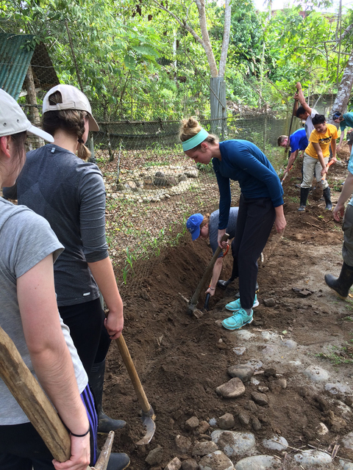
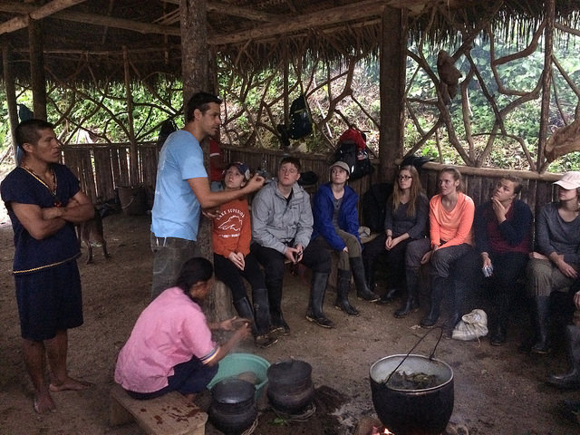
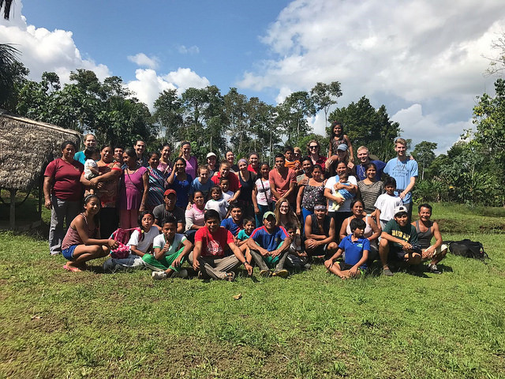
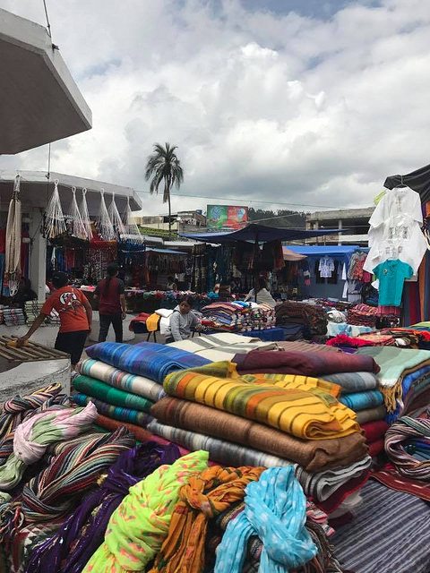
Tourism Impacts on Indigenous Communities within Ecuador: A Critical Analysis
Anna Khan and Taylor Tremain, Shanti Freitas Cultural Immersion Coordinator and Dr. DeGrave
Department of Geography and Anthropology, University of Wisconsin- Eau Claire
Introduction
Huaorani and PetroEcuador
Lowland Kichwa & Guayusa Ceremony
During Winterim of 2017 a group of 16 students and 2 faculty embarked on an immersion experience to Ecuador to learn about the culture and geography of the Andes and Amazon River Basin. During this 3-week immersion experience multiple indigenous tribes were visited. Connections between globalization, tourism and indigenous tribes in Ecuador were drawn; causing us to understand the impact our actions in the U.S. have on others such as the indigenous people in the Amazon and others in Latin America. The indigenous tribes visited were the Huaorani and Lowland Kichwa in the Amazon Basin and the Upland Kichwa in the Highlands of Ecuador. All of these tribes showed different examples of being affected by globalization and tourism.
The Huaorani were located within lands owned by PetroEcuador, the national oil company of Ecuador. The “intrusion of tourists and outside entrepreneurs” like our group and the activities of PetroEcuador, “brings cultural shock to those formerly isolated communities” (Yang et al. p.87, 2012). Since the oil company’s appearance in the 1940’s, the Huaorani have been subjected to the ideals of Western society. The Huaorani as a tribe have rejected assimilation and aim to continue their traditional way of living though this has not made them impervious to cultural change. When we visited the village, women were raising money to fund their children’s schooling. Public education is free in Ecuador; however, there are the “hidden” expenses of education in the purchase of uniforms, books, writing utensils, etc. Additionally, due to land restrictions from PetroEcuador and pollution caused from past spills, the Huaorani have had to stop their tradition of hunting and gathering. The cultural changes of the Huaorani caused us to reflect on how our actions impact the tribe. Our travel to and around Ecuador relied on fuel made from oil thus encouraging companies like PetroEcuador to dig for oil reserves in the Amazon, affecting indigenous communities like the Huaorani. Consequently, we began to critically analyze our way of life back in the States. Many of us have cars and drive around Eau Claire when other means of transportation are available. Since arriving back home, we carpool more, ride bikes, walk, and use public transportation rather than each individually driving everywhere. By using these other forms of alternative transportation, we reduce our dependency on oil which in turn reduces our impact on tribes like the Huaorani.
Our immersion continued with the Lowland Kichwa and involved partaking in a traditional guayusa ceremony, a service learning project, and homestays located along the Rio Napo outside the small town of Misahuallí. Our participation in the ritual also involved a talk from the village elder of how climate change has impacted their community. The rains has begun to cause the river to rise higher than normal flood levels which the elder attributed to effects of climate change. In recognizing our influence on climate change through our travels we planted 75 guayusa trees in the community which we were told would offset the carbon footprint of our flights and help the community by giving them guayusa trees to harvest. The trees could be harvested for guayusa ceremonies and sold to manufacturers. The guayusa ceremony was a part of the community’s efforts in engaging in community tourism. The ritual, however, is in danger of fading from traditions as the “youth do not drink guayusa because they do not want to cook. Furthermore, they refuse to wake up early in the morning anymore” (Sidali et al. p.9, 2016). Including the guayusa ceremony within the tourism economy preserves the communal values of the people and maintains the tradition amongst the young Kichwa as they help to prepare the guayusa for tourists.
Service Learning
Our service learning activity involved working with a Kichwa family at Museo de Kamak Maki. Kamak Maki is an eco-tourism opportunity where tourists are led by young Kichwa guides around the outdoor museum and learn about the medicinal plants, plants used to make traditional clothing, and animals that are found in the Amazon ranging from the docile capybara to macaws to monkeys roaming the preserve. In this way tourists have a positive impact on the Kichwa by providing a source of revenue while the system teaches the young Kichwa members about their culture through acting as a guide for the tourists. The situation in Kamak Maki is not unique. In a study of guayusa food tourism in the Amazon it was noted how “[n]ot only do young Kichwas refuse to speak their mother tongue, but they are also abandoning the intimate habits related to their daily culinary life” (Sidali et al. p.9 , 2016). The Kichwa people have been exposed to western influences and as such has caused their way of life to slowly be forgotten through the generations. Xerardo Periero notes how the power of a community and collective identity can achieve success in tourism for Indigenous communities. As described by Margarita Barreto, an Anthropologist, this Indigenous tourism is “the result of community-based cultural revitalization and Indigenous identity affirmation and in this way tourism can “provide the basis for defending and affirming Indigenous values and practices” (Periero, p.1125, 2016).
Homestays
Our homestays were with families that ran a communally-operated hostel resort outside of Tena, Ecuador called Sinchi Warmi. The homestays were a unique experience and were characteristic of how each of the families lived their everyday lives. Some were without running water or electricity and relied on rain to fill water barrels that were used for taking showers and cleaning clothes. Food and materials were cultivated on the land on chakras – the Kichwa traditional agroforestry system. The Sinchi Warmi hostel and some of our homestays also had compostable toilets that reused the waste they created. Though each homestay experience was unique to the family that the group members stayed with, the experience taught the importance of natural resources and the value of less consumption.
Figure 1. Map of areas visited in Ecuador
Figure 2. Standing on the Equator
Figure 3. Huaorani Tribal Ceremony
Figure 7. Taking GCP’s
Figure 5. Guayusa Ceremony
Figure 6. Familia de Homestays
Figure 8. Installing Pipes
Upland Kichwa
Reflection
In the city of Otavalo, in the Andes mountains, this Indigenous tribe is the most assimilated within society and there is much distinction between them and Lowland Kichwa. This was the most assimilated indigenous tribe that we interacted with. The Lowland Kichwa have found community and ecotourism to be beneficial for preserving their culture and improving their economic standing. The Highland Kichwa have gone about it another way. The indigenous market in Otavalo is known as the largest indigenous market in South America on Wednesdays and Saturdays. Many of the vendors are bilingual and even multilingual to sell their goods to tourists. The Otavalo market continues a tradition of the Otavalo Kichwa that extends back hundreds of years to pre-Incan times. The Otavaleños are skilled weavers and have been for hundreds of years (Bain 2014). The market allows them to turn their craft into an economic activity and helps to keep the tradition alive. In Otavalo the population is close to about 50% indigenous--people who are extremely proud of their heritage and will walk around the city in traditional dress (2014). The Kichwa here have adopted capitalism as a means of supporting their traditions and culture and the market provides an important means of revenue for these Kichwa.
During the immersion experience our group visited three indigenous groups of the Andes Mountains and Amazon River Basin in Ecuador. We learned how our actions as tourists and in the U.S. have an impact on others around the globe. As tourists our actions more directly impact the communities we visit, not only due to colliding cultural differences, but consumer behaviors can help or hinder a population. In resort areas the local people rarely see benefit from tourists; but in community tourism efforts like those that we experienced with the guayusa ceremony and the Huaorani, the revenue generated from our group directly benefitted the local indigenous people by helping their communities economically and preserving their way of life. The indirect impacts include things like carbon emissions which enter the atmosphere and contribute to climate change, causing issues like the flooding at the guayusa hut. We also took into consideration the White Savoir Complex when thinking about our effects on the indigenous communities. Instead of going in thinking we were going to “fix them,” we asked what we could provide to the community using our resources and skills – like creating a map for Kamak Maki. We also looked at how our actions at home impact others, like the people we met in Ecuador. Choosing to drive more consumes more fossil fuels which in turn encourages the continuation and expansion of operations like PetroEcuador. This immersion experience has caused us to reflect on the consequences that our actions have on other people, directly and indirectly, so we can minimize our negative impacts on others around the globe.
References
We would like to thank the following people/entities for their assistance and knowledge on this research. The Huaorani tribe of the Amazon Basin, The Lowland Kichwa tribe, Sinchi Warmi, Homestay families, Upland Kichwa tribe, Andy Gavilanes, and Shanti Freitas.
Bain, Andrew. “Travel - Otavalo: The Land of Andean Artistry.” BBC, BBC, 7 Jan. 2014, Bain, Andrew. “Travel - Otavalo: The Land of Andean Artistry.” BBC, BBC, 7 Jan. 2014, www.bbc.com/travel/story/20131230-otavalo-the-land-of-andean-artistry.
Pereiro, Xerardo. “A Review of Indigenous Tourism in Latin America: Reflections on an Anthropological Study of Guna Tourism (Panama).” Journal of Sustainable Tourism, vol. 24, no. 8-9, 2016, pp. 1121–1138., doi:10.1080/09669582.2016.1189924.
Sidali, Katia, et al. “Food Tourism in Indigenous Settings as a Strategy of Sustainable Development: The Case of Ilex Guayusa Loes. in the Ecuadorian Amazon.”Sustainability, vol. 8, no. 10, 2016, p. 967., doi:10.3390/su8100967.
Yang, Jingjing, et al. “Social Conflict in Communities Impacted by Tourism.” Tourism Management, Pergamon, 17 July 2012, www.sciencedirect.com/science/article/pii/S026151771200115X.
Figure 4. Indigenous Market in Otavalo

