Slide 1
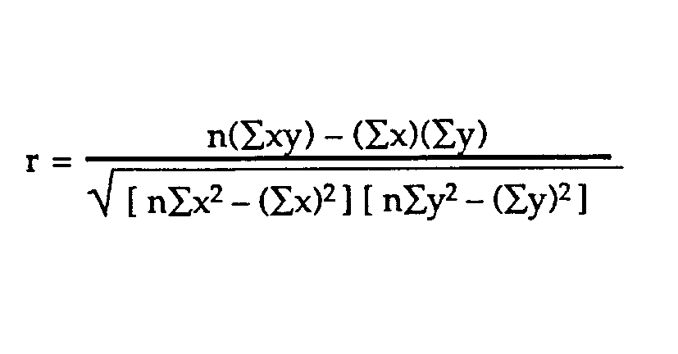
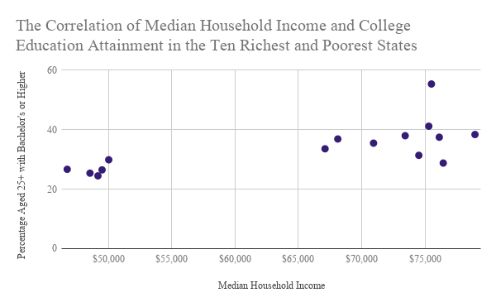
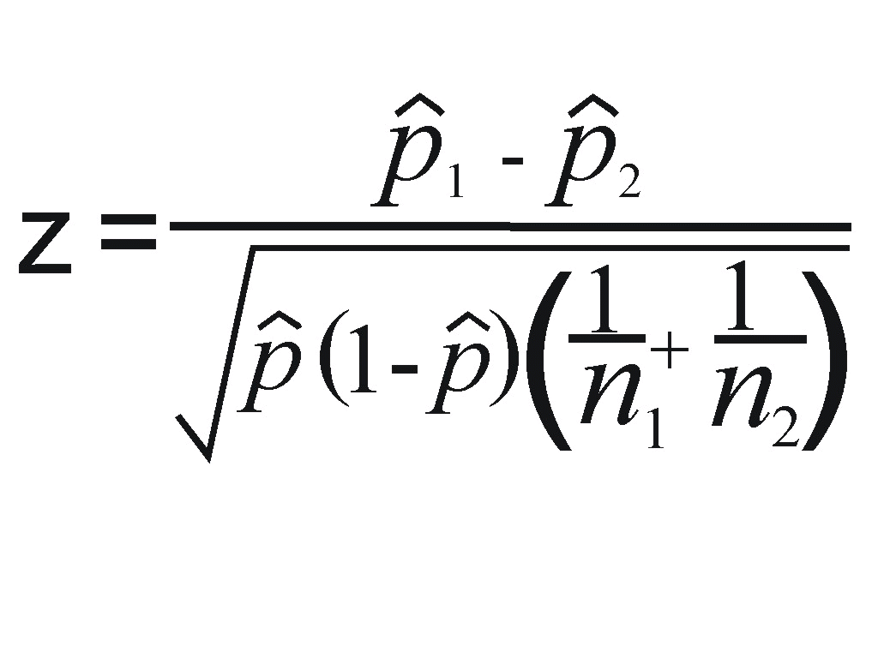
Examining the Impact of Wealth on Obtaining a College Degree in the United States
Rebecca Nelson | Fariba Khoshnasib-Zeinabad | Economics
Abstract & Intention
Percentages of citizens in the ten poorest states, aged 25 years or older who have a bachelor’s degree or higher
Comparing Income and Degree Obtainment on a National Level in Terms of Race
The purpose of this research project is to examine if wealth is a contributing factor in the attainment of a college degree. This objective was pursued by investigating the correlation between median household income in a state to the percentage of adults aged twenty-five or older living in that state who have a bachelor's degree or higher. This study is focused on the ten states with the highest median household income and the ten states with the lowest. All of the data being used was obtained from the 2016 United States Census. I will use my knowledge of statistics in hypothesis testing to analyze the data and show with above 95% confidence that wealth among other factors plays a very important role in pursuing and obtaining a college degree.
Mississippi 21%
West Virginia 19.6%
Arkansas 21.5%
Louisiana 23%
Kentucky 22.7%
New Mexico 26.7%
Tennessee 25.4%
Oklahoma 24.5%
South Carolina 26.5%
Montana 29.9%
According to CBS, the American economy grew by 1.6% from 2015 to 2016. According to the correlation found in the first part of this project, the growth of the economy should be reflected by an increase in median income across the nation, and by effect, and increase in the number of people earning bachelor’s degrees or higher.
To test if this was the case, and to test if it was true for people of all racial backgrounds, I compared data from the 2015 and 2016 censures as listed below.
Raw data
ten us states with the highest median household income
Interpreting the Data
Maryland $78,945
Alaska $76,440
New Jersey $76,126
District of Columbia $75,506
Massachusetts $75,297
Hawaii $74,511
Connecticut $73,433
New Hampshire $70,936
Virginia $68,114
Washington $67,106
The data collected seemed to suggest that there is a correlation between the median level of household income and the obtainment of a college degree in that states with a higher average median household income tend to have higher percentages of college-educated residents.
To determine if the median income and the obtainment of a college education were truly correlated, I calculated the correlation coefficient of my data using the formula and data found below.
From this I found that the correlation coefficient equaled .81, meaning that there was an 81% correlation between the median household income of a state and the level of education an adult resident of that state aged 25 or greater received.
Income and Education by Race in 2015
Race | Median Income | Number of People with Bachelor’s+ | Percentage of People with Bachelor’s+
White | $61,941 | 46,996,181 | 33.2%
African-American | $36,923 | 4,812,215 | 19.5%
Asian-American | $78,285 | 5,770,522 | 51.4%
Hispanic | $45,124 | 4,275,337 | 14.3%
Percentages of citizens in the ten richest states, aged 25 years or older who have a bachelor’s degree or higher
n=20
∑x= 1,201,691 ∑y=617.5 ∑xy=39,060,989 ∑x²=76,080,188,997 ∑y²=20543.89
Income and Education by Race in 2016
Race | Median Income | Number of People with Bachelor’s+ | Percentage of People with Bachelor’s+
White | $63,155 | 48,069,724 | 33.8%
African-American | $38,555 | 5,011,535 | 20%
Asian-American | $80,720 | 6,006,063 | 52.1%
Hispanic | $46,882 | 4,513,125 | 14.7%
Maryland 38.4%
Alaska 28.8%
New Jersey 37.5%
District of Columbia 55.4%
Massachusetts 41.2%
Hawaii 31.4%
Connecticut 38%
New Hampshire 35.5%
Virginia 36.9%
Washington 33.6%
Data Summarized in a Scatter Plot to Show Positive Correlation
When conducting a GOF test comparing the number of people with a bachelor’s degree or higher in 2015 to those with a bachelor’s degree or higher in 2016, the results showed a p-value of zero, indicating that across all tested racial categories, all groups increased their level of education.
When conducting a GOF test comparing the median income of people in 2015 with the median income in 2016, the results showed a p-value of 8.799129ꓰ⁻⁹⁹, indicating that the median income increased across all tested racial categories.
Ten us states with the lowest median household income
Mississippi $41,754
West Virginia $43,385
Arkansas $44,334
Louisiana $45,146
Kentucky $46,659
New Mexico $46,748
Tennessee $48,547
Oklahoma $49,176
South Carolina $49,501
Montana $50,027
Conclusions
The correlation of the data observed did support the hypothesis that wealth is positively correlated with the obtainment of a college degree in the United States.
In addition, the national data collected on income and education suggested that an economic growth will lead to increase in the percentage of US citizens who earn a college degree.

