Slide 1


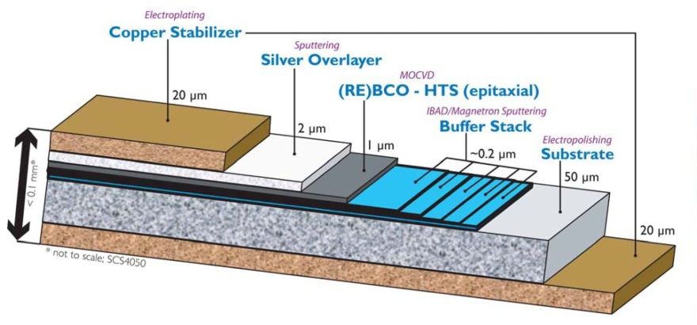
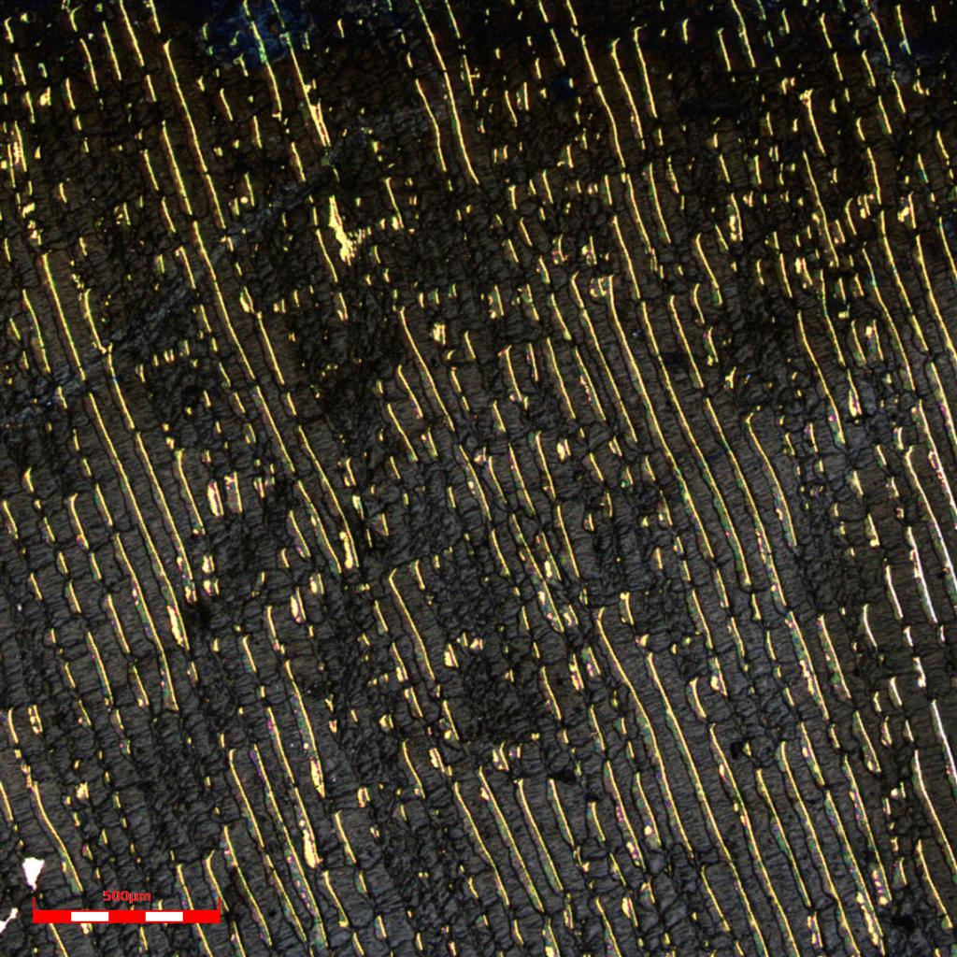
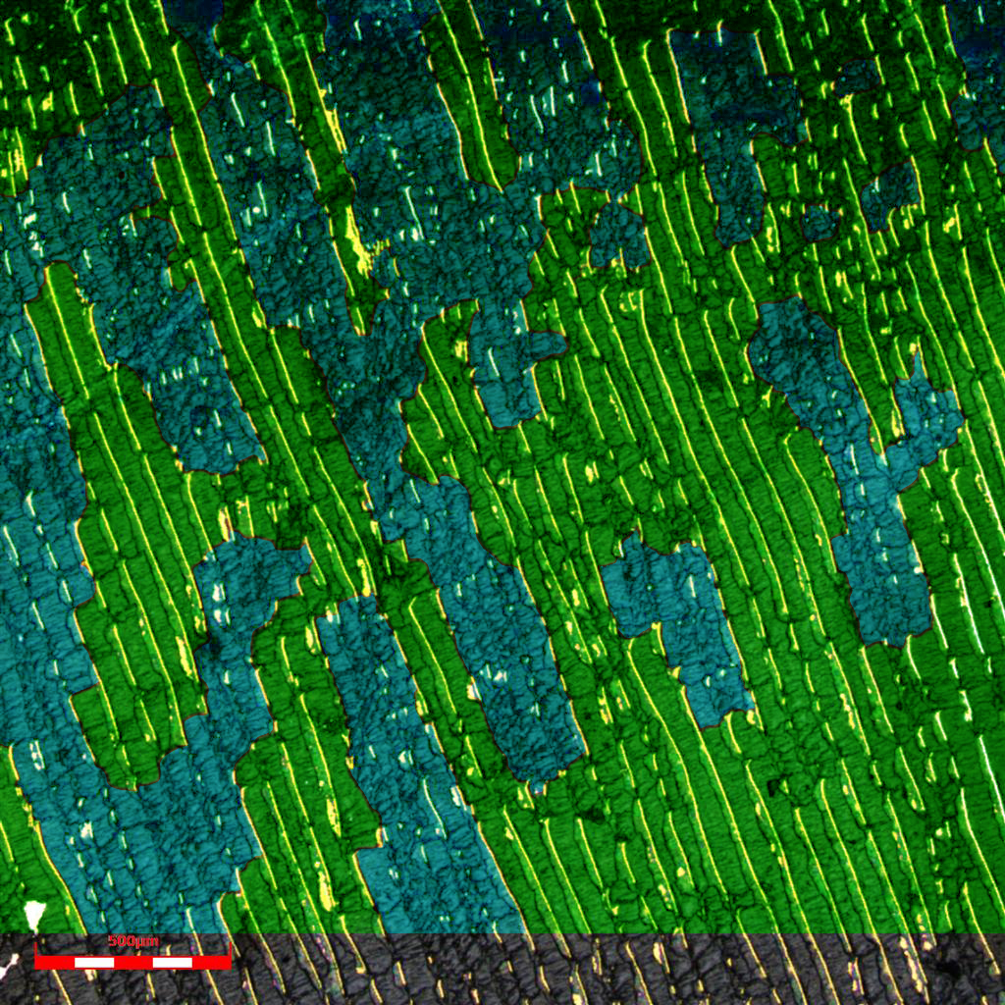
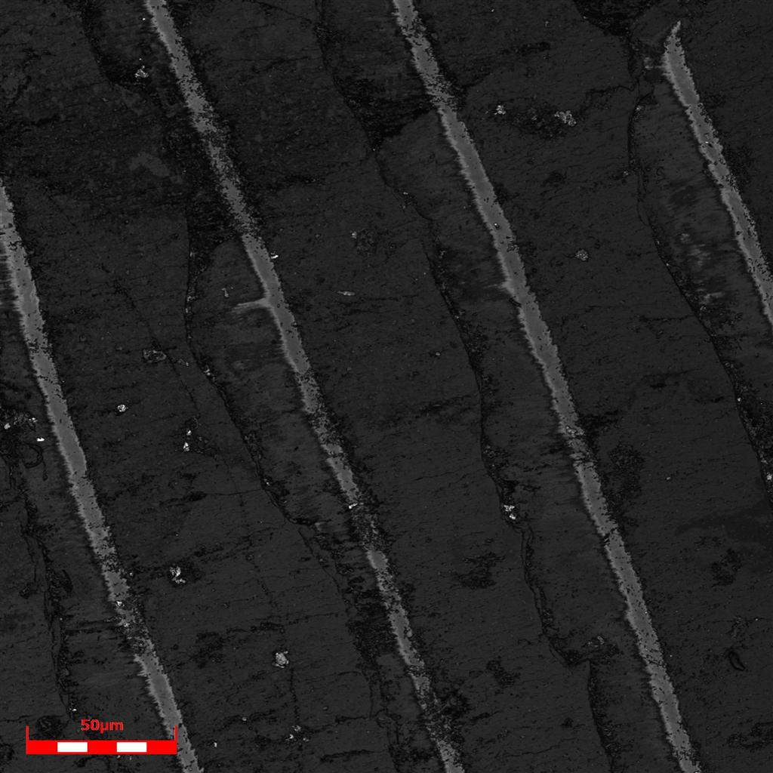
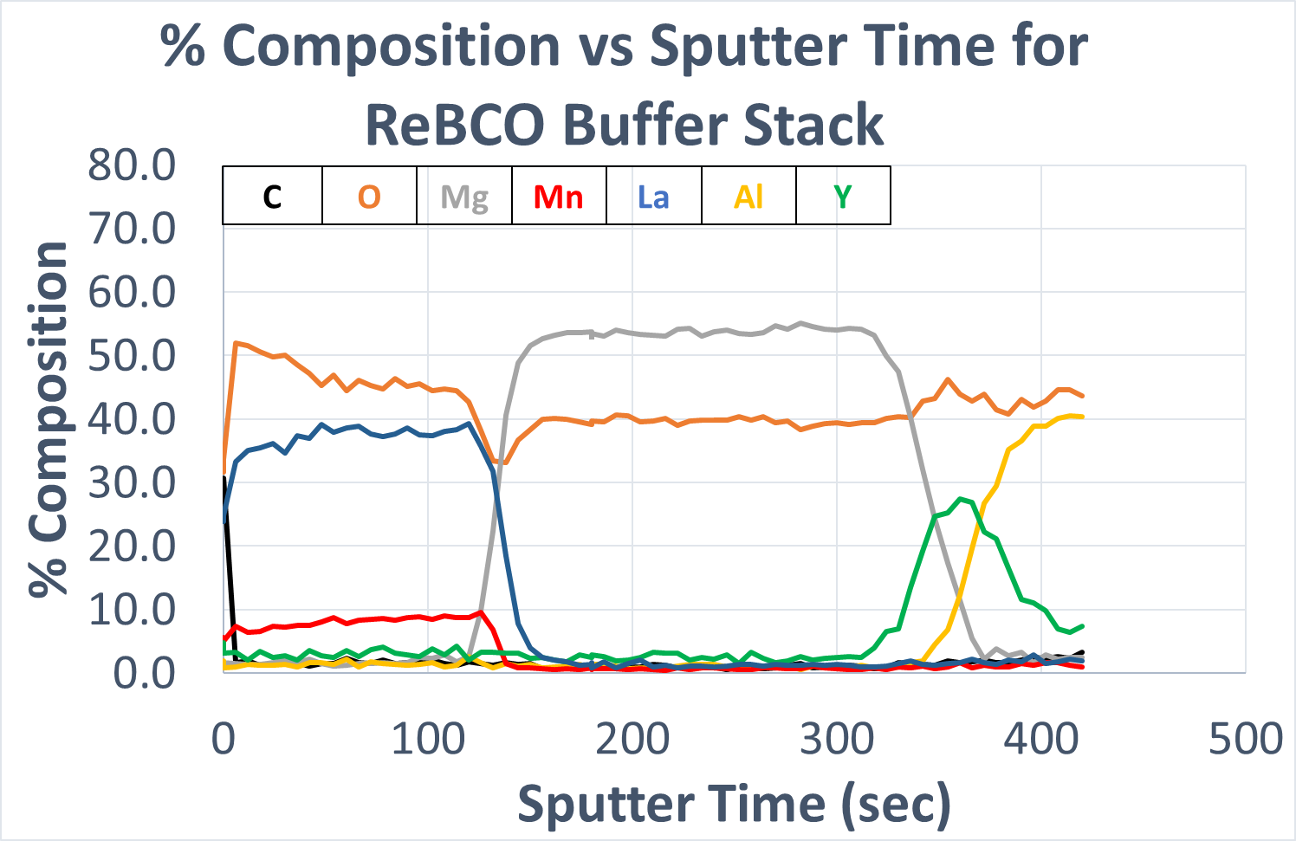
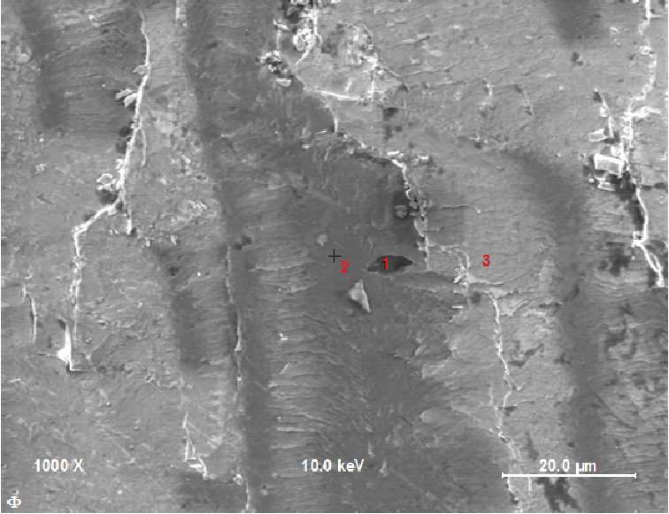
Investigation of Surface Composition and Topography of REBCO Superconducting Tape using Auger Electron Spectroscopy
Tanner Olson¹, Brynn Dallmann¹, Chris Hopp¹, Yifei Zhang², Matthew Jewell¹
¹Materials Science & Engineering Program  University of Wisconsin – Eau Claire
²SuperPower, Inc.  Schenectady, NY
UW-Eau Claire
Introduction
Acknowledgements
YBa₂Cu₃O₇ (YBCO) is a rare-earth based superconductor that is fabricated as a composite tape. The material has a critical temp. of 93 K, and with the composite structure it can reach up to 400A at 77K, self field.
Under certain conditions the composite tape can delaminate, either at an interface or within a layer.
The goal of this study is to analyze and quantify the damage present in peel-tested samples, in order to learn more about the nature of delamination initiation and propagation to increase the effectiveness and resiliency of this material.
This work was financially supported by the U.S. Department of Energy, Office and High Energy Physics, award DE-FG02-13ER42036, and benefited from the support of the Materials Science & Engineering Center at UW-Eau Claire. The authors thank SuperPower, Inc. for providing the samples under investigation.
Initial Steps & Identification
Morphology
Surface Coverage & Auger
wide
Since we have verified that the ridge types represent a bimodal distribution and are comparable across our different samples, we can now quantify the area of our samples covered by each ridge type (using Photoshop to manually add an overlay to the capture images). The data shown from this process indicates a second bimodal distribution across our samples in which they possess a 60%/40% wide/narrow coverage or 0%/100% coverage.
LaMnO₃ (LMO)
MgO (Homo)
MgO (IBAD)
Y₂O₃
Al₂O₃
narrow
Sample 1
wide
narrow
The structure of the tape includes a nickel-based Hastelloy substrate for mechanical strength, 5 buffer stacks (as detailed above) to provide epitaxial crystal growth of the YBCO, a silver capping layer for mechanical protection, and a copper layer for electrical stability.
The samples being used in this study have been peel-tested by SuperPower. This leaves us with two halves of the composite tape, which we are then able to analyze. Our first priority was to identify the different layers in the samples in order to gain an understanding of how the delaminations occur. Using a combination of imaging (SEM and laser confocal microscopy) and chemical identification (EDS supplemented with Auger), we were able to successfully identify all layers in our samples.
Above are two confocal images taken from our samples. The boxes indicate two different morphology types that are present. The blue boxes indicate ‘narrow’ ridges, which have a more sporadic shape and have a narrower width compared to the other ridge type: ‘wide’ ridges. These have a much more regular, repeatable shape and are shown by the green boxes on the images above.
From these images, we are then able to map the surface in 3D using the laser confocal microscope. Here we show a wide ridge and the associated width and height of the ridges. Through other measurement tools (such as image analysis in Photoshop), we were able to verify this data with similar results.
% Coverage | n | Wide % | Narrow % | Verify
Sample 1 | 2 | 60.4 | 39.6 | 100.0
Sample 3 | X | 0.0 | 100.0 | 100.0
Sample 4 | 3 | 62.5 | 37.5 | 100.0
Sample 6 | 3 | 62.4 | 37.6 | 100.0
Sample 7 | 3 | 65.3 | 34.7 | 100.0
Sample 8 | X | 0.0 | 100.0 | 100.0
Sample 9 | X | 0.0 | 100.0 | 100.0
These values we can relate back to the peel testing strength for our supplied samples. Although our sample provider does not want us disclosing the actual values of the peel test, we can state that Sample 3 is weaker than Sample 4 by a factor of 3. This
Sample 1
LaMnO₃
MgO (IBAD & Homo)
concludes that samples with the 60%/40% coverage are stronger than their 0%/100% counterparts.
Currently, we are using the Auger Electron
Spectroscopy to further analyze newer
samples and determine the depth of
buffer layers that have been experimentally
varied. This process is known as a sputter
and we can compliment this with an
elemental depth graph (as shown here).
Y₂O₃
Sample 1
Al₂O₃
YBCO
Y₂O₃
Shown to the left is the graph of our data. The error bars show the confidence value range. Both wide and narrow ridge types show consistency across our samples; we can therefore state that the bimodal distribution is similar and comparable across all of our samples.
Conclusion
At high magnification and with complementary Auger analysis, we determined that the yellow striations in the YBCO area are not actually a buffer layer as previously thought, but instead a thin layer of retained YBCO. In this case the delamination occurred within the YBCO layer rather than at an interface.
wide
YBCO composite tape typically delaminates within the superconductor layer in a bimodal fashion (narrow and wide)
Among samples that delaminated within the REBCO layer, there exists a second bimodal trend of narrow and wide coverage in which higher peel strength is correlated with a higher wide ridge coverage percent
Future work:
Collect data from our Auger technique to determine layer dimensions
Use this information to relate back and improve the YBCO samples
Use this data to form relations linking breakage morphology to sample strength
narrow
Celebration of Excellence in Research and Creative Activity (CERCA) April 30-May 4, 2018
The authors thank the UWEC Office of Research and Sponsored Programs for student support at CERCA 2018

