Slide 1
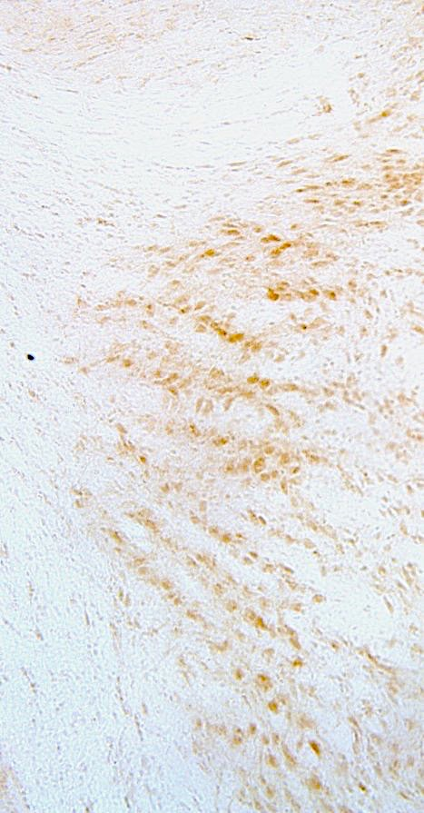
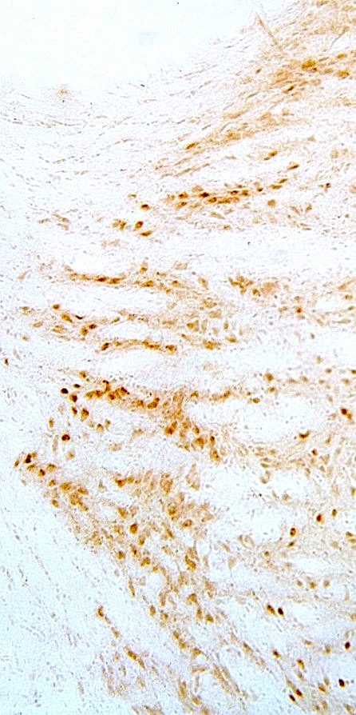
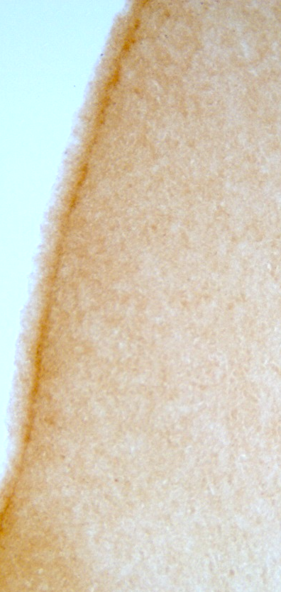
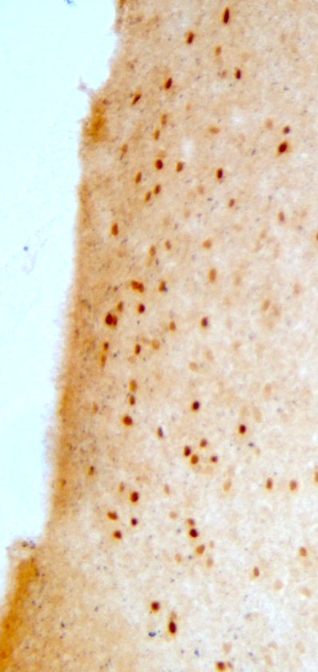
Identification of Brain Regions Activated with Arousal-Induced Clock Resetting in Male and Female Mice
Cera Langton, Sarah Mackowski, and Dawn Paukner | Biology Department
Introduction
Results
Results (cont.)
The suprachiasmatic nucleus (SCN) is a vital area of the brain involved in regulating circadian rhythms. Various important biological functions rely on this circadian rhythm to maintain a 24 hour cycle. Sleeping and waking, alertness, and hormone secretion are among these functions. Stimuli from the external environment, as well as input and output pathways from other areas of the brain, maintain the synchronization of these functions to their circadian clocks. Improper synchronization can result in many health issues including sleep and mood disorders.
Desynchronization of circadian rhythms with the external environment can be caused by disruptions in the light-dark cycle or arousal levels. The purpose of this study is to understand the neural pathways involved in circadian rhythms by subjecting the animal to a stimulus that resets their circadian clock. In order to visual brain activity we utilized the expression of a known marker of neuronal activity, Fos protein.
Behavioral controls show that the stimulus results in extensive clock resetting
Reticular Thalamic Nucleus
Figure 4: Mean ± SEM nuclei count in control Rt (n=9) compared to lights out Rt (n=9). Unpaired t-test; p<0.0001.
Control
Lights Out
Figure 1: Wheel activity actogram from a single mouse.
Average phase shift = 2.5 hr.
Summary
Brain regions that show significant fos activation to a resetting stimulus
Methods
1. Previous research has shown that the intergeniculate leaflet is crucial for mediating clock-resetting effects on non-photic stimulation. Our results support this notion.
2. According to this study, the lateral septal nucleus, previously shown to be involved in stress reactions, is also connected to arousal-induced clock resetting.
3. The reticular thalamic nucleus, shown to be involved in with gating, sleep and drowsiness in previous work, is identified to have a strong association with arousal-induced clock resetting in this study.
4. More work needs to be done in identifying other brain regions involved in arousal-induced clock resetting, as well as quantifying Fos expression in these regions. Some of these regions include the thalamic intralaminar nucleus, anterior cingulate cortex and the piriform cortex.
5. Differences in Fos visualization between male and female brains needs to be analyzed.
Experiment Conditions
Intergeniculate leaflet (thalamus)
Male and female C57BL/6 mice seven to eight months of age were housed in wheel cages with food and water provided ad libitum. All animals were entrained to a 12-hour bright light (200 lux)/dim light (<0.1 lux) cycle for at least two weeks prior to experimentation. Circadian phase onsets were measured by locomotor activity using ClockLab hardware and software.
After 2 weeks in the bright-dim cycle animals were abruptly transitioned to complete darkness in the middle of the bright phase and were kept in darkness until the end of the experiment. Animals were euthanized (n=9) 1.5 hr after the transition to darkness and their brains were prepped to visualize Fos protein. The remaining animals remained in darkness for 5 days to assess clock resetting. In addition, control animals (n=9) that did not receive the stimulus were euthanized and prepped at the same time as the animals that received the stimulus.
Brains were sectioned and then stained for Fos protein using the ABC method with diaminobenzidine as the chromogen. Images of the regions of interest, including the intergeniculate leaflet, lateral septal nucleus, and reticular thalamic nucleus were taken using Leica Acquire. Nuclei counts were taken using ImageJ and data was analyzed using GraphPad Prism 7.03.
Control
Circadian Clock Resetting
Lights Out
Figure 2: Mean ± SEM nuclei count in control IGL (n=9) compared to lights out IGL (n=7). Unpaired t-test; p=0.0005.
Lateral septal nucleus
Acknowledgments
Fos Visualization
Funding for this project came from the UWEC Office of Research and Sponsored Programs and from the UWEC Biology Department. Faculty Advisor: Dr. Dan Janik.
Figure 3: Mean ± SEM nuclei count in control LSN (n=9) compared to lights out LSN (n=9). Unpaired t-test; p=0.0004.
Control
Lights Out

