Slide 1
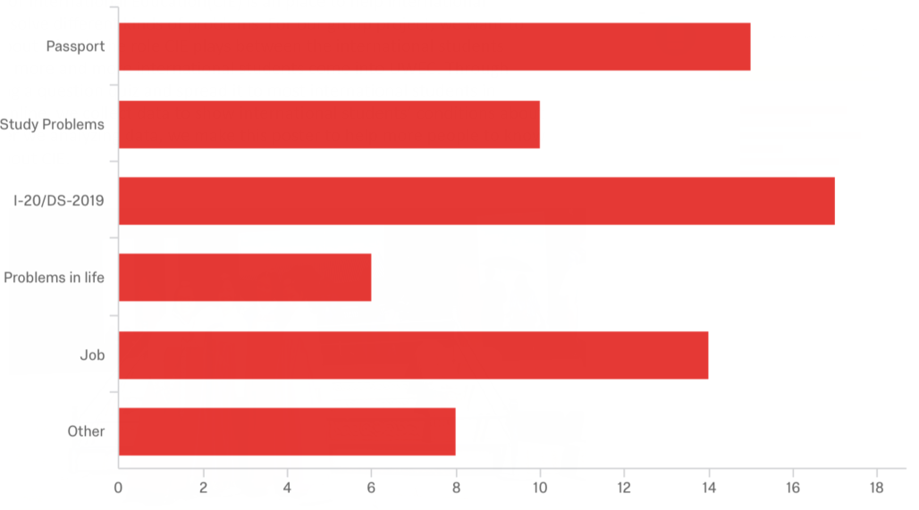




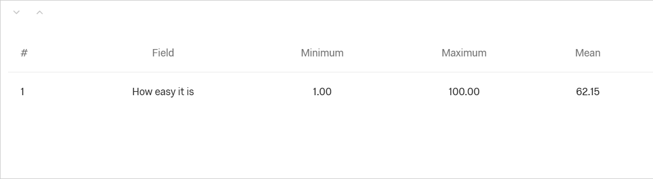





Students’ Understanding of CIE
In addition to the multitude of places that Blugolds are able to study abroad, CIE is the office that oversees the international student experience on campus.
Bella (Xinyan Yang), Chris (Yuting Ma), Shon (Xiaochun Chen), Max (Yinxing Xia)
Department Name: ESL 391 Advisor: Ami Christensen Mentor: Lucas
Introduction
Results Analysis
We did a survey to learn about students’ understanding of CIE
1.
Solutions and Suggestions
Center for International Education(CIE) is an place to help international student solve different kinds of problems. For our group project, we want to know about what is the role CIE plays between the international students because more and more international students come into UWEC. Through designing a question quiz and spread it to most international students in UWEC online, we collect data to show international students’ conditions about CIE. After we analyzing data, we make this poster to help more people to know more about CIE.
21.43%
According to the result analysis, we learned that there are some problems of CIE.
First, there are still some students think it hard to find CIE, so we have the responsibility to solve the problem. We will send e-mails about the information and details of CIE to every international students in the beginning of the semester. In addition, we will send people to give out leaflets about CIE on campus. All these can make international students. feel easier to find CIE.
Second, the data shows that the service of CIE needs some improvements. Thus, we are going to make a session about how do you feel about the staff of CIE. That will effectively help us improve the services of CIE.
Third, to satisfy the international students’ needs, we will provide the service of part time job. We plan to open the classes about job and provide some opportunities for international students to work on campus.
.
14.29%
8.57%
24.29%
11.43%
20.00%
CIE
Other:
Total responses:70
First, it is international students’ responses of what kind of questions do they usually have to turn to CIE for help. It can bees seen from the results that students usually have questions about the passport, study problems, the documents, personal life and job. And some of the students also have questions about inviting host family.
2.
Total responses: 27
When it comes to how easy it is for international students to find CIE for help, and the average figure is 62.15%. It turns out that most students think it is easy for them to find CIE to help them. However, almost the half still think it is not easy to find CIE to solve their problems.
3.
Learn More
To learn more about CIE, we can get to know CIE program.
International Students and Scholar Services
UWEC offers exciting opportunities for students from around the world. You will have access to a wealth of experiences and opportunities to learn about a new culture while attaining an education.
Conclusion
By doing this research, we can easily find that the most international students are satisfied with CIE, they consider CIE plays an important role in their college life. When they have difficulty in something, they can easily turn to CIE for help. There are also some aspects that CIE had not been covered, some international students give us some feedbacks. To be more specific, they think CIE can improve the aspects such as part time job. We believe that CIE could be better to provide international students with more convenience after receiving these feedbacks.
/
In the survey, we ask international students that how was the service of CIE the last time they visited. From this pie chart, we can clearly see that most international students thought the service of CIE was extremely good. But few international students thought the service of CIE was neither good or bad. So, it can been seen that there is still room for CIE to improve their Service.
4.
Host an International Student
CIE's Host Friend Program matches international students with kindhearted and compassionate individuals and families from the Chippewa Valley area.
What service to you want CIE to provide?
In addition, we ended up asking international students a question that what service do they want CIE to provide in the future. The results show that most students hope CIE can provide some help in part time job.
Pictures are from:
https://cdn.uwec.edu/athena/images/11040/karen_friends_in_tradition_dress_at_landmark-homepage.jpg
https://www.uwec.edu/academics/explore-opportunities/study-abroad/cie/host-friend-program
https://www.google.com.hk/url?sa=i&source=images&cd=&ved=2ahUKEwiWqYT6ttjhAhVRR60KHfKWDVQQjRx6BAgBEAU&url=http%3A%2F%2F90sheji.com%2Fsucai%2F14561305.html&psig=AOvVaw0MYcLDD0EEJOQMoe7PymvX&ust=1555635222556535
https://cdn.uwec.edu/athena/images/6426/20150401_cob_tutors_0060-homepage.jpg
https://cdn.uwec.edu/athena/images/10861/Copy_of_IMG_8980-homepage.jpg
Contact: chenx6378@uwec.edu
yangx4525@uwec.edu
may0489@uwec.edu
xiay6444@uwec.edu
/

