Slide 1

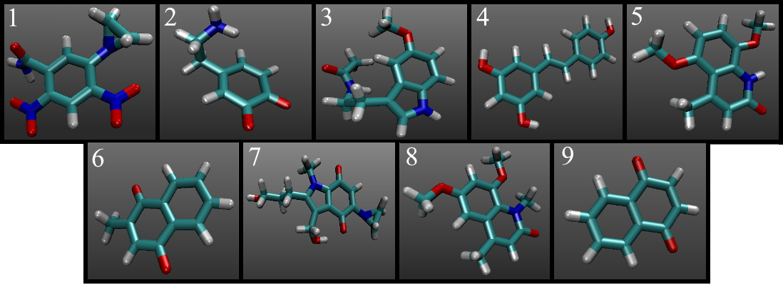
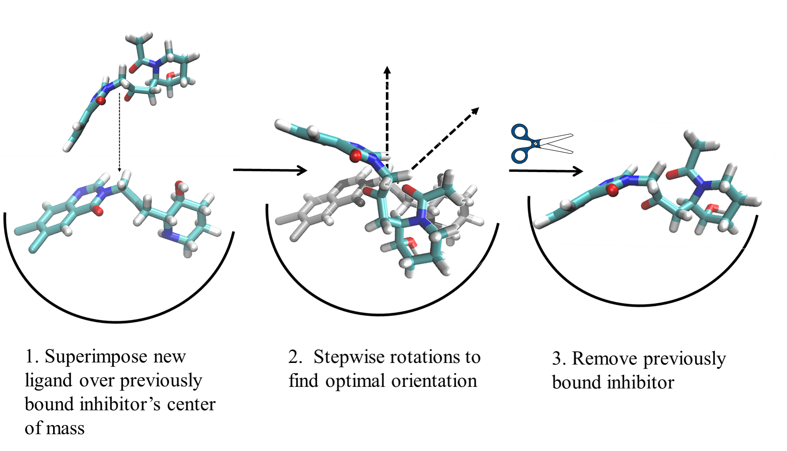
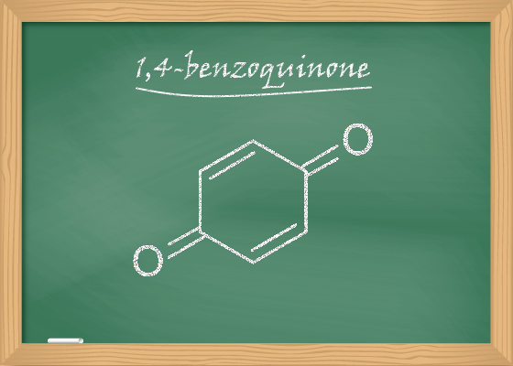
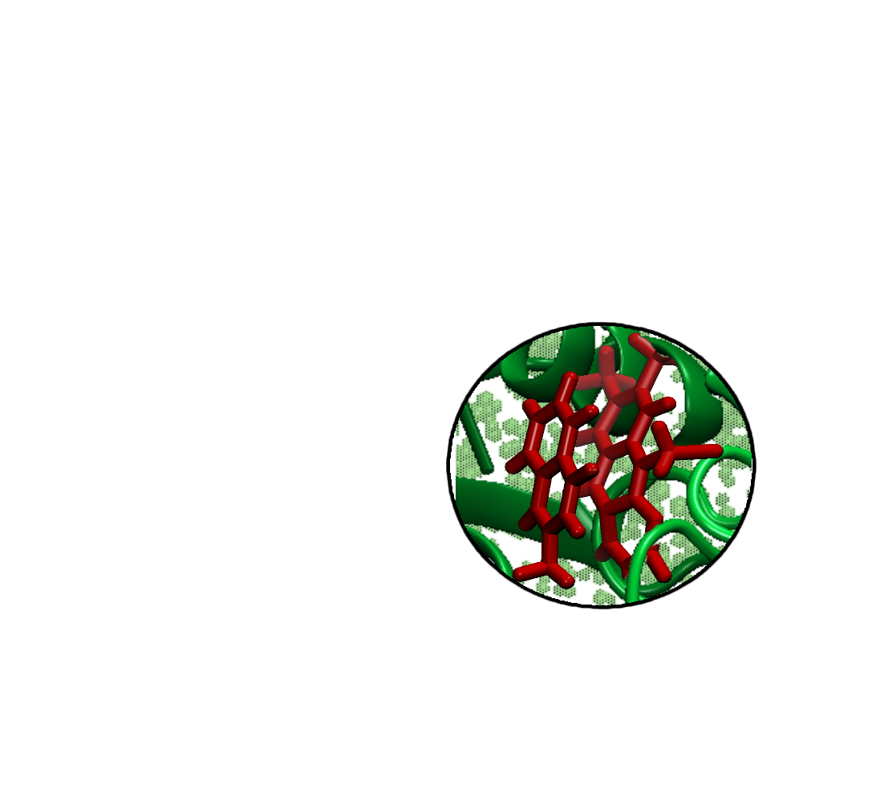
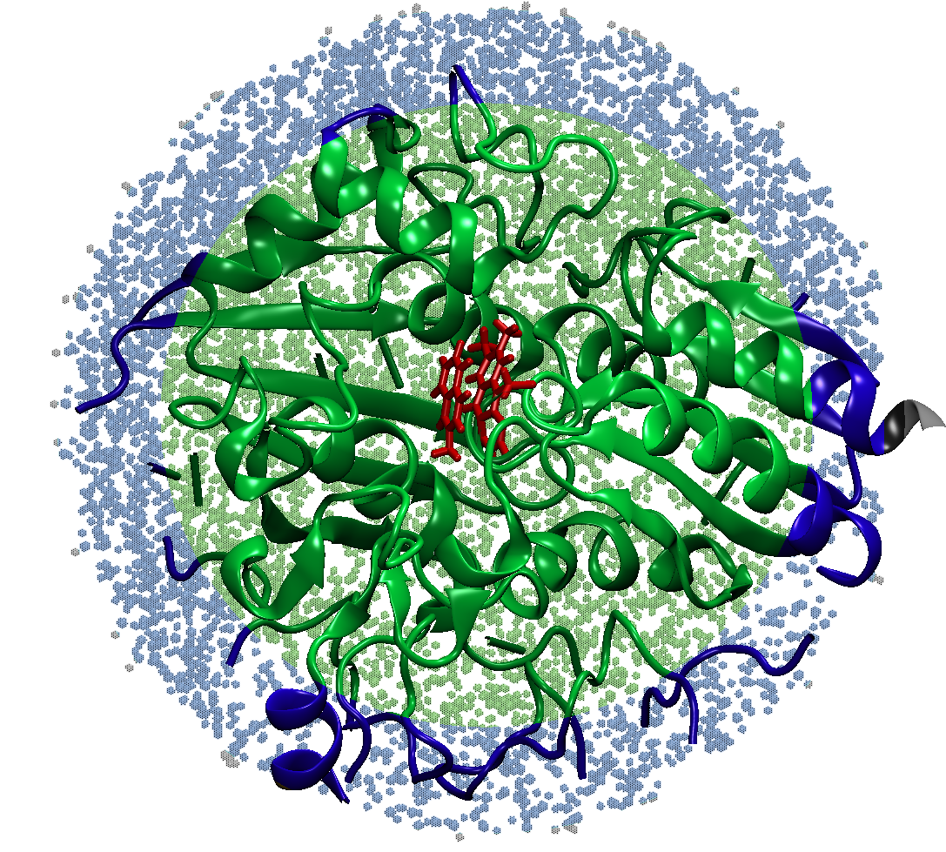
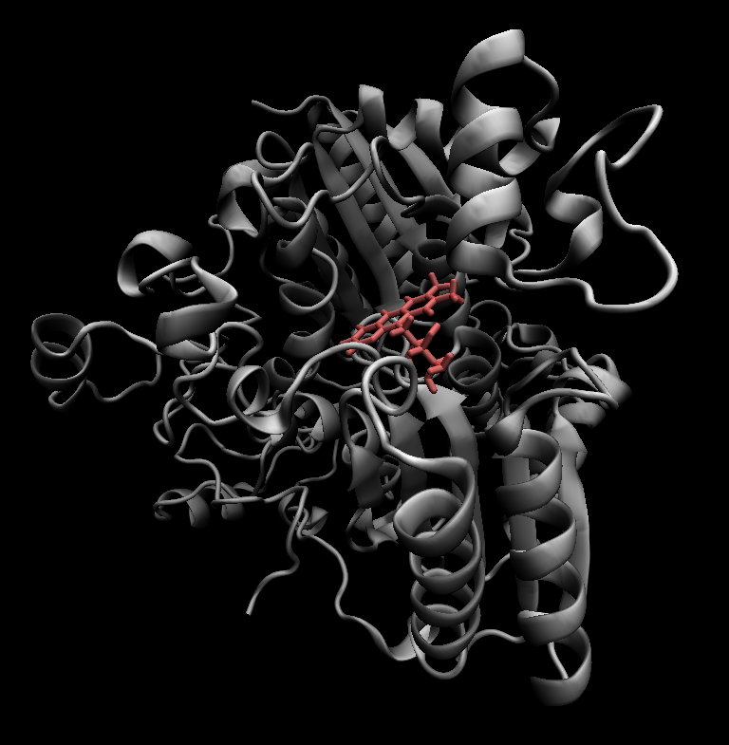
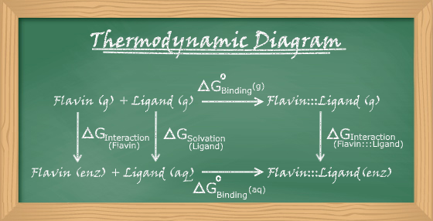
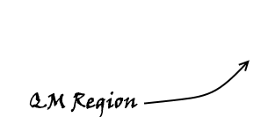
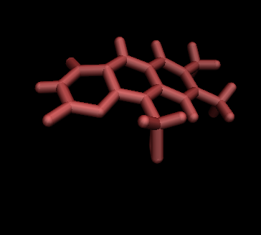
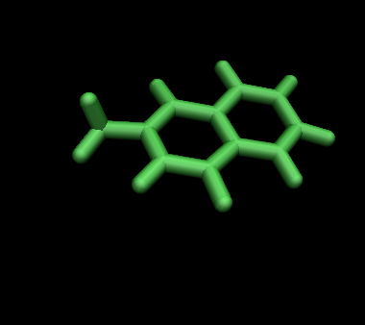
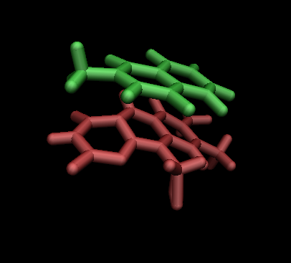
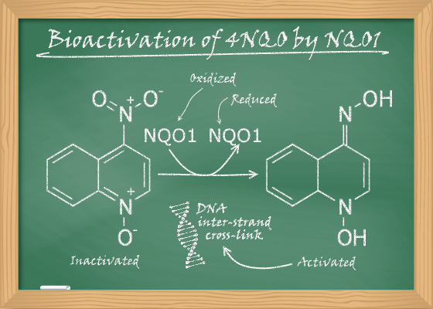
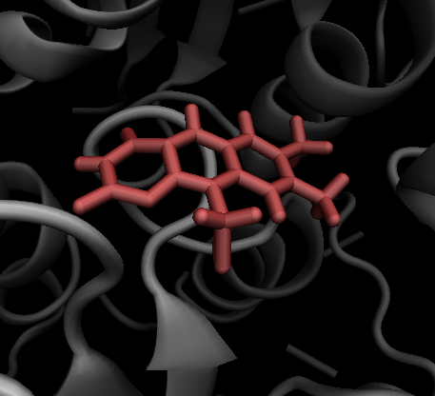
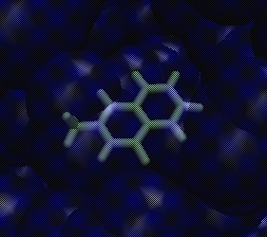
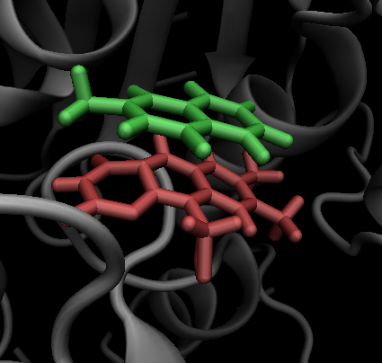
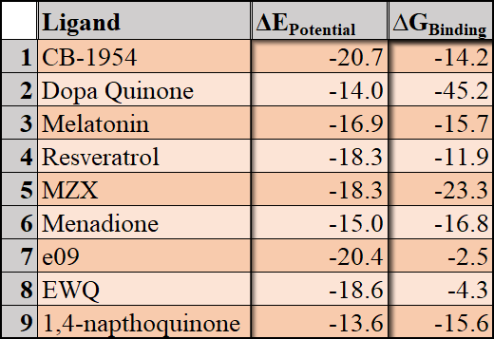
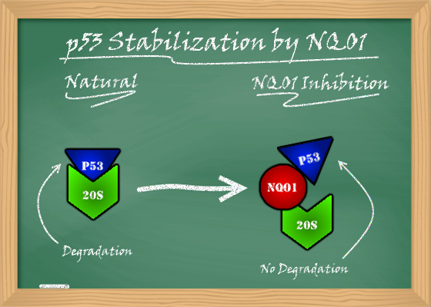



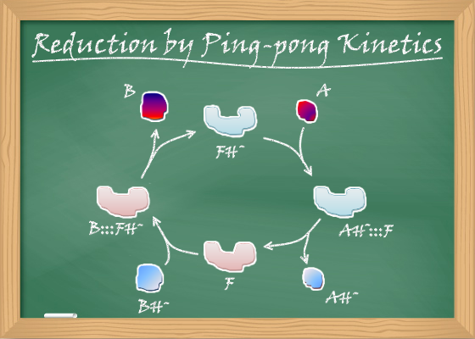
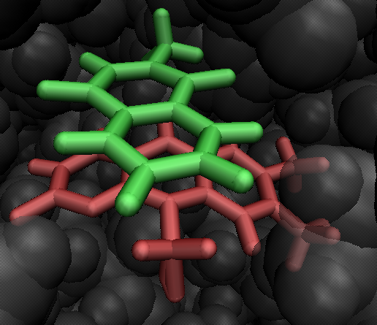
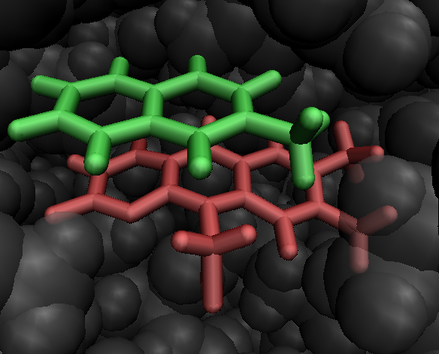
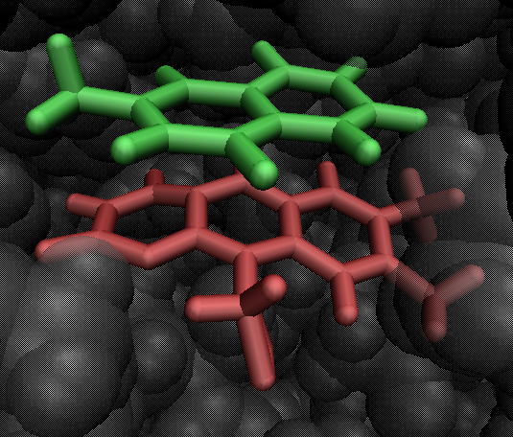
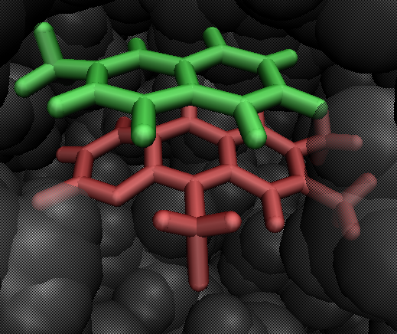
Calculation of Binding Free Energies of NAD(P)H:Quinone Oxidoreductase 1 Inhibitors
Jonathan W. P. Zajac and Sudeep Bhattacharyya
Department of Chemistry, University of Wisconsin-Eau Claire, WI 54702
Abstract
Ligands
Dynamic Simulation Setup
NAD(P)H:quinone oxidoreductase 1 (NQO1) plays a key role in cellular defense in humans. It is known to reduce quinones to hydroquinones, inhibiting their ability to become a free radical semiquinone state, and cause cellular damage. NQO1 also has the ability to stabilize the tumor suppressor protein, p53, by inhibiting proteasomal degradation. In particular, it has been observed that NQO1 is activated by the reduction of the cofactor flavin – an event that triggers binding and subsequent stabilization of p53. Due to this mechanism, NQO1 holds promise for drug-targeted cancer therapy. In the proposed work, a comparative study will be conducted to explore the binding characteristics of various ligands that have the potential to be used in the drug design, including menadione, resveratrol, melatonin, and other quinone analogs that have potential binding affinity to the active site of NQO1. The docked structures of these ligands bound to the active site pocket of the enzyme have been developed in a previous project. Dynamic simulations will be run using hybrid quantum mechanical/molecular mechanical methods, and will be accompanied by free energy calculations to determine the binding characteristics of these ligands. Preliminary results of energetics from these simulations will be presented.
Geometric Docking
What makes a good candidate for binding?
Good candidates for inhibition can be reduced by NQO1 and bind tightly to its flavin-containing active site. They must be quinone derivatives, which have a similar skeletal structure to 1,4-benzoquinone.
NAD(P)H:quinone oxidoreductase 1
Methods
QM/MM Setup
Active Site
Center of solvated enzyme system. Region where chemistry is occurring. Ligand and FADH treated with quantum mechanics.
Secondary Subsystem
Region between active site and 24Å. Responds to change in active site. Treated with classical mechanics.
Between 24-30Å
Treated with Langevin dynamics. Increasing viscosity as atoms are further from the center of the solvated enzyme system.
Beyond 30Å
All atoms are fixed. Applied generalized Born’s model of continuum electrostatics.
Quantum Mechanical region atoms were treated with Approximate Density Functional Theory
Classical Mechanical region atoms were treated with Molecular Mechanics using a CHARMM forcefield.
NQO1 and Cancer Treatment
NQO1 is upregulated in and around certain cancerous cells¹
Bioactivation of certain ligands may cause cytotoxicity within these cancerous cells²
NQO1 and Protein Stabilization
p53 is a protein that suppresses tumorigenesis
p53 is naturally degraded by a proteasomal pathway
NQO1 inhibits this degradation, and stabilizes p53³
NQO1 and Oxidative Stress Protection
Quinones can be reduced to an unstable free radical state, that causes oxidative stress⁴
NQO1 inhibits quinones from entering this unstable state by a flavin-dependent 2e⁻ / 2H⁺ reduction, known as Ping-pong Kinetics⁵
Preliminary Results
A
ΔG_{Interaction (F)}
B
ΔG_{Solvation (L)}
C
ΔG_{Interaction (F:::L)}
Calculation
Our primary focus is calculating the interaction energy within the active site of NQO1. To do so, we calculate each individual component in a gaseous state outside of NQO1, and subtract this energy from each individual component inside of NQO1. In this way, process A determines the free energy when a no ligand is bound to NQO1, process B determines the energy of solvation of the ligand when it enters the system, and process C is used to determine the energy when a ligand is bound to NQO1.. This provides us with the following equation:
∆G_{Binding} = ∆G_{Int. (F:::L)} - ∆G_{Int. (F)} - ∆G_{Solv. (L)}
Conclusion
After running dynamic simulations as outlined previously, it was determined that all 9 of the tested ligands would spontaneously bind to NQO1. Particularly promising, resveratrol produced a binding free energy similar to an experimental value determined in NQO2 (-11.86 kcal/mol to -9.8 kcal/mol). Interestingly, when the ligand is removed from the system to calculate NQO1 (aq), the data is not uniform. Some structural changes may be occurring when each ligand is added/removed, and these structural differences will be investigated in future studies. Menadione and 1,4-napthoquinone had multiple orientations in the active site that successfully bound to NQO1, though each ligand clearly had an optimal orientation, which is reported here.
Optimal Orientations
Our ligands are rotated multiple times in an effort to find the most optimal binding orientation. For some ligands, binding does not occur at all in suboptimal positions. However, according to our simulations, menadione had many modes of binding, with the third orientation shown proving to be the most optimal. Dynamic simulations are run on each possible orientation, though only the most optimal orientations are presented in our preliminary results.
Future Directions
Comparative study on experimentally tested dicoumarol analogs
Application of high level energy correction
Investigation into structural differences of NQO1 upon addition/removal of ligand
References
1. Ma Y, Kong J, Yan G et al., NQO1 overexpression is associated with poor prognosis in squamous cell carcinoma of the uterine cervix. BMC Cancer. 2014, 14, 414.
2. Benson, A. M., Conversion of 4-nitroquinoline 1-oxide (4NQO) to 4-hydroxyaminoquinoline 1-oxide by a dicumarol-resistant hepatic 4NQO nitroreductase in rats and mice. Biochem. Pharmacol., 1993, 46, 1217-1221
3. Dinkova-Kostova A and Talalay P, NAD(P)H:quinone acceptor oxidoreducatase 1 (NQO1), a multifunctional antioxidant enzyme and exceptionally versatile cytoprotector. Arch Biochem Biophys. 2010, 501, 116-123
4. Schlager JJ and Powis G, Cytosilic NAD(P)H: (quinone-acceptor)oxidoreductase in human normal and tumor tissue: effects of cigarette smoking and alchol. Int J Cancer 1990, 45, 403-409
5. Kucera, H. R.; Livingstone, M.; Moscoso, C. G.; Gaikwad, N. W., Evidence for NQO1 and NQO2 catalyzed reduction of ortho- and para-quinone methides. Free Radic. Res. 2013, 47, 1016-1026.
Acknowledgements
Office of Research and Sponsored Programs at University of Wisconsin-Eau Claire.
Blugold Supercomputing Cluster and LTS at University of Wisconsin-Eau Claire.
University of Wisconsin-Eau Claire Student Travel for the Presentation of Research Results Program
Research Corp (CCSA 23223)

