Slide 1


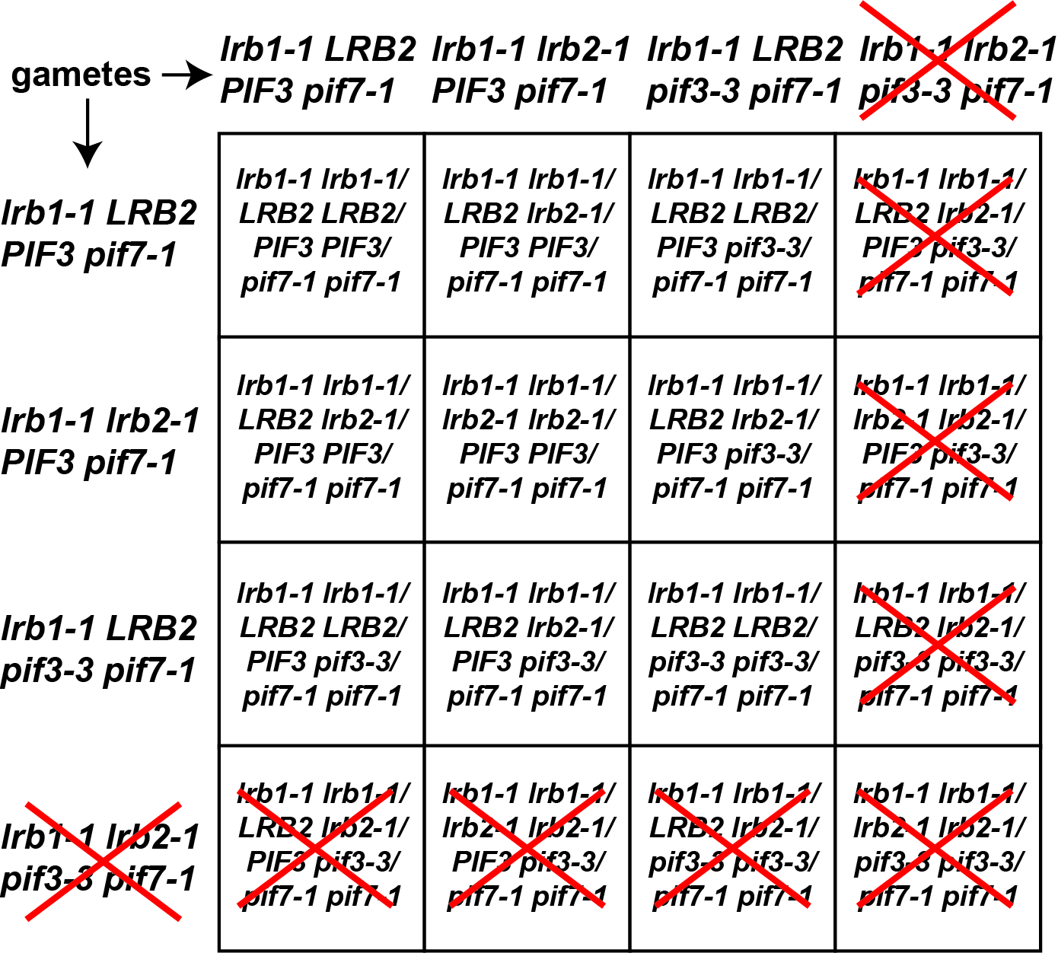
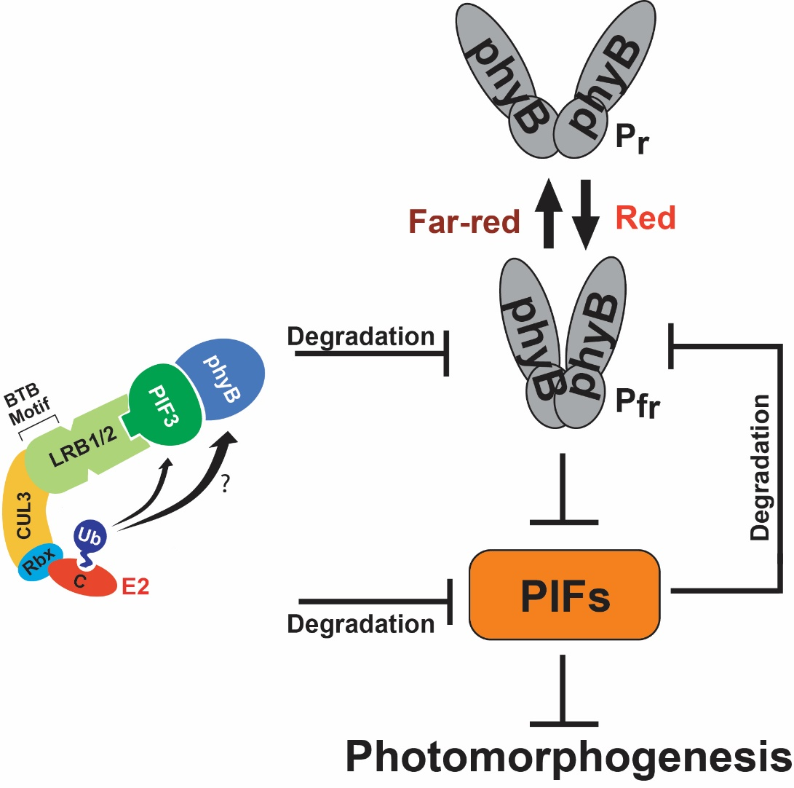
Creation and Characterization of LRB (Light-Response BTB) /PIF (Phytochrome-Interacting Factor) Mutant Lines in Arabidopsis thaliana
Meghan Bauer
Faculty Mentors: Derek Gingerich, Jamie Lyman Gingerich
Department of Biology, University of Wisconsin-Eau Claire, Eau Claire, WI
For more information contact: Derek Gingerich email: gingerdj@uwec.edu
Example Genotyping Reactions
Conclusions
Introduction
Conclusions and Future Work
Light is vital to plant survival and thus plants have developed sophisticated pathways to respond properly to their light environments¹. Plants sense specific wavelengths of light via photoreceptors, one family of which are the red (R)/far-red (FR)-absorbing phytochromes (phys). Absorption of red light activates the phys, which causes their translocation from the cytosol to the nucleus where they modulate gene expression². They do so by regulating the activity and levels of a family of transcription factors called Phytochrome-Interacting Factors (PIFs). In response to red light the active phys cause PIFs to be ubiquitylated and degraded, which activates expression of PIF-repressed genes. There is feedback regulation of this pathway as, in response to red light, the PIFs also induce ubiquitylation and degradation of the phys³.
The genes Light-Response BTB 1 and 2 [LRB1 and LRB2]) are critical regulators of the phy/PIF light-response pathway^{4,5}. LRB1 and LRB2 encode BTB (Bric-a-Brac, Tramtrack, Broad Complex) domain-containing proteins that act as target adapters in E3 ubiquitin-ligase complexes (Figure 1)^{4,5}. Plants with disruptions of the LRB genes have reduced light-dependent degradation of phys and, like plants with disruptions of PIF genes, exhibit hypersensitivity to red light ^{4,5,6}. The mechanism by which the LRBs modulate phy levels is not entirely clear, however it has been shown that the LRBs can bind to a complex of a PIF protein (PIF3) and a phy (phyB), leading to ubiquitylation and degradation of both (Figure 1)⁵.
In order to better understand how the LRB and PIF genes interact we are taking a genetic approach, creating plants with T (transfer)-DNA disruptions of both LRB and PIF genes. Study of the phenotypes of these plants may shed light on how these two families of genes work together to regulate light responses or plant growth and development in general.
Example #1: Genotyping the PIF3 gene in self-cross offspring from an lrb1-1 lrb1-1; LRB2 lrb2-1; PIF3 pif3-3; pif7-1 pif7-1 parent
The Gingerich lab has successfully generated a number of pif lrb genotypes, however that are certain genotypic combinations that we have been consistently unable to find in our populations.
My analysis of self-cross offspring of an lrb1-1 lrb1-1; LRB2 lrb2-1; PIF3 pif3-3; pif7-1 pif7-1 parent has shown that it may not be possible for a plant to be homozygous mutant for both LRB2 and PIF3, or for a plant to be homozygous mutant for one of the genes while heterozygous mutant for the other (at least with the lrb1 pif7 background).
The absence of these genotypes may be because they are lethal to a plant during the embryonic development. Preliminary analysis of siliques, however, has failed to detect visual evidence of the aborted seeds expected if this were true.
It may be that certain allele combinations cannot be transmitted through the male or female gametes (Figure 3).
Primer Combination:
PIF3-3WTF, PIF3-3R3
1
2
3
4
5
6
7
8
9
10
WT
pif3-3
H₂O
2
3
6
8
9
10
WT
Primer Combination:
PIF3-3R3, PIF3-3DelF
1
4
5
7
pif3-3
H₂O
Individual
Genotype for PIF3
Individual
Genotype for PIF3
1 heterozygous
2 homozygous mutant
3 heterozygous
4 homozygous mutant
5 heterozygous
6
7
8
9
10
homozygous mutant
wild-type
heterozygous
heterozygous
wild-type
No DNA
control
G5-55-16
Homozygous
Mutant Control
G5-55-17
G5-55-20
Example #2: Genotyping the LRB1 gene in self-cross offspring from an lrb1-1 lrb1-1; LRB2 lrb2-1; PIF3 pif3-3; pif7-1 pif7-1 parent
DNA Size
Standards
Wild-type
control
No DNA
control
G5-55-16
G5-55-17
G5-55-18
G5-55-19
G5-55-20
Homozygous
Mutant Control
Primer Combination:
RP145146, LP145146
1
2
3
4
5
6
7
8
9
10
WT
lrb1-1
H₂O
Primer Combination:
LP145146, LBa1
1
2
3
4
5
6
7
8
9
10
WT
lrb1-1
H₂O
Figure 1. Structure and function of the LRB/CUL3 E3 ubiquitin ligase complex in the red light response pathway in Arabidopsis thaliana. Red light activates phytochrome B, which then blocks the activity of PIF proteins, which are negative regulators of red light responses. The LRB/CUL3 E3 complex mediates ubiquitylation and degradation of both PIF3 and phyB. Figure is based partly on model of LRB action presented by Ni et. al. (2014).
Individual
Genotype for LRB1
Indvidual
Genotype for LRB1
Figure 3. Expected genotypes of offspring from an lrb1-1 lrb1-1; LRB2 lrb2-1; PIF3 pif3-3; pif7-1 pif7-1 parent, if the lrb2-1 and pif3-3 alleles cannot be transmitted together through the gametes. Red X’s indicate the absence of plants homozygous mutant for both LRB2 and PIF3 or homozygous mutant for one while heterozygous for the other.
1 homozygous mutant
2 homozygous mutant
3 homozygous mutant
4 homozygous mutant
5 homozygous mutant
6
7
8
9
10
homozygous mutant
homozygous mutant
homozygous mutant
homozygous mutant
homozygous mutant
Lack of Certain pif lrb Genotypes is Unexpected
References
Mathews, S., Phytochrome-mediated development in land plants: red light sensing evolves to meet the challenges of changing light environments. Molecular Ecology, 2006, 15, p. 3483-3503.
Jiao, Y.; Lau, O. S.; Deng, X.-W., Light-regulated transcriptional networks in higher plants. Nature Reviews Genetics, 2007, p. 217-230.
3. Leivar, P.; Quail, P.H., PIFs: pivotal components in a cellular signaling hub.
Trends Plant Science, 2011, 16(1), p. 19-28.
4. Christians, M. J.; Gingerich, D.J.; Hua, Z.; Lauer, T.D; Vierstra, R.D., The light-
response BTB1 and BTB2 proteins assemble nuclear ubiquitin-ligases that
modify Phytochrome B and D signaling in Arabidopsis. Plant Physiology,
2012, 160, p.118-34.
5. Ni, W.; Xu, S.-L.; Tepperman, J.M.; Stanley, D. J.; Maltby, D.A.; Gross, J. D.;
Burlingame, A. L.; Wang, Z.-Y.; Quail, P. H. A mutually assured destruction
mechanism attenuates light signaling in Arabidopsis. Science, 2014,
344(6188). p. 1160-1164
6. Leivar, P.; Monte, E.; Al-Sady, B.; Carle, C.; Storer, A.; Alonso, J. M.; Ecker, J. R.;
Quail, P.H., The Arabidopsis phytochrome-interacting factor PIF7, together
with PIF3 and PIF4, regulates responses to prolonged red light by modulating
phyB levels. Plant Cell, 2008, 20(2), p. 337-52.
T-DNA Mutant Genotyping Strategy
I have genotyped 47 individuals that are self-cross offspring from an lrb1-1 lrb1-1; LRB2 lrb2-1; PIF3 pif3-3; pif7-1 pif7-1 parent. Results are shown below.
T-DNAs are pieces of foreign DNA that can insert into genes. When they do so, they usually disrupt function of the genes. T-DNAs can be detected by PCR analysis.
Genotype* | Plants With This Genotype | Plants Expected with this Genotype
LRB2 LRB2; PIF3 PIF3 | 0 | 6
LRB2 LRB2; PIF3 pif3-3 | 18 | 12.1
LRB2 lrb2-1; PIF3 PIF3 | 4 | 12.1
LRB2 lrb2-1; PIF3 pif3-3 | 27 | 24.3
LRB2 LRB2; pif3-3 pif3-3 | 27 | 6
lrb2-1 lrb2-1; PIF3 PIF3 | 21 | 6
LRB2 lrb2-1; pif3-3 pif3-3 | 0 | 12.1
lrb2-1 lrb2-1; PIF3 pif3-3 | 0 | 12.1
lrb2-1 lrb2-1; pif3-3 pif3-3 | 0 | 6
LP, LBa1
LP, LBa1
LP, LBa1
RP, LP
RP, LP
RP, LP
LBa1
Predicted T-DNA insertion site
RP
LP
Gene
Wild-Type
Heterozygous
HomozygousMutant
We did not find plants with the following genotypes in this population:
lrb2-1 lrb2-1; pif3-3 pif3-3
LRB2 lrb2-1; pif3-3 pif3-3
lrb2-1 lrb2-1; PIF3 pif3-3
LRB2 LRB2; PIF3 PIF3
Funding
Figure 2. Strategy for identifying individuals with T-DNA insertions in a gene of interest. Genomic DNA is isolated from Arabidopsis seedlings and PCR reactions are performed with primer combinations that will produce products depending on whether or not the T-DNA is present in the gene. The PCR products are then visualized on agarose gels.
This work was funded a National Science Foundation-Research in Undergraduate Institutions (RUI) grants (#1354438), and University of Wisconsin Eau Claire Differential Tuition through the UWEC office of Research and Sponsored Programs. We thank the UWEC Learning and Technology Services for printing this poster.
It may be that some/all of these genotypes are embryo lethal, or that certain
genotypes cannot be transmitted in the gametes.

