Slide 1

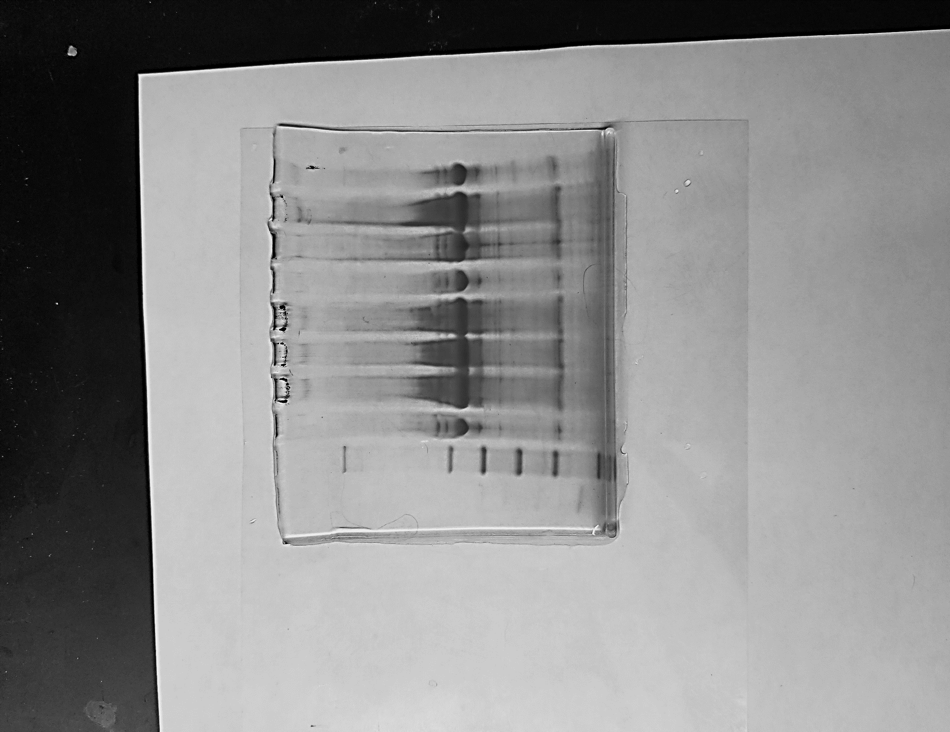
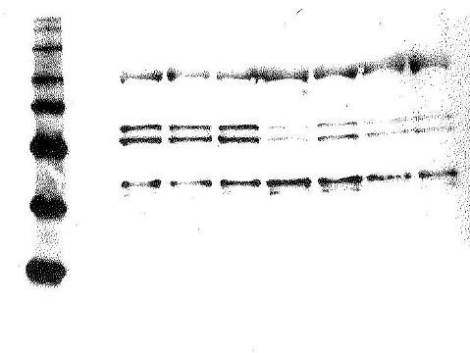
Protein Expression in Breast Tissue Challenged with Environmental Estrogens
Katelyn Rypka and Winnifred Bryant
Department of Biology
University of Wisconsin - Eau Claire
Abstract
Results and Conclusions
Estrogen (E₂) has many beneficial effects but paradoxically estrogen exposure increases cancer risk in the breast and in the uterus. Bisphenol A (BPA) and methylparaben (MP) are environmental estrogens that are known to influence the expression of estrogen sensitive genes. To further elucidate the mechanism of action of environmental estrogens in breast cancer cells, we treated T47D and MCF-7 cells with MP and BPA, respectively, and measured the expression of proteins in the E₂ signaling pathway utilizing Coomassie blue staining and Western Blotting.
MCF-7 cells
T47D cells
MagicMark
Protein
Standard
MagicMark
Protein
Standard
V
E₂
5
10
15
20
30
60
V
E₂
15
30
60
90
120
60 KDa
ERα
66 KDa
ERα
66 KDa
Introduction
50 KDa
MAPK
42/44 KDa
60 KDa
40 KDa
50 KDa
Estrogen (E₂) is an ovarian steroid that modulates reproductive function and governs a number of other physiological events. The genomic effects of E₂ are mediated though interactions with estrogen receptors a and b, ligand inducible transcription factors. Non-genomic effects of estrogen are mediated through membrane associated receptors coupled to second messenger systems or phosphorylation cascades.
E₂’s effects are beneficial, but paradoxically, excessive estrogen exposure increases risk of developing cancer in breast and uterine tissue. Moreover, E₂ signaling is often dysregulated in estrogen dependent breast and uterine cancers.
Environmental estrogens (EEs) mimic the effects of ovarian estrogen and interact with the estrogen receptors. The precise effects of EEs depend on cell and promotor context. These compounds are ubiquitous. BPA is an EE found in many plastics and resins.
When treated with 10 nM BPA, mammospheres derived from MCF-7 cells exhibit increased size (Lillio et al.).
MP is commonly used in personal care products, food, and pharmaceutical and has been shown to increased tumor size of MCF-7 breast cancer cells (Lillio et al.).
We have measured the expression of ERa (involved in classic, genomic pathways) and MAPK (involved in rapid, non-genomic pathways) to generate a mechanistic model of EE action.
40 KDa
MAPK
42/44 KDa
Figure 1. Bis-Tris gel containing proteins from the MCF-7 breast cancer cell line treated with BPA was visualized via a Western Blot. MCF-7 cells are a breast cancer cell line that expresses endogenous estrogen receptors. A MagicMark dye ladder was utilized to indicate the approximate protein length of the bands. ERα was observed at approximately 66 KDa for each of the time trails (15, 30, 60, 90, and 120 minutes). MAPK was visualized as a doublet at 42 KDa and 44 KDa at each of the time trails.
Figure 3. Bis-Tris gel containing proteins from the T47D breast cancer cell line treated with MP was visualized via a Coomassie Blue stain. T47D cells are a breast cancer cell line that expresses endogenous estrogen receptors. A MagicMark dye ladder was utilized to indicate the approximate protein length of the bands. ERα was observed at approximately 66 KDa for each of the time trails (5, 10, 15, 20, 30, and 60 minutes). MAPK was visualized as a doublet at 42 KDa and 44 KDa at each of the time trails.
Methods & Materials
Cell Culture:
MCF-7 and T47D cells, are breast cancer cells that express endogenous estrogen receptors. They were obtained from Sigma Aldrich and cultured in T75 culture flasks with RPMI media supplemented with FBS at 37ºC in 95% O2 and 5% CO2.
Exposure Time Trial:
Cells were plated at 2 million cells per well in 6 well plates with E₂ free RPMI culture media. There were treated with MP (1μM) for indicated periods of time. Controls included ethanol vehicle, and E₂ (10⁻⁸M). After treatments cells were collected using RIPA Lysis Buffer Protein concentration in cell lysates was quantified by a BCA assay.
Electrophoresis:
60μg of lysate was electrophoresed on 4-12% Bis-Tris gel at 200V.
Visualization:
The gels were stained with Coomassie Blue. ERα (66 KDa), ERβ (59 KDa), and MAPK (42 KDa, 44 KDa) were identified by size relative to the protein marker (Magic Mark).
Densitometry was utilized to quantify expression of proteins.
Figure 2. Average density of MAPK expression in MCF-7 cells treated with BPA for the vehicle, E_{2,} 5, 30, and 60 minute increments.
Figure 4. Average density of MAPK expression in T47D cells treated with MP for the vehicle, E₂, 5, 30, and 60 minute increments (.85 to .77 to .84 to .79 and .68).
1) There was no change in ERα expression in either cell line over the time course with either the MP or the BPA treatment.
2) In the case of the T47D breast cancer cells there was no change in ERβ expression and no change in ERα/ERβ ratio over time with the MP treatment (data is not shown).
3) MAPK expression changes when breast cancer cells are challenged with MP and BPA. MAPK expression is increased with E₂ treatment (as compared to vehicle). MAPK expression decreased initially with EE (BPA and MP) treatment (as compared to E₂). MAPK increased after 30 minutes and then decreased at 60 minutes. The time trials for the MCF-7 and T47D cells were different, but the patterns of expression at 15, 30, and 60 minutes is the same.
4) The lack of effect on ER expression makes it unlikely that MP and BPA affect breast cancer cells via a genomic mechanism.
The activation and cycling of MAPK in both cases suggests that effects of environmental estrogens are nongenomic.
We continue to examine this phenomenon and want to observe precise effects environmental estrogens are having on the MCF-7 and T47D breast cancer cell lines. Future studies will determine if MAPK expression is correlated with proliferation of these cell lines.
References
Acknowledgements
Lillio MA et al. Hom Cancer. 2017 Apr;8(2):90-99.
Lillio et al. Jour of App Toxi. 2016;37(4), 417-425.
We would like to thank the UWEC Office of Research and Sponsored Programs for the finding for this project.

