Slide 1
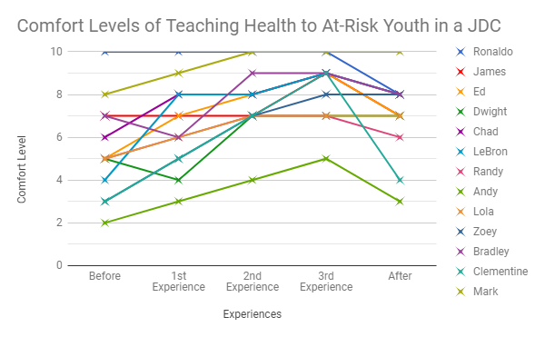
Preservice Health Teachers Perceptions of Teaching Health at a Juvenile Detention Center
Jordan Ellenbecker, Riley Gebelein, Daniel Gengenbach, Mark McMillan, and Eric Zake | Department of Kinesiology
Faculty Mentors: Yoonsin Oh, Ph.D. and Marquell Johnson, Ph.D.
Abstract
Before and After JDC Survey
The main purpose of this study is to explore how the perceptions of preservice health education teachers’ change over the course of teaching health lessons to at-risk youth at a Juvenile Detention Center (JDC). Undergraduate preservice student teachers enrolled in a Health Education course during the time of this study were invited to take part in group interviews as well as complete surveys before, during, and after their experiences teaching and observing Health lessons at a JDC. Through coding and thematic analysis, themes were developed from participants' responses to the interview questions and surveys. The results showed that majority of them had negative perceptions of teaching students at a JDC prior to their experience. Throughout the experience, preservice teachers' perceptions were positively changed. This study found that preservice teachers had a negative perception of at-risk youth before they had ever had any experience working with that type of youth. After going through experiences with at-risk youth we found that preservice teachers had gained enthusiasm and a positive outlook towards them. Undergraduate courses for preservice Health education teachers should consider providing opportunities to teach at-risk or incarcerated youth as a field experience.
 | Before Survey | After Survey
Question 1 | Rate your comfort level of teaching health education. | Rate your comfort level of teaching health education.
Question 2 | Rate your comfort level of teaching at risk youths. | Rate your comfort level of teaching at risk youths.
Question 3 | Rate your level of anxiety about teaching health at a public school. | Rate your level of anxiety about teaching health at a public school.
Question 4 | Rate your level of anxiety about teaching health at the JDC. | Rate your level of anxiety about teaching health at the JDC.
Question 5 | How much experience do you have working with adolescents? | N/A
Question 6 | How much experience do you have working with at risk youths? | N/A
DISCUSSION
BEFORE
This study aligned with previous similar studies in that many of the participants were nervous about teaching at a JDC
Randy said “My first thought about teaching at the juvenile detention center was honestly that I thought that I would be teaching a bunch of ‘bad kids’ and that it would be really difficult to teach them.”
Dwight said “I was nervous just like anyone would be to hear ‘Juvenile Detention Center.’ I think you think kids might be violent or have severe behavioral issues.”
AFTER
Larger increase in comfort level following from teaching a lesson compared to only observing a lesson
Examples would be Dwight who’s comfort level on the Likert scale went from a 4 to a 5 after observing and to a 7 after teaching
LeBron jumped from a comfort level of 4 on the Likert scale to a 8 after his teaching experience
Mark stated that “Teaching this lesson helped my confidence.” showing that teaching a health lesson had a greater impact than just observing one
Results gathered were similar to findings within previous studies such as Nichols & Sullivan (2016) and Pytash (2017)
Introduction
This study's hypothesis is that the preservice Health teachers will have negative perceptions towards at-risk youth in the JDC prior to going through this experience. Teaching at-risk youth a health lesson will provide preservice Health teachers the opportunity change their perceptions of at-risk youth to a more positive outlook on this population of students.
JDC During Experience Survey
 | Experience Description | Comfort Level
Question | Please indicate whether you were a teacher or observer for today’s JDC health lesson. Teacher/Observer (Circle one). In a short paragraph (3-5 sentences) please explain what your thoughts on today’s lesson were. How were the at-risk youth students behaviors? Were their behaviors any different than what you expected? | On a scale of 1-10, 10 being the most comfortable, rate how comfortable you feel now working with at-risk youth. Circle the number, and write a sentence to explain.
Materials and Methods
PROCEDURE
INSTRUMENTATION
14 Preservice Health Education teachers
(10 Male, 4 Female)
Kinesiology majors with emphasis in Physical Education Teacher Education (Health Education Certificate)
Before JDC Experiences Survey
After JDC Experiences Survey
Before JDC Experiences Group Interview
After JDC Experiences Group Interview
During JDC Experiences Survey
PARTICIPANTS
Comfort and anxiety level of teaching health education in Likert Scales
Audio Recorder/Microphone
RESULTS
13 of 14 participants had negative or neutral perceptions regarding the at-risk youth at the JDC
10 of 14 participants had negatives thoughts when they found out they would be teaching at-risk youth in a JDC.
Impact on Teaching
  4 of 14: Beneficial for behavior management
  10 of 14: Help development as a teacher
Prior to JDC experience
  Average comfort and anxiety level of teaching Health:
    Comfort: 6.71
    Anxiety: 4.29
  Average comfort level teaching Health at a JDC:
    Comfort: 5.57
    Anxiety: 5.68
After JDC experience
  Average comfort and anxiety level of teaching Health:
    Comfort: 7.18
    Anxiety: 4.36
  Average comfort level teaching Health at a JDC:
    Comfort: 7.14
    Anxiety: 4.82
REFERENCES
Auerbach, C., & Silverstein, L. B. (2003). Qualitative data: An introduction to coding and analysis.
New York: NYU Press.
Braun V. & Clarke V., 2006. Using thematic analysis in psychology. Qualitative Research in Psychology 3, pp.77-101.
Corbin, J., & Strauss, A. (2008). Basic of qualitative research (3rd ed.). Los Angeles, CA: Sage.
Jones, S. G., Sinelnikov, O., Curtner-Smith, M., Childers, S., Hardin, B., & Richardson, M. (n.d.). Perspectives of physical education from teachers, staff, and students in a juvenile justice setting (Unpublished doctoral dissertation).
Nichols, J., & Sullivan, B. M. (2016). Learning through dissonance: Critical service-learning in a juvenile detention center as field experience in music teacher education. Research Studies in Music Education, 38(2), 155-171.
Pytash, K. E. (2017). Preservice Teachers' Experiences Facilitating Writing Instruction in a
Juvenile Detention Facility. High School Journal, 100(2), 109-129.
Son, J., Miller, W. M., Tossone, K., Butcher, F., & Kuo, K. (2017). The effect of interprofessional student-led reproductive health education on Youths in Juvenile Detention. Journal of Pediatric and Adolescent Gynecology, 30(3), 370-375.
Russell, J. A., Russell, M. (2014). Preservice science teachers and cultural diversity awareness. Electronic Journal of Science Education, 18(3).
Wilson, C. E. (2006, November/December). Triangulation: The explicit use of multiple methods,
measures, and approaches for determining core issues in product development. Interactions -
Waits & Measures, 13(6), 46-47.
“...definitely positively helped me for my future profession just knowing that I could be in a classroom setting with at risk students and or regular students and just having the experience to interact with those students in the classroom.” - Chad

