Slide 1

Climate Change, Population Control, and Catholic Environmental Ethics
Population Control as a Dangerous Solution to Climate Change
Rachel Groth
Theology BA, Bioethics
Loyola University Chicago, ‘21

Slide 2
What is Climate Change?
“a change of climate which is attributed directly or indirectly to human activity that alters the composition of the global atmosphere…” (UNFCCC)

Slide 3
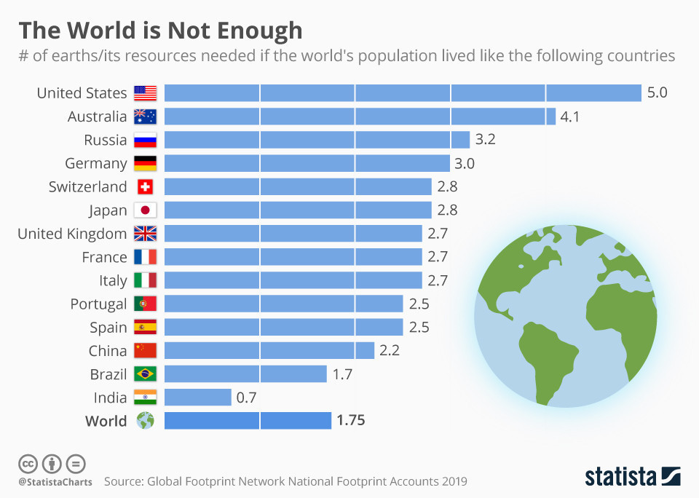
The Overconsumption of the Global North

Slide 4
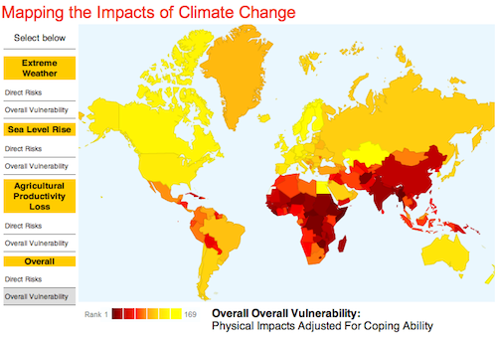
Who is the most vulnerable?

Slide 5
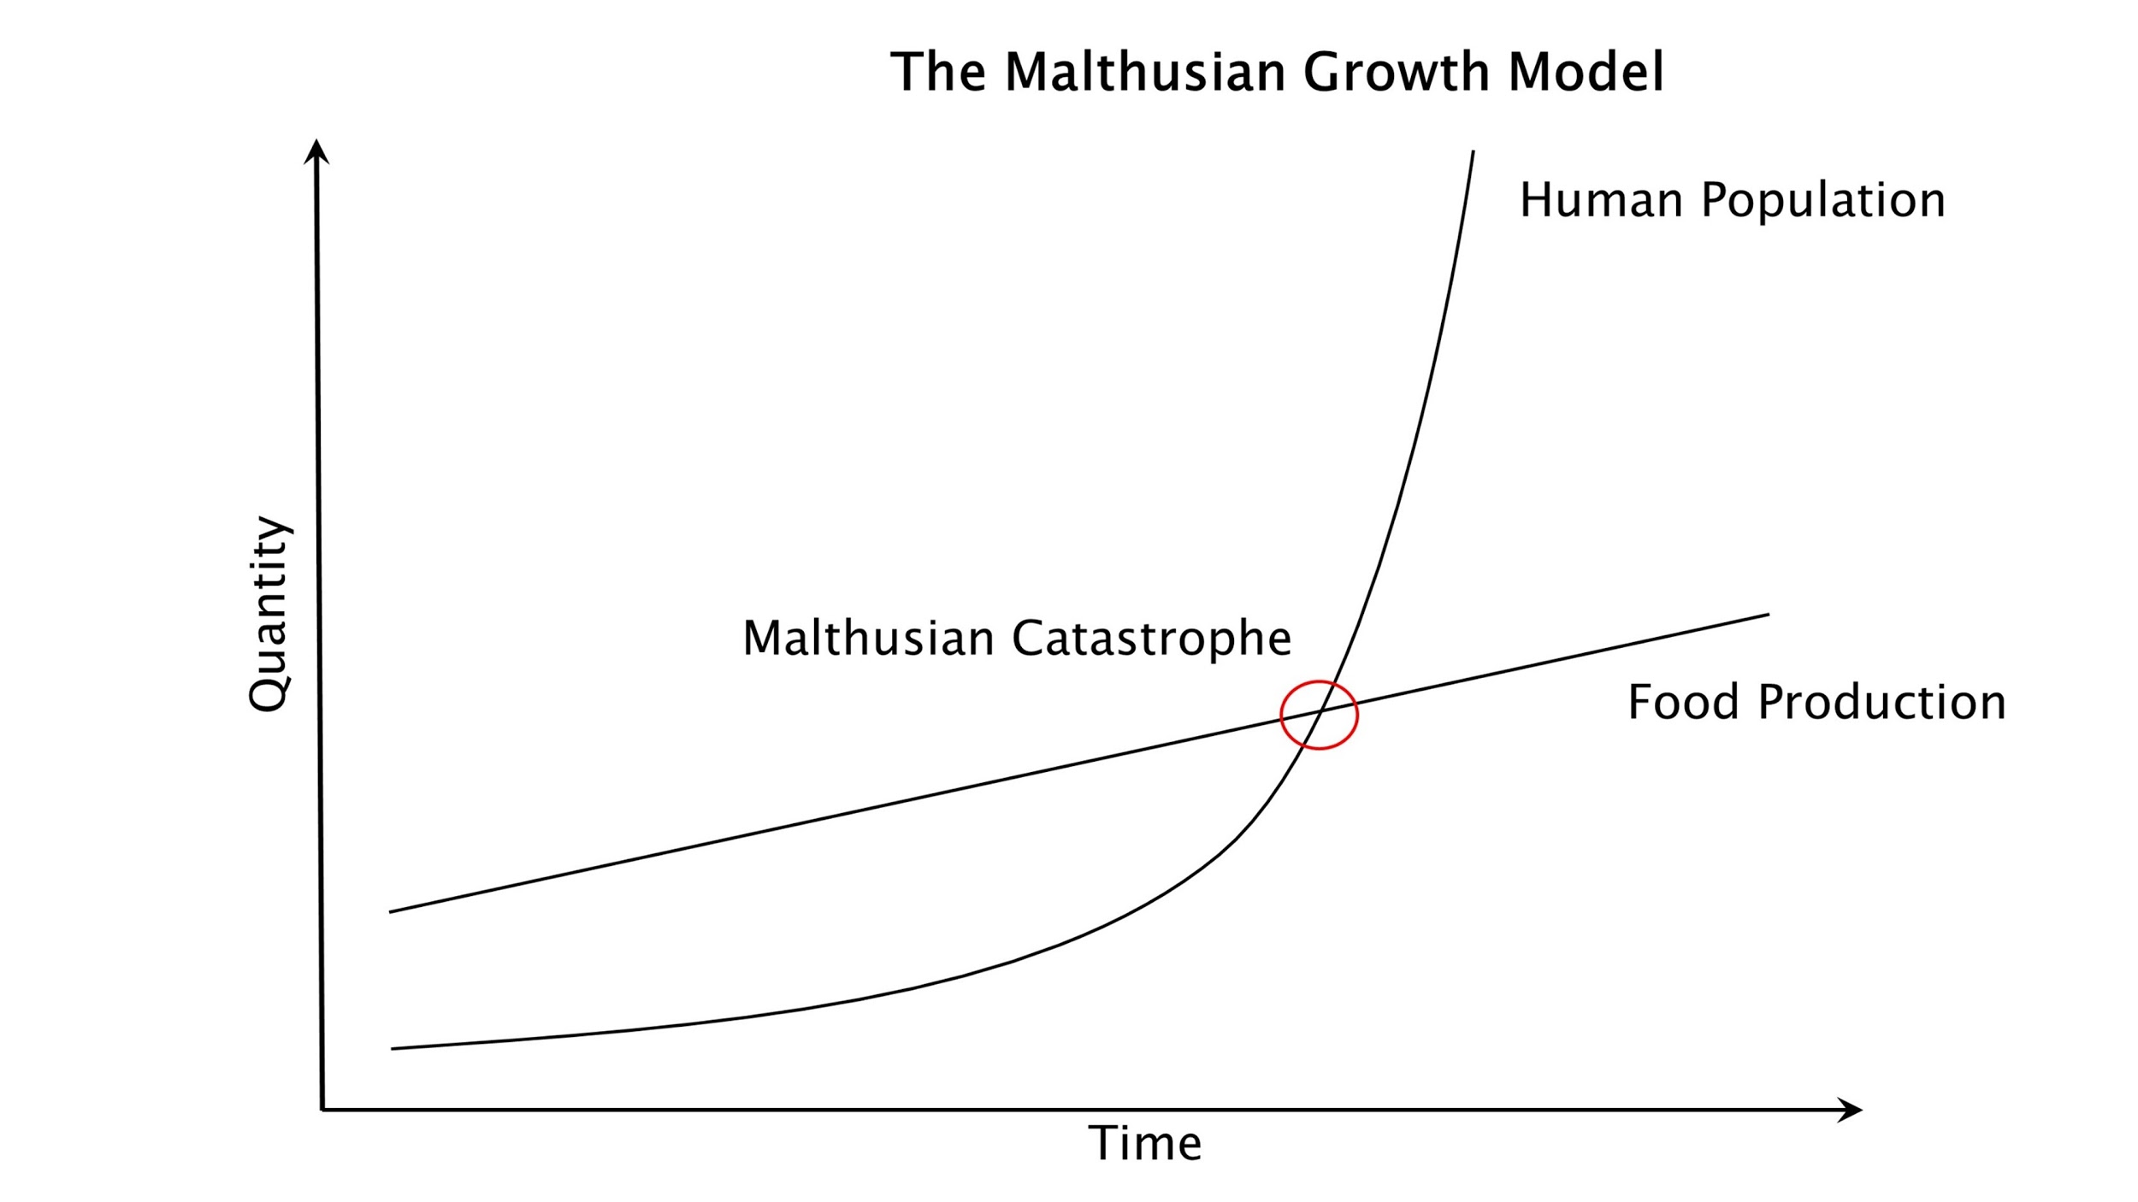
Malthusianism

Slide 6
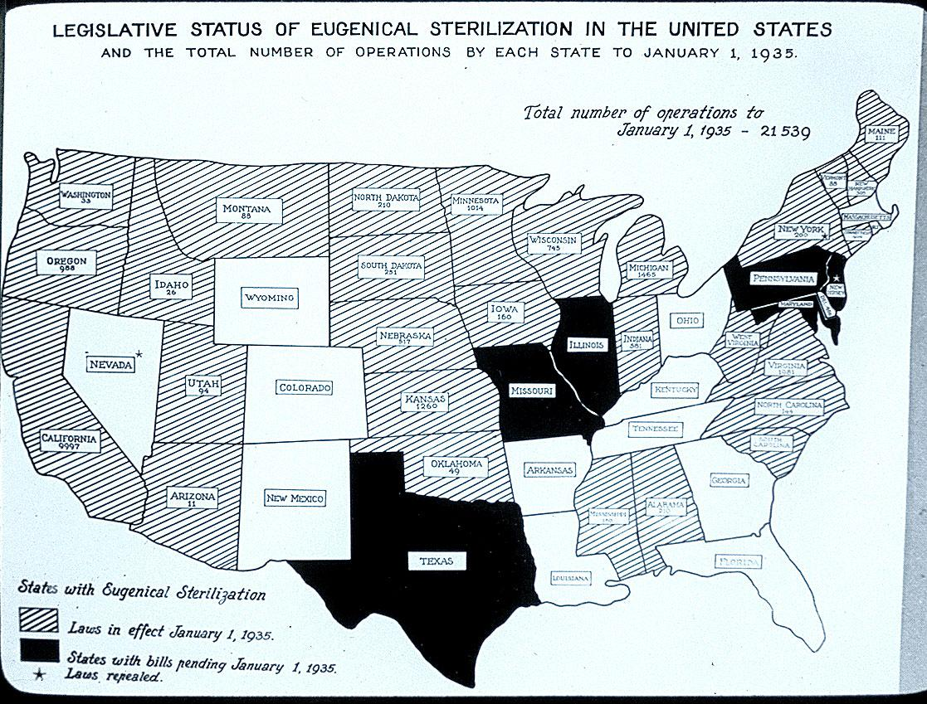
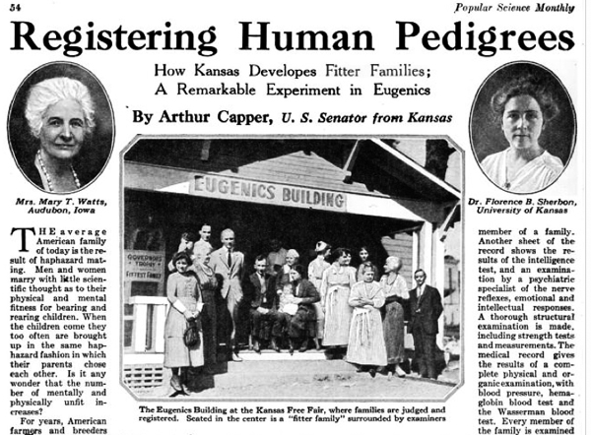
Eugenics and Forced Sterilization

Slide 7
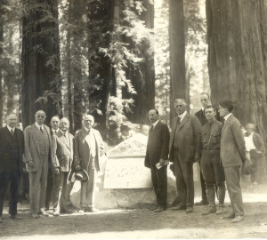
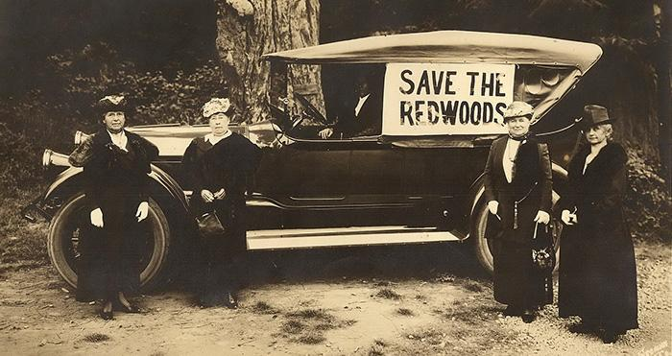
20th Century Conservation

Slide 8
Carrying Capacity
“The maximum number of individuals of a given species that an area’s resources can sustain indefinitely without significantly depleting or degrading those resources” (McConnell and Abel).

Slide 9
Integral Ecology
“An integral ecology includes taking time to recover a serene harmony with creation, reflecting on our lifestyle and our ideals, and contemplating the Creator who lives among us and surrounds us, whose presence “must not be contrived but found, uncovered” (Laudato Si, 155).

Slide 10
Catholic Social Teaching
Life and Dignity of the Human Person
Rights and Responsibilities
Care for Creation
Preferential Option for the Poor and Vulnerable
“Today…we have to realize that a true ecological approach always becomes a social approach; it must integrate questions of justice in debates on the environment, so as to hear both the cry of the earth and the cry of the poor” (LS 49).

Slide 11
Image Links
https://www.weforum.org/agenda/2019/11/economy-circular-recycling/
https://www.colorado.edu/ecenter/energyclimate-justice/general-energy-climate-info/climate-change/climate-justice
http://blogs.oregonstate.edu/anthropocene/2019/12/04/the-malthusian-crisis-revisited/
https://www.pbs.org/independentlens/blog/unwanted-sterilization-and-eugenics-programs-in-the-united-states/
https://www.savetheredwoods.org/about-us/mission-history/

